Slide 1
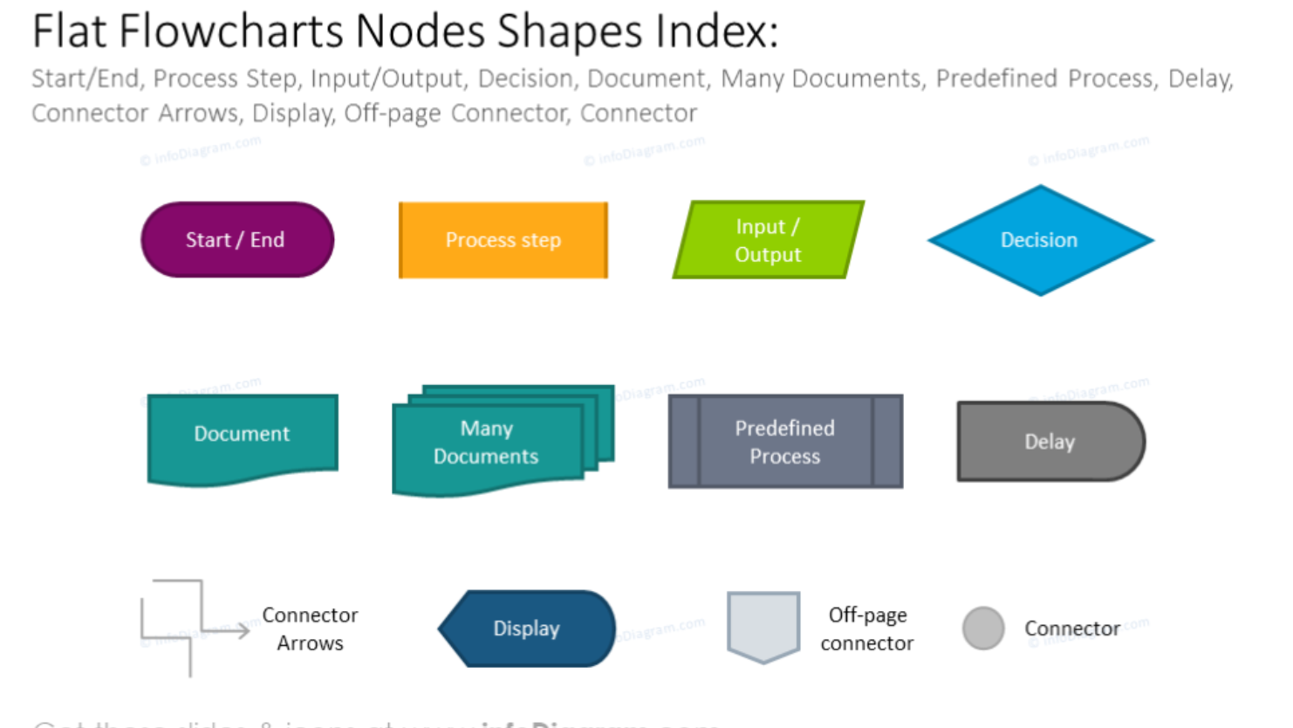

Slide 2

cat
Interactive search
User-defines parameters
Event.html created by Eqerg_webupdate
Parent pkl of events
(rterg_summary.pkl)
QuakeML cat
Create downloadable data
Create search-formatted url
Update parent pkl
(program name here)
Create/update interactive map
Recreate or update quakeML
(program name here)
User-selects event(s)

