Slide 1
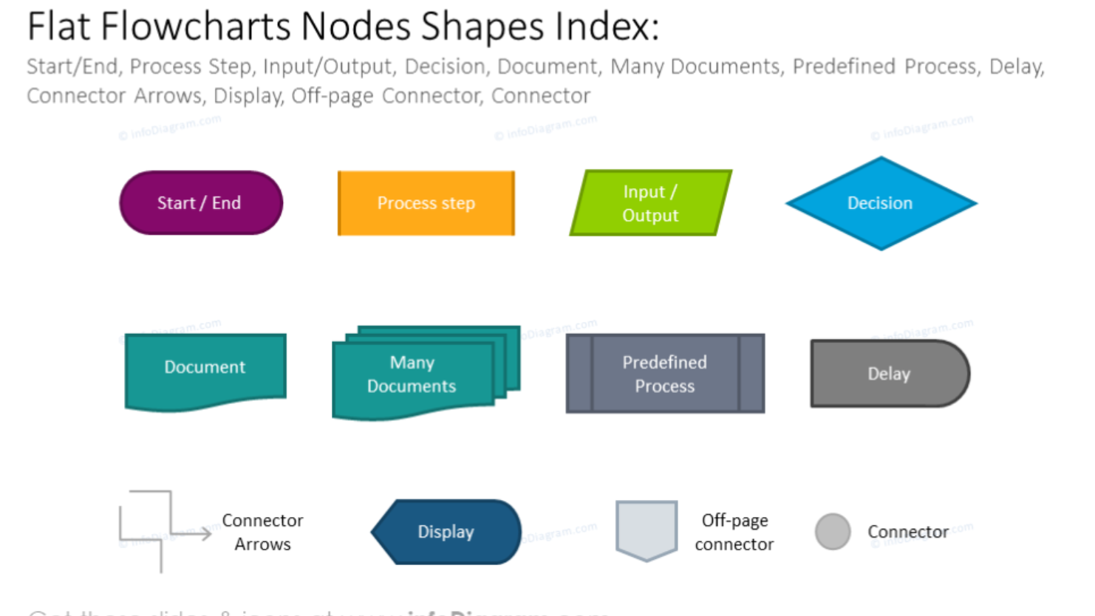

Slide 2
New event occurs (Andy)
User-defines parameters
cat
Interactive search
Event.html created by Eqerg_webupdate
Parent pkl of events
(rterg_summary.pkl)
Create search-formatted URL
QuakeML cat
Update parent pkl
(program name here)
Recreate or update quakeML
(program name here)
Create/update interactive map
User-selects event(s)
Back-end (programs not run through web)
Front-end (programs run through/visible on web)

