Slide 1
Project Moshe
Dry run

Slide 2
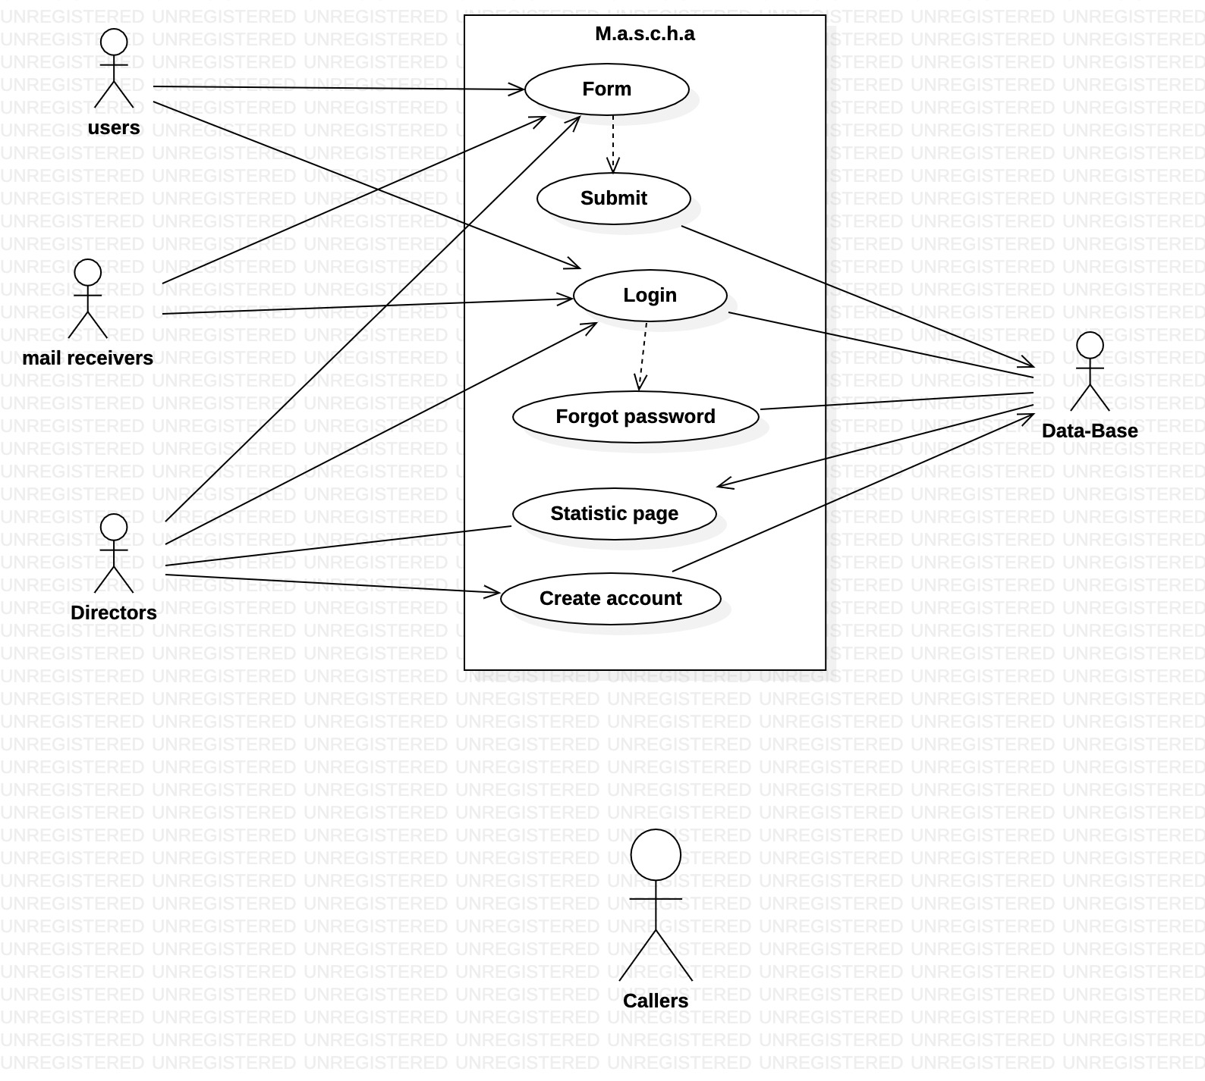
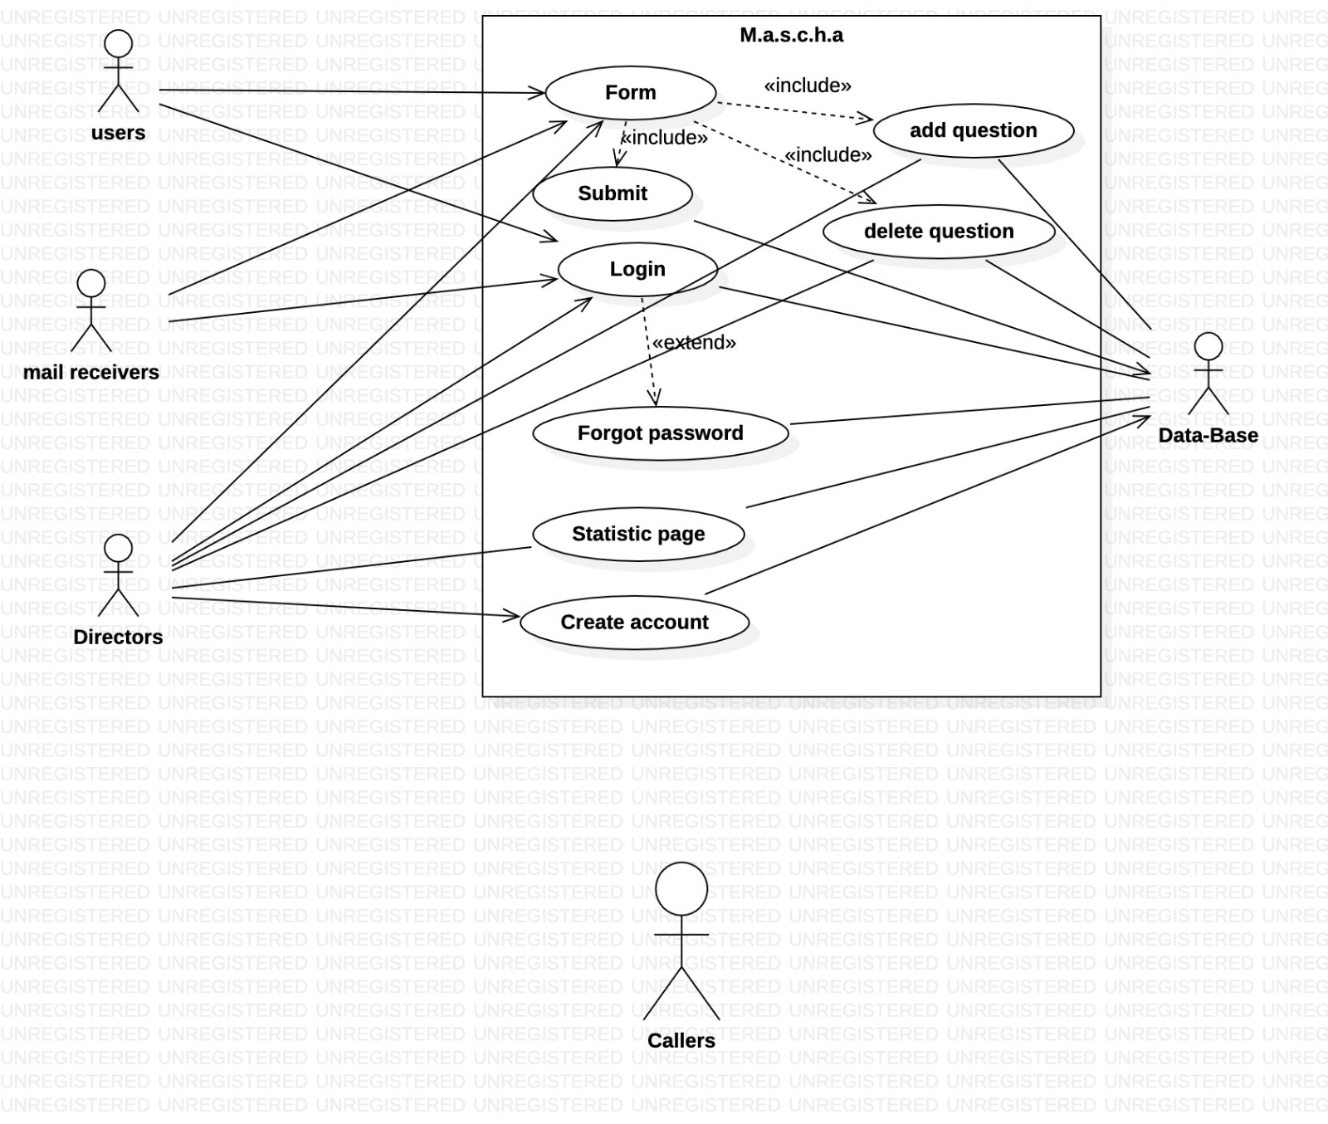
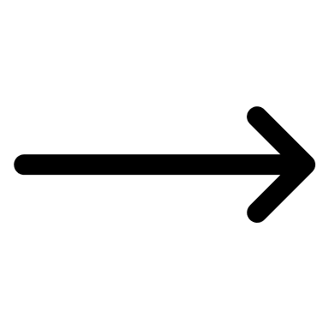
Major Change use-cases/requirements
Main change on our use-cases and requirements was the option to add question or to delete a question.
BEFORE
AFTER

Slide 3
Risks
We were afraid of a staff turnover and it happened because one of our co-worker had to go to the army.
Another risk we didn’t consider is lack of time and communication from the project owner. We handled that by a lot of creativity and open mindlessness since the PO didn’t ask for a lot and didn’t know what he wanted,we wanted to give him more then he asked.

Slide 4
Testing
Pass to Sign-in page : our problem was to limit the access of the page Sign-in(“the admin zone”), it has been resolved by making a list of admins in our data-base that will Enable the button “create user” only for them , using disable for the button who routes us there.
Functionality Testing-submit button : the button wasn’t work in a good way because of our structure of the page, we had to add an action “mail to” and transform the current form to a modular form. also due to that change we managed to add the admin list as our mail receivers.

Slide 5
What we learned as a team
First we learned that to work as a team we need a good and strong organization .
Second as team we had to be flexible when a co-worker are block on a task we had to help him and vise versa.
Lastly Always be in a good atmosphere, that helped a lot to be more efficient.

Slide 6
Thank You
By Yuval, Ytshak, Yakim, Moshe

