Slide 1

Project Title - Seasonal Agriculture Performance Analysis
Student Name – Avni Verma
College Name – Manipal University Jaipur
AICTE STU ID : STU69d6630e4bac11775657742

Slide 2

PROBLEM STATEMENT
Agricultural activities are influenced by seasonal variations in environmental conditions, farming practices, resource availability and market conditions. As a result, agricultural performance may differ from one season to another. However, raw agricultural data does not clearly explain how agricultural performance changes across seasons or what patterns can be observed in different seasonal conditions. The problem is to analyze the given agricultural dataset and investigate seasonal differences in agricultural performance by identifying meaningful patterns, trends, relationships and variations within the available data.

Slide 3
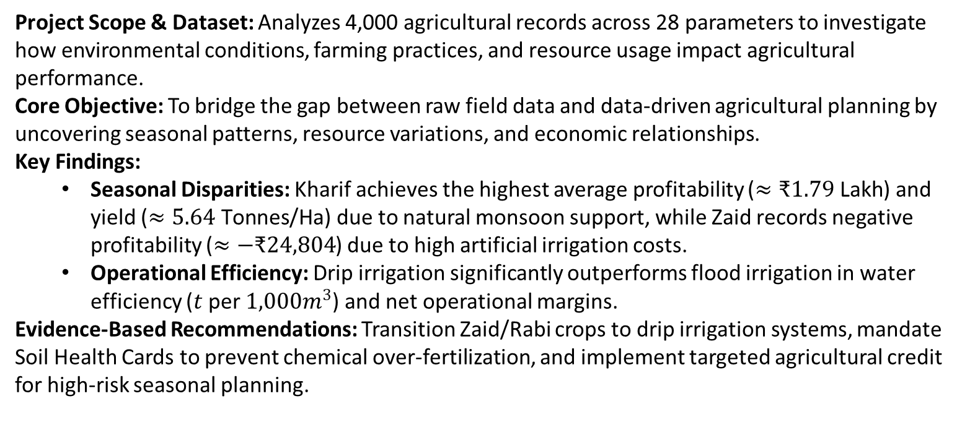
Project Description
Project Scope & Dataset: Analyzes 4,000 agricultural records across 28 parameters to investigate how environmental conditions, farming practices, and resource usage impact agricultural performance.
Core Objective: To bridge the gap between raw field data and data-driven agricultural planning by uncovering seasonal patterns, resource variations, and economic relationships.
Key Findings:
  Seasonal Disparities: Kharif achieves the highest average profitability ($≈₹1.79\text{ Lakh}$) and yield ($≈5.64\text{ Tonnes/Ha}$) due to natural monsoon support, while Zaid records negative profitability ($≈−₹24,804$) due to high artificial irrigation costs.
  Operational Efficiency: Drip irrigation significantly outperforms flood irrigation in water efficiency ($t$ per $1,000m^{3}$) and net operational margins.
Evidence-Based Recommendations: Transition Zaid/Rabi crops to drip irrigation systems, mandate Soil Health Cards to prevent chemical over-fertilization, and implement targeted agricultural credit for high-risk seasonal planning.

Slide 4

WHO ARE THE END USERS?
Agricultural Policymakers & Government Planners: Utilize evidence-based seasonal insights to design targeted agricultural policies, regional resource allocation, and seasonal subsidy programs.
Farming Communities & Agronomists: Benefit from optimized resource strategies (such as drip irrigation adoption and rationalized fertilizer use) to improve crop yields and net profitability.
Agricultural Extension Officers: Guide local farmers on best practices derived from seasonal pattern analysis, helping them mitigate high-risk seasons like Zaid.
Agri-Business & Financial Stakeholders: Leverage economic performance metrics (revenue, cost, and profit variations) to assess seasonal credit risks, design better crop insurance frameworks, and make informed supply chain investments.

Slide 5

Technology Used
Programming Language: Python for core data processing, statistical analysis, and modelling.
Data Manipulation & Analysis: pandas and NumPy for structured dataset loading, cleaning, data wrangling, missing value imputation, and aggregations.
Data Visualization: Matplotlib and Seaborn for generating univariate, bivariate, and multivariate visual plots (such as histograms, boxplots, scatter plots, and correlation heatmaps).
Development Environment: Jupyter Notebook for interactive script execution, documentation, and stepwise project reporting.

Slide 6
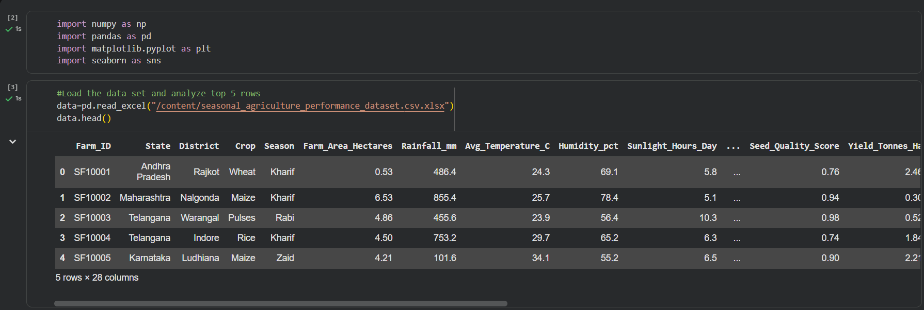
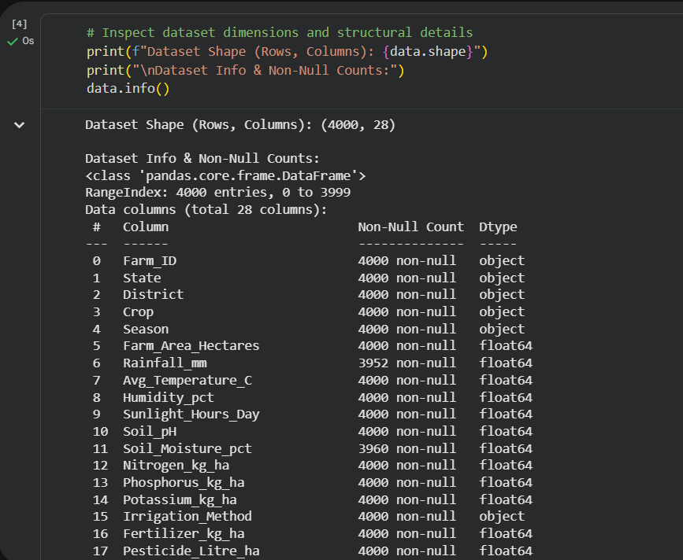
RESULTS
Import Libraries
Load the dataset and analyze the top 5 rows.
Inspect dataset dimensions and structural details.

Slide 7
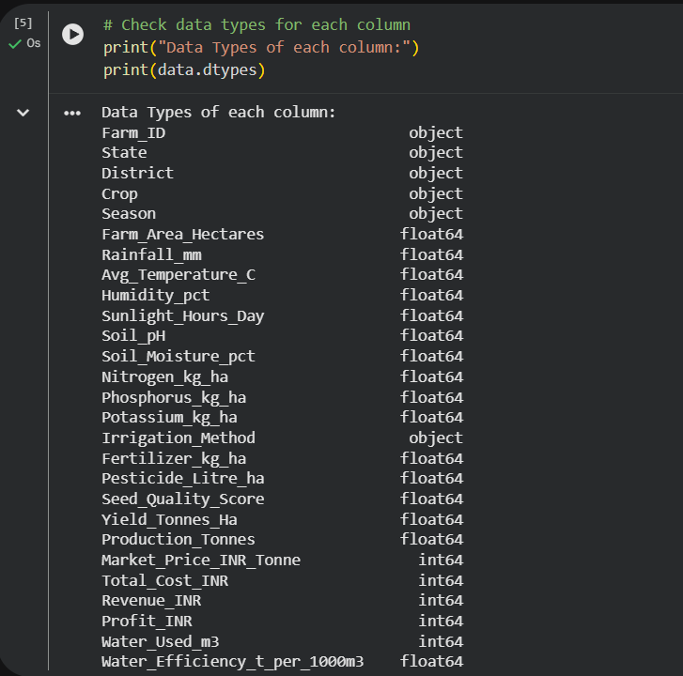
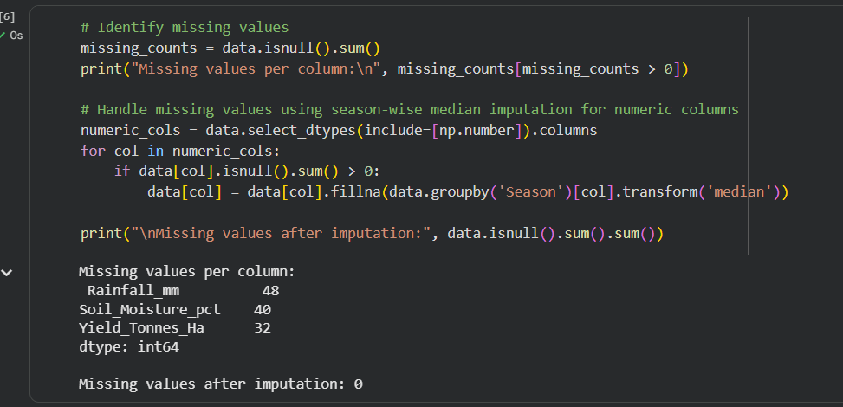
RESULTS
4. Check datatypes for each column. 5. Identify and handle missing values

Slide 8
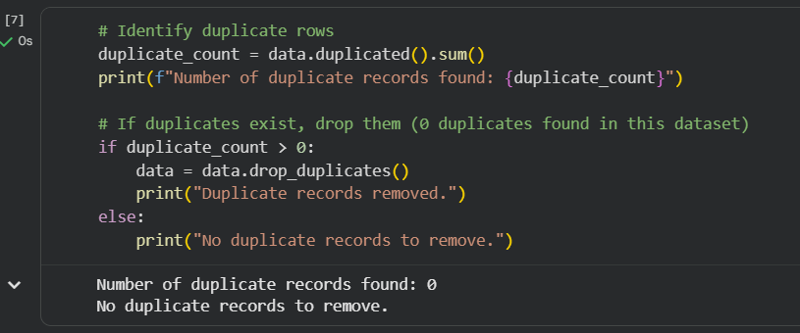
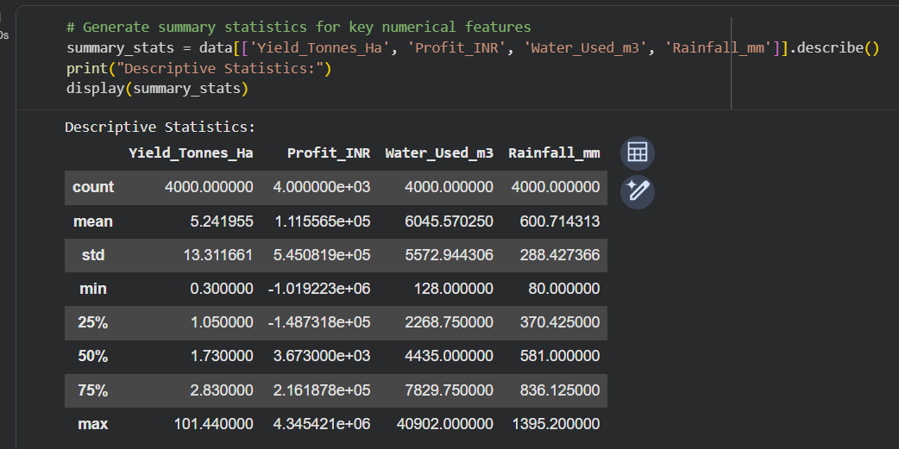
RESULTS
6. Identify duplicate rows.
7. Drop existing duplicates.
8. Summarise statistics for key numerical features.

Slide 9
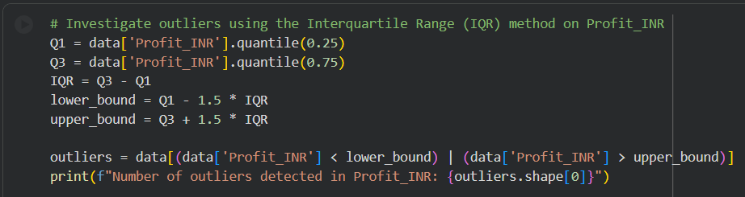
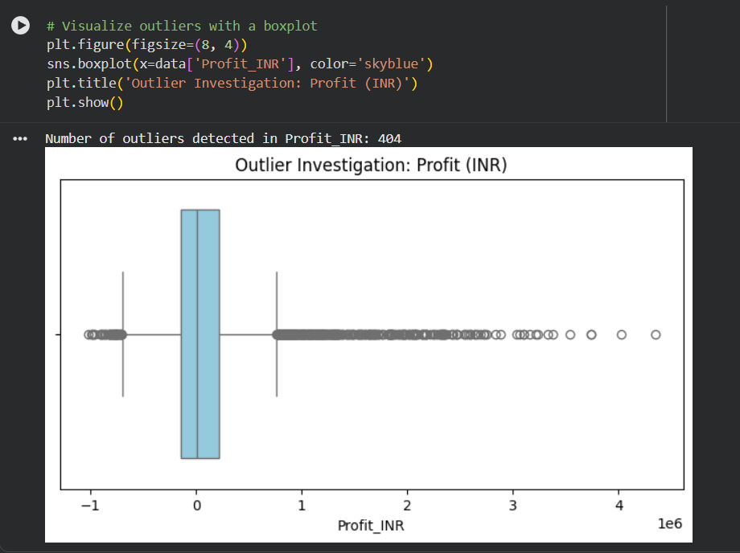
RESULTS
9. Investigate and visualise outliers

Slide 10
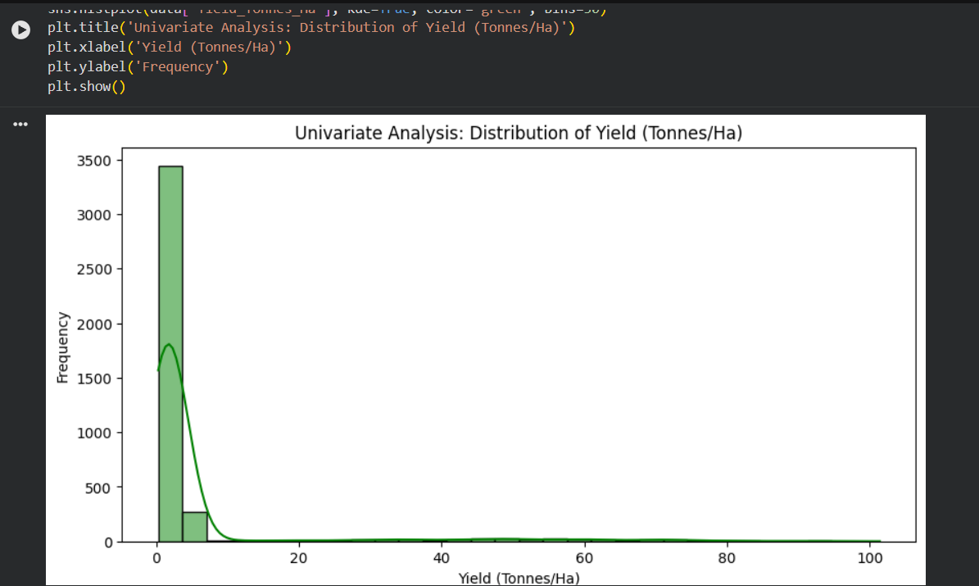
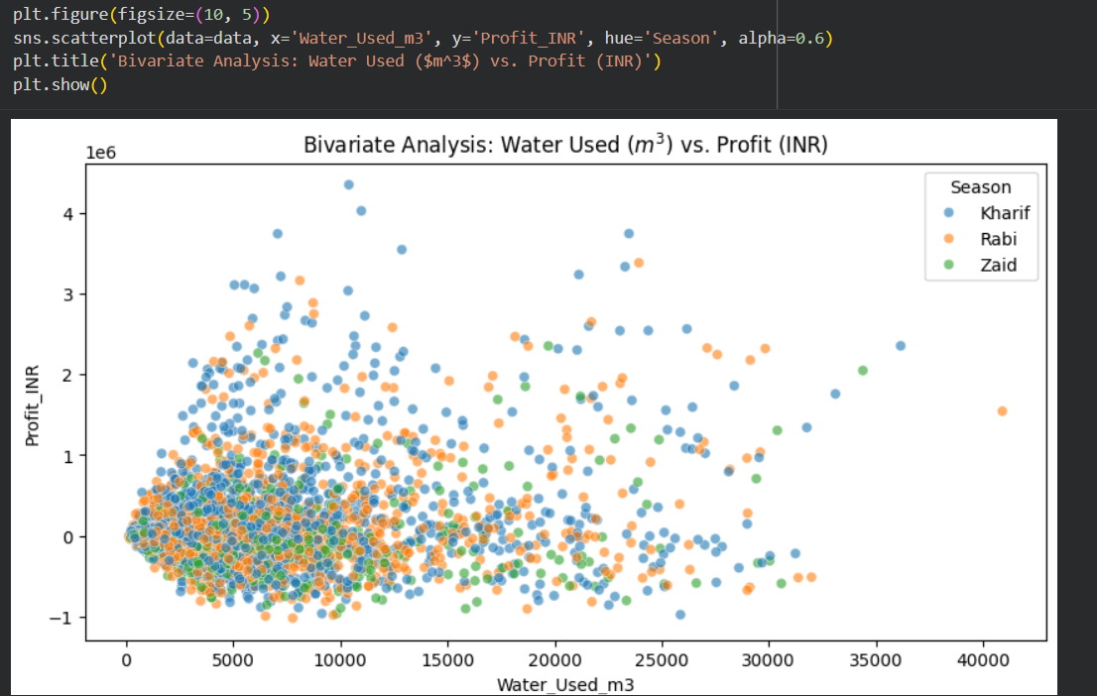
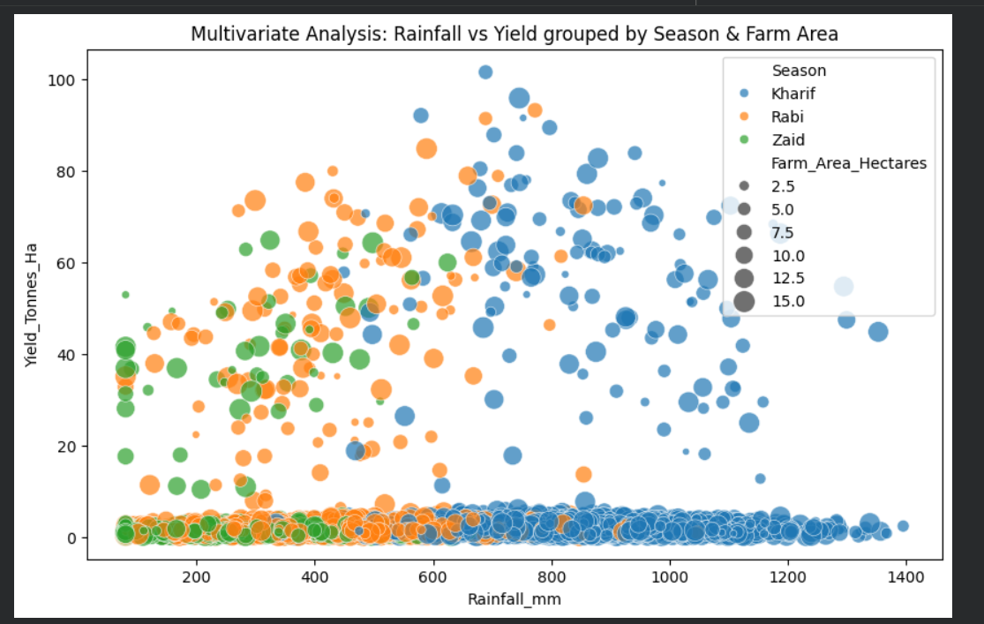
RESULTS
10. Univariate Analysis
11. Bivariate Analysis
12. Multivariate Analysis

Slide 11
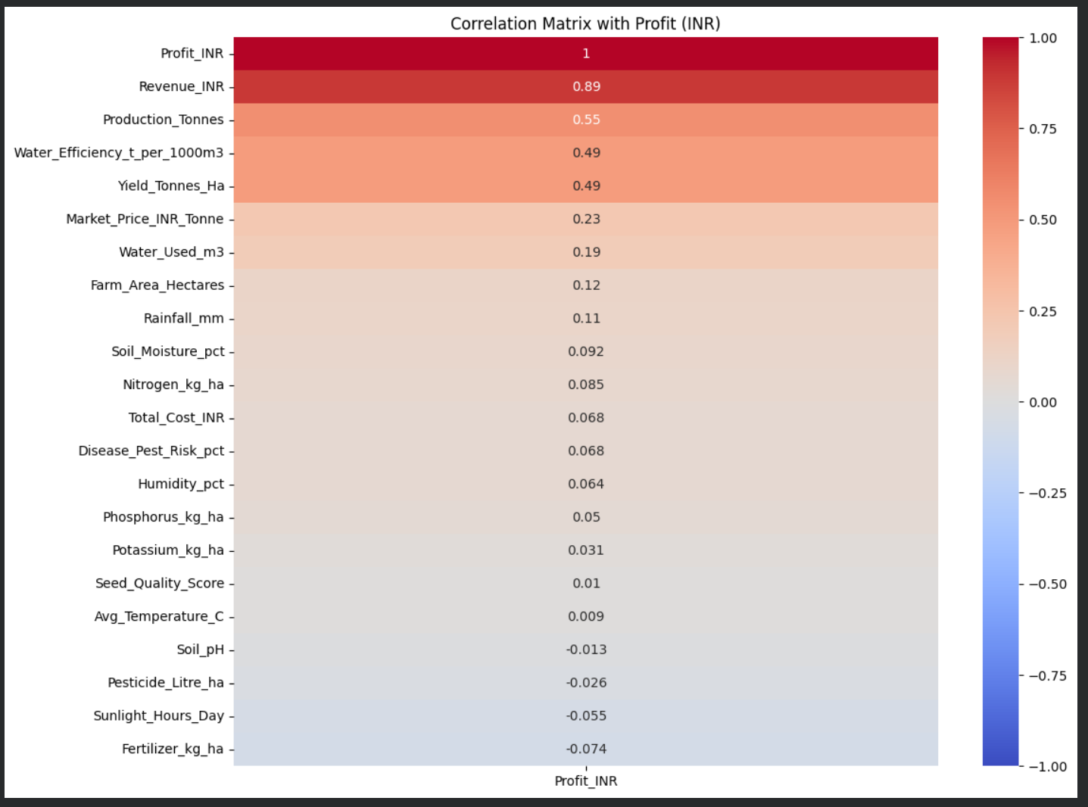
RESULTS
13. Correlation Matrix

Slide 12
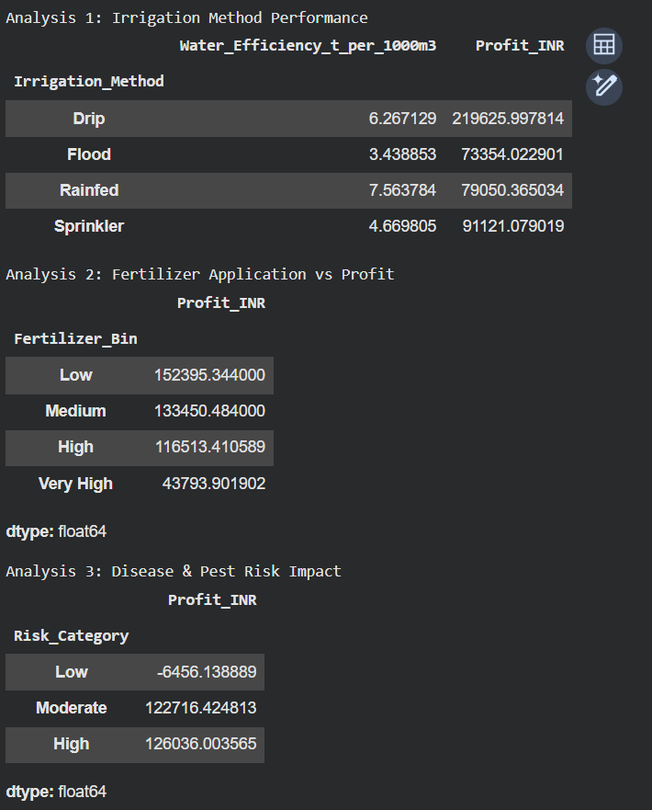
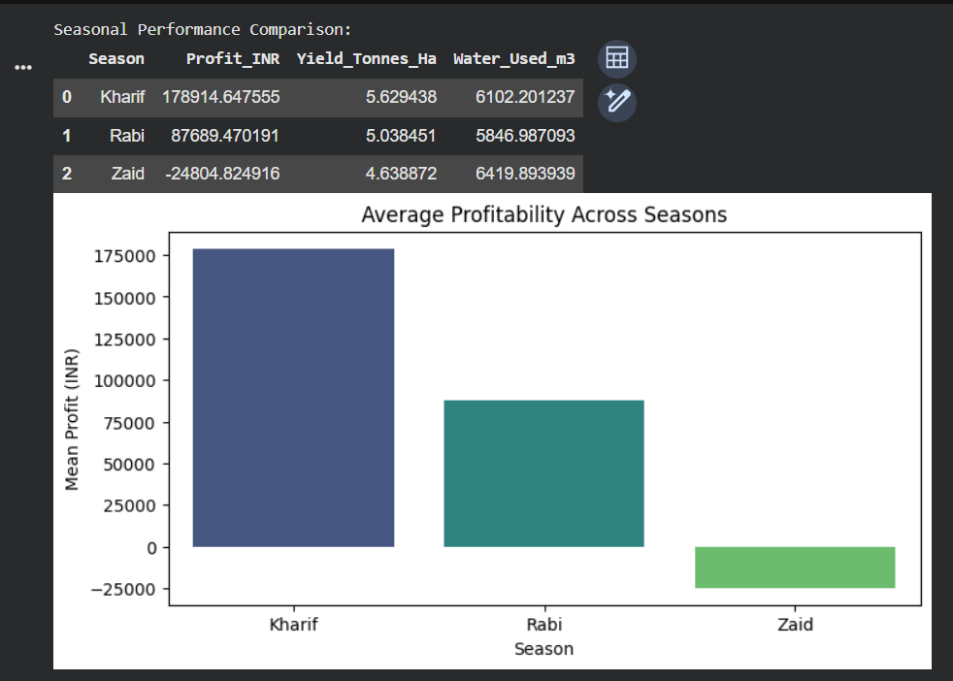
RESULTS
14. Seasonal Performance Comparison
15. Student designed analysis

Slide 13
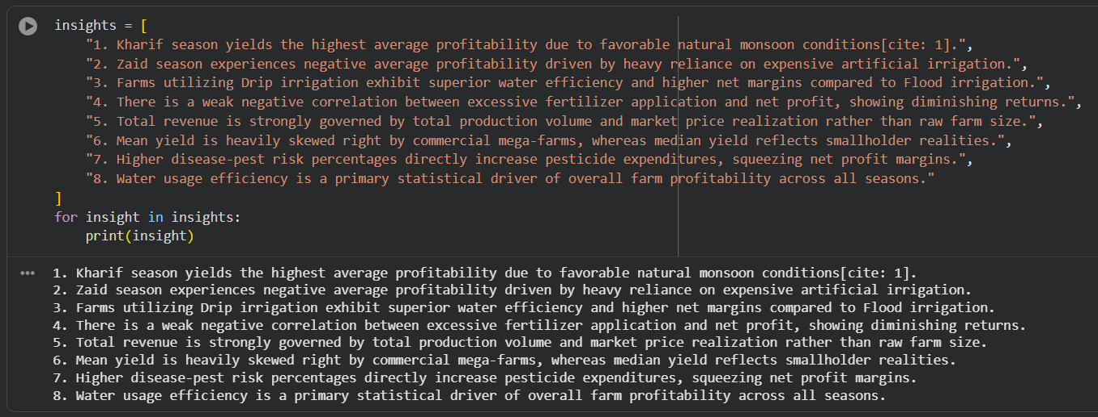
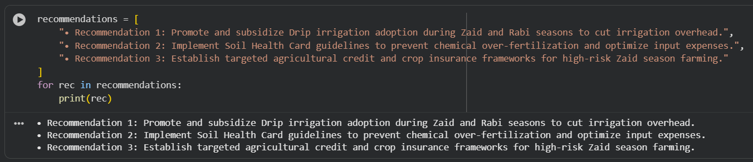
RESULTS
16. Meaningful insights
17. Evidence-based recommendations

Slide 14
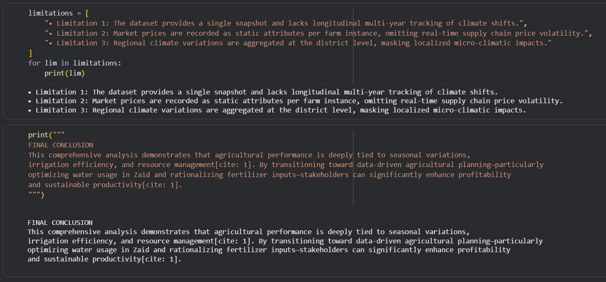
RESULTS
18. Limitations and Final Conclusion

Slide 15
Future scope
Longitudinal Multi-Year Tracking: Expand the dataset to capture multi-year climate shifts and historical weather cycles, enabling predictive time-series forecasting for long-term agricultural planning.
Real-Time Market Integration: Integrate live supply chain pricing and regional demand feeds to dynamically optimize crop selection and harvest timing for maximum market realization.
Micro-Climate & IoT Sensor Integration: Incorporate hyper-local IoT sensor data (soil sensors, automated weather stations) to move beyond district-level aggregations and provide farm-specific precision advice.
Advanced Machine Learning Models: Develop predictive classification and regression models to automatically forecast seasonal pest outbreaks, optimal fertilizer thresholds, and localized yield risks before planting begins.

Slide 16
GitHub Link
https://github.com/avniiverma24-droid/Seasonal-Agriculture-Performance-Analysis.git

Slide 17

VOIS Course completion certificate -
Course name- Data Visualization

Slide 18
Thank you
.
.

