Slide 1
Building a Recommendation System for Finding Cities to Live in the United States of America
IBM/Coursera Capstone Project- The Battle of the Neighborhoods
Avnika Manaktala

Slide 2
Building a Recommendation System for Finding Cities to Live in the United States of America
Although cities comprise of just 3.5% of the total land area in the U.S., 62.7% of the population chooses to live in these metropolitan centers.
I am currently a graduate student studying in a small college town; however, I am graduating soon, and I would like to know which major cities could offer me the best services. Like me, there are many people who are looking to find cities to live in that could offer the services they need.
Finding a city which has all the services people need is now more important to people who are constantly on the move.

Slide 3
Data
The data I will be using for this project is listed below:
1. Foursquare API: This API will be used to identify services, restaurants and shops available in each city and the frequency of each service that is present in each city, which will give an idea of its popularity.
2. U.S. Largest Cities (Source: Open data for largest cities in the US: https://public.opendatasoft.com/explore/dataset/1000-largest-us-cities-by-population-with-geographic-coordinates/table/?sort=-rank): This dataset holds data on the major cities in the U.S. and the location columns will be used for mapping the cities on the map. The cities listed in this database will be the candidates examined for this project.

Slide 4
Methodology
Use the cities dataset as a guide to the largest cities to consider for this analysis.
Use the latitude and longitude columns to look for services for each city (limited to 25Km radius and 2000 services per city).
Process the dataset to find the 10 most common categories of venues for each city.
Use K-means clustering to divide the cities with similar attributes into 10 clusters.
Ask user to input their preferences for their 10 most important venues they require.
Run k-means clustering on the user database with all the cities considered for the previous run.
Display results of the users recommended cities.

Slide 5
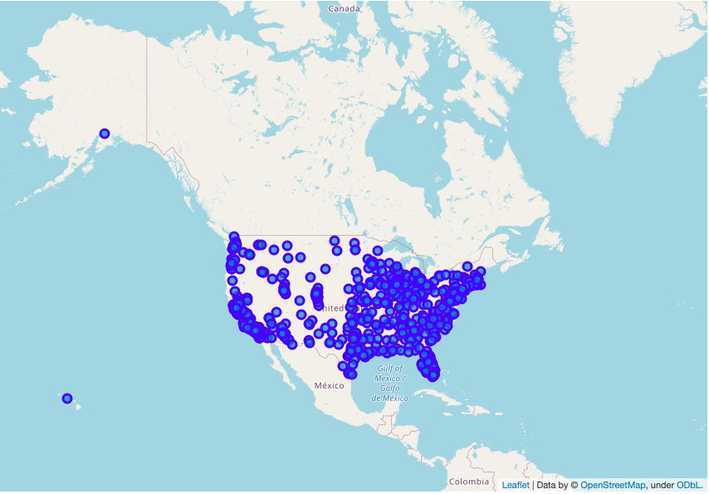
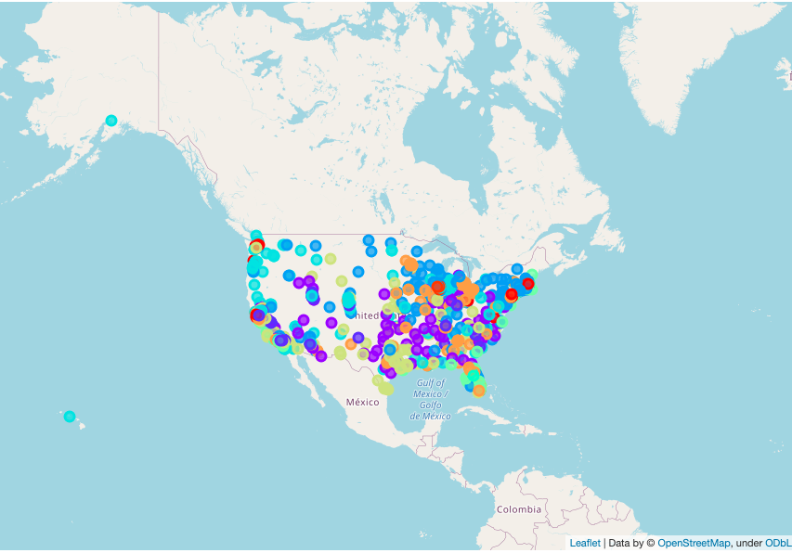
Results of K-means clustering
Location of all the cities considered in the analysis
K-means clustering analysis for all cities considered
Average distance to centroids: 0.14

Slide 6
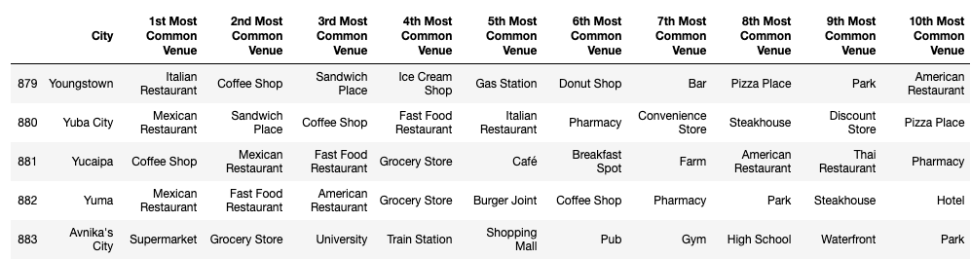
User defined preferences
The following table shows the entry of the 10 most important venues that the user requires as part of a cloned database of all the cities with their most common venues.
This table is then used to cluster the cities again and provide the cluster of cities that may be the most suitable for the user

Slide 7
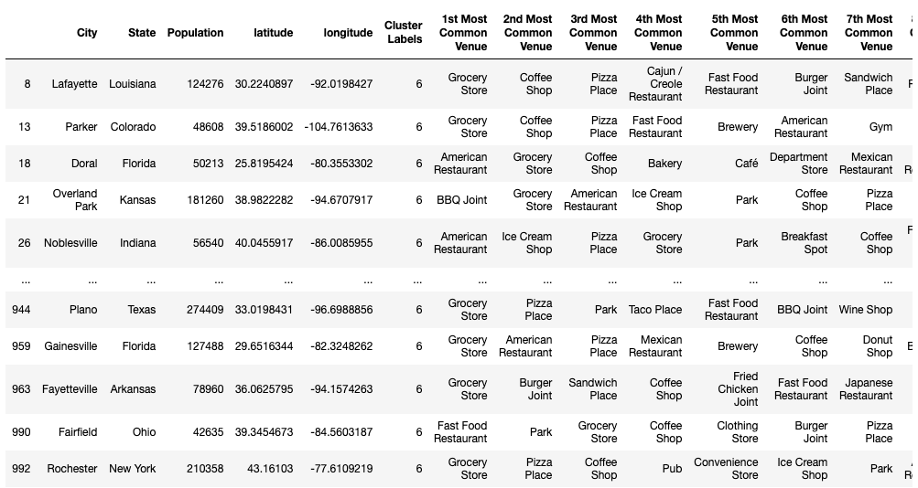
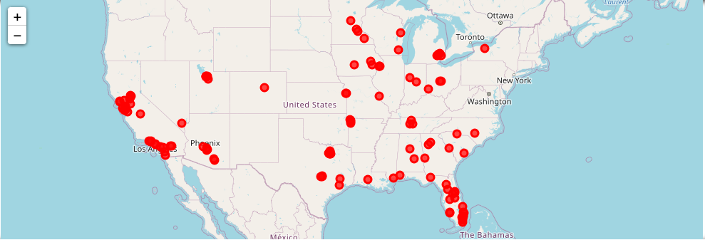
Results for the User
The results of which cities match the requirements of the user are displayed as a table of cities with their most common venues and as a map.

Slide 8
Results and Discussion
The following list shows what venues seem to be the most popular in each cluster:
Cluster 0: Fast Food Restaurants, American Restaurants and Mexican Restaurants are the most important venues
Cluster 1: American Restaurants and Parks seem to be the most important venues
Cluster 2: Fast Food Restaurants, Theme Parks and Grocery Stores are the most important venues
Cluster 3: Coffee Shops and Parks seem to be the most important venues
Cluster 4: Beaches, Seafood Restaurants and Parks seem to be the most popular
Cluster 5: Coffee Shops, Grocery Stores and Pizza Places seem to be the most popular venues
Cluster 6: Grocery stores, Hot Dog Joints, Bakeries and Breweries are the most important venues
Cluster 7: Supermarkets and Coffee Shops seem to be the most important venues
Cluster 8: Fast Food Restaurants, Grocery stores and Coffee Shops are the most important venues
Cluster 9: Parks, Bakeries and Pizza Places are the most important venues

Slide 9
Conclusions
Future work into this project could include an analysis on crime, size and housing cost as part of the analysis and ask the user specifically for their preferences on these statistics.
A deeper analysis on the best k value would prove to be beneficial to providing the user with a more accurate set of cities.
This project, therefore, uses a starting point of the largest cities in the U.S., uses the Foursquare API to identify the most important services in each city and clusters similar cities together. The code then asks the user to add the services most important to them in order and finds a cluster of cities that are most suitable for them.

