Slide 1
T4D AI COHORT 2 · MIDPOINT SHOWCASE
Building Generative AI Workflows:
Deterministic Rails, Agentic Judgement
Lessons from Avni App Configurator
Notes:
30 seconds.
Hook: 'We're building an AI configurator for Avni. This talk isn't about that — it's about three things we learnt while building Agentic Workflows.'
Tone: honest, peer-to-peer.

Slide 2
The Problem
Why a chat-first AI configurator for Avni
Manual webapp config
IDE-based AI (Cursor, Claude Code)
Click-by-click through Avni UI. Avni expertise required. Consistency on the user.
Developer-only. Decoupled from Avni. Quality varies with AI + user effort.
Our AI App Configurator — chat-first, not click-first
• Chat-first. No webapp, no code, no Avni expert. • Program managers drive the setup themselves.. • Schema validation + guardrails in the flow, not LLM judgment. • Deterministic pipeline → reproducible, auditable bundles. • Earlier it used to take few hours for average form creation, now that gets done in few minutes
• Usage is high during initial setup and sporadic usage later on
Looks like an LLM problem. Most of it is deterministic.
2 / 7

Slide 3

Avni App Configuration complexity

Slide 4
What We Built
Tier architecture — user chat down to the database
User
Program manager · chat-first, no code
chat messages
Dify (The Brains)
Orchestration · agent nodes · human gates
HTTP tool calls
Function Tool Calling (The Brawn)
Stateless tool service · 60+ endpoints · parser / spec / bundle / rules / validator
bundle ZIP upload
Avni Backend
Receives bundle ZIP · imports config · serves field app + webapp
reads / writes
Database
PostgreSQL · config, observations, audit trail
Deterministic on the rails, agentic in the gaps.
3 / 7

Slide 5
Avni App Configurator Demo

Slide 6
Lesson 1 — WHERE to put the LLM
System-level architecture · deterministic code + LLM agents + variables
Write the contract first. Writable → deterministic. Fuzzy → scoped agent.
Go deterministic when
Use an LLM agent when
• Schema is writable • Reproducibility matters • Validation expressible using logic • LLM cost not justified e.g. parsing · validation · state management
• Input shape varies • Judgment or reasoning needed • User dialog / clarification • Open-ended synthesis or correction e.g. classification · dialog · generation · auditing
THE GLUE — variables thread state between the two sides
session ids · phase flags · approvals · retry counters · pause signals
Can write the contract → deterministic. Can't → agent.
4 / 7

Slide 7
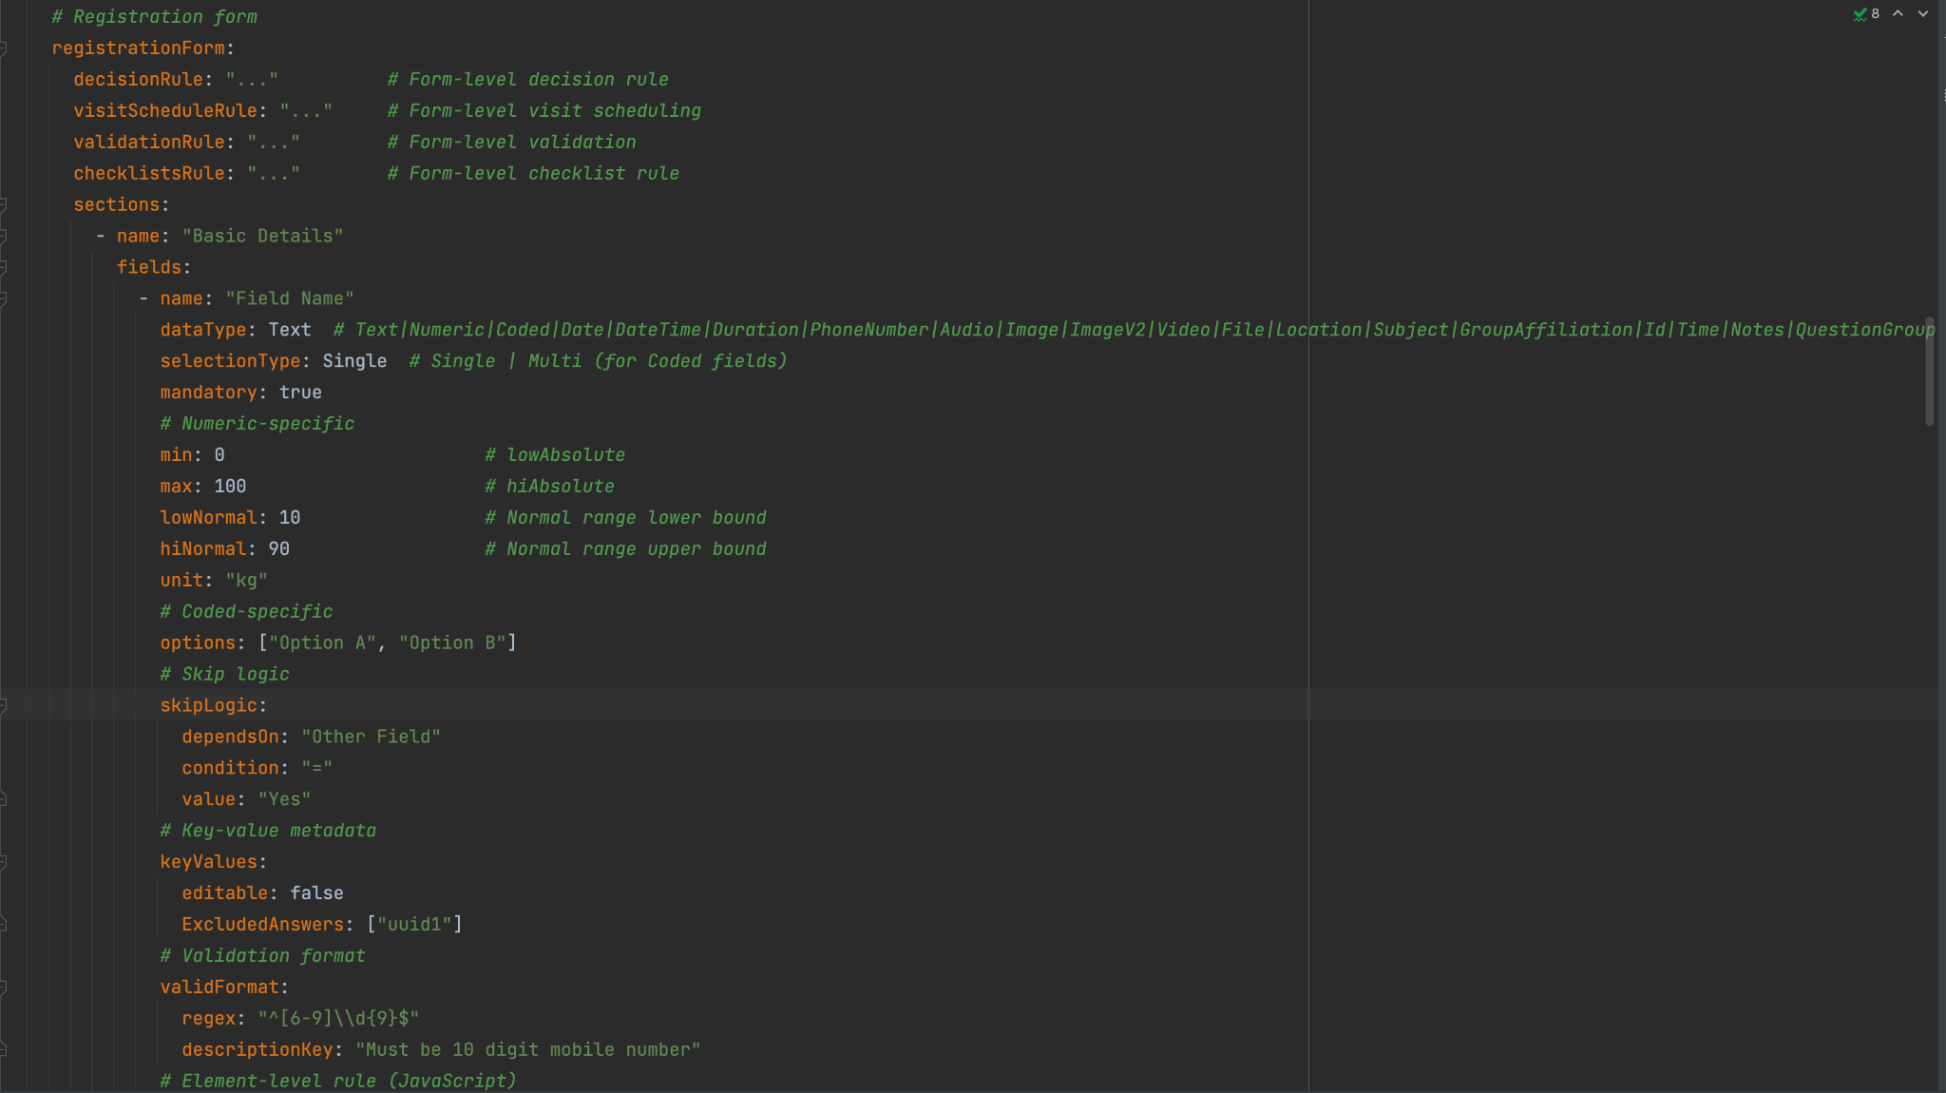
Avni Spec Configuration Template

Slide 8
Lesson 2 — HOW to shape the agents
Agent-level design · sub-agents, divide and conquer
One big agent → specialist sub-agents. Smaller brain. Clearer job. Surgical edits.
Small context
Low tokens
One specialist, one job
Surgical edits
Each agent sees only its slice.
Small contexts × many agents = cheap. Caching wins.
Clear I/O contract. Bounded iterations.
Edit one file, one rule. Never regenerate the whole.
Common sub-agent archetypes
Classifier
Planner
Synthesizer
Patcher
Inspector
Route input to the right path.
Break task into ordered steps.
Produce the artifact as per the spec.
Edit one part. Not regenerate.
Audit output. Read-only critic.
Small brain. Clear job. Surgical edits.
5 / 7

Slide 9
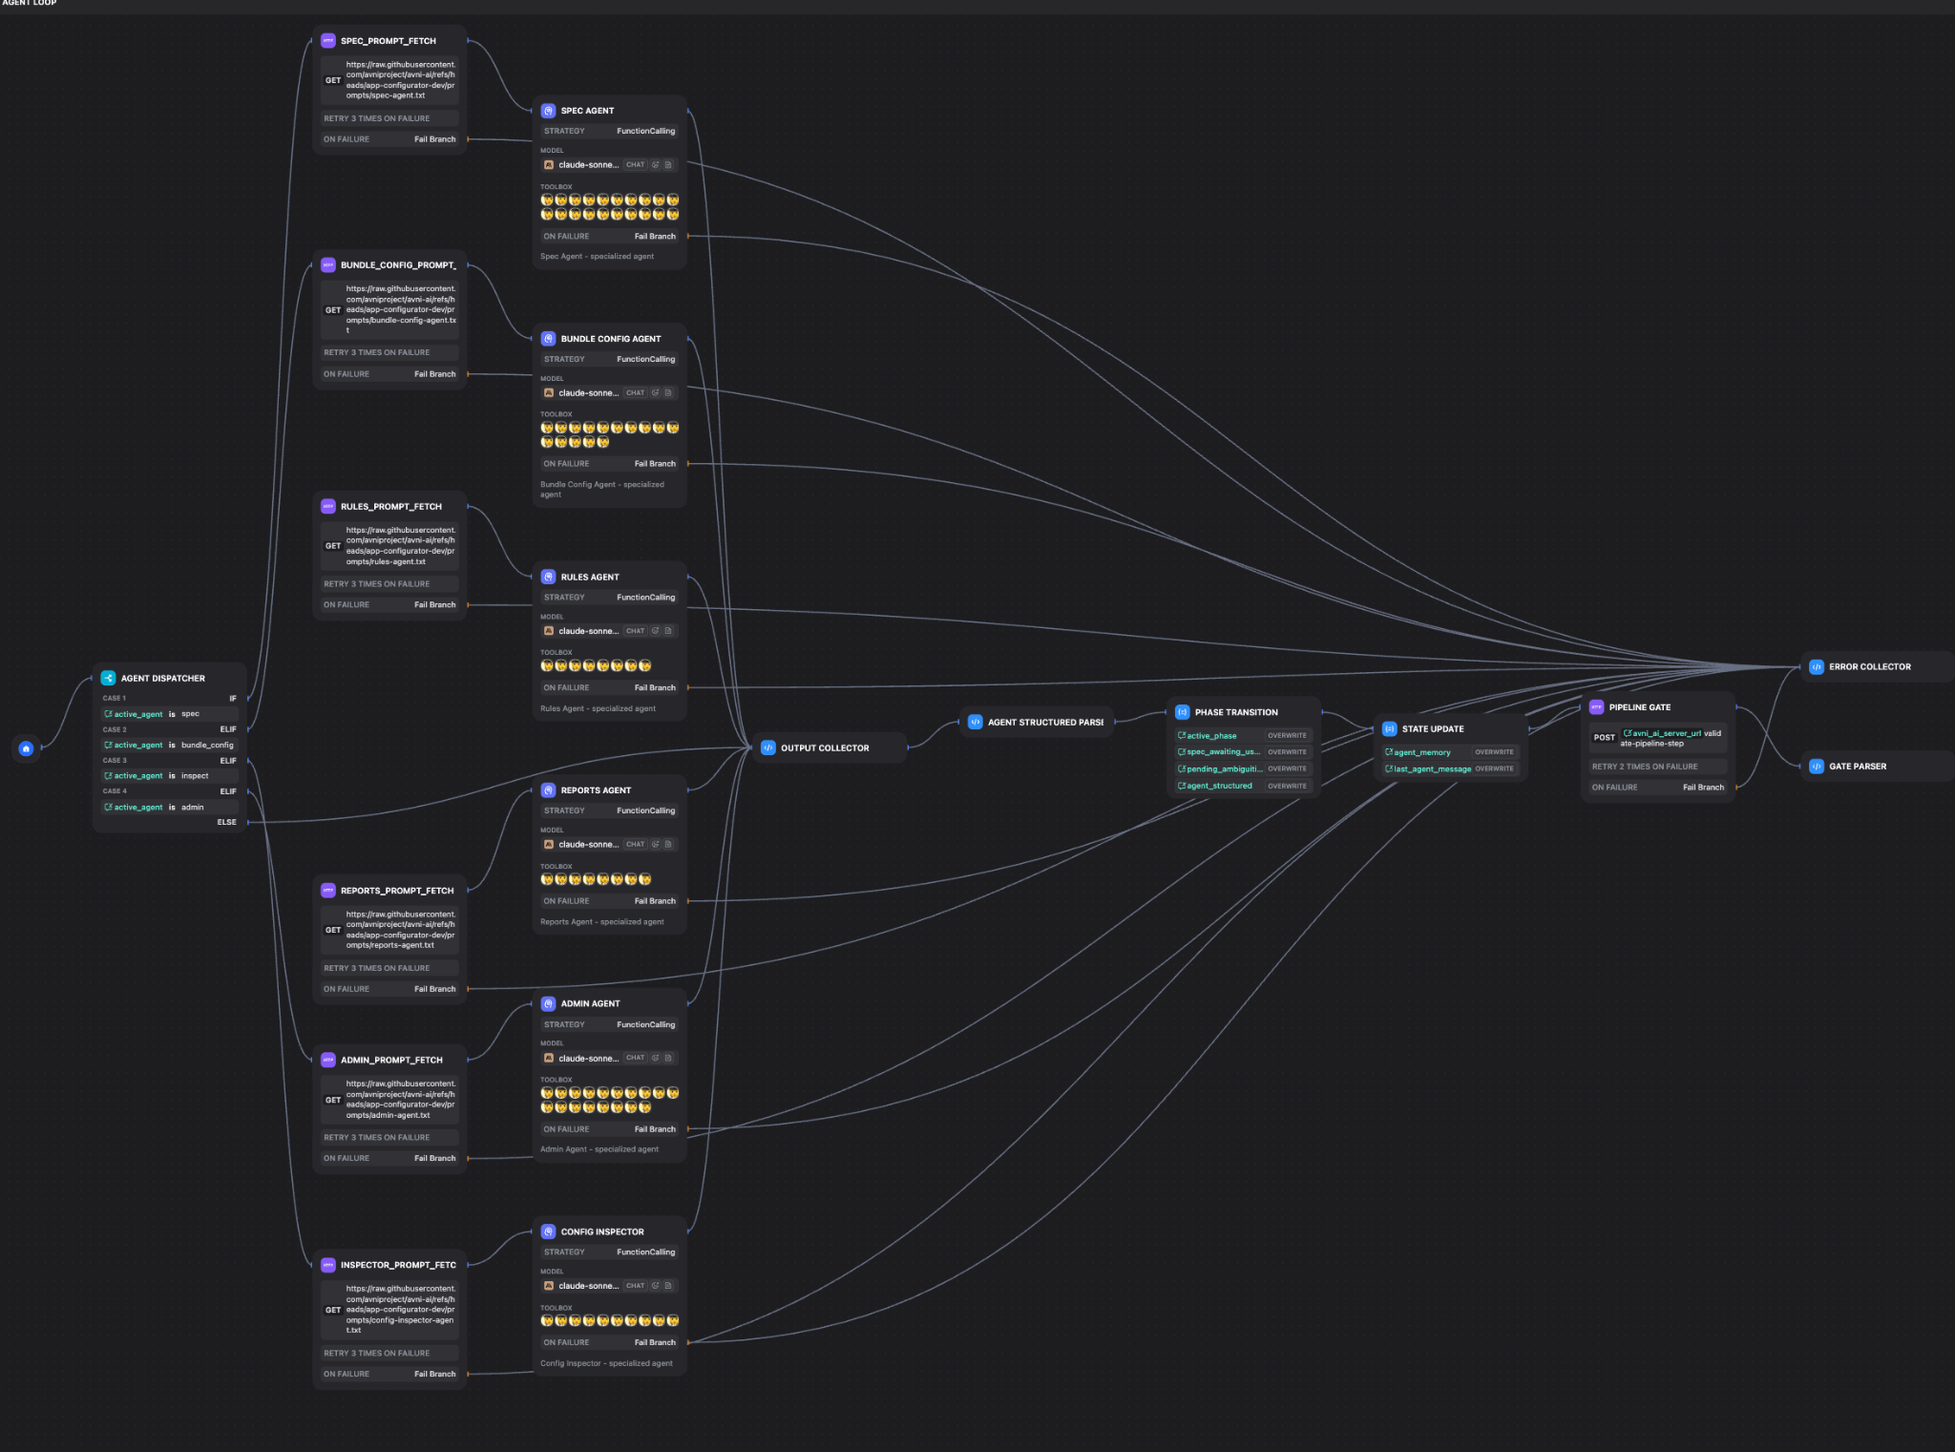
Avni App Configurator Agentic Workflow
Notes:
https://cloud.dify.ai/app/0b859aeb-9c7b-4881-b9fc-3769e64de168/workflow

Slide 10
Lesson 3 — HOW to design the tools
Tool-level design · keeps the LLM cheap, fast, capable of depth
Design every tool assuming an LLM will call it. Return only what's needed.
Sectional retrieval
Response truncation
Surgical edits
Return only what this turn needs. Not the whole base.
Cap outputs. Send 'top 20 + count'.
Target + patch. Not full rewrite.
Stateless
Handles, not payloads
Defensive guards
Individual tools do not maintain state within themselves.
But you could have tools to save, modify or retrieve overall state(data).
Heavy state in a store. LLM sees a handle + summary.
Validate in, validate out. Bound depth. Fail clean.
Before — LLM exhausted on initial entities. Couldn't go deeper.
With these — 10× fewer tokens per turn. Depth becomes routine.
Design the tool for the Agent that will call it.
6 / 7

Slide 11
Avni AI OpenAPI

Slide 12
What's Next, and What's in the Way
Roadmap · Dify workflow shortcomings
Orchestrating open-ended long-horizon tasks using LangChain/LangGraph/Dify was a lost cause for us. Moving to Claude-managed agents instead.
Shipping next
Dify workflow — shortcomings
• Complete the bundle — enhance support for complex configuration
• Handle multi-turn conversation for configuration refinement
• Production org safety — trial-only today • Adopt cohort guardrails — regex + small-LLM guards • Benchmark setup time vs. manual webapp config
• Unstructured scoping docs (PDF / image) → spec
• Doc extractor misses content — parsing moved to our own parser on avni-ai • Agent nodes can't call auth'd tools using perishable tokens — token lives in conversation-scoped in-memory store • No sub-workflow imports — HTTP-self (200–500 ms) or copy-paste across flows • Prompt length UI limits — inject long prompts as variables • YAML / visual-flow config — adoption curve for developers used to code files
The Devil is in the details.!
7 / 7

Slide 13
THE NEXT CHAPTER · FROM DIFY TO CLAUDE-MANAGED AGENTS
avni-skills-sdk
Claude-managed agents, in production
“Claude Code, but for an AVNI bundle author”

Slide 14
The New Architecture — two stages, one workflow
System-level · deterministic generator + Claude Agent SDK refinement loop
Forms.xlsx + Modelling.xlsx in. Ready-for-AVNI bundle out. The LLM only refines.
Stage 1 · Deterministic
Stage 2 · Chat-driven refinement
• No LLM · < 1 s · free • 2 Excel files → 30+ JSON + zip • Reproducible, auditable bundles • Runs the validator, not a model e.g. parse · generate · validate
• Claude Agent SDK loop • Each turn becomes a git commit • Validator runs after every turn • Correct, extend, ship — in chat e.g. fix C5 · add subject · rename
THE BRIDGE — slide 12’s “moving to Claude-managed agents,” realized
deterministic rails stay free & fast · agentic judgement now audited, capped, reversible
Same thesis as before — now without Dify.
avni-skills-sdk · overview

Slide 15
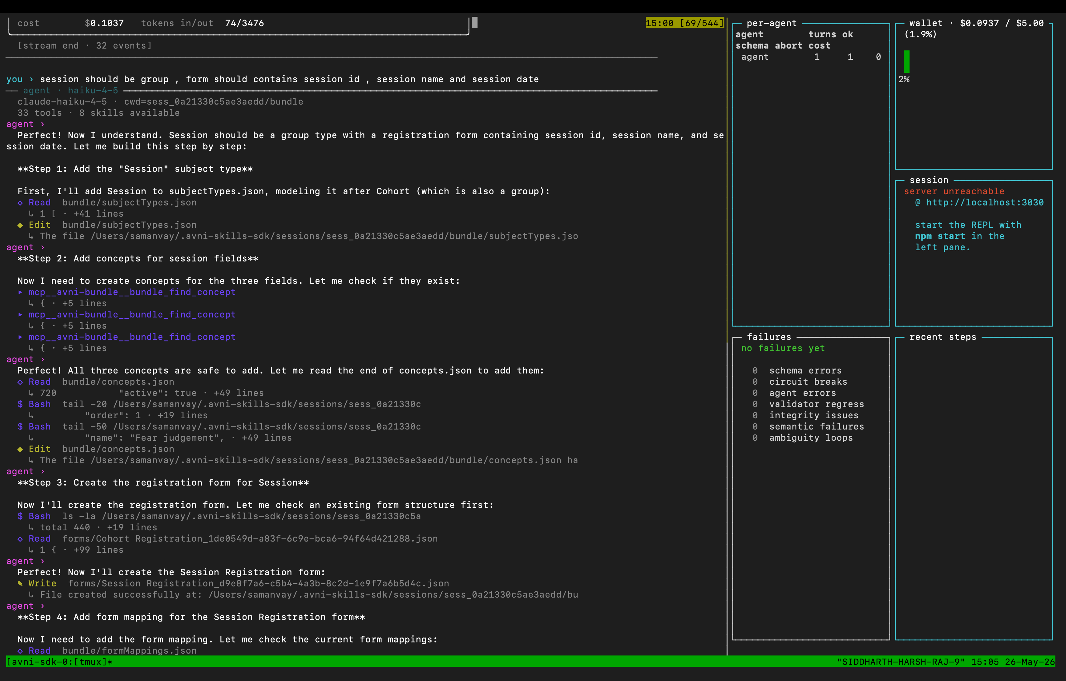
Multi-step build — tools run before every edit

Slide 16
Building block 1 — spec in, bundle out, round-trip
Stage 1 · deterministic · avni-skills
One human-readable YAML spec compiles to a full Avni bundle — and decompiles back. Edits patch the live bundle; they never regenerate it.
Spec → bundle
Bundle → spec
Patch, don’t regen
YAML parses to entities; generator emits 30+ JSON files.
Emitter reverses it; parse→emit is byte-equivalent.
New spec merges onto the live bundle — UUIDs + UI edits kept.
Deterministic IDs
Canonical ZIP order
21-org schema
Hash-seeded UUIDs. Same spec → same bundle, every run.
Files in server load order. No silent import failures.
Reverse-engineered from 21 prod orgs. Zero missed keys.
Before — bundles hand-built in the UI or regenerated from scratch; edits and UUIDs lost.
Now — a versioned spec compiles, round-trips, and patches in place.
The bundle is a build artifact of a spec — not a hand-edited blob.
avni-skills · 1 / 5

Slide 17
Building block 2 — bundle must adhere to a graph
Stage 1 · deterministic · avni-skills
Model the bundle as a UUID graph of foreign keys. Then you can ask what depends on what — and catch broken references before the server ever sees them.
Every entity a node
Every link an edge
Impact check
Concepts, forms, programs, mappings — keyed by UUID.
Typed references: form element → concept, mapping → program.
What breaks if I delete this? See it first.
Prerequisites
Broken-link scan
Form-type aware
What must already exist for this to be valid?
Flags every reference to a missing UUID.
Knows a program encounter needs a program + type.
Before — dangling references slipped through and failed silently on upload.
Now — integrity is checked locally; delete-impact is visible before you act.
Know what breaks before it breaks.
avni-skills · 2 / 5

Slide 18
Building block 3 — knowledge the agent can actually use
Knowledge corpus · avni-readme · avni-ai · avni-skills
Three sources — implementer docs, a merged corpus, and patterns mined from real bundles — compressed into chunked, tagged knowledge the agent pulls on demand.
Docs as source
Merged corpus
Compressed + chunked
203 implementer guides (~21k lines) from avni-readme.
Assembled into merged.md — ~557 KB, ~22.5k lines.
Split into 68 topic files with semantic chunks.
Metadata-tagged
Patterns from prod
Retrieval-ready
Keywords, audience, retrieval-boost per chunk.
4,949 concepts + 132 rule templates mined from real orgs.
Agent pulls the right topic, not the whole monolith.
Before — one 557 KB monolith; retrieval dragged in noise — ~half was infra/reporting.
Now — 68 focused, tagged topics (~96% implementer) + mined patterns.
Compress for retrieval — high signal beats raw volume.
knowledge base · 3 / 5

Slide 19
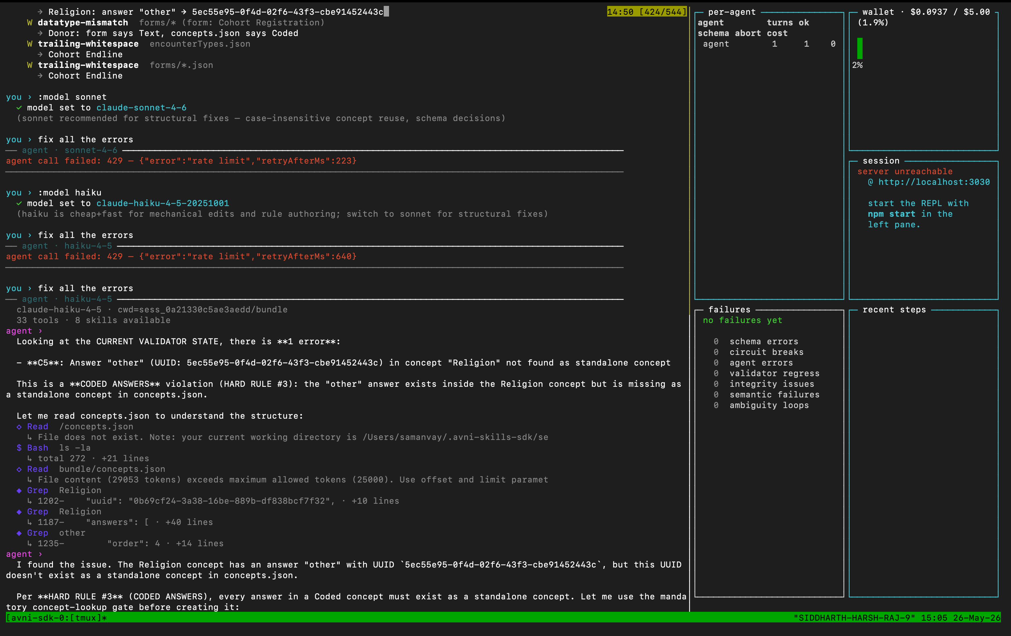
Validator-state injection + :model switching mid-session

Slide 20
Building block 4 — logged, gated, capped
Stage 2 · agentic SDK · avni-skills-sdk
Assume the agent will try everything. Make every turn recorded, every destructive path blocked, and every dollar capped — by construction, not by trust.
Git-backed history
Audit by construction
One commit per turn — a git repo. Diff, revert, or resume any turn.
Validator state in every prompt; self-corrects on resume; durable.
Destructive ops gated
Cost capped
Hook blocks git / rm -rf / sudo; a detector reverts foreign commits.
Hard wallet: $5/session, $1/turn; aborts a no-edit token spree.
Before — state lived in chat memory; an agent could wander or burn the budget.
Now — every turn is git-backed and auditable; destructive paths gated; spend capped.
Audit-rigorous and bounded — by construction.
avni-skills-sdk · 4 / 5

Slide 21
Building block 5 — prefer the tools, observe everything
Stage 2 · agentic SDK · avni-skills-sdk
Give the agent purpose-built tools it reaches for instead of raw shell — and make everything it does observable, three ways.
Prefer tools over shell
Determinism on rails
Four in-process bundle tools: validate, find-concept, summary, export.
Deterministic :summary handles routine; LLM :eval audits the gaps.
Captured three ways
See it live
On-disk JSONL, live HTTP endpoints, and REPL commands.
A live dashboard: per-agent cost and failures by category.
Before — the agent improvised with shell; runs were opaque and hard to debug.
Now — it prefers a few bundle tools, and every action is logged, served, inspectable.
Deterministic checks on rails; LLM judgement only in the gaps.
avni-skills-sdk · 5 / 5

Slide 22
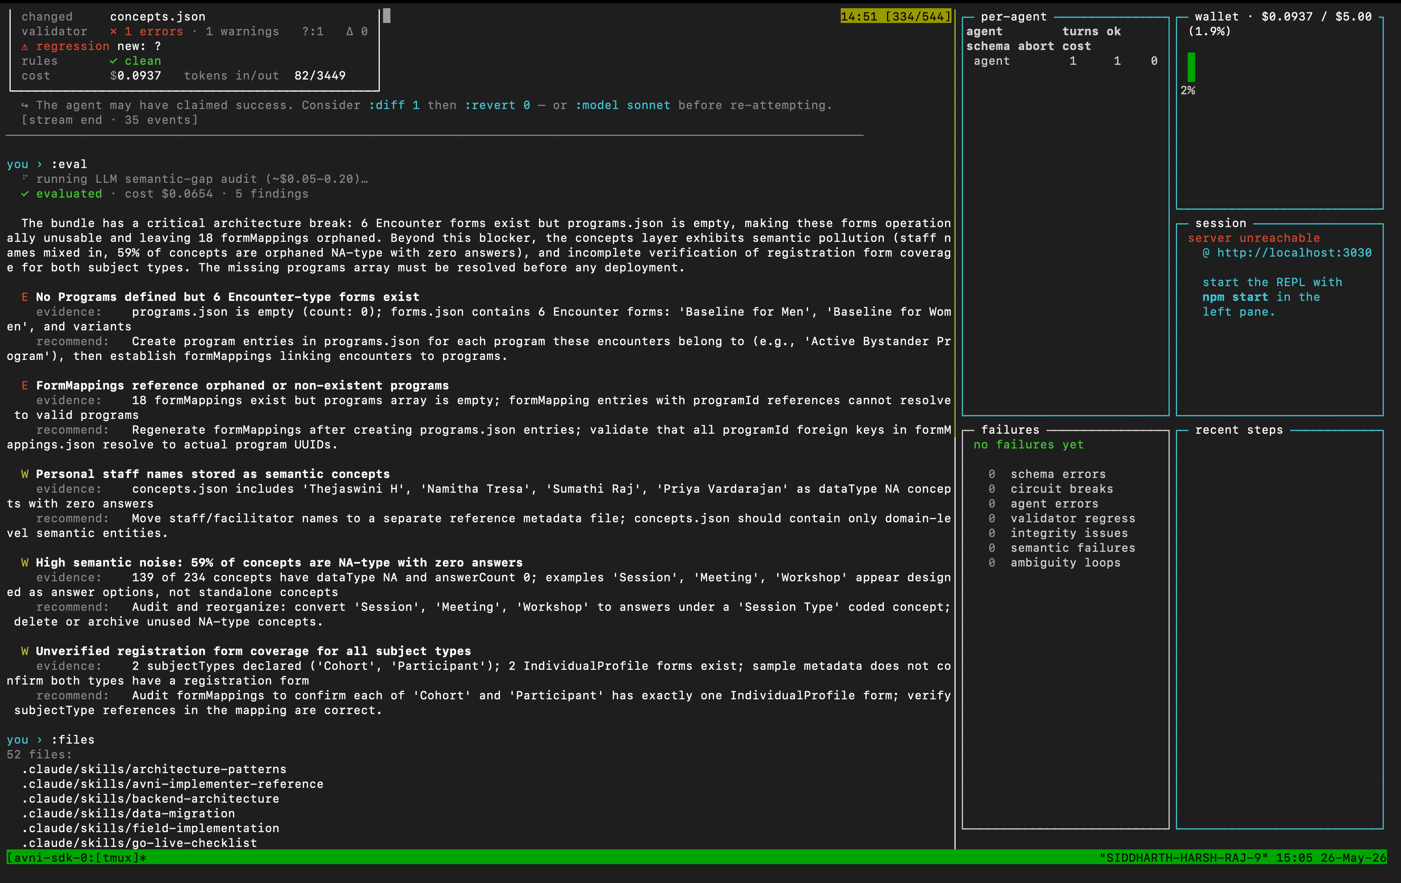
Regression detection + :eval LLM semantic audit

Slide 23
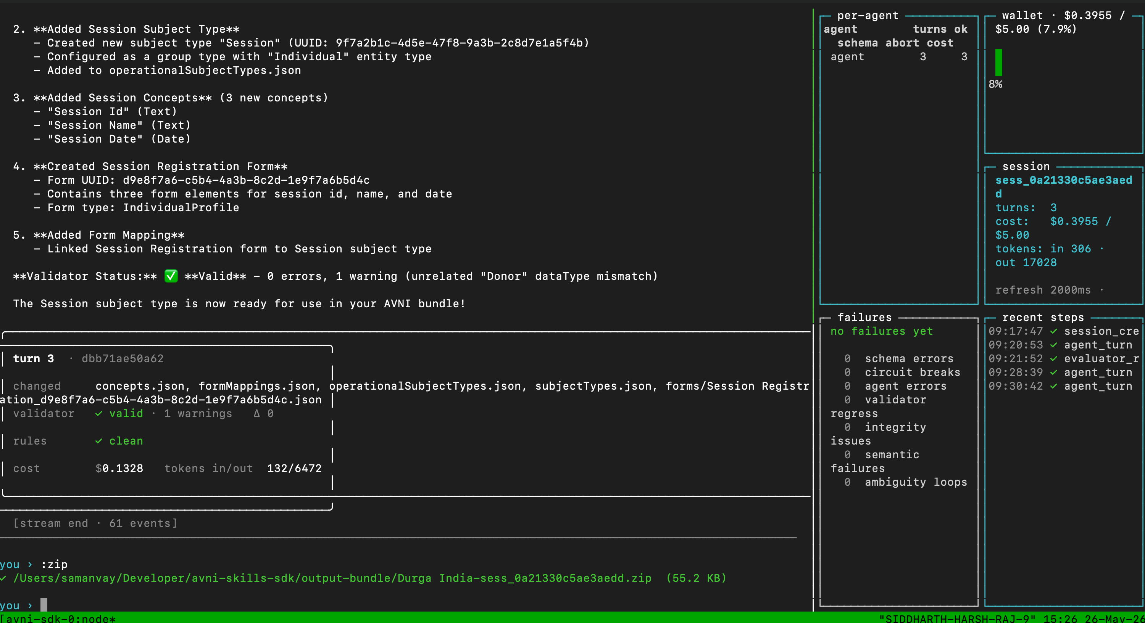
One bundle, end to end · :zip export · $0.13

