Slide 1
SIGNAL EARTH // ENVIRONMENTAL RESEARCH SUITE
Atmospheric Telemetry, Statutory NAQI & Satellite LST Thermodynamics
Multi-Year Computational Investigation Across the Indo-Gangetic Basin (2017–2023)
Featuring Central Pollution Control Board (CPCB) Formulations & NASA POWER Reanalysis

Slide 2
EXECUTIVE BRIEFING
Macro Findings & Empirical Metrics
Summary statistics evaluated across continuous multi-year observation windows
1,825 Days
Total Timespan
5 Complete Years (2017-18, 2021-23) continuous daily monitoring telemetry
221.0 AQI
Mean Airshed Level
Classifies as 'Poor' health band across 1,137 CPCB statutory valid days
78.80%
Non-Compliant Days
Exceed acceptable threshold (AQI > 100); 36.15% in Very Poor or Severe
95.20%
Particulate Hegemony
PM2.5 (51.8%) and PM10 (43.4%) trigger peak sub-index determinations
R² = 0.769
24-hr Ahead Forecast
Random Forest Regressor prospective validation on out-of-time test year 2023
ΔT Inversion
Radiant Decoupling
Winter skin drops -0.97°C below air, capping boundary layer below 250m

Slide 3
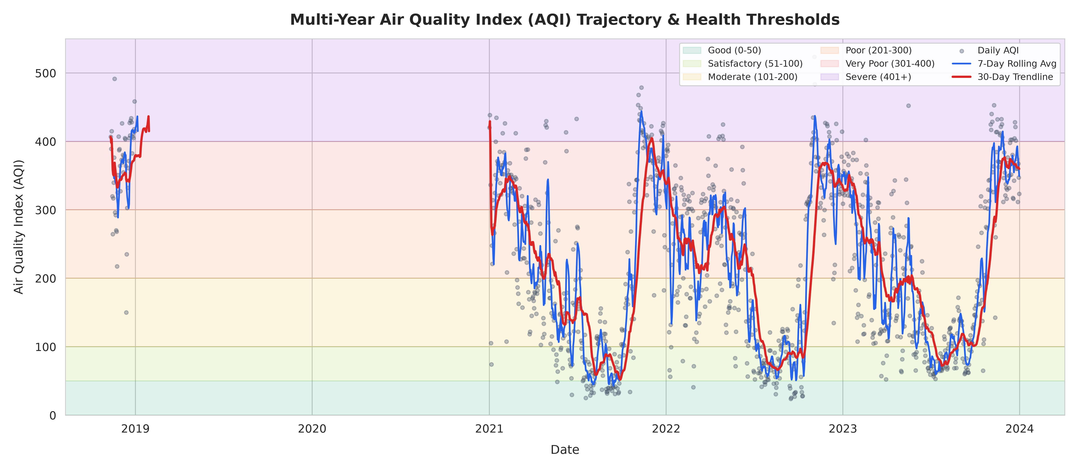
DELHI NCR ATMOSPHERIC PIPELINE
Multi-Year AQI Trajectory & CPCB Health Bands
Reindexed daily time series removing multi-year bridging artifacts

Slide 4
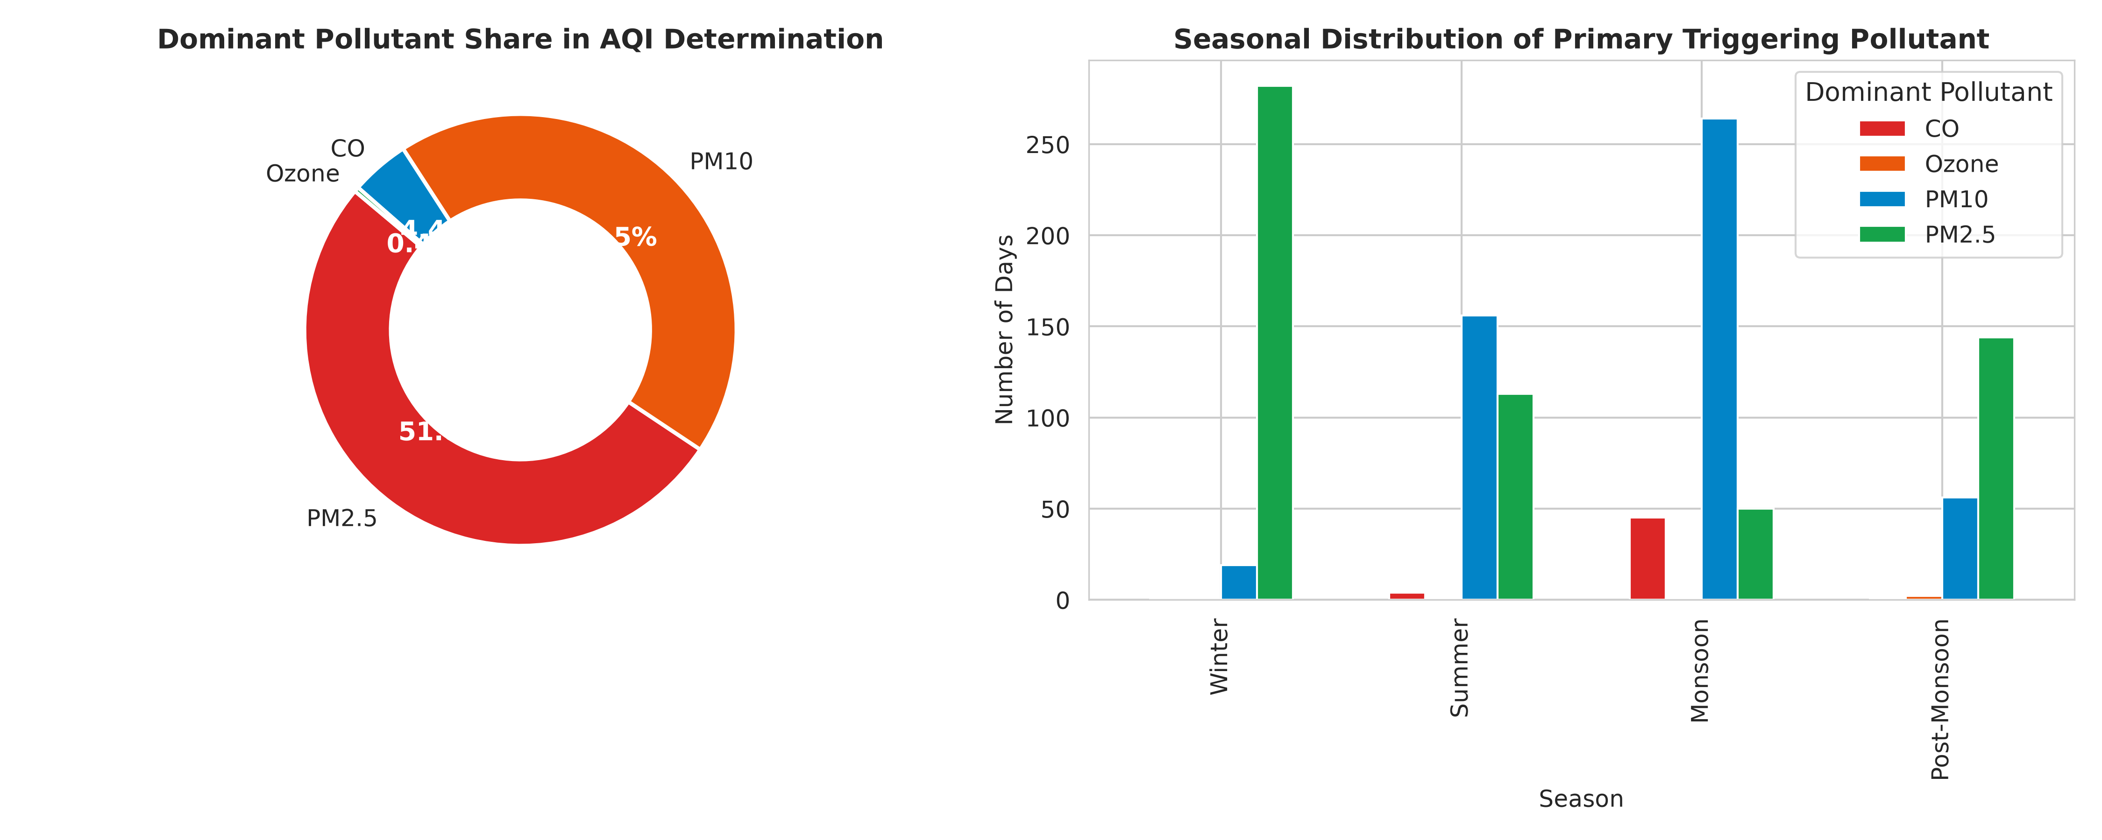
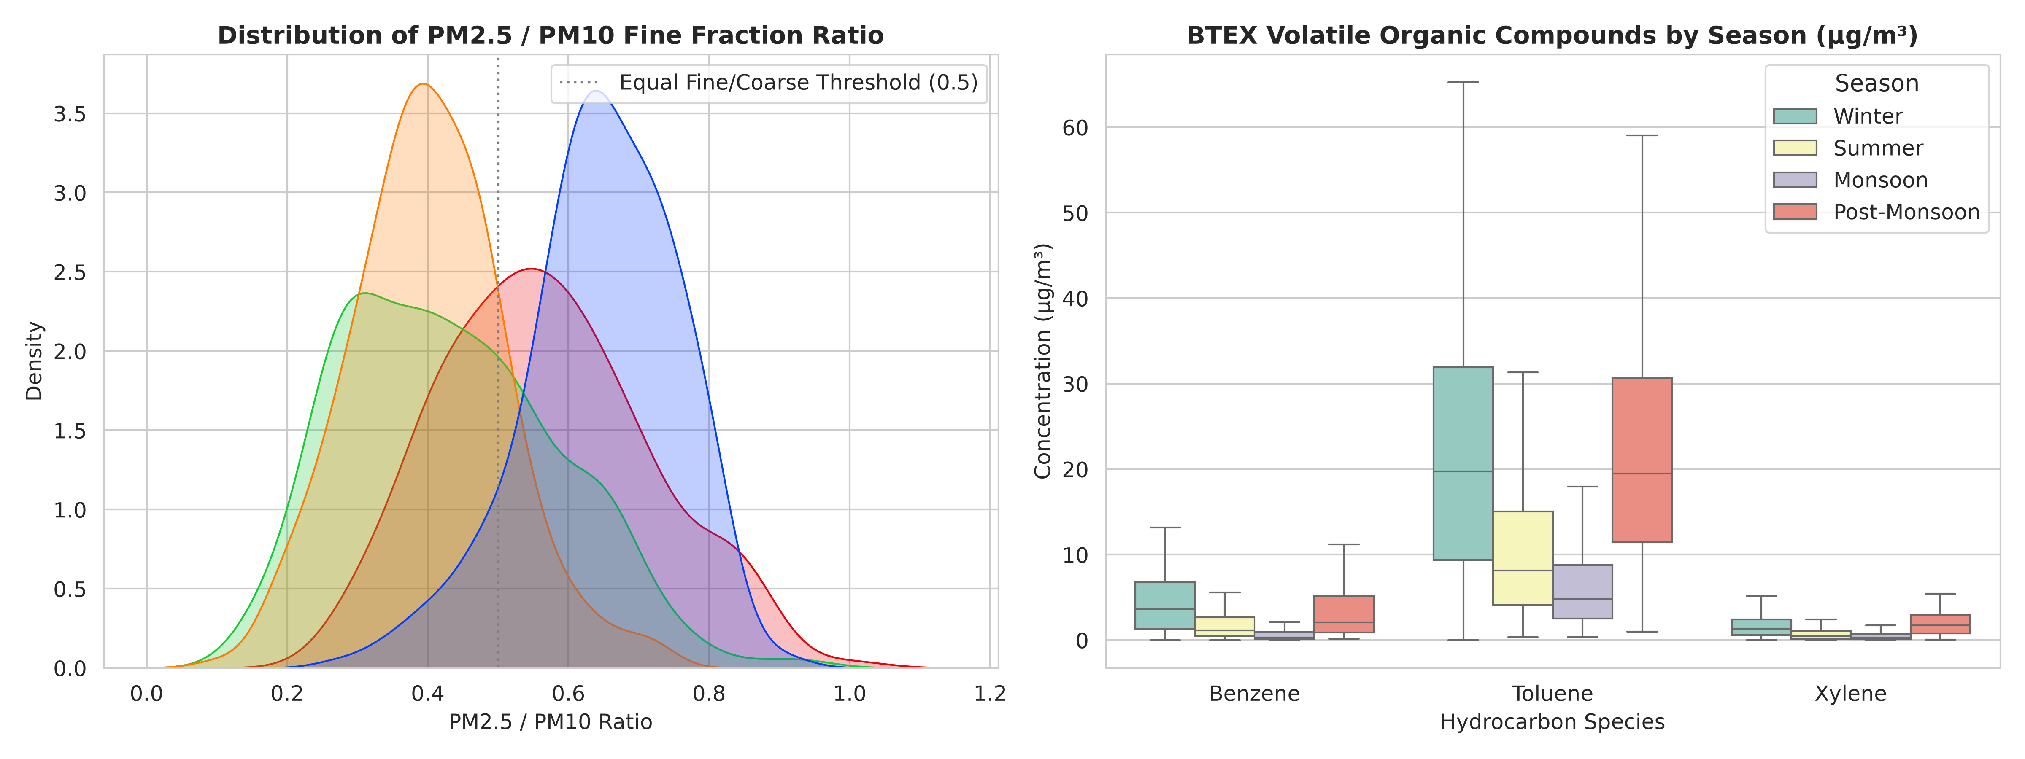
CHEMICAL FORENSICS
Particulate Hegemony & Volatile Organic Tracers
Dominant pollutant breakdown and diagnostic emission ratios

Slide 5
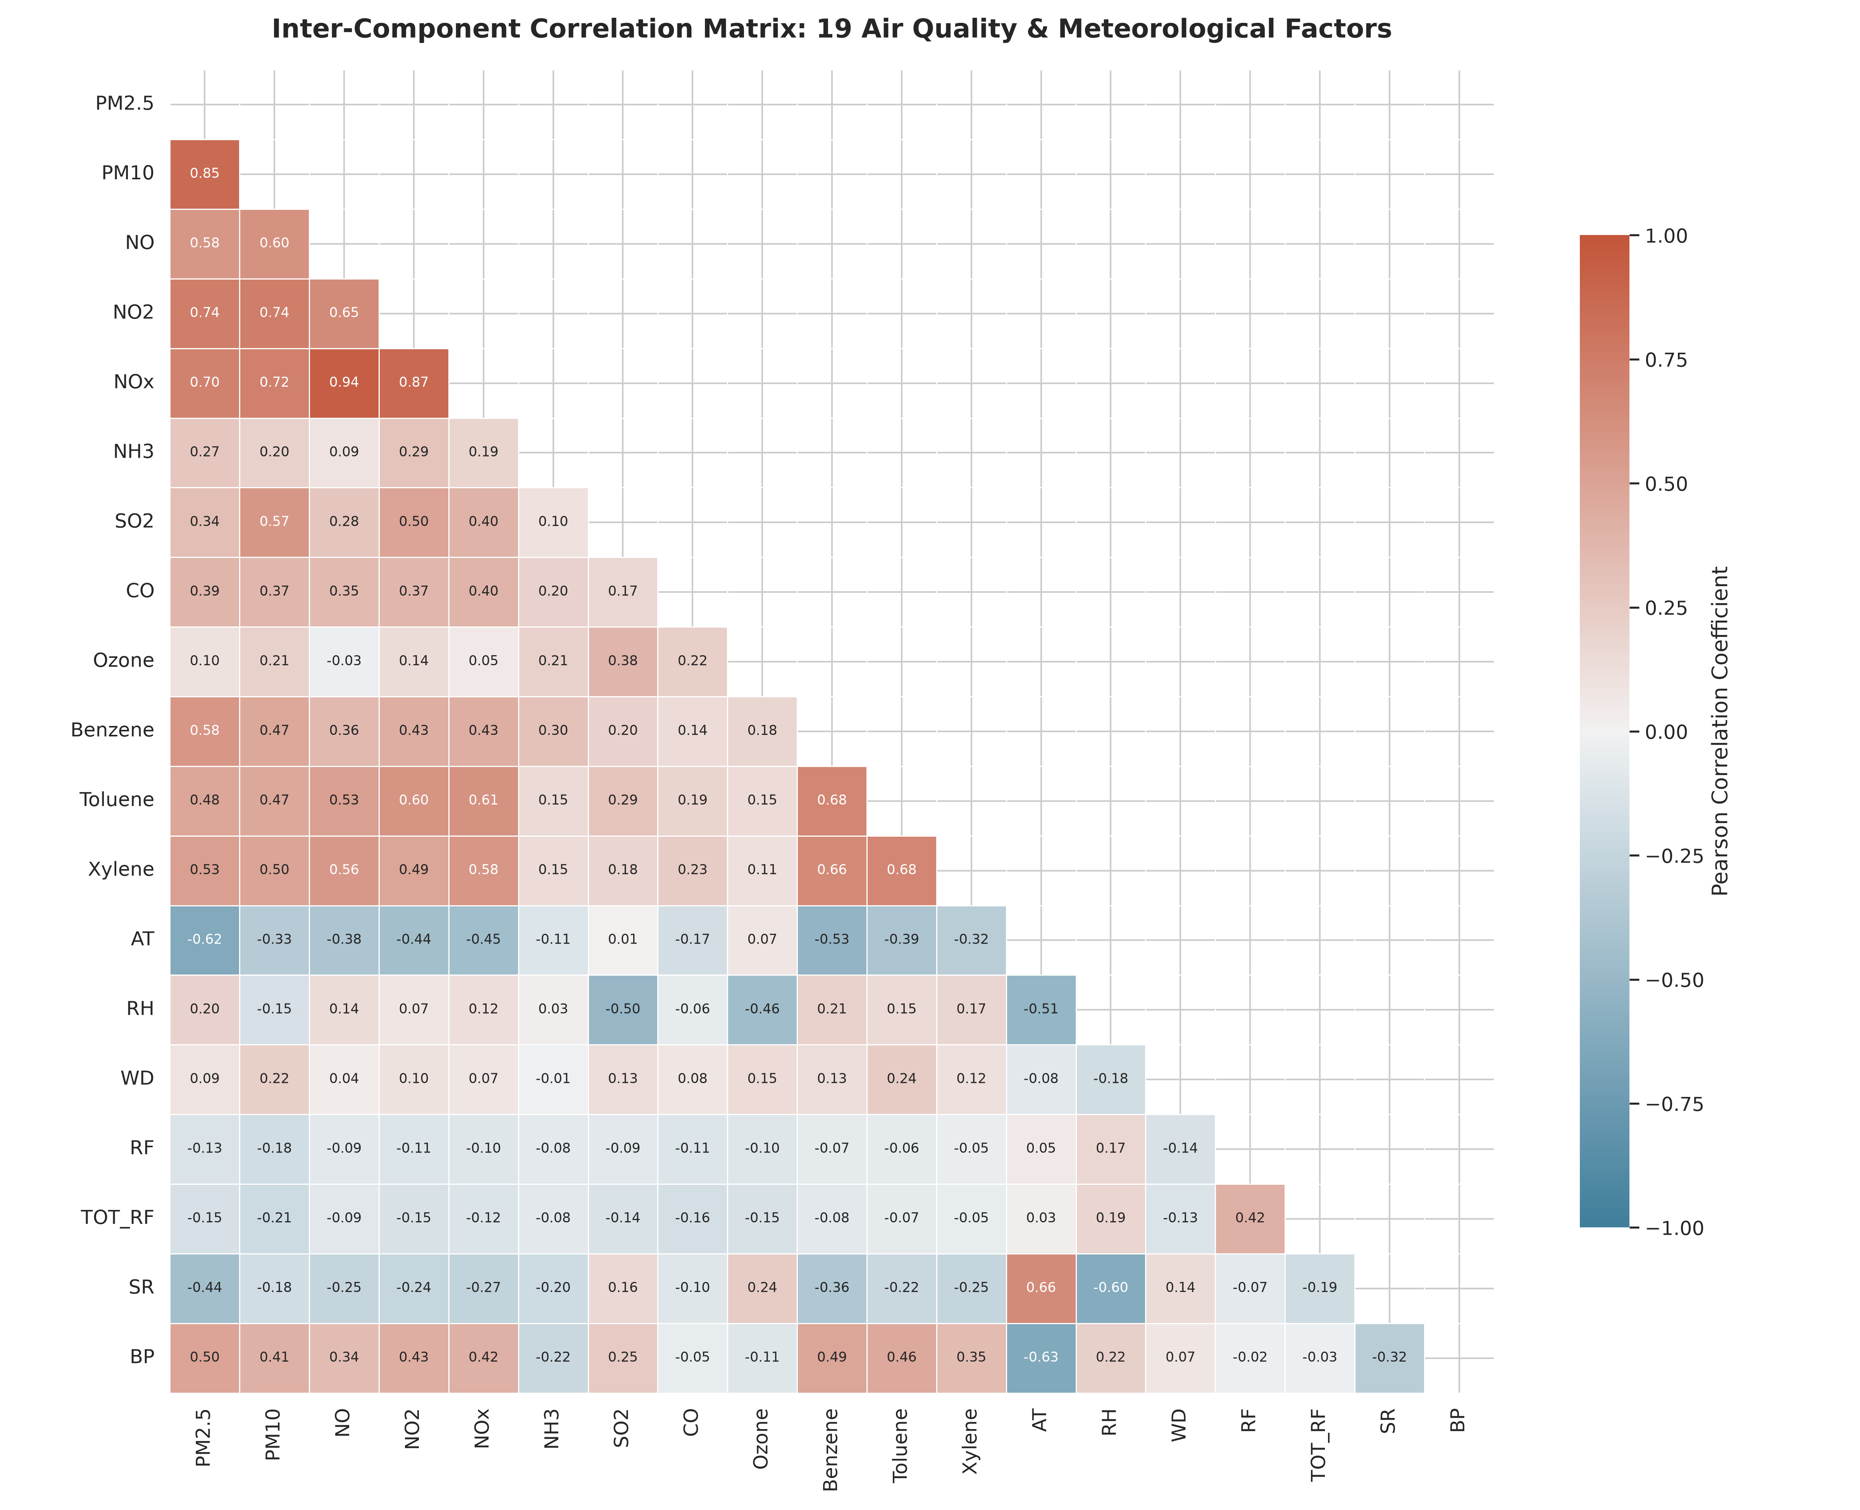
MULTI-PARAMETER CORRELATION
Inter-Component Coupling Across 19 Parameters
Pearson correlation matrix trimmed of 100% missing sensor channels

Slide 6
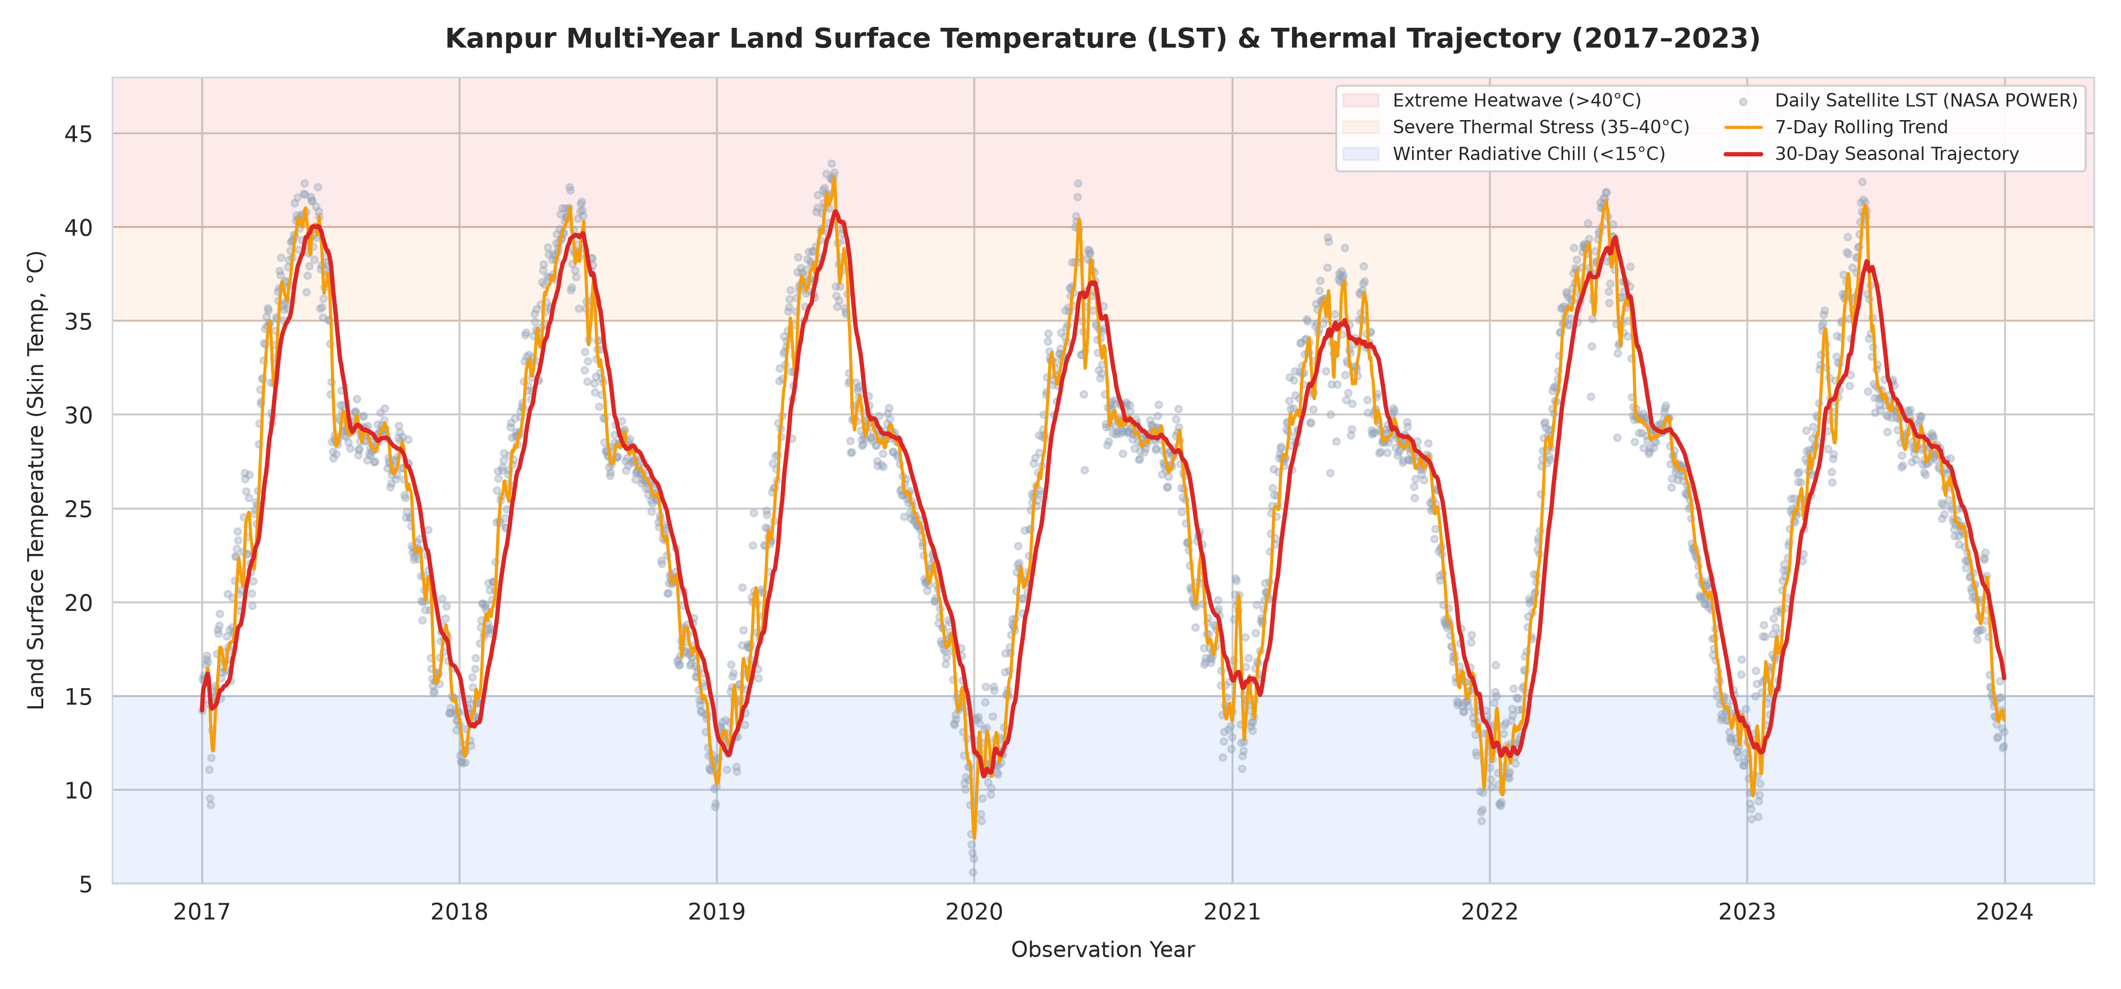
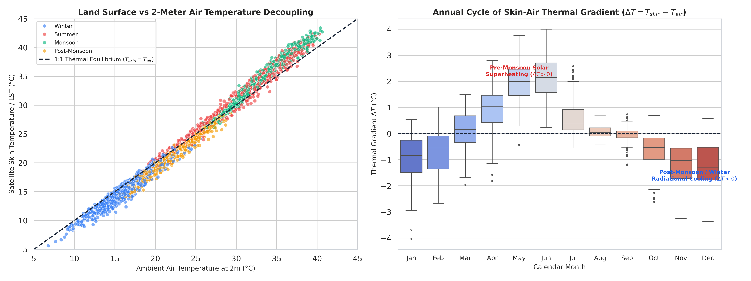
REMOTE SENSING & THERMODYNAMICS
Kanpur Land Surface Temperature (LST) & Inversion
7-Year Climatology (2017–2023) NASA POWER MERRA-2 skin-to-air thermal gradient

Slide 7
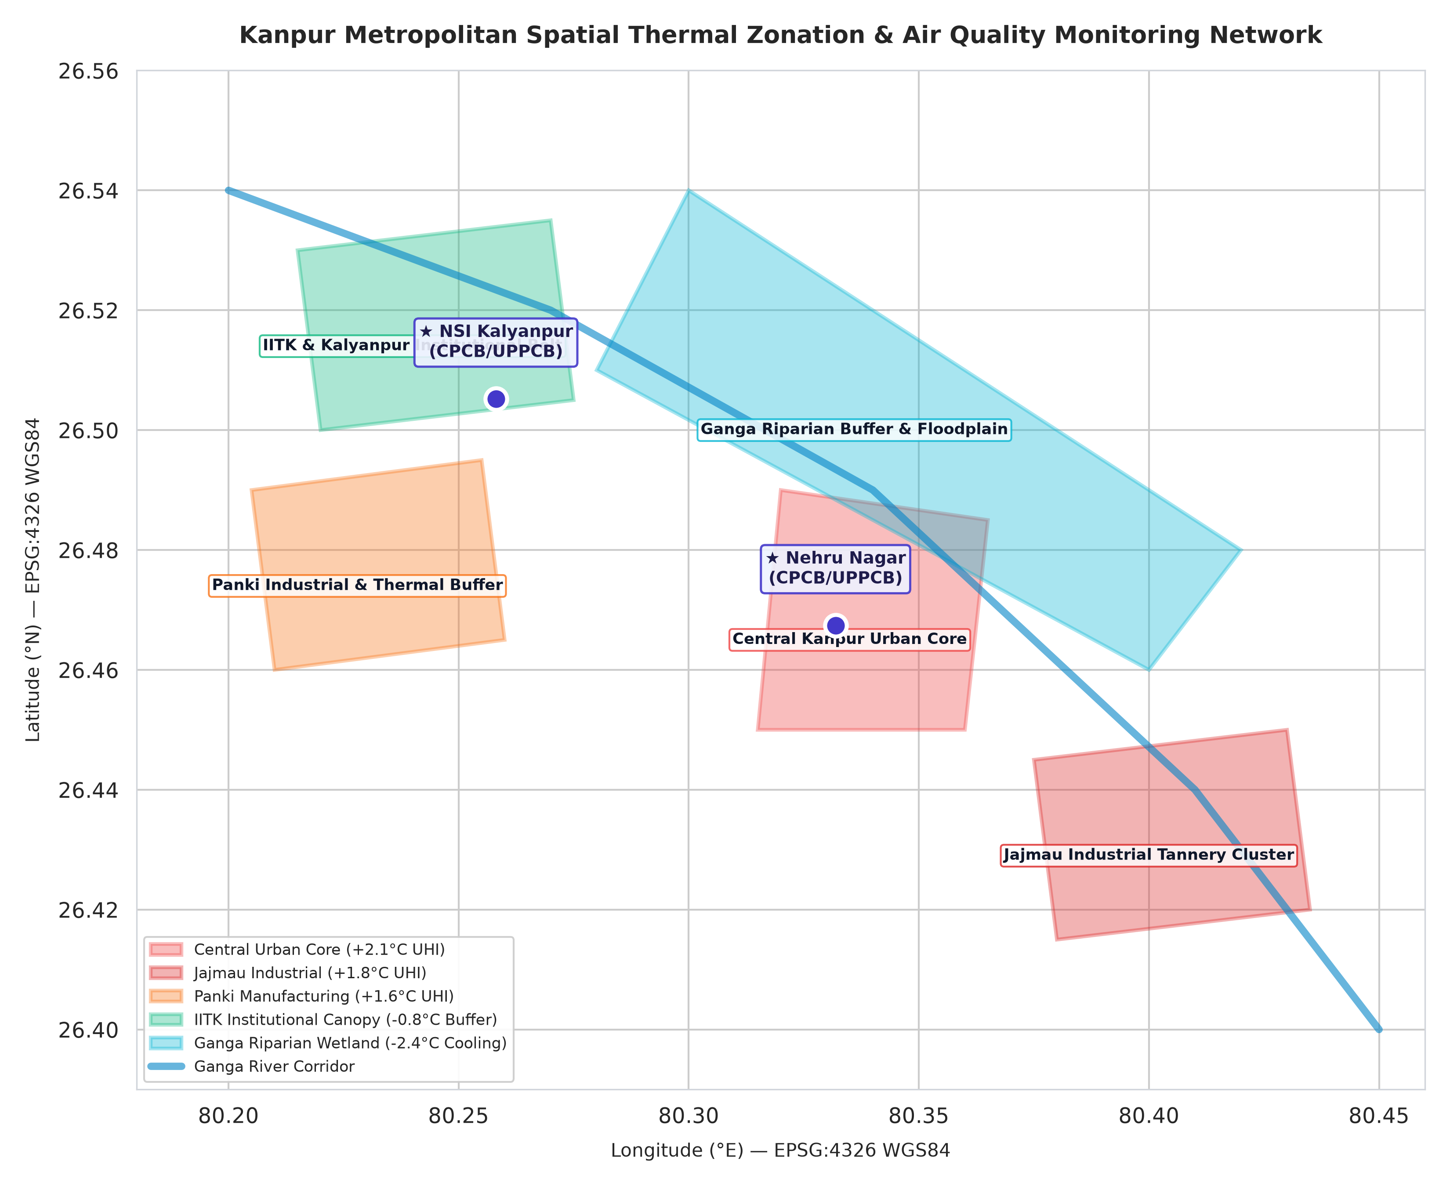
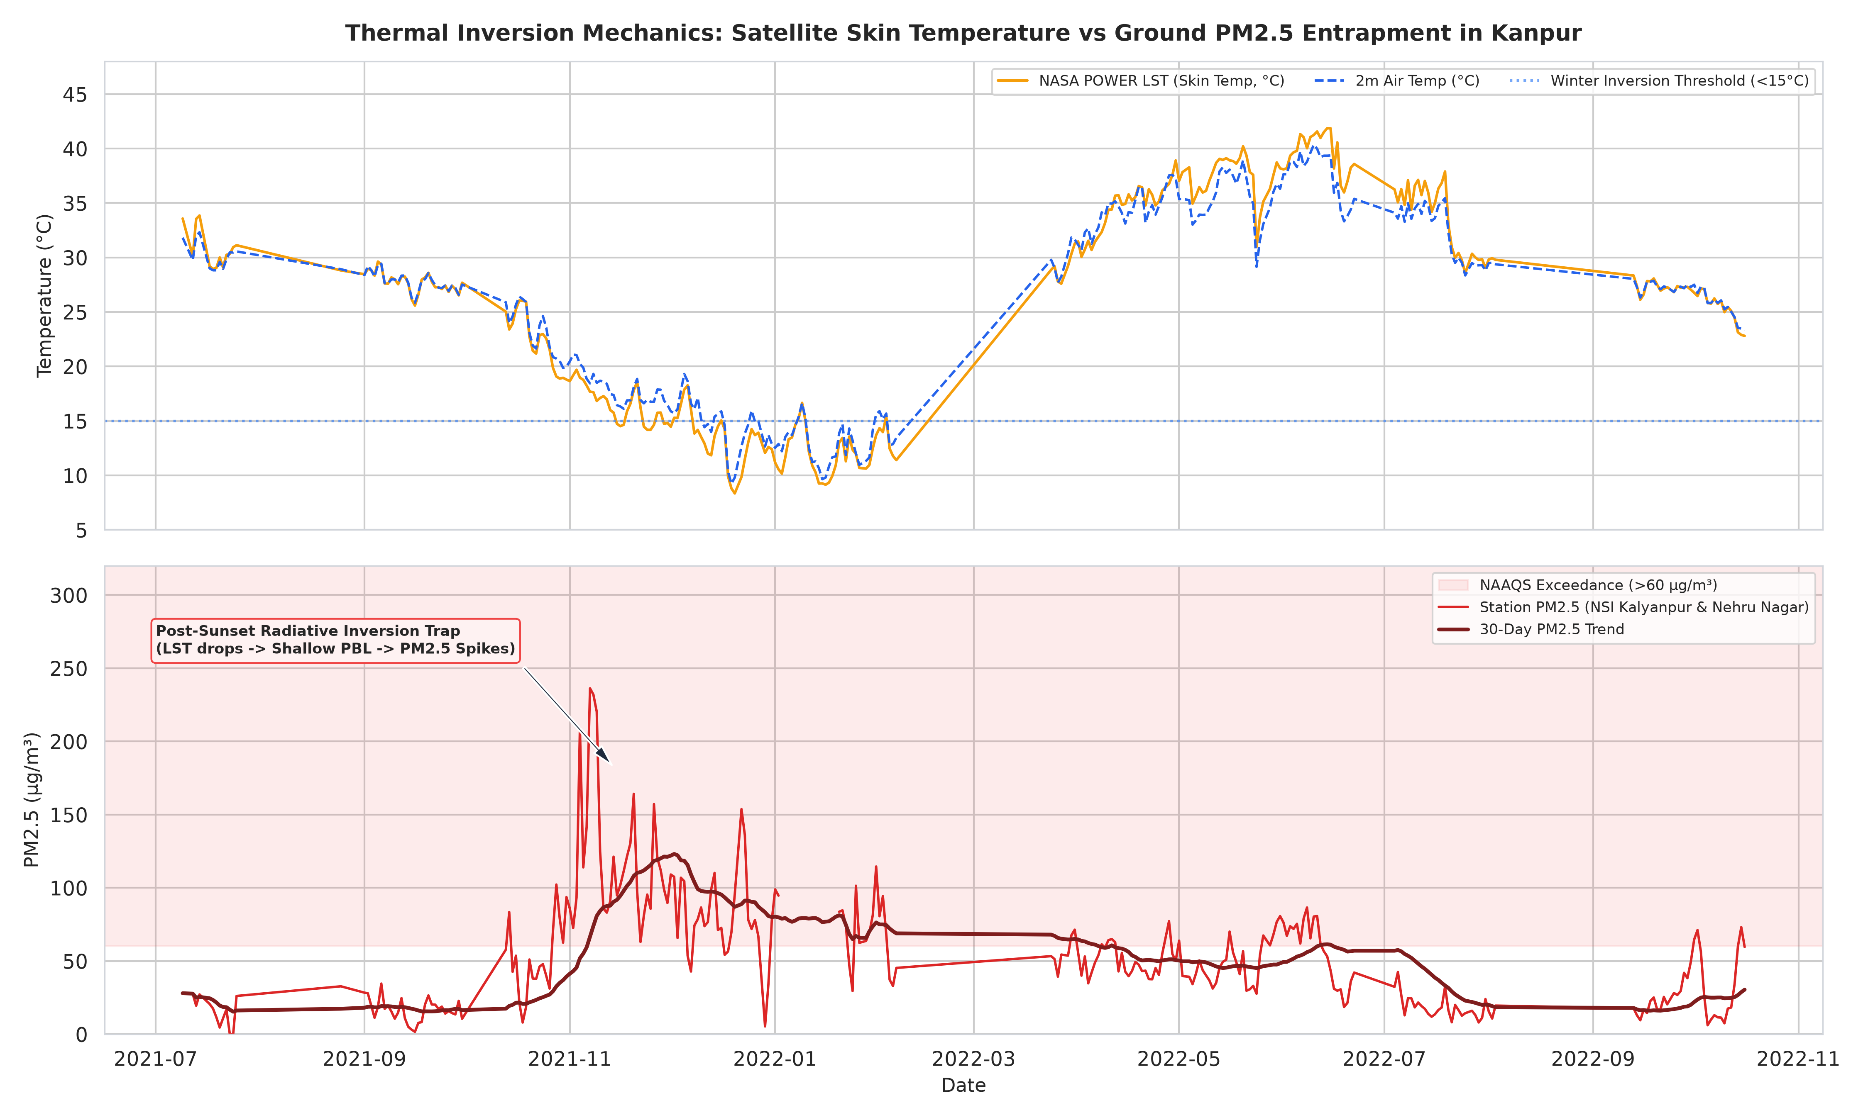
GEOSPATIAL MODELING
QGIS 3.x Vector Thermal Microclimate Zoning
Kanpur Urban Heat Island anomalies (+2.1°C) vs vegetative cooling (-0.8°C)

Slide 8
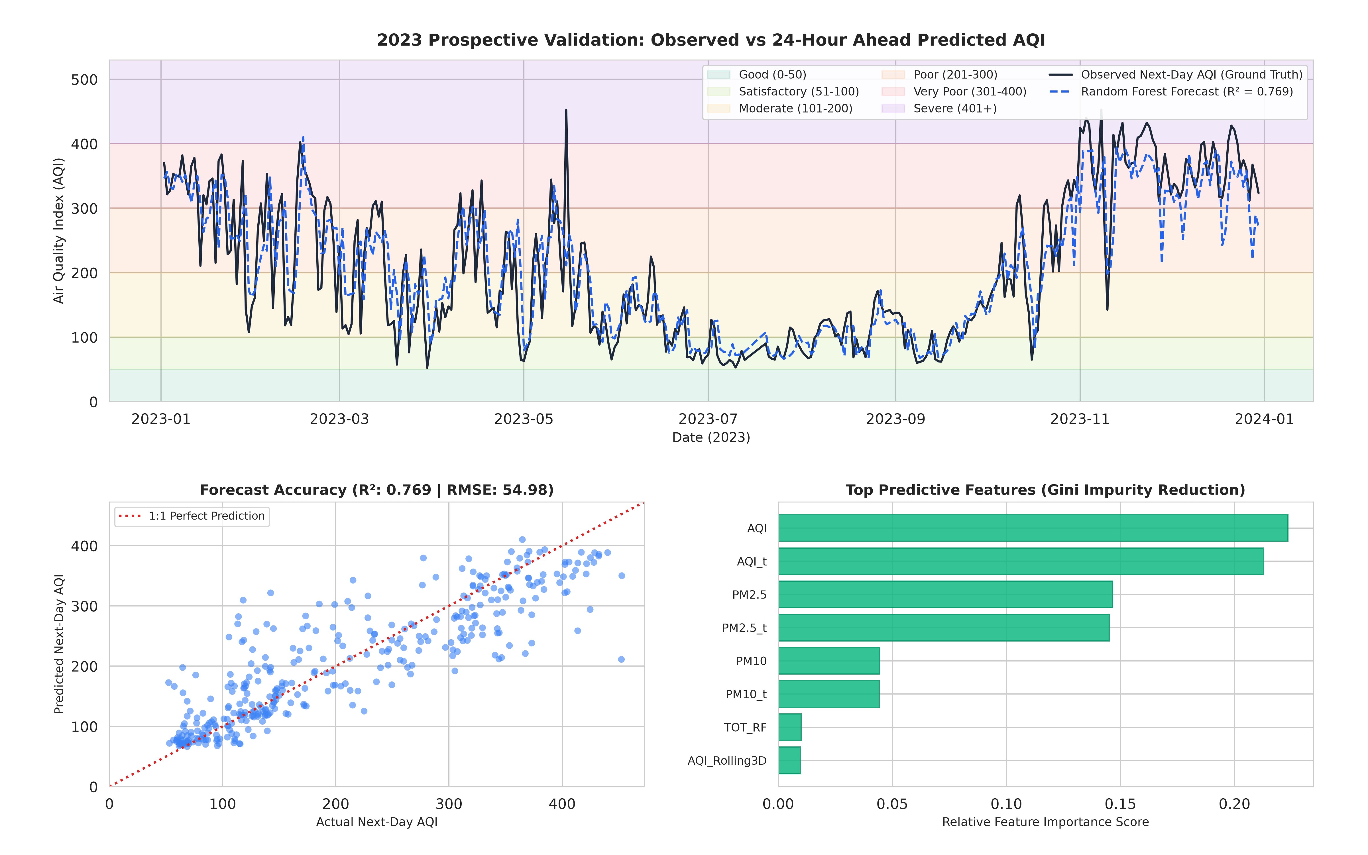
PREDICTIVE MACHINE LEARNING
24-Hour Ahead AQI Forecasting & Feature Importance
Out-of-time prospective testing on calendar year 2023 with zero data leakage

Slide 9
OPEN ENVIRONMENTAL SCIENCE
Signal Earth Open-Source Repository Architecture
Fully reproducible data pipelines, GIS vectors, and scientific documentation
• Delhi NCR Atmospheric Telemetry Pipeline
github.com/avnish36singh-arch/delhi-air_qaulity_cpcb
1,825 daily records | CPCB piecewise interpolation | 24 parameters | ML forecast
• Kanpur Satellite LST & QGIS Analysis
github.com/avnish36singh-arch/Kanpur-LST-Thermal-Analysis-GIS
2,556 daily NASA POWER records | Boundary layer inversion modeling | QGIS thermal vectors
• Signal Earth Environmental Portal
github.com/avnish36singh-arch/signal-earth-portal
Unified environmental dashboard, documentation suite, and observatory UI

