Slide 1
PROTOTYPE
Voice Fill for DQMS
Hands-free quality records: the QA executive speaks the readings, AI fills the form, the executive confirms.
Demonstrated on the real Kinley form “Treated Water Analysis Record” (WA-FRM-1105-1.0.0.8)
October 2026

Slide 2
THE PROBLEM
Readings are taken hands-on, but recorded by typing
Shop-floor reality: the executive samples at the line, often with gloves on or wet hands, then types each value into a tablet.
High frequency: forms such as Treated Water Analysis need a full set of readings every 4 hours, across many parameters.
Typing is the slow part: readings get written on paper first and keyed in later, which means double handling and a delay before the record is current.
Data-integrity risk: late or batched entry and transcription slips are exactly what auditors look for under ALCOA+ (attributable, contemporaneous, accurate).
The opportunity
DQMS already holds ~160 digitised forms with typed fields, units and spec limits.
That structure is exactly what an AI needs to map spoken words onto the right field reliably, so the executive can record at the point of sampling, by voice.
DQMS Voice Fill · Prototype 2

Slide 3
THE IDEA
Speak → Understand → Check → Confirm
1
2
3
4
Speak
Understand
Check
Confirm
Hold the mic and say the readings naturally.
“Round 1, time 10:30, chlorine zero, turbidity 0.18, pH 6.8, TDS 410.”
Speech-to-text, then Claude maps the words onto this form’s own fields and rounds, including Hinglish and self-corrections.
Every value is type-checked, matched to spec limits, and flagged if it overwrites an existing reading.
The executive ticks what is right. Accepted values go into the draft with a full audit trail. Submitting stays manual.
The AI only proposes. A named person always confirms, and only a person submits.
DQMS Voice Fill · Prototype 3

Slide 4
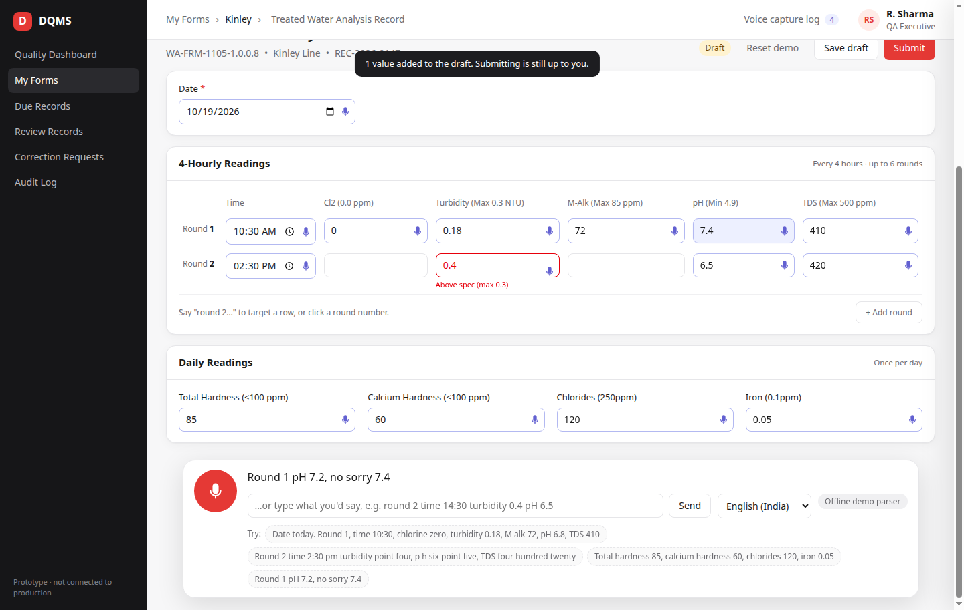
DEMO
The prototype: a real DQMS form, filled by voice
Real form: same fields, keys, 6-round grid and daily block as the production seed.
Voice dock: hold the mic (or Space); the transcript appears live.
Mic badge on every voice-filled cell shows who confirmed it and when.
Spec limits are highlighted on the form itself (Turbidity 0.4 > 0.3).
Manual edits still work; voice is an extra input, not a replacement.
DQMS Voice Fill · Prototype 4

Slide 5
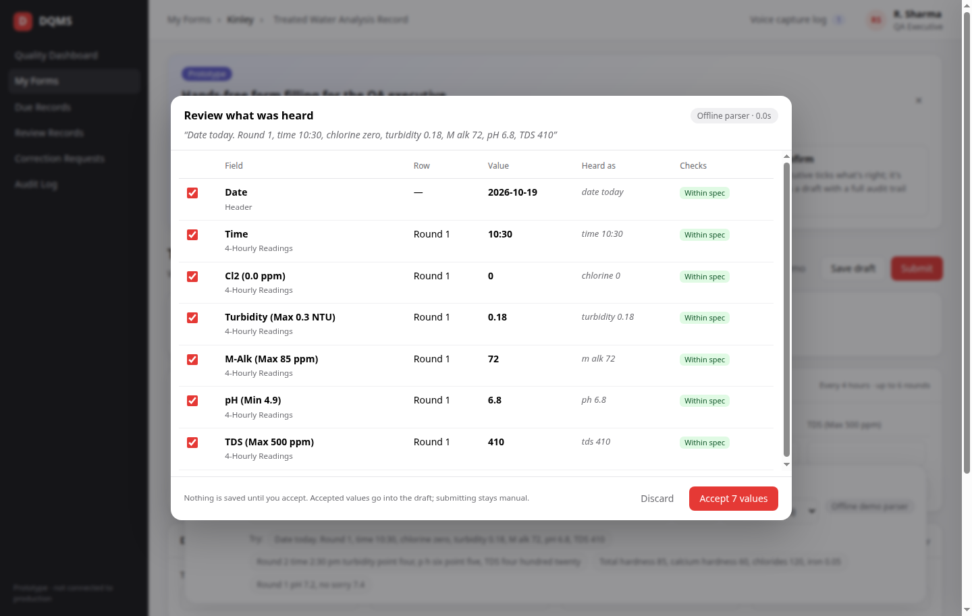
HUMAN IN THE LOOP
Nothing is saved until the executive accepts
Every value is shown with the words it was heard from (“Heard as”).
Row targeting: “round 2”, “second reading”, or the round the executive taps.
Checks per value: within spec, above or below spec, replaces an earlier reading, low confidence.
Untick anything wrong. Only ticked values reach the draft.
Unplaced numbers are listed as “heard but not placed”, never guessed.
DQMS Voice Fill · Prototype 5

Slide 6
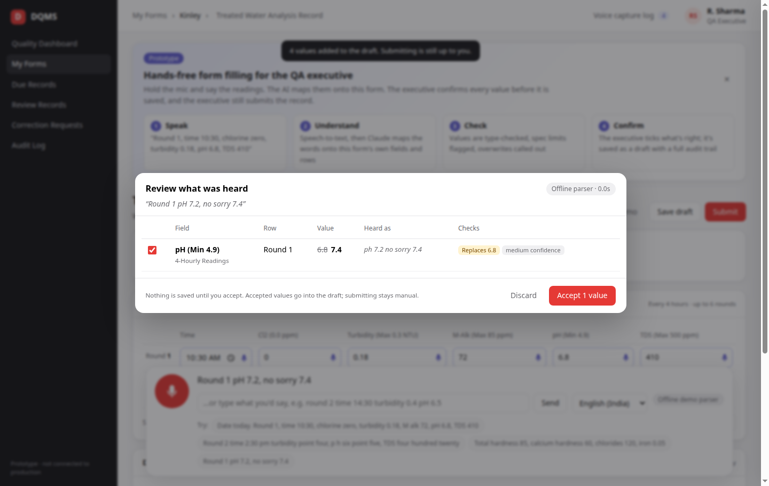
SAFETY IN ACTION
Built-in checks catch problems before they are saved
Self-corrections
“pH 7.2, no sorry 7.4” → only 7.4 is proposed, marked “Replaces 6.8”.
Out-of-spec
Turbidity 0.4 is flagged “Above spec (max 0.3)” in the review and on the form.
Strict validation
Unknown fields, bad times, rows past the 6-round limit and non-numbers are rejected, whatever the AI said.
DQMS Voice Fill · Prototype 6

Slide 7
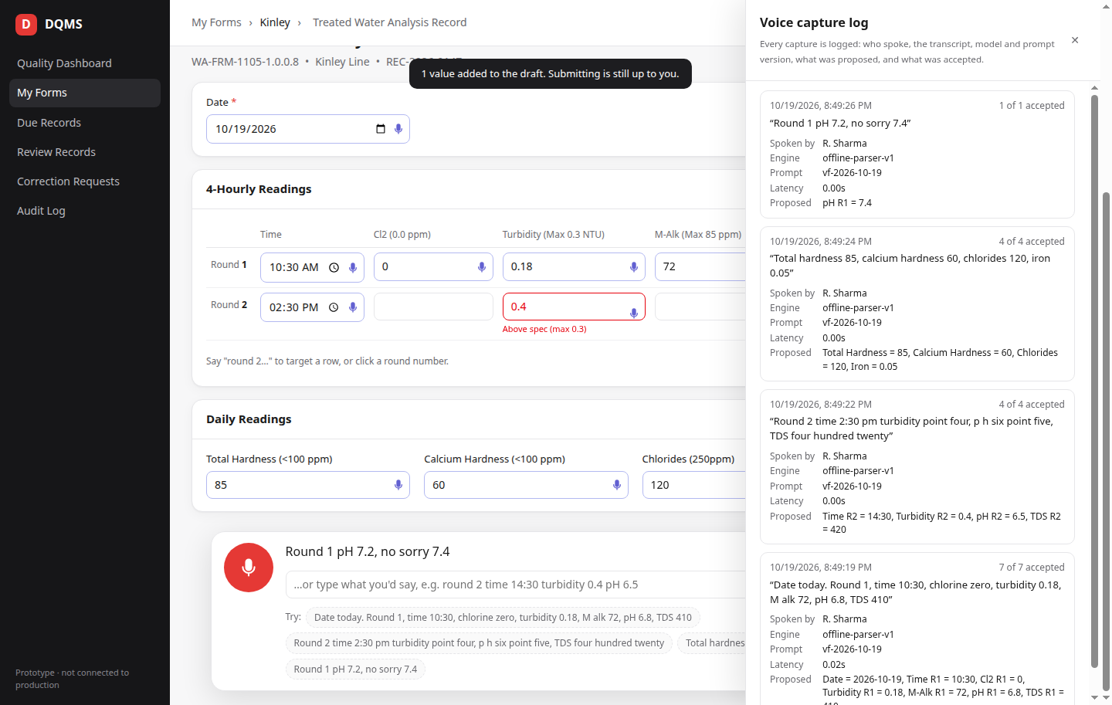
DATA INTEGRITY
Every capture is logged: an audit trail QA can stand behind
Attributable: who spoke and who confirmed (the logged-in executive).
Contemporaneous: captured at the point of sampling, time-stamped.
Traceable: exact transcript, AI model and prompt version for every capture.
Complete: what was proposed, what was accepted, what was rejected.
Original: the record still shows each value’s source (voice or manual).
DQMS Voice Fill · Prototype 7

Slide 8
SCOPE
What the prototype does today
Included in the prototype
Not yet (intentionally)
• Real Kinley form: Treated Water Analysis Record
• Push-to-talk speech capture (English-India, Hindi)
• Claude AI maps speech onto form fields and rounds
• Handles number words, “round N”, Hinglish, corrections
• Type, row and spec-limit validation on every value
• Review and confirm dialog; save as draft; manual submit
• Voice capture audit log
• Offline fallback parser if the AI is unreachable
• Not connected to production DQMS or its database
• Single demo user, no real login
• Browser speech recognition (Chrome/Edge) instead of Azure Speech
• One form; grids with many columns (e.g. 50 valves) come later
• No spoken read-back yet
• Not validated for GMP use. This is a concept demo.
DQMS Voice Fill · Prototype 8

Slide 9
ARCHITECTURE
How it works
Executive
Speech-to-text
Claude
Validation
Review
Tablet / phone
hold-to-talk
Prototype: browser
Production: Azure AI Speech
Form schema + current
record → structured JSON
Types, rows, spec limits,
overwrites (server-side)
Executive ticks
and accepts
Draft record
Audit log
Fallback
Accepted values saved with source = voice; the executive submits as today.
Transcript, model, prompt version, proposed vs accepted, who and when.
If the AI is unreachable, an offline parser keeps the flow working.
DQMS Voice Fill · Prototype 9

Slide 10
INTEGRATION PATH
From prototype to production DQMS
Area | Prototype | Production in DQMS
Speech-to-text | Browser Web Speech API | Azure AI Speech (en-IN / hi-IN), audio stays in the client’s Azure tenant
AI | Claude via API key | Claude through Microsoft Foundry, behind an LLM adapter in dqms_be
Form knowledge | One hand-copied form | Built from each FormVersion; optional voice aliases added per form in seed files
Validation | Prototype rules | The same checks the record save already runs, shared
Storage & audit | Local files | New voice_captures collection + audit-log entries; values carry source = voice
Access | One demo user | Real login + new “record.voiceFill” permission, enabled per plant / form
DQMS Voice Fill · Prototype 10

Slide 11
PLAN
Phased rollout, measured at every step
1
2
3
Pilot
Grids
Hands-free
Flat fields and simple rounds on one high-volume form, one line. Push-to-talk, English + Hinglish.
Large grids (“valve 12 gross 512.3”), spec-master rows by name, day-of-month rows. More forms per department.
Continuous capture per field with spoken read-back (“Brix 10.8, confirm?”) for gloved or wet-hands work.
What we measure in the pilot
Time to complete a form (voice vs typing)
Share of AI-proposed values accepted unchanged
Corrections after submission, and how soon after sampling each reading is recorded
DQMS Voice Fill · Prototype 11

Slide 12
NEXT STEPS
What we need to move to a pilot
1
Pilot scope
Choose the pilot form and line.
2
QA sign-off
QA head agrees the model: AI proposes, the executive confirms, every capture is logged.
3
Azure access
Azure AI Speech and Claude in Microsoft Foundry in the client’s tenant.
4
Audio policy
Keep transcripts only (recommended), or also store audio for a set retention period.
5
Hardware
Tablets or phones on the line with a headset mic; a built-in mic will struggle next to a filler.
DQMS Voice Fill · Prototype 12

