Slide 1
Speak the reading. The form fills itself.
DQMS · VOICE FILL
Hands-free quality records for the QA executive: AI proposes, a person confirms, every capture is audited.
Working prototype on the real Kinley “Treated Water Analysis Record” (WA-FRM-1105-1.0.0.8) · October 2026
Notes:
Open with the one-line idea: the executive speaks the readings at the point of sampling, the AI fills the right fields, and the executive confirms. Nothing is saved or submitted without a human.

Slide 2
What we will cover today
AGENDA
1
The problem
How readings are recorded on the floor today, and what that costs in time and data integrity
2
The solution
Voice Fill: Speak → Understand → Check → Confirm, shown on a real DQMS form
3
Safety & compliance
Human-in-the-loop, spec checks and a full ALCOA+ audit trail
4
Benefits
What changes for executives, QA heads and auditors, and how we will measure it
5
Costing
Running cost per capture and per month, plus one-time implementation effort
6
Plan & next steps
Phased rollout, risks, and what we need from you to start a pilot

Slide 3
DQMS has already taken the plant from paper to digital
WHERE WE ARE TODAY
130+
7
6×
100%
quality forms digitised, with typed fields, units and spec limits
departments: Kinley, Juice, RGB, BIB, Microbiology, ETP and WTP
rounds a day on 4-hourly forms such as Treated Water Analysis
of entries still typed by hand on a tablet or PC
What DQMS already does
Role-based forms per plant, line and department · due-record tracking · maker/checker review · correction and deletion requests · line holds and breakdowns · material, AQL and specification masters · quality dashboard · full audit log.
Because every form is already structured data, an AI can map spoken words onto the correct field reliably. That is what makes voice possible now.
Notes:
Set the context: DQMS is live, forms are digital, approvals and audit logs exist. Voice Fill is the next step on top of that foundation, not a new system.

Slide 4
Readings are taken by hand, but typed in later
PART 1 · THE PROBLEM
The last manual step in a digital process is the slowest and the riskiest.

Slide 5
Hands are busy exactly where the reading is taken
THE PROBLEM · 1 OF 3
Gloves & wet hands
Many values per visit
Noise & time pressure
Sampling at the filler, RO plant or lab bench. Touchscreens and gloves don’t mix.
One round of Treated Water Analysis = time + 5 parameters. A 50-valve net-content check is 100+ numbers.
Lines keep running. Every minute at the tablet is a minute away from the line.
What happens in practice: readings are written on paper or memorised, then keyed into DQMS later, often in a batch at the end of the round or shift.
Result: double handling, delayed records, and a gap between when a reading was taken and when it entered the system.
Notes:
Paint the picture: the executive is at the filler or the water plant, gloves on, sample in hand. Typing on a tablet there is awkward, so they jot on paper and type later.

Slide 6
Typing is the slow part, and it repeats all day
THE PROBLEM · 2 OF 3
One form, one line, one day
With voice
Treated Water Analysis Record (Kinley)
“Round 1, time 10:30, chlorine zero, turbidity 0.18, M alk 72, pH 6.8, TDS 410.”
6 rounds × 6 values (time, Cl2, turbidity, M-Alk, pH, TDS)
36
Daily block (hardness, calcium, chlorides, iron)
4
41 → ~8
1
Header (date)
1
typed entries become about 8 spoken sentences a day
review tap per sentence to accept all its values
Typed entries per day
41
This is one form. DQMS has 130+, many filled every round on every line.
Notes:
Use the Treated Water form as a concrete example. 41 values per day on one form on one line. Multiply by every form, line and plant.

Slide 7
Late, re-typed entries are what auditors look for
THE PROBLEM · 3 OF 3
ALCOA+ principle | What happens today | Risk
Contemporaneous | Values entered at shift end, not when sampled | Record time ≠ reading time
Accurate | Paper → tablet transcription slips (7.4 typed as 4.7) | Wrong value, found late or never
Attributable | Readings jotted by one person, typed by another | Who actually took the reading?
Complete | Rounds skipped when the line is busy | Gaps discovered at review
Timely action | An out-of-spec value is noticed only after it is typed | Slower line hold / correction
Voice Fill closes this gap by recording the value where and when it is measured.
Notes:
ALCOA+ is the regulator and brand-owner expectation for quality records. Batched, late typing and transcription slips weaken “contemporaneous” and “accurate”.

Slide 8
Voice Fill for DQMS
PART 2 · THE SOLUTION
Hold the mic, say the readings naturally. AI maps them onto the form, every value is checked, and the executive confirms.

Slide 9
Speak → Understand → Check → Confirm
HOW IT WORKS
1
2
3
4
Speak
Understand
Check
Confirm
Hold the mic and say the readings in plain English, Hindi or Hinglish.
Speech-to-text, then Claude AI maps words onto this form’s own fields and rounds.
Every value is type-checked, compared to spec limits and flagged if it overwrites a reading.
The executive ticks what is right. Accepted values go to the draft. Submit stays manual.
The AI only proposes. A named person always confirms, and only a person submits.
Notes:
Four steps. Stress step 4: the AI never saves or submits anything on its own.

Slide 10
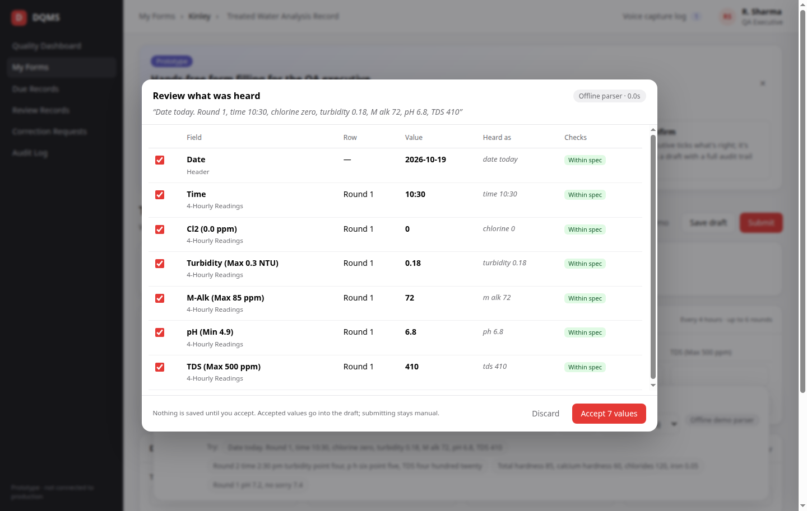
Nothing is saved until the executive accepts
PROTOTYPE · REVIEW SCREEN
1
Heard as
Each value shows the exact words it came from
2
Right round
“Round 2”, “second reading” or the tapped row
3
Spec check
Within / above / below spec, before saving
4
Overwrite
Flags a value that replaces an earlier one
5
Untick
Anything wrong never reaches the draft
Notes:
Show the review dialog. Each value is listed with the words it was heard from, the round it goes into and its spec check.

Slide 11
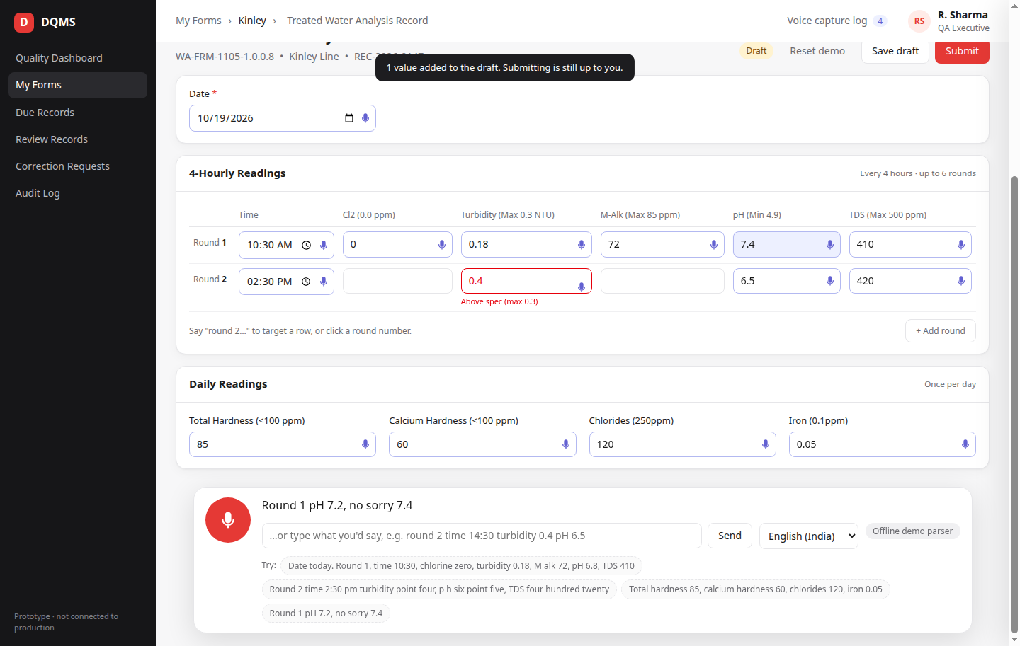
A real DQMS form, filled by voice
PROTOTYPE · FILLED FORM
Real form, real structure
Same fields and rounds as the live Kinley form.
Out-of-spec in red
Turbidity 0.4 flagged “Above spec (max 0.3)”.
Manual still works
Voice is an extra input, not a replacement.
Notes:
The same fields, keys, 6-round grid and daily block as the production seed. The mic badge marks voice-filled cells. The red cell is an out-of-spec reading caught on the form itself.

Slide 12
It understands how people actually speak
BUILT FOR THE SHOP FLOOR
Situation | What the executive says | What the form gets
Hinglish & accents | “dusra round, pH saat point do” | Round 2 → pH 7.2
Self-correction | “pH 7.2, no sorry 7.4” | Only 7.4 proposed, “replaces 6.8”
Number words | “turbidity point four, TDS four hundred twenty” | 0.4 and 420
Shop-floor names | “M alk”, “chlorine”, “calcium” | M-Alk, Cl2, Calcium Hardness
Speech-to-text slips | “p h”, “tea ds”, “em alk” | pH, TDS, M-Alk
Unclear numbers | A number with no clear field | Listed as “heard but not placed”, never guessed
No network or AI outage? An offline parser takes over automatically, so the flow never dead-ends.
Notes:
Live demo moments: Hinglish, self-correction, number words, unrecognised phrases. If the AI is unreachable, an offline parser keeps the flow working.

Slide 13
Every capture is logged for audit (ALCOA+)
SAFETY & COMPLIANCE
Attributable
Legible & Original
Who spoke and who confirmed: the logged-in executive
Each value keeps its source (voice or manual) in the record
Contemporaneous
Accurate
Captured and time-stamped at the point of sampling
Type, row and spec-limit checks on every value before it is saved
Traceable
Complete
Exact transcript, AI model and prompt version for every capture
What was proposed, accepted and rejected, all retained
Notes:
Map each ALCOA+ principle to what Voice Fill records. This is the answer to “can we trust an AI in a GMP record?”: the AI never decides, a person does, and everything is traceable.

Slide 14
Architecture: from microphone to audited draft
HOW IT IS BUILT
Executive
Speech-to-text
Claude AI
Validation
Review
Tablet / phone
hold-to-talk
Azure AI Speech
(en-IN / hi-IN)
Form schema + current
record → structured JSON
Types, rows, spec limits,
overwrites (server-side)
Executive ticks
and accepts
Draft record
Audit log
Data stays with you
Accepted values saved to the existing DQMS record with source = voice. The executive submits exactly as today; review and approval are unchanged.
New voice-capture log plus DQMS audit-log entries: transcript, model, prompt version, proposed vs accepted, who and when.
Speech and AI run inside your own Microsoft Azure tenant (Azure AI Speech + Claude in Microsoft Foundry). Audio need not be stored.
Notes:
Walk the flow left to right. Then the bottom row: what stays exactly as DQMS works today.

Slide 15
From prototype to production DQMS
INTEGRATION PATH
Area | Prototype (today) | Production (pilot)
Speech-to-text | Browser Web Speech API (Chrome/Edge) | Azure AI Speech, audio stays in the client’s Azure tenant
AI model | Claude via API key | Claude in Microsoft Foundry, behind an LLM adapter in the DQMS API
Form knowledge | One hand-copied form | Built from each live form version; voice aliases added per form
Validation | Prototype rules | The same checks DQMS already runs on record save, shared
Storage & audit | Browser / local files | voice_captures collection + DQMS audit-log entries
Access control | One demo user | Real login + new “record.voiceFill” permission per plant / form
Notes:
The prototype is deliberately standalone. This table is the engineering scope of the pilot integration.

Slide 16
What changes for the plant
PART 3 · BENEFITS
Faster recording, better data, stronger audits, with no change to how records are reviewed and approved.

Slide 17
Benefits for every role in the quality chain
WHO GAINS WHAT
1
2
3
QA executive
QA head / plant
Audit & compliance
• No typing with gloves or wet hands
• One sentence per round instead of 6–7 entries
• No paper notes to re-type later
• Out-of-spec values flagged instantly
• Manual entry still available
• Records are current, not end-of-shift
• Faster reaction to out-of-spec readings
• Fewer correction requests from typos
• More executive time on the line
• Same review and approval flow
• Stronger ALCOA+ evidence
• Every value traceable to its words
• Proposed vs accepted kept on record
• AI never submits; people do
• Data stays in your Azure tenant
Notes:
Go role by role. Avoid promising percentages until the pilot measures them; the next slide shows how we will measure.

Slide 18
What we measure in the pilot
HOW WE PROVE IT
1
Time per form
Minutes to complete a form, voice vs typing (same form, same line)
2
Acceptance rate
Share of AI-proposed values accepted unchanged by the executive
3
Entry delay
Gap between sampling time and the value reaching DQMS
4
Corrections
Correction requests after submission, before vs during the pilot
5
Adoption
Share of rounds captured by voice once the pilot settles
6
User feedback
Executive and QA-head feedback on ease and trust
Notes:
We commit to measuring, not to a number we cannot yet prove. Baseline is taken from current DQMS data for the same form and line.

Slide 19
What it costs
PART 4 · COSTING
Two parts: a small running cost per voice capture, and a one-time effort to build it into DQMS.

Slide 20
Sonnet 5.5 does the job at about ₹1 per capture
RUNNING COST · PER CAPTURE
Per capture | Haiku 5.5 (lightest) | Sonnet 5.5 (recommended) | Opus 5.5 (top)
AI price (input / output, per million tokens) | $0.10 / $0.50 | $2 / $10 | $4 / $20
Claude AI cost | ≈ $0.0004 | ≈ $0.0075 | ≈ $0.0147
Azure AI Speech (~15 s at ~$1 / hour) | $0.0042 | $0.0042 | $0.0042
Total per capture | ≈ $0.0046 (≈ ₹0.40) | ≈ $0.0117 (≈ ₹1.0) | ≈ $0.0189 (≈ ₹1.7)
Recommended: Sonnet 5.5. About 40% cheaper than Opus. In the pilot we check its accuracy against Opus, also try Haiku 5.5, and keep the cheapest model that matches.
Exchange rate assumed ₹88 = $1. Azure Speech price varies by region and agreement: confirm with your Azure account team.
Notes:
One capture = one sentence of about 15 seconds, e.g. one full round. The job is short and structured: map a sentence onto known fields. That suits a mid-size model such as Sonnet 5.5; Haiku 5.5 is an even cheaper option to test. Token figures are estimates from the prototype prompt (about 1,500 cached instruction tokens, 600 input, 600 output) and will be confirmed from real usage logs in the pilot. List prices; Foundry bills Claude at the same rates. With Haiku, speech-to-text becomes most of the cost.

Slide 21
With Sonnet 5.5, a full plant runs under ₹10,000 a month
RUNNING COST · PER MONTH
Scale | Captures / month | Haiku 5.5 | Sonnet 5.5 | Opus 5.5
Pilot (1 line, 5 forms) | 1,200 | ₹500 | ₹1,200 | ₹2,000
One plant (40 forms) | 9,600 | ₹3,900 | ₹9,900 | ₹16,000
Five plants (200 forms) | 48,000 | ₹19,400 | ₹49,400 | ₹80,000
Estimates. Assumes 8 captures per form per day for 30 days and ₹88 = $1. Hosting runs on the existing DQMS servers: no new server cost for the pilot.
Notes:
Assumption: 8 captures per form per day (one per round plus the daily block), 30 days. Sonnet 5.5 is the recommended model at about 60% of the Opus cost. Haiku 5.5 would cut it to about a quarter if it proves accurate enough in the pilot.

Slide 22
Building it into DQMS, phase by phase
ONE-TIME COST · IMPLEMENTATION
Phase | Scope | Duration | Team | Cost
1. Pilot | Azure Speech + Claude adapters, voice on 1–3 forms, review dialog in DQMS, audit log, permission, UAT on one line | 6–8 weeks | 1 backend, 1 frontend, QA (part-time), PM (part-time) | ₹[____]
2. Grids & scale-out | Large grids (“valve 12 gross 512.3”), spec-master rows, more forms per department | 6 weeks | Same team | ₹[____]
3. Hands-free | Continuous capture with spoken read-back (“Brix 10.8, confirm?”) | 8 weeks | Same team | ₹[____]
Hardware (client side)
Azure access (client side)
Headset or lapel mic per executive. A tablet’s built-in mic struggles next to a filler.
Azure AI Speech + Claude in Microsoft Foundry enabled in your tenant.
Notes:
Effort is our estimate for the scope on the integration slide. Fill in the commercial rate before sending. Phases 2 and 3 are optional and only start after the pilot results are reviewed.

Slide 23
Phased rollout, measured at each step
PART 5 · PLAN
Start small on one form and one line, prove it with numbers, then scale.

Slide 24
Three phases, each gated on results
ROADMAP
1
2
3
Pilot
Grids & scale-out
Hands-free
One high-volume form on one line. Push-to-talk, English + Hinglish. Baseline vs voice on the KPIs.
6–8 weeks
Large grids, spec-master rows by name, day-of-month rows. More forms per department.
~6 weeks
Continuous capture per field with spoken read-back for gloved or wet-hands work.
~8 weeks
Gate after each phase: acceptance rate, time per form, entry delay and user feedback reviewed with the QA head before moving on.
Notes:
Each phase ends with a review against the pilot KPIs before the next one starts.

Slide 25
What could go wrong, and how we handle it
RISKS & MITIGATIONS
Risk | Mitigation
Line noise | Headset mic; push-to-talk; typed fallback in the same box
AI maps a value wrongly | Human review of every value; “heard as” shown; strict server validation
Accents / Hinglish | en-IN and hi-IN speech models; shop-floor aliases per form
Network or AI outage | Automatic offline parser; manual entry always available
Data privacy | Runs in your Azure tenant; transcripts only, audio not stored by default
GMP validation | AI never submits; full audit trail; QA sign-off before pilot
Notes:
Be open about risks; each has a concrete mitigation already designed into the prototype or the pilot plan.

Slide 26
What we need from you to start the pilot
NEXT STEPS
1
Pilot scope
Choose the pilot form and line (we suggest Treated Water Analysis, Kinley)
2
QA sign-off
QA head agrees the model: AI proposes, executive confirms, every capture logged
3
Azure access
Enable Azure AI Speech and Claude in Microsoft Foundry in your tenant
4
Audio policy
Keep transcripts only (recommended), or also store audio for a set period
5
Hardware
Headset mics for the pilot executives; tablets or phones on the line
Notes:
Close with the ask. These five decisions unblock the pilot.

Slide 27
Live prototype
TRY IT YOURSELF
protoype-b7i8ckokl-avnish12.vercel.app
Open in Chrome or Edge on a laptop, tablet or phone. Allow the microphone, enter the access code from the project team, hold the mic and say: “Round 1, time 10:30, chlorine zero, turbidity 0.18, pH 6.8, TDS 410.”
Thank you
Notes:
Leave the link on screen for questions. Each visitor gets a private sandbox: entries stay in their own browser.

