Slide 1
Speak the reading at the machine. Skip the paper.
DQMS · VOICE FILL PROTOTYPE
The QA executive says the readings out loud, the form fills itself, and the executive checks and accepts every value.
Prototype built on the real Kinley “Treated Water Analysis Record” (WA-FRM-1105-1.0.0.8) · October 2026
Notes:
One line: readings are spoken at the machine instead of written on paper and typed later. A person still reviews and accepts every value.

Slide 2
132 quality forms across 7 departments
THE PROBLEM · SCALE
132
digital quality forms in DQMS: water, process, packaging, calibration, microbiology, effluent
7
departments, each with its own plants, lines and shifts
Every one of these forms is still filled by hand.
Notes:
Count of form definitions in DQMS today. Many are filled several times a day: 4-hourly rounds, every batch, every changeover.

Slide 3
Every reading is written twice before it reaches DQMS
THE PROBLEM · TODAY’S PROCESS
1. Read
2. Write on paper
3. Walk to the desk
4. Type into DQMS
QA executive takes the reading from the machine or instrument
Value is noted on a paper sheet or notebook at the line
Readings wait on paper until the round or shift ends
Every value is typed again into the form on the system
Example: one form, one line, one day
Treated Water Analysis Record: 6 rounds × 6 values (time, Cl2, turbidity, M-Alk, pH, TDS) + 4 daily values + date = 41 values written on paper and then typed again, every day, on every line that fills it.
Notes:
Walk through the four steps. The value is read once, but written on paper and then typed again. That is the double handling.

Slide 4
Double entry costs time and lets errors in
THE PROBLEM · IMPACT
1
2
3
Multiple writes
Time lost
Errors creep in
The same value is handled twice: written on paper, then typed into DQMS. Double the work for every reading on every form.
Writing, walking back, then typing. The record in DQMS is only current after the paper is typed in, often at the end of the round or shift.
Misread handwriting, swapped digits (7.4 → 4.7), value typed in the wrong round, a lost or wet paper sheet.
Data integrity: late, re-typed entries weaken the “contemporaneous” and “accurate” principles auditors check under ALCOA+.
Notes:
Three costs of the paper step: more writing, more time, more mistakes. And none of the mistakes are visible until someone reviews the record later.

Slide 5
Speak the reading where it is taken
THE SOLUTION · OUR PROTOTYPE
Mic on at the machine. Say the readings using the form’s own parameter names. The AI fills the form; the QA executive accepts or corrects every value.

Slide 6
From spoken words to a checked draft in seconds
HOW THE PROTOTYPE WORKS
1. Mic on
2. Speak
3. AI fills
4. Check
5. Accept
At the machine, hold the mic button on the tablet or phone
Say the readings with the form’s own parameter names
Speech-to-text, then AI maps each value to the right field and round
Type, round and spec-limit checks on every value
Executive accepts, unticks or corrects. Submit stays manual
What the executive says
“Round 1, time 10:30, chlorine zero, turbidity 0.18, M alk 72, pH 6.8, TDS 410.”
Works with Indian English and Hinglish, number words (“point four”), self-corrections (“pH 7.2, no sorry 7.4”) and shop-floor names (“M alk”, “chlorine”).
Notes:
Demo phrase: “Round 1, time 10:30, chlorine zero, turbidity 0.18, M alk 72, pH 6.8, TDS 410.” The executive uses the parameter names already printed on the form.

Slide 7
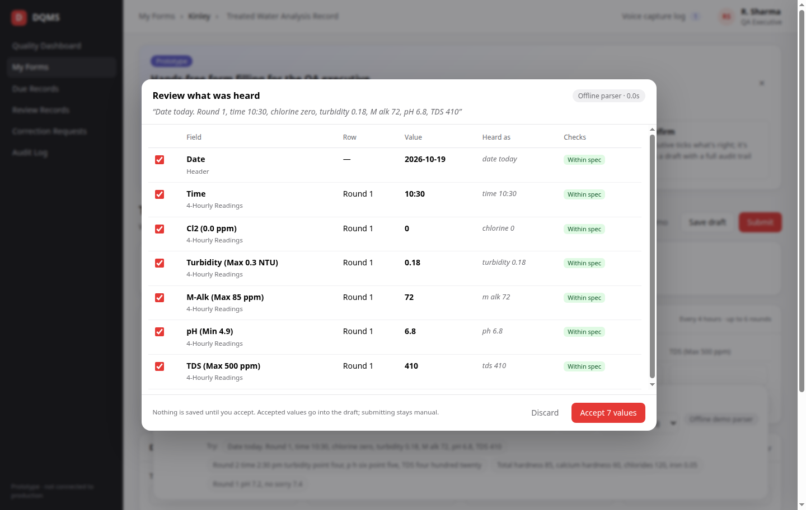
The executive checks every value before it is saved
PROTOTYPE · REVIEW SCREEN
1
Heard as
The exact words each value came from
2
Round
Which round or row it goes into
3
Spec check
Within / above / below spec
4
Accept
Ticked values go into the draft
5
Reject
Untick a wrong value; it is not saved
Notes:
Real prototype screen. Each value shows the round, the words it was heard from, and its spec check. Untick anything wrong.

Slide 8
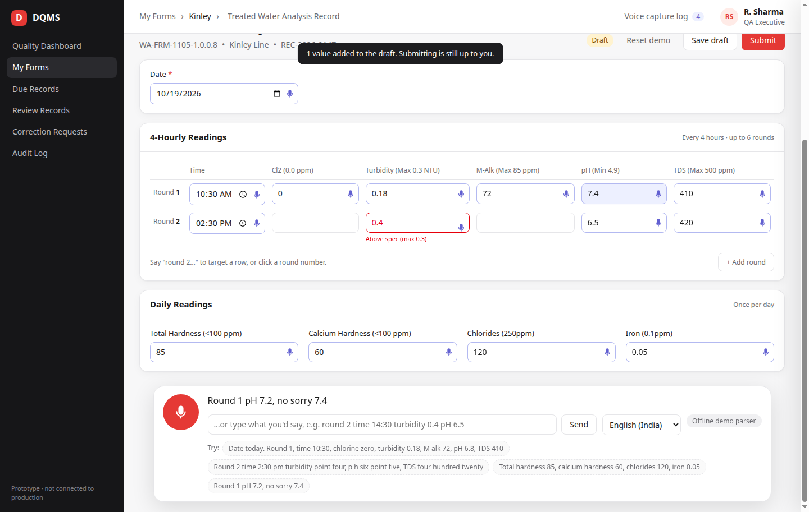
Accepted values land on the real form
PROTOTYPE · FILLED FORM
Real form
Same fields and rounds as the live Kinley form.
Out-of-spec in red
Turbidity 0.4 flagged “Above spec (max 0.3)”.
Manual edit still works
The executive can correct any value by hand.
Notes:
Same fields and 6-round grid as the live Kinley form. The red cell is an out-of-spec value caught as it was spoken. Any cell can still be typed manually.

Slide 9
The AI proposes. The QA executive decides.
HUMAN IN THE LOOP
1
2
3
4
Accept
Reject
Correct
Submit
Correct values go into the draft with one tap.
Untick a wrong value. It never reaches the record.
Type over any value manually on the form.
Only the executive submits, then normal DQMS approval.
Voice capture log (in the prototype today)
Every capture records who spoke, when, the exact transcript, the AI model and prompt version, what was proposed, and what was accepted or rejected.
Notes:
This is the trust model. The AI never saves or submits on its own. Every capture is logged so QA and auditors can trace any value back to what was said.

Slide 10
Record at the machine, review at the desk
NEXT STEP · WHAT WE ADD
Save the audio of every capture. The QA executive takes all the readings first, then listens and accepts them later at the desk.
Notes:
Be clear this is the next change to the prototype, not something the demo does yet.

Slide 11
Capture all readings first, review them together later
PLANNED FLOW
At the machine
Saved as a capture
At the desk
Listen & decide
Mic on, speak the readings for each round or instrument
Audio clip + transcript + AI-proposed values, marked “Pending review”
Executive opens the list of pending captures for the shift
Play the audio, accept, reject or correct each value
Concept: desk review list
Capture | Time | Audio | What was heard | Proposed values | Decision
Capture 1 | 10:30 | ▶ 0:14 | “Round 1, pH 6.8, TDS 410…” | pH 6.8 · TDS 410 · Turb. 0.18 | Accepted
Capture 2 | 14:30 | ▶ 0:11 | “Round 2, turbidity point four…” | Turb. 0.4 (above spec) · pH 6.5 | Corrected
Capture 3 | 18:30 | ▶ 0:09 | “Round 3, pH seven…” | pH 7.0 · TDS 395 | Pending
Notes:
At the machine the executive only speaks; nothing is final. At the desk they see Capture 1, 2, 3 in order, can play each audio clip, and accept, reject or correct each value.

Slide 12
What we change to support review at the desk
CHANGES NEEDED IN THE PROTOTYPE
Area | Prototype today | Change
Audio | Not saved; browser speech-to-text only | Record and save an audio clip for every capture
When review happens | Immediately, in a dialog after speaking | Also later: captures wait as “Pending review”
Desk review screen | Capture log shows the transcript only | List of captures per shift with audio playback
Decision per value | Accept or untick in the dialog | Accept / reject / correct per value, per capture
Speech engine | Browser (Chrome / Edge) | Azure AI Speech, Indian English and Hindi
Forms | One demo form | All 132 DQMS forms, from their existing definitions
Users & storage | One demo user, browser storage | DQMS login + permission; data and audio in DQMS
Notes:
The engineering list for the next iteration. Rows 1 to 4 deliver the record-now, review-later flow; rows 5 to 7 are what moving into live DQMS needs.

Slide 13
What changes for the QA executive
BEFORE AND AFTER
 | Today | With Voice Fill
Writes per reading | Twice: paper, then typing | None: spoken once at the machine
Paper sheets | Needed for every round | Not needed
When the value reaches DQMS | End of round or shift | At the moment of reading
Out-of-spec values | Seen when typed, later | Flagged as soon as they are spoken
Evidence for a value | A paper sheet, if kept | Transcript (and audio, next step) + who accepted it
Who makes the final call | The executive | Still the executive
Notes:
Summarise the difference in one table. Each row maps to one of the three problems: multiple writes, time, errors.

Slide 14
Less work, faster records, fewer mistakes
BENEFITS
1
2
3
No double entry
Time saved
Fewer errors
• No paper step
• One spoken sentence per round instead of 6–7 typed values
• Hands stay free at the machine
• No walking back to type
• Records current at the time of reading
• Review in one sitting at the desk
• No handwriting to misread
• Spec limits checked instantly
• Every value traceable to what was said
We will measure it in a pilot: time per form, share of AI values accepted unchanged, and correction requests, before vs after.
Notes:
Do not quote percentages yet. The pilot will measure time per form, share of AI values accepted unchanged, and correction requests.

Slide 15
About ₹1 per spoken capture
RUNNING COST
Scale | Captures / month | Monthly cost (Sonnet 5.5)
Pilot: 1 line, 5 forms | 1,200 | ≈ ₹1,200
One plant: 40 forms | 9,600 | ≈ ₹9,900
Five plants: 200 forms | 48,000 | ≈ ₹49,400
≈ ₹1
per capture: AI (Claude Sonnet 5.5) + Azure speech-to-text
≈ 30 KB
Estimates: 8 captures per form per day, 30 days, list prices, ₹88 = $1. Confirmed from real usage in the pilot.
audio per capture; a plant’s month of audio is about 0.3 GB
Notes:
One capture = one sentence of about 15 seconds. Sonnet 5.5 recommended; Haiku 5.5 could cut it further if accurate enough. Estimates at list prices, ₹88 = $1. Audio at a low bit-rate is roughly 30 KB per clip, so storage cost is negligible.

Slide 16
What we need to move forward
NEXT STEPS
1
Feedback on the flow
Confirm “record at the machine, review at the desk” matches how your QA team works
2
Pilot form & line
Pick the first form and line (we suggest Treated Water Analysis, Kinley)
3
Audio policy
How long to keep audio clips, and who may listen to them
4
QA sign-off
QA head agrees the model: AI proposes, executive confirms, everything logged
5
Hardware
Headset mics for pilot executives; tablets or phones at the line
Notes:
Close with the ask.

Slide 17
Thank you
TRY THE PROTOTYPE
protoype-b7i8ckokl-avnish12.vercel.app
Open in Chrome or Edge, allow the microphone, hold the mic and say: “Round 1, time 10:30, chlorine zero, turbidity 0.18, pH 6.8, TDS 410.”

