Slide 1
Nonlinear Algorithm for Formation Control and Rendezvous
Avnish Kumar (09001007)
Giri Prashant (09001008)
Ankit Shah (09001006)

Slide 2
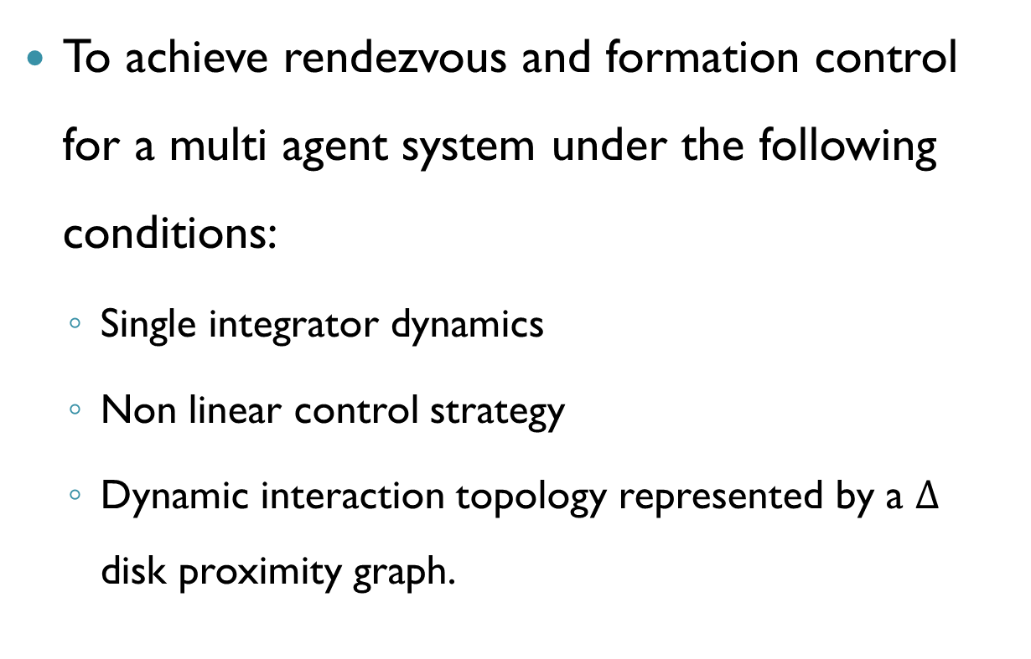
Problem Definition
To achieve rendezvous and formation control for a multi agent system under the following conditions:
Single integrator dynamics
Non linear control strategy
Dynamic interaction topology represented by a $Δ$ disk proximity graph.

Slide 3
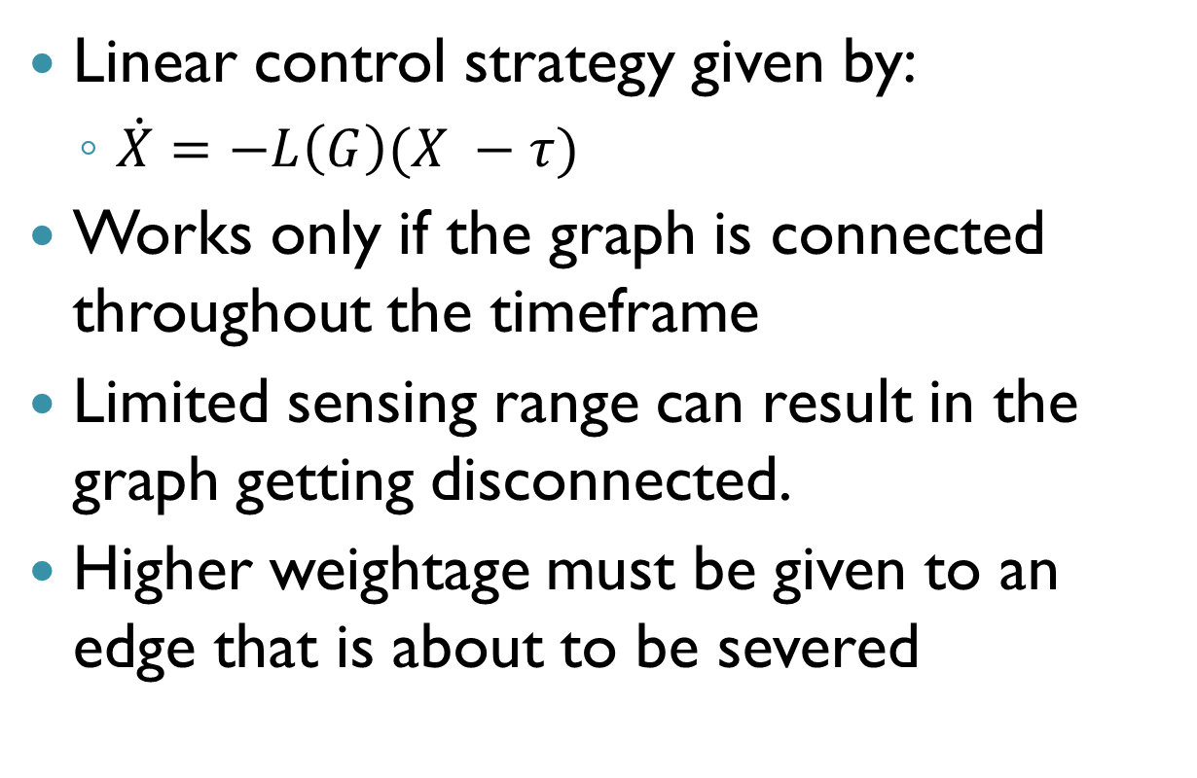
Challenges
Linear control strategy given by:
$\dot{X}=−L\left(G\right)(X −τ)$
Works only if the graph is connected throughout the timeframe
Limited sensing range can result in the graph getting disconnected.
Higher weightage must be given to an edge that is about to be severed

Slide 4
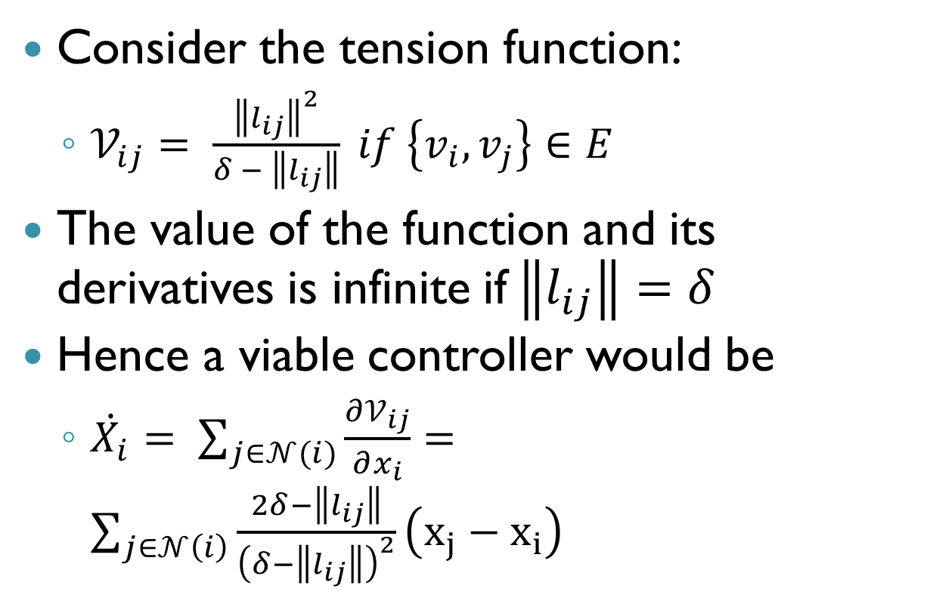
Rendezvous Case
Consider the tension function:
$𝒱_{ij}= \frac{{\left\|l_{ij}\right\|}^{2}}{δ − \left\|l_{ij}\right\|} if \left\{v_{i}, v_{j}\right\}∈E$
The value of the function and its derivatives is infinite if$\left\|l_{ij}\right\|=δ$
Hence a viable controller would be
$\dot{X_{i}}= \sum_{j∈𝒩(i)}{\frac{∂𝒱_{ij}}{∂x_{i}}}=\sum_{j∈𝒩\left(i\right)}{\frac{2δ−\left\|l_{ij}\right\|}{{\left(δ−\left\|l_{ij}\right\|\right)}^{2}}}\left(x_{j}−x_{i}\right)$

Slide 5
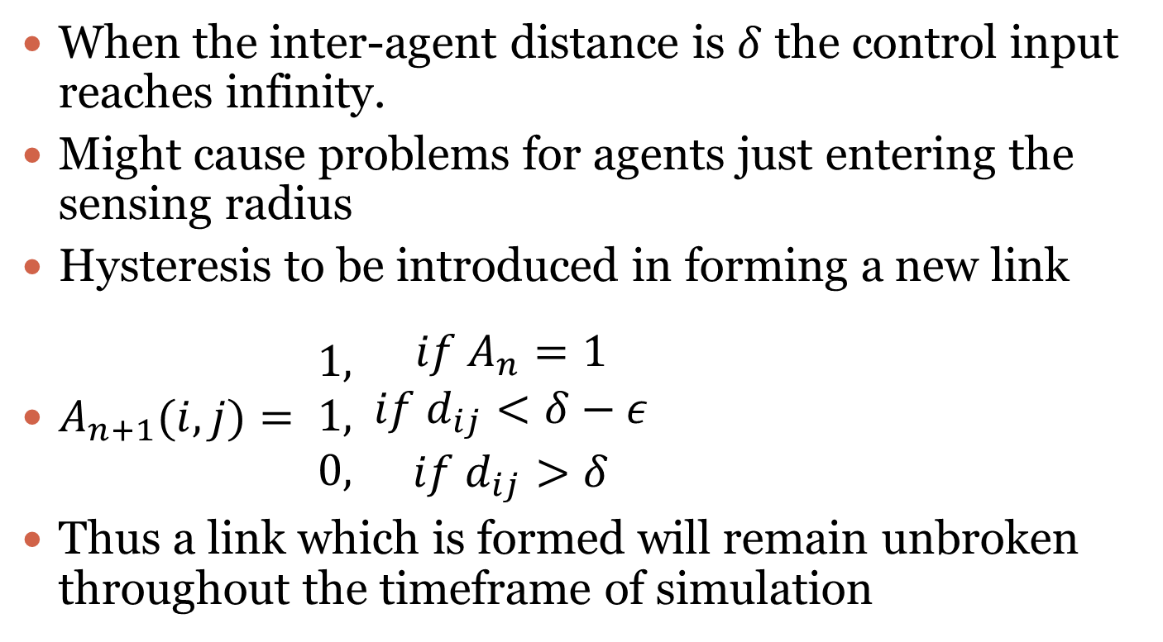
Hysteresis
When the inter-agent distance is $δ$ the control input reaches infinity.
Might cause problems for agents just entering the sensing radius
Hysteresis to be introduced in forming a new link
$A_{n+1}(i,j)= \begin{aligned}1, \\ 1, \\ 0,\end{aligned} \begin{aligned}if A_{n}=1 \\ if d_{ij}<δ−ε \\ if d_{ij}>δ\end{aligned}$
Thus a link which is formed will remain unbroken throughout the timeframe of simulation

Slide 6
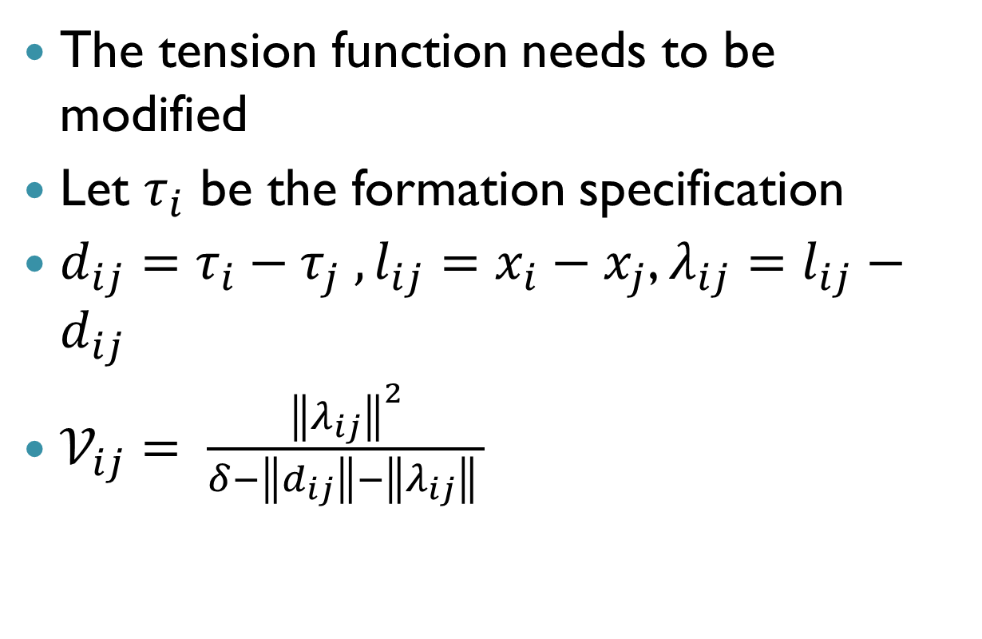
Formation Case
The tension function needs to be modified
Let $τ_{i}$ be the formation specification
$d_{ij}=τ_{i}−τ_{j} , l_{ij}=x_{i}−x_{j}$, $λ_{ij}=l_{ij}−d_{ij}$
$𝒱_{ij}= \frac{{\left\|λ_{ij}\right\|}^{2}}{δ−\left\|d_{ij}\right\|−\left\|λ_{ij}\right\| }$

Slide 7
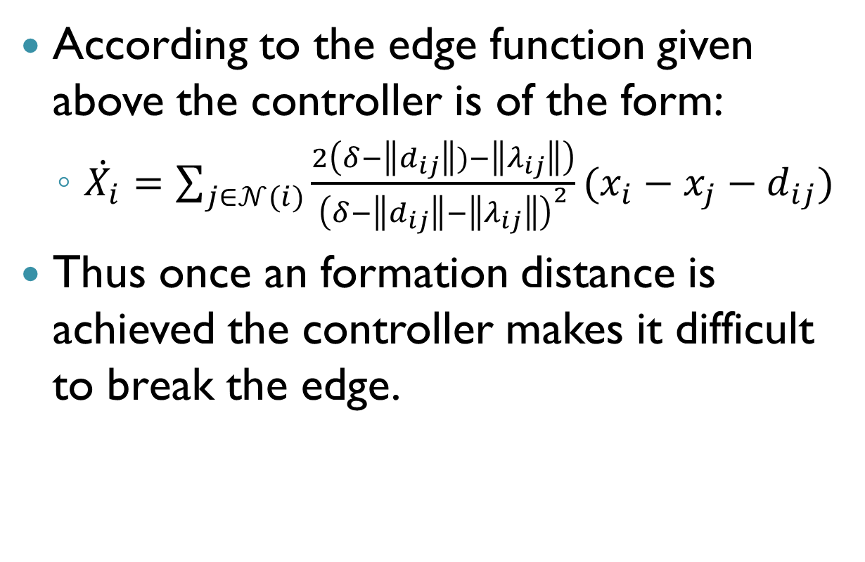
The controller
According to the edge function given above the controller is of the form:
$\dot{X_{i}}=\sum_{j∈𝒩(i)}{\frac{2\left(δ−\left\|d_{ij}\right\|)−\left\|λ_{ij}\right\|\right)}{{\left(δ−\left\|d_{ij}\right\|−\left\|λ_{ij}\right\|\right)}^{2}}(x_{i}−x_{j}−d_{ij})}$
Thus once an formation distance is achieved the controller makes it difficult to break the edge.

Slide 8
Restrictions
Both methods require the initial graph to be connected to achieve the objective.
For the formation strategy the entire formation must be contained within a circle of diameter equal to the sensing radius.
Cannot handle larger formations with inter-agent distances greater than the sensing radius

Slide 9
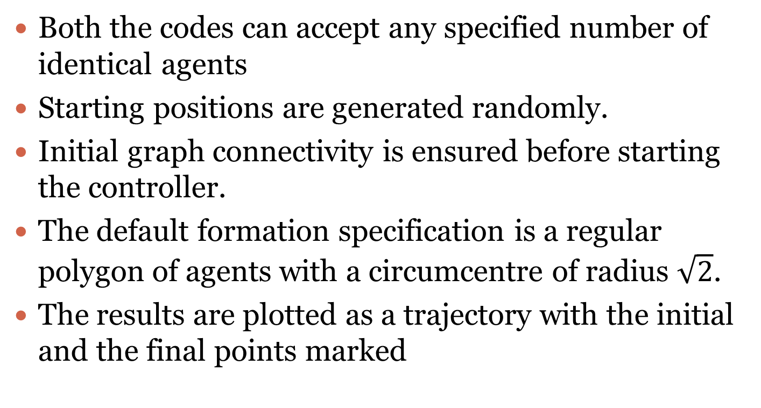
Features of the code
Both the codes can accept any specified number of identical agents
Starting positions are generated randomly.
Initial graph connectivity is ensured before starting the controller.
The default formation specification is a regular polygon of agents with a circumcentre of radius $\sqrt{2}$.
The results are plotted as a trajectory with the initial and the final points marked

Slide 10
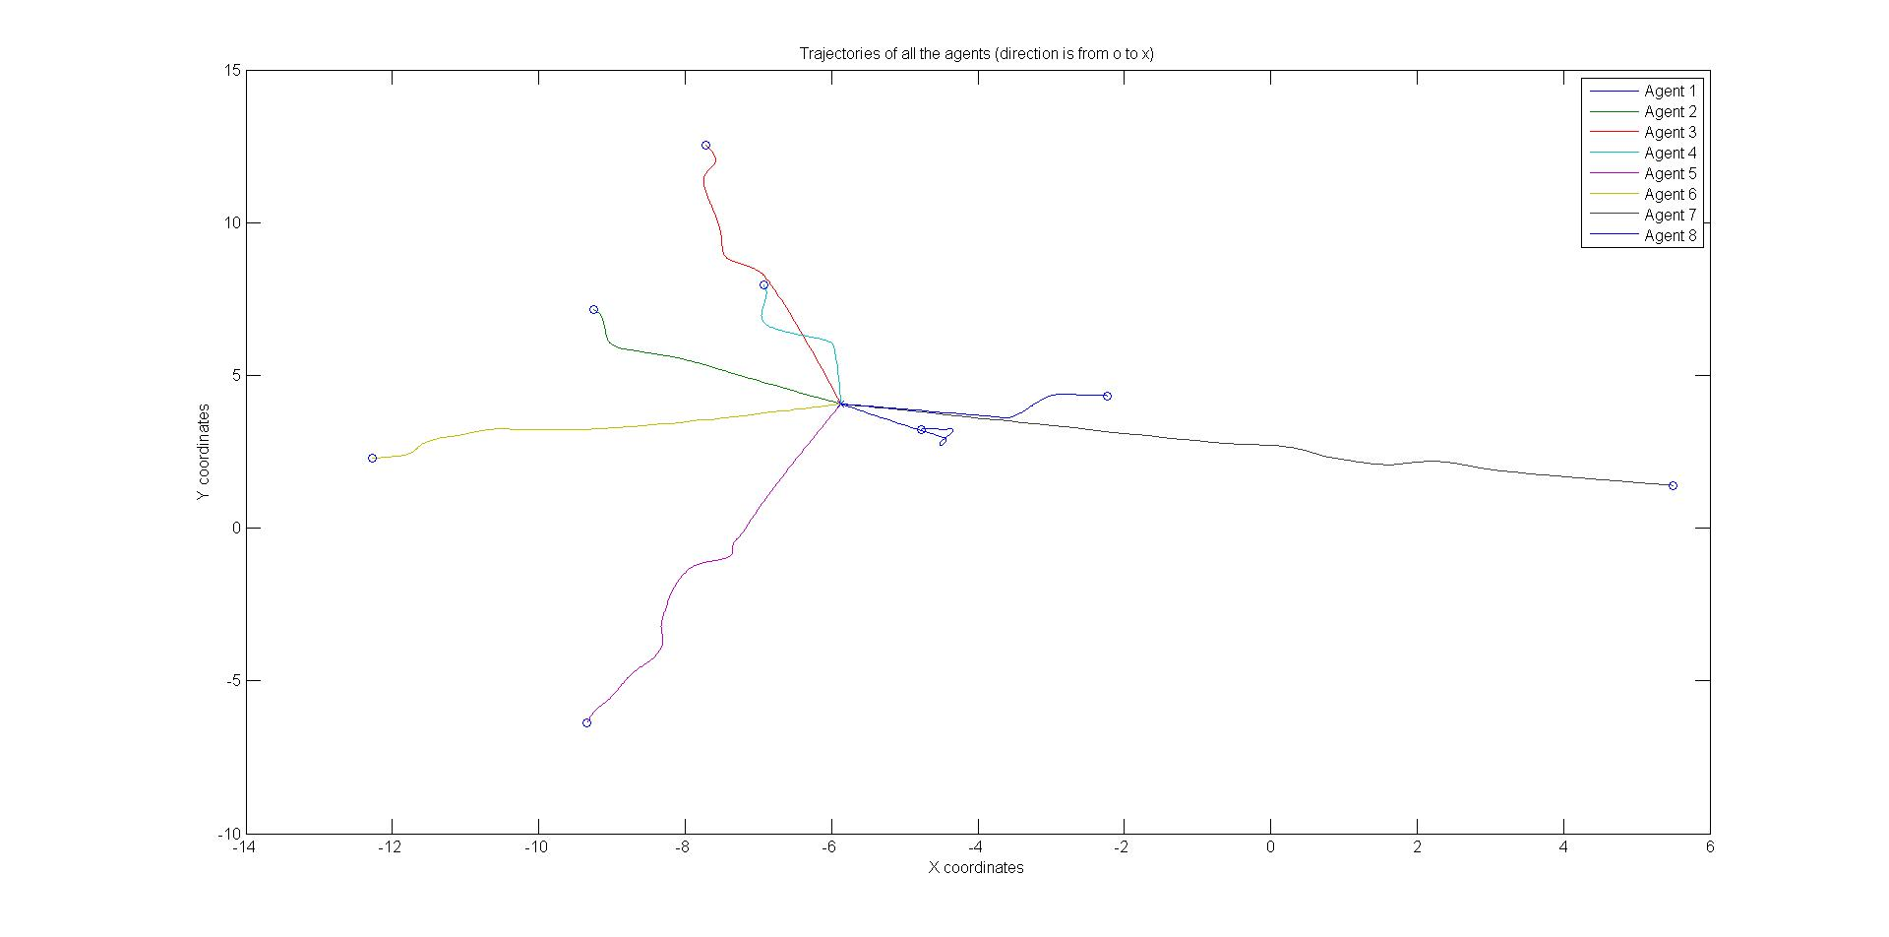
Results: Rendezvous (N = 8)

Slide 11
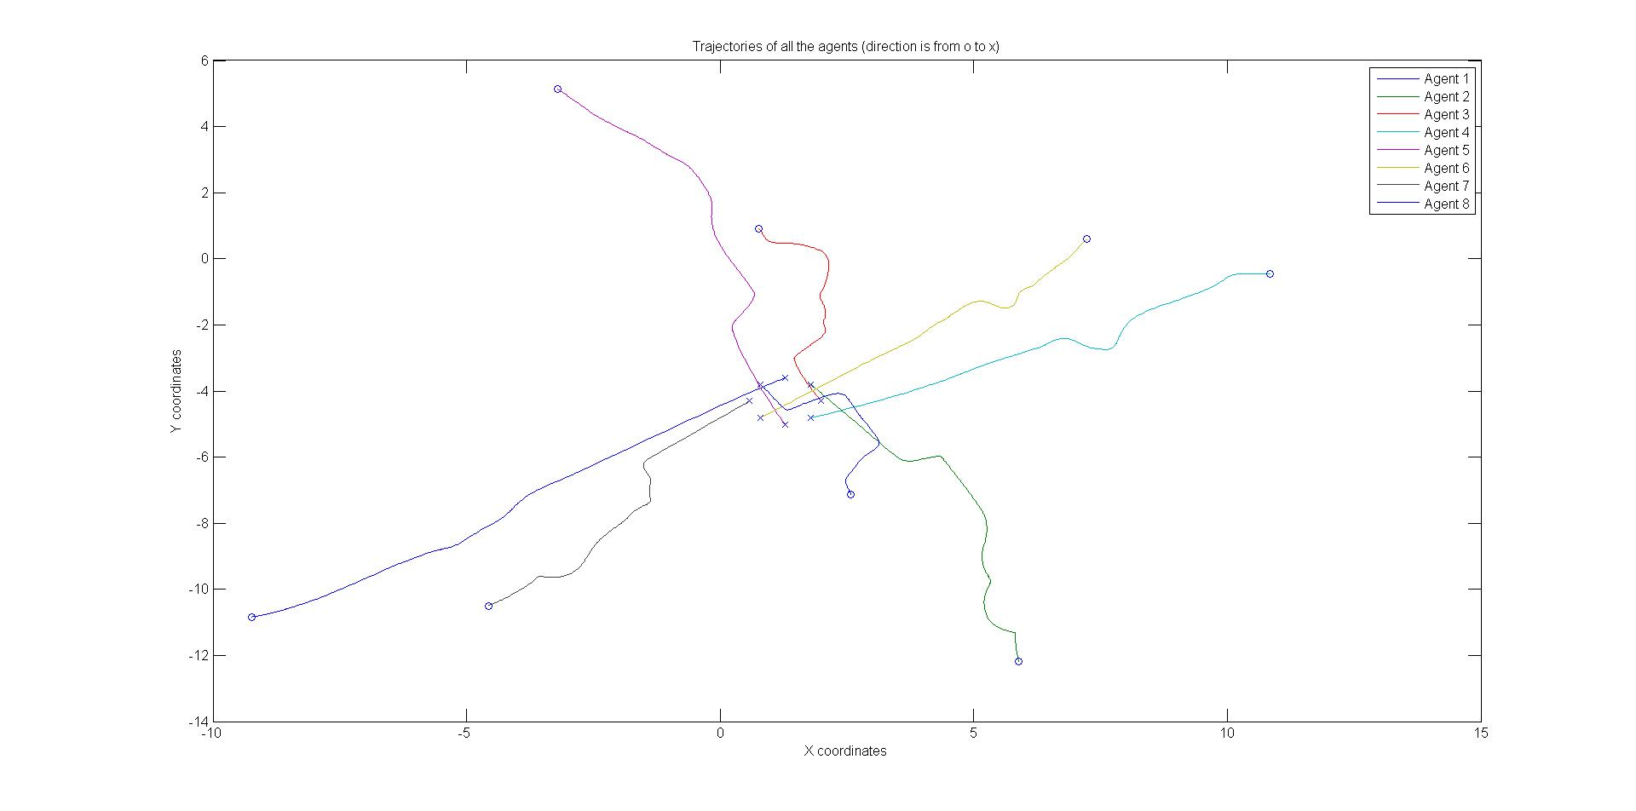
Results: Formation control (N=8)

Slide 12
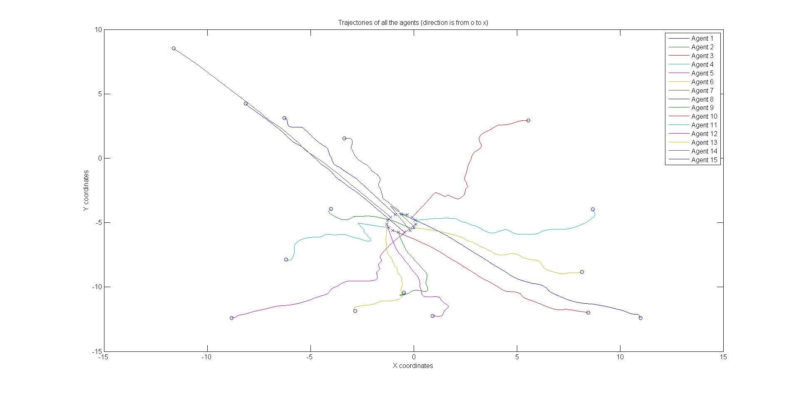
Results: Formation control (N=15)

Slide 13
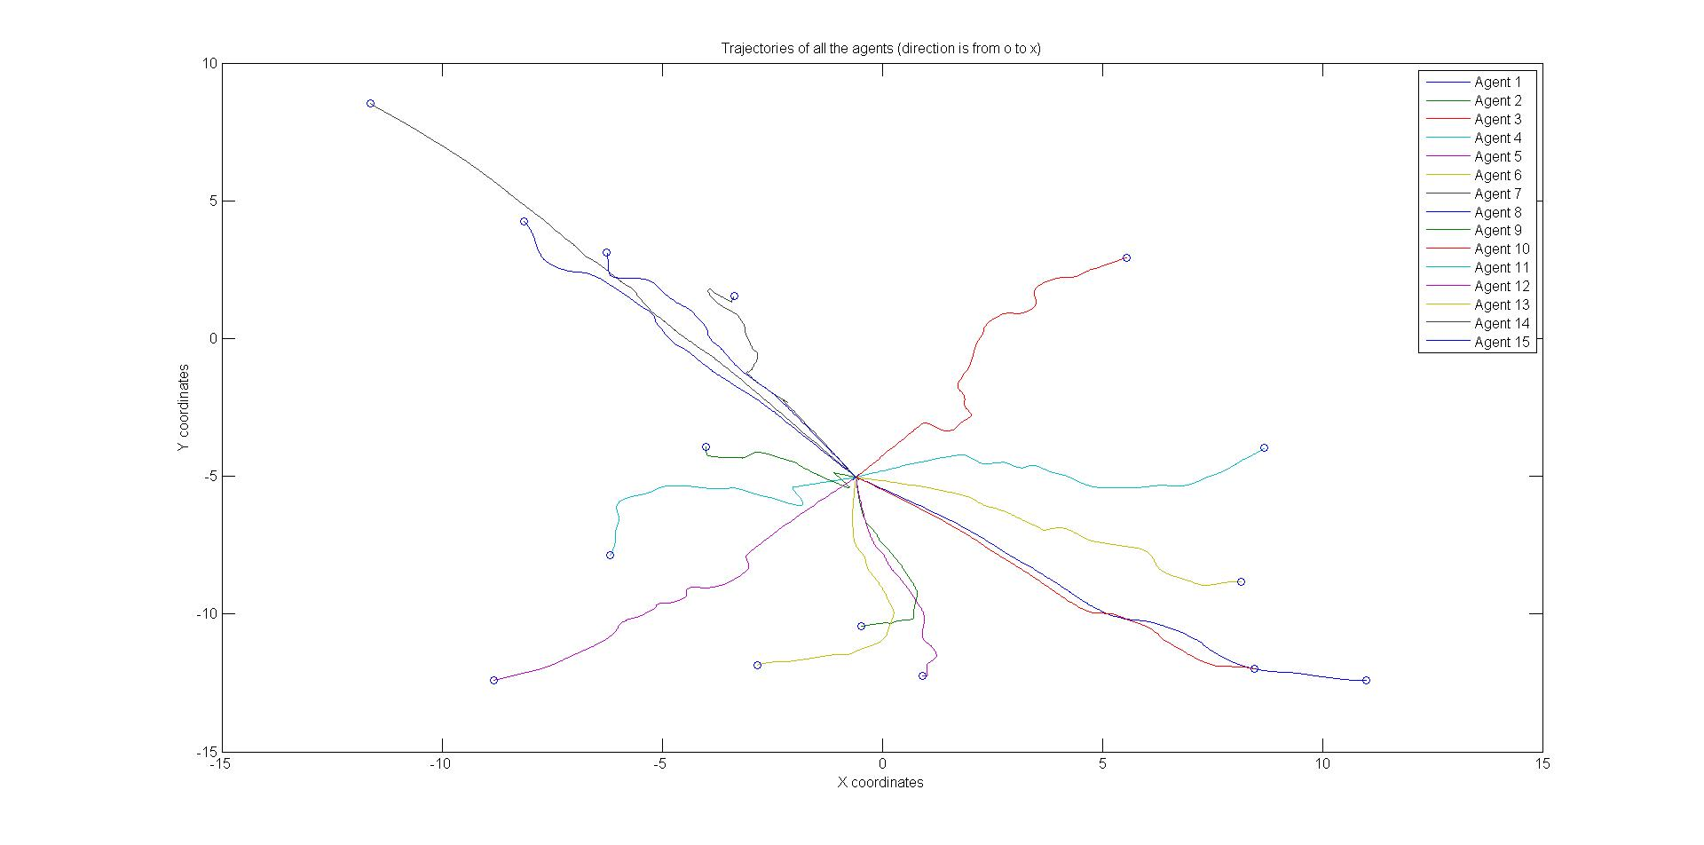
Results: Rendezvous (N=15)

Slide 14
Thank you

