Slide 1
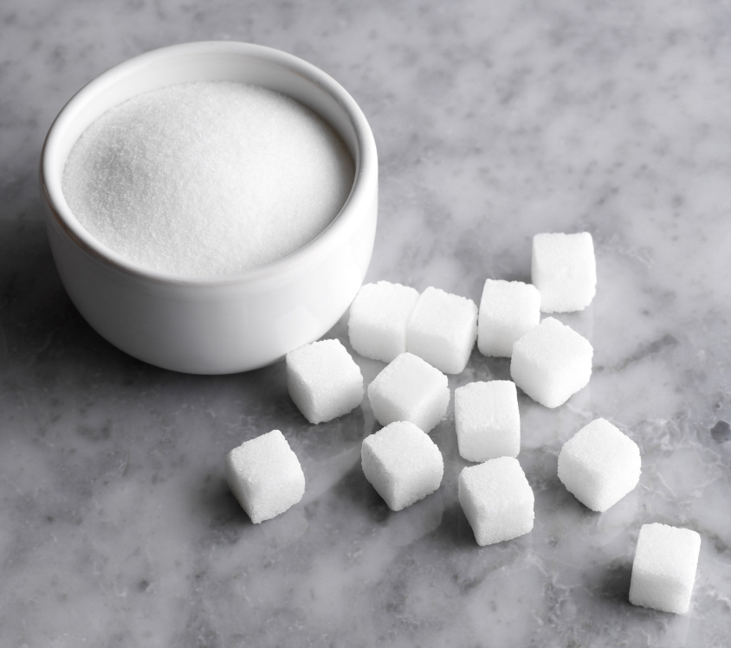
Sugar Quant 40
FINC 621
Professor Harilaos Georgakopoulos
By: Preedee Temprom, Avnit Bambah, Hetal Patel and Evan Neuberger

Slide 2
Agenda
Theory
Target Stocks
Technical Tools
Mechanics of a Trade
Performance Measures
Works Cited

Slide 3
Theory
Short Term trading strategy involving the price of sugar
Inverse relationship between sugar prices and stock prices of food and beverages company
Four technical tools:
Change in sugar prices
Relative Strength Index (RSI)
Commodity Channel Index (CCI)
Bollinger Bands
RSI measures the speed and change of price movements
CCI measures the current price level relative to an average price level
Bollinger Bands used to judge volatility and given a buy and sell threshold
Also used RSI and CCI

Slide 4
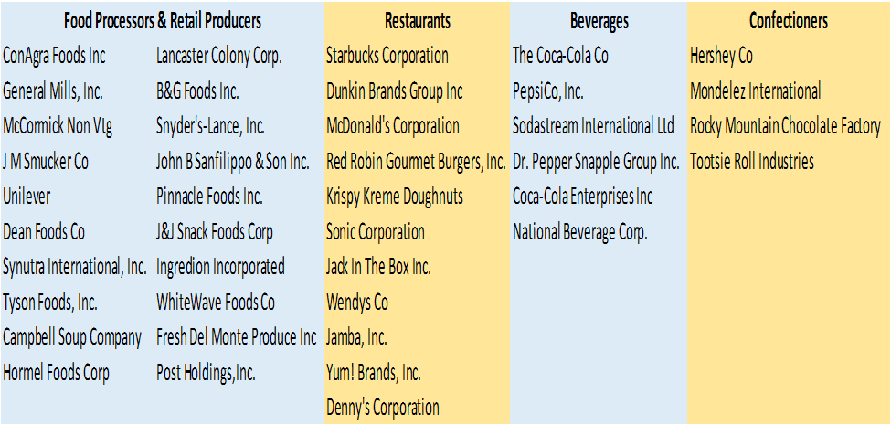
Target Stocks
Diverse Selection dictated by industry conditions
Economic expectations across the groups
Price sensitivity expectations

Slide 5
Technical Tools
Sugar Price Change: more than 0.1
Relative Strength Index: 70/30
Commodity Channel Index: 60/20
Bollinger Bands

Slide 6
Mechanics of a Trade
$50,000.00 starting allowance
Directional indicators must be satisfied for a trade to take place
RSI
CCI
Bollinger Bands
Price Change
Trade Size: 10,000
Broker: Interactive Brokers
Tiered Pricing System conducive to quant trading

Slide 7
Performance Measures: Profit Ratios

Slide 8
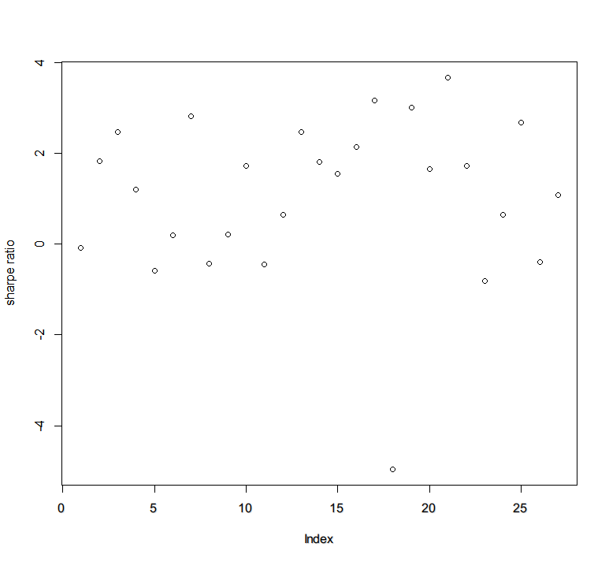
Performance Measures: Sharpe Ratio

Slide 9
Performance Measures: HSY Trade Plot

Slide 10
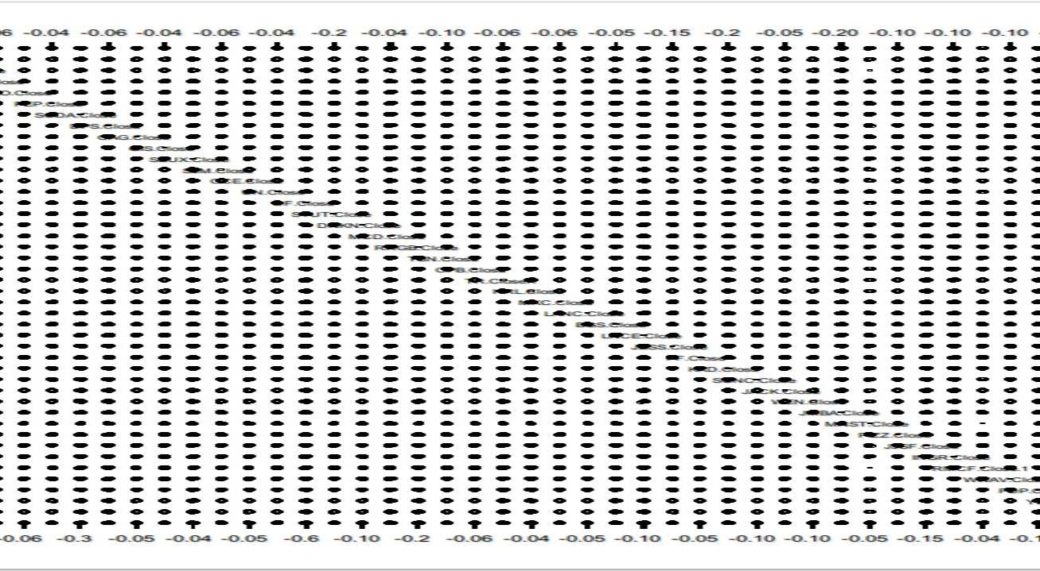
Monte Carlo

Slide 11
Works Cited
http://stockcharts.com/school/doku.php?id=chart_school:technical_indicators:relative_strength_index_rsi
http://stockcharts.com/school/doku.php?id=chart_school:technical_indicators:commodity_channel_index_cci
http://stockcharts.com/school/doku.php?id=chart_school:technical_indicators:bollinger_bands
https://cran.r­project.org/web/packages/TTR/TTR.pdf
https://www.interactivebrokers.com/en/home.php
https://cran.r­project.org/web/packages/IBrokers/IBrokers.pdf
http://www.thertrader.com/category/trading-strategies/
"Candy Production in the US." IBISWorld. IBISWorld, n.d. Web. 7 Feb. 2016.
"North American Tiered Commissions." Interactivebrokers.com. Interactive Brokers, n.d. Web. 6 Feb. 2016.
Ryan, Jeffrey A. "IBrokers-Interactive Brokers and R." (2014): n. pag. Cran.r-project.org. Cran.r-project.org, 21 Sept. 2014. Web. 5 Feb. 2016.
"Soda Production in the US." IBISWorld. IBISWorld, n.d. Web. 7 Feb. 2016.
http://www.investopedia.com/terms/c/covariance.asp#ixzz3ziLmsQN9
http://www.investopedia.com/articles/07/monte_carlo_intro.asp

Slide 12
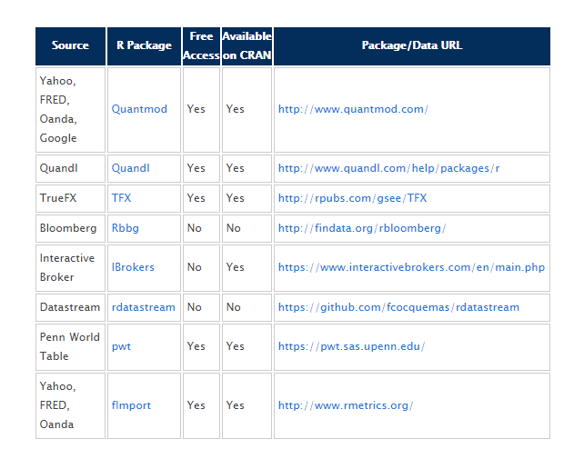

Slide 13
Questions?

