Slide 1

AVNIT SHARMA U101112FCS041 B.TECH 3rd YEAR CSE
Project Learning Technologies

Slide 2
PROJECT
Project Advisors(customers) :
Mr. Balendu Bhatnagar
Mr. Devesh Pant
Personal Counseling Interaction System
(PCI)

Slide 3
ISSUES
What are the issues people face while dealing with a
Video conferencing tool -
plug-in
Not Cross compatible.
Customer not satisfied.

Slide 4
Customer requirements
Should be a Web App.
Cross compatible.
Be open source.
Have a user friendly GUI.
Connection to the client (applicant) should be via a hyper-link that the server (interviewer) provides.
Must be safe and secure.
Options for one to one and group conference.
Questionnaires fill up option.
Document Sharing/Uploading mechanism.
Chat Box.
Queuing mechanism with time slots for the clients (applicants).

Slide 5
Our Project
Online Personal Counseling Interaction system.
One stop solution for admission process to college.
Establish an audio-video communication channel. (bi-directional)
Uploading necessary documents and pictures for admission.
Filling of questionnaires.
Ease/speedup the admission process (PCI).

Slide 6
WebRTC
WebRTC (Web Real-Time Communication) is an API that supports browser-to-browser applications for voice calling, video chat, and P2P(pear 2 pear) file sharing without plug-in.
DEMO

Slide 7
THE THREE MAIN STEPS
REQUEST FOR MEDIA

Slide 8
ESTABLISH CONNECTION

Slide 9
SEND DATA

Slide 10
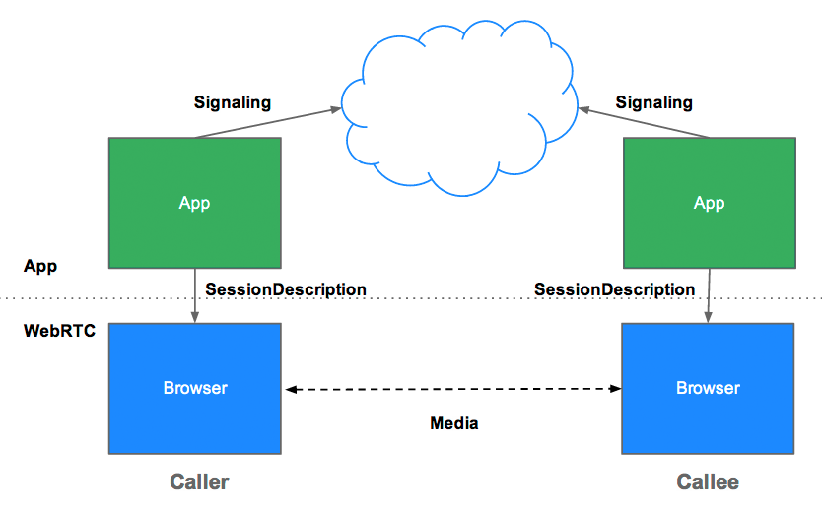

Slide 11
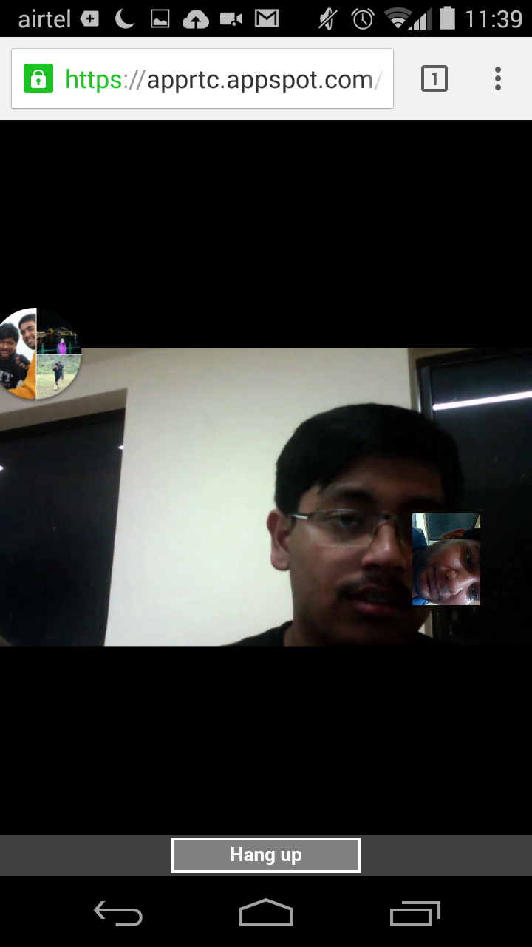
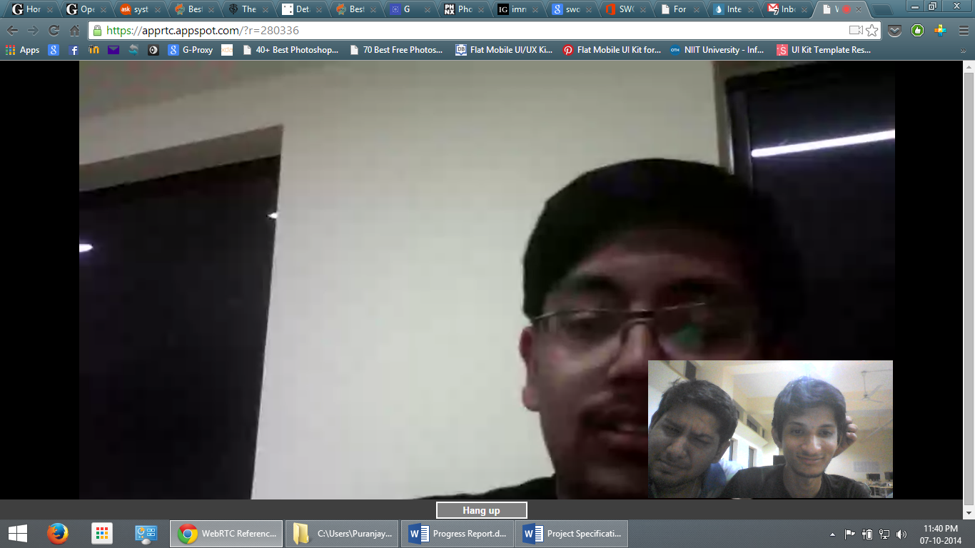
SNAPSHOTS

Slide 12
CURRENT SCENARIO
Selected WebRTC as the platform.
Selected GoogleDrive for data storage.
Selected Google Forms for questionnaire.
Started testing the above mentioned.

Slide 13
PORTFOLIO
THE PORTFOLIO

Slide 14
OUR WAY FORWARD
Developing our first prototype using the WebRTC platform.
Adding more features such as live recording, snapshots.
Working on the security of the Web App.
Hosting the project on github.
Adding 3rd party support.
Finally, publishing it.

Slide 15
THANK YOU

