Slide 1
TIMESAVVY
Revolutionize timesheet management process by automating manual tasks and providing a user-friendly interface for efficient timesheet generation.

Slide 2




Timesheet Flow (Currently)
Employee fills the timesheet manually using Excel.
Sanity checks are performed manually on the filled timesheet.
Managers verify the data format.
Timesheet is converted into Stoxx sheet and Client Timesheet.

Slide 3
What We Aim To Achieve!
01
02
03
04
05
Create an interactive user interface to replace manual Excel timesheets.
Integrate built-in checks and alerts for accurate data entry.
Simplify new employee onboarding by eliminating use of Excel, reducing administrative time.
Enable detailed visibility for approvers to quickly review and approve timesheets.
Implement automatic format updates across all relevant sheets for consistency.

Slide 4




Technologies Used
v
STREAMLIT
FASTAPI
POSTGRESQL
PYTHON

Slide 5
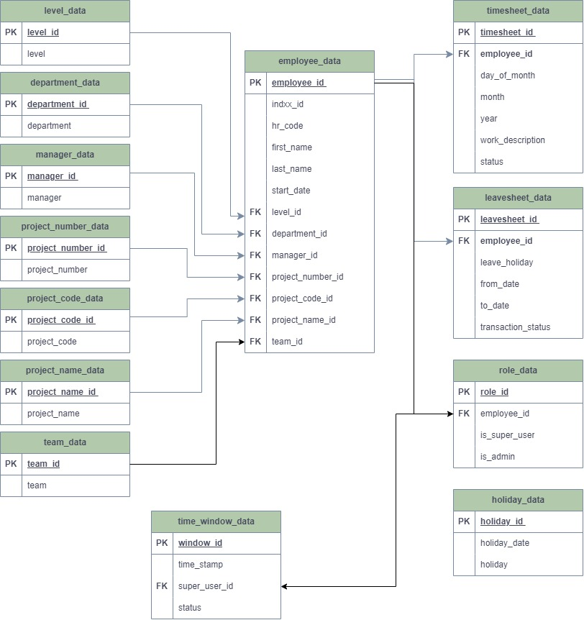
ER Diagram

Slide 6
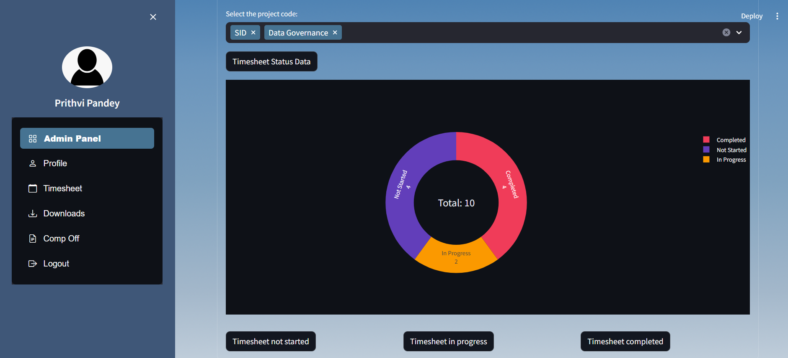
User Interface

Slide 7
Features for User
Monthly Timesheet submission
Displays user details in the profile section
Can download the previously filled timesheet
Can opt for Comp Off

Slide 8
User Guide To Fill Timesheet
Login to TIMESAVVY
Navigate to the 'Timesheet' section
Select the 'Month' and 'Year', then click 'Generate'
A timesheet grid with prefilled details will appear
Fill the timesheet grid
Click 'Save' to store the timesheet in the database

Slide 9
User Guide To Avail Comp-Off
Login to TIMESAVVY
Navigate to the ‘Comp Off' section
Select 'From Date’ , 'To Date' and 'Status'
Click 'Submit' button
(For Admin) An extra option of 'Indxx ID' to approve Comp-Off of any user

Slide 10
Features For Admin
Stoxx Sheet
Download Stoxx and Summary Sheet by Project Code
Timesheet Window
Freeze/Unfreeze Timesheet window
Timesheet Status
Display employee timesheet status. (Completed, In-progress, Not started)
Edit Timesheet
Fill/Edit timesheets for any user
Comp Off
Add Comp Off for any user
Auto-Unfreeze at month's start

Slide 11
Admin Panel
Timesheet Status
Upload Data
Edit Timesheet
Stoxx Sheet
Role Allocation

Slide 12
Timesheet Status
Option to Freeze and Unfreeze the Timesheet Filling Window
Chart Displaying Current Timesheet Status
Data Showing Employees' Timesheet Completion Status (Completely Filled, In Progress, Not Started)

Slide 13
Upload Data
Option to Upload CSV Files for Leave sheet, Holiday, and Employee Data, Saving to the Database
Option for Admin to Fill or Edit Timesheets for Any User in the Database
Option to assign ‘Super User’ and ‘Admin’ role to user
Edit Timesheet
Role Allocation

Slide 14
Download STOXX Sheet (Admin Only)
Navigate to the 'Dashboard' section
Select the ‘Month’ , ‘Year’ and ‘Project codes’
A hyperlink will appear, Click on it to download the zip file
Zip file will contain STOXX Sheet and Summary Sheet for the chosen Project codes
Browse to the "Download Stoxx Sheet" option
Click 'Download Stoxx Sheet' Button to generate it

Slide 15
Demonstration

Slide 16
Thank You!

