Slide 1
Testing Techniques
Applied to Virt Development
Cleber Rosa
Sr. Software Engineer
Oct. 26Th, 2017
Notes:
* Hello everyone, welcome!
* My name is Cleber Rosa, I'm a Software Engineer at Red Hat
* I'm part of the Virtualization Team (KVM, libvirt, etc)
* I work mostly on the Testing related initiatives and projects
such as Avocado and Avocado-VT.

Slide 2
AGENDA
Software Testing Basics
Equivalence Partitioning
Boundary Value Analysis
Combinatorial Testing
Applying the Theory
Notes:
* Today we're going to talk about Software Testing basic principles
* It starts with Software Testing 101 review, textbook stuff - bear with me
* We'll move into Equivalence Partitioning
* Then into Boundary Value Analysis
* Combinatorial Testing
* And finally talk about how we can apply, and why should we apply that theory on virtualization related development

Slide 3
Glenford J. Myers’ Triangle Check
Takes as input: lengths of a triangle’s sides
Outputs the triangle classification:
  Equilateral
  Isosceles
  Scalene
How hard can it be to write a comprehensive set of test cases?
Notes:
* As "promised", we'll start by reviewing very basic approaches to testing
(those techniques usually go unnoticed, even when they're being used
and they'll be useful references when we move into more advanced topics)
* Most software testing texbooks draw inspiration, or incorporate and quote
Glenford J. Myer's Triangle example. So this is like the "hello world" for
software testing.
* It presents a simple program that takes as input 3 lengths, which are the
triangle's sides
* It outputs the triangle classification: equilateral, isoceles or scalene
* The point of this example/exercise is to reason on how such a simple program
can, or should, be tested

Slide 4
Triangle Check – First (Naive) Version
def triangle_check(a, b, c):
if a == b == c:
return "equilateral"
elif a != b != c:
return "scalene"
else:
return "isoceles"
Notes:
* The basic checks are:
- 3 equal sides: equilateral
- 2 equal sides: isoceles
- 3 different sides: scanele

Slide 5
Triangle Check Basic Test Cases
INPUT | EXPECTED OUTCOME
1, 1, 1 | Equilateral
2, 2, 3 | Isosceles
3, 4, 5 | Scalene

Slide 6
Triangle Check – Test for First (Naive) Version
class Triangle(Test):
def test_equilateral(self):
self.assertEqual(triangle_check(1, 1, 1), "equilateral")
def test_isosceles(self):
self.assertEqual(triangle_check(2, 2, 3), "isosceles")
def test_scalene(self):
self.assertEqual(triangle_check(3, 4, 5), "scalene")

Slide 7
Triangle Check - Another Basic Test Case
INPUT | EXPECTED OUTCOME
1, 1, 1 | Equilateral
2, 2, 3 | Isosceles
2, 3, 2 | Isosceles
3, 4, 5 | Scalene

Slide 8
Triangle Check – Extra Test for First Version
class Triangle(Test):
def test_equilateral(self):
self.assertEqual(triangle_check(1, 1, 1), "equilateral")
def test_isosceles(self):
self.assertEqual(triangle_check(2, 2, 3), "isosceles")
self.assertEqual(triangle_check(3, 2, 3), "isosceles")
def test_scalene(self):
self.assertEqual(triangle_check(3, 4, 5), "scalene")

Slide 9
Triangle Check Error Test Cases
INPUT | EXPECTED OUTCOME
0, 1, 1 | Error
-1, 1, 1 | Error
1, 1, 2 | Error (not isosceles)
1, 2, 3 | Error (not scalene)

Slide 10
Triangle Check – Invalid Individual Lengths
class Triangle(Test):
...
def test_no_length(self):
self.assertEqual(triangle_check(0, 1, 1), "error")
self.assertEqual(triangle_check(-1, 1, 1), "error")

Slide 11
Triangle Check – Invalid Lengths for a Triangle
class Triangle(Test):
...
def test_sum_2_sides_larger_3rd(self):
self.assertEqual(triangle_check(1, 1, 2), "error")
self.assertEqual(triangle_check(1, 2, 3), "error")

Slide 12
Triangle Check Extended Test Cases
Permutations of lengths order
  “(A + B) <= C” .vs. “(C + B) <= A”
Input is not a number
  Give me a side with length “π”
More or less than 3 input values
  AKA “what do you mean by triangles must have three sides?”

Slide 13
Lessons from a simple example
Even experienced developers will only think of a subset of those test cases
If the software we write is not this simple, we should do better than in this example
Choosing good input data is key
  Some input can be no better than other input already being used
  Not all input are created equal, some will have a better shot at finding issues

Slide 14
Equivalence Partitioning
Don’t let the name scare you
Think of groups of input that should generate similar outcome
  A good pick is worth at least other two individual inputs
  It usually tells us about what would happen (errors?) when values above or beyond itself would be used

Slide 15
Identifying Input Types and Equivalent Classes
// snippets from qemu/hw/acpi/cpu_hotplug.c
/* The current AML generator can cover the APIC ID range [0..255],
* inclusive, for VCPU hotplug. */
QEMU_BUILD_BUG_ON(ACPI_CPU_HOTPLUG_ID_LIMIT > 256);
...
if (pcms->apic_id_limit > ACPI_CPU_HOTPLUG_ID_LIMIT) {
error_report("max_cpus is too large. APIC ID of last CPU is %u",
pcms->apic_id_limit - 1);
exit(1);
}

Slide 16
Input Types and Classes
Number of CPUs
INVALID | VALID | INVALID
<= 0 | 1 .. 256 | >= 257
CPU IDs
INVALID | VALID | INVALID
<= -1 | 0 .. 255 | >= 256

Slide 17
Boundary Analysis
Also not scary
When input classes are ordered, you can easily spot them
These values are usually very good bets for tests

Slide 18
Boundary Values
Number of CPUs
INVALID | VALID |  | INVALID
0 | 1 | 256 | 257
CPU IDs
INVALID | VALID |  | INVALID
-1 | 0 | 255 | 256

Slide 19
Boundary Values in Tests
// snippets from tp-qemu/qemu/tests/cfg/cpu_add.cfg
smp = 4
vcpu_maxcpus = 255
variants:
- cpuid_outof_range:
cpuid_hotplug_vcpu0 = 255
qmp_error_recheck = Unable to add CPU:.*, max allowed:.*
- invalid_vcpuid:
cpuid_hotplug_vcpu0 = -1
qmp_error_recheck = Invalid parameter type.*, expected:.*
- cpuid_already_exist:
cpuid_hotplug_vcpu0 = 1
qmp_error_recheck = Unable to add CPU:.*, it already exists

Slide 20
Boundary Analysis in “qemu-img bench”
“Run a simple sequential I/O benchmark on the specified image.”
“A total number of count I/O requests is performed”

Slide 21
qemu-img bench – number of I/O requests
Actual
INVALID | VALID |  | INVALID
-1 | 1 | INT_MAX | INT_MAX + 1
Perceived
INVALID | VALID |  | INVALID
0 | 1 | UINT_MAX | UINT_MAX + 1

Slide 22
Combinatorial Testing
Also known as “pair-wise”
Basic principle is that the generated test cases will have at least a pair of unique values
Good values can use Equivalent Classes and Boundary Analysis
Combinatorial will optimally test all unique values on a single test plan execution

Slide 23
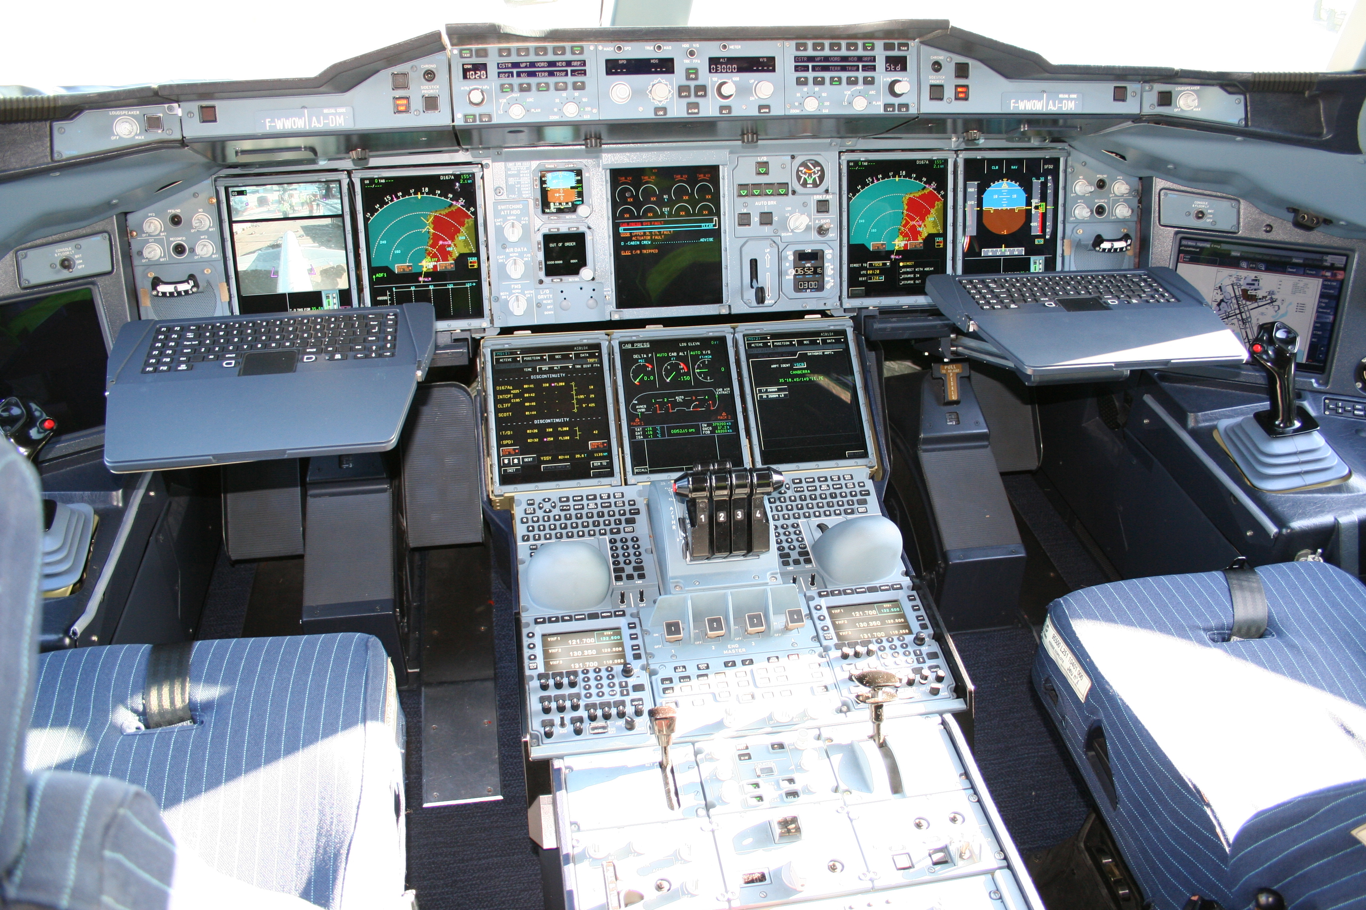
The more knobs you have…
Source: https://en.wikipedia.org/wiki/Cockpit#/media/File:Airbus_A380_cockpit.jpg

Slide 24
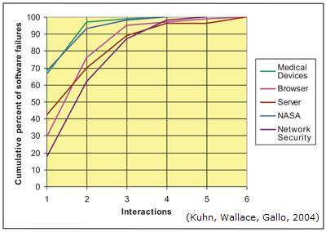
Combinatorial Testing Results in the Industry
Source: https://csrc.nist.gov/Projects/Automated-Combinatorial-Testing-for-Software

Slide 25
qemu-img convert knobs
[--object objectdef]
[--image-opts]
[-c]
[-p]
[-q]
[-n]
[-f fmt]
[-t cache]
[-T src_cache]
[-O output_fmt]
[-o options]
[-s snapshot_id_or_name]
[-l snapshot_param]
[-S sparse_size]
[-m num_coroutines]
[-W] filename [filename2 [...]] output_filename

Slide 26
qemu-img convert knobs – let’s pick some
[--object objectdef]
[--image-opts]
[-c]
[-p]
[-q]
[-n]
[-f fmt]
[-t cache]
[-T src_cache]
[-O output_fmt]
[-o options]
[-s snapshot_id_or_name]
[-l snapshot_param]
[-S sparse_size]
[-m num_coroutines]
[-W] filename [filename2 [...]] output_filename

Slide 27
Picking a tool - pict
pict, as in “Pairwise Independent Combinatorial Testing”
“PICT generates test cases and test configurations”
“With PICT, you can generate tests that are more effective than manually generated tests and in a fraction of the time required by hands-on test case design.”
https://github.com/microsoft/pict

Slide 28
qemu-img convert parameter file
# Interesting values (at boundaries): -1, 0b, 9223372036854775808b (== 8EiB exbibytes), 8EiB+1b
# Values that shows some issues: 0b
# Safe values: 2b, 1M, 1G
input_size: 2b, 1M, 1G
# qemu-img convert parameters
fmt: parallels, qcow, qcow2, qed, raw, vdi, vhdx, vmdk, vpc
output_fmt: parallels, qcow, qcow2, qed, raw, vdi, vhdx, vmdk, vpc
src_cache: off, writeback, unsafe, writethrough
cache: off, writeback, unsafe, writethrough

Slide 29
Picking a test runner - avocado
Versatile test runner
Long time history (heritage) in virtualization testing
  KVM Autotest, virt-test, Avocado-VT
Built-in support for “test variants”
Proof of concept integration with pict:
  https://github.com/avocado-framework/avocado/pull/2050
More info:
  http://avocado-framework.github.io/
  https://github.com/avocado-framework/avocado
  https://avocado-framework.readthedocs.io

Slide 30
What’s Next?
Make Combinatorial Testing (and other tools and techniques) easily available to Virt developers
  Packaging pict in for Fedora and EPEL
  Upstream work in QEMU
Combinatorial Testing Implementation
  Merge the pict integration into Avocado’s next release
  Another Implementation to be made native to Avocado
    Currently in development
    Collaboration with the Czech technical university in Prague
    Let the best solution win!
Special Interest Group?

Slide 31
THANK YOU

