Slide 1

Google Play vs. Apple Store
Who has the highest reviews?

Slide 2
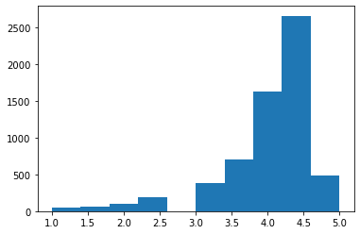
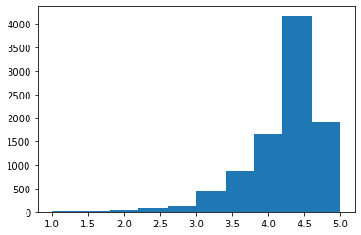
Too close to call?
Apple Store
Mean Review Rating: 4.132658
Google Play
Mean Review Rating: 4.136237
Means are nearly identical, but let’s run random permutations of the data to see if there might be a meaningful difference in app review ratings.

Slide 3
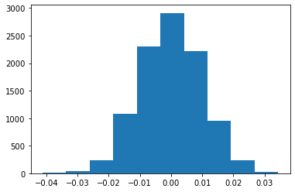
Turns out there is a meaningful difference
Absolute value of difference in random permutated means: 0.14206
Whereas the difference between means of the original data sets is nearly zero (0.001103)
Histogram shows normal distribution of means, but with slightly higher mean ratings to the left of center.
Which app has the higher average review ratings in randomized permuted data?

Slide 4
the winner is…
Google Play
Randomized permutated data shows that Google Play is more likely to receive higher review ratings.

