Slide 1

IDS 575 Final Project Predicting Caravan Potential Insurance Buyers
Submitted By:
Chaitra Venkatesahiah
670760100
Notes:
Good morning everyone! I am Jigyasa and I am here to present my final presentation with all of you today. The topic of my presentation is Predicting Caravan’s Insurance buyers based on customer information of an insurance firm.

Slide 2
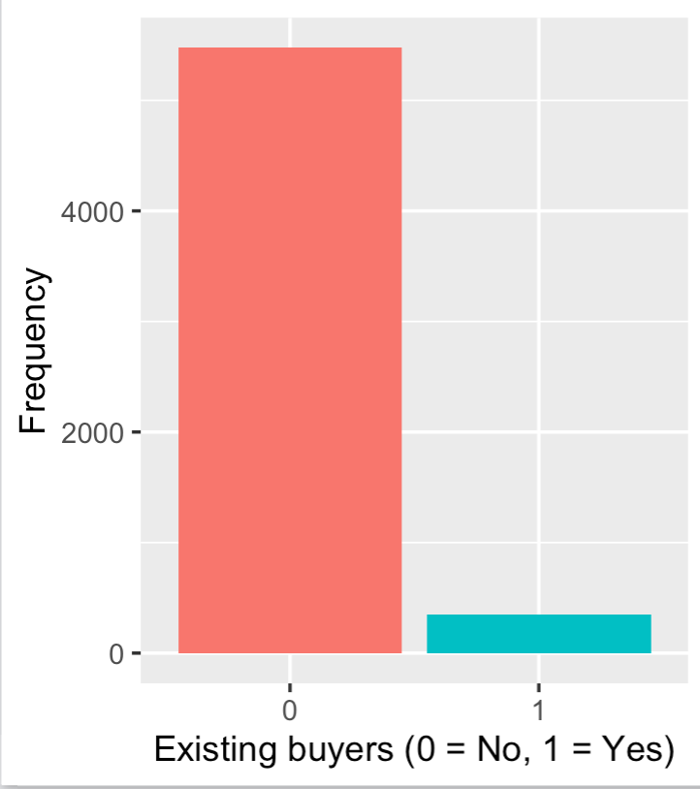
Project description
Based on customer information of an insurance firm, predict potential buyers for a particular Caravan insurance policy.
For 9822 customers, there are 87 variables including: socio- demographic statistics, product ownership and insurance statistics
The data is divided into train and test based on a column ‘ORIGIN’ (Train: 5822, Test: 4000)
The bar plot depicts the distribution of existing buyers (target variable: CARAVAN) which is 5.4%
Notes:
The data has been taken from Kaggle, it consists of 9822 observations which represent customers and their characteristics. The characteristics are explained by 87 variables which includes socio- demographic, product ownership and insurance statistics. A variable ‘ORIGIN’ determines the train and test observations which are 5822 and 4000 respectively. The target variable is CARAVAN which tells us whether the customer buys CARAVAN insurance policy or not. The target variable can be seen as very highly imbalanced with about buyers constituting 5.4%.

Slide 3
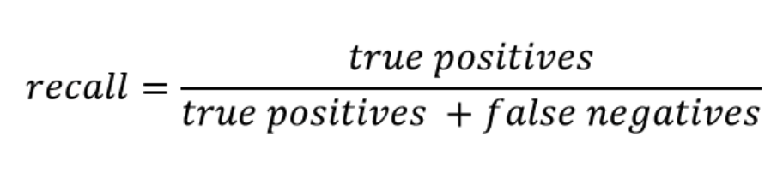
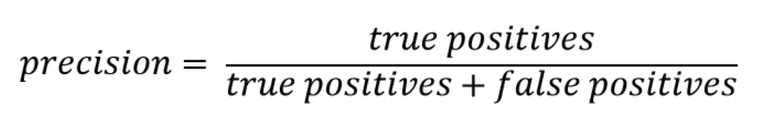
Motivation
Target marketing is a very important scheme for businesses these days. Understanding characteristics of potential buyers, personalizing advertisements and managing customer relations is possible only when there is a smaller pool of customers. Hence, identifying a pool of potential customers is very important.
The cost of losing on a possible buyer is much more than advertising to an extra candidate.
Recall: Correctly identifying the insurance buyers out of total actual buyers; Precision: Correctness of insurance buyers’ prediction
Notes:
I took up this project because target marketing is a very important scheme for business these days. Understanding characteristics of potential buyers, personalizing advertisements and managing customer relations is possible only when there is a smaller pool of customers. Rather than promoting one’s product to an entire population, it is necessary to focus on a potential customer base.
While determining this potential pool, one should remember that the cost of losing on a possible buyer is much more than advertising to an extra candidate. Recall in this scenario can be defined as the proportion of Identifying the insurance buyers out of actual buyers. Precision, on the other hand is the correctness of our prediction.

Slide 4
Evaluation Criteria
Correctly predicting 5 buyers
Case 1
Recall is more important than precision
Cannot neglect precision
F1 score gives equal weight to recall and precision
Hence, using F score: with β² = 4, implying recall being 2 times more important than precision
Predicting
5 out of
348 buyers
Precision = 100%, Recall = 1.44%
Correctly predicting 300 buyers, incorrectly predicted 200 non buyers as buyers
Case 2
Predicting 300 out of 348 buyers
Precision = 60%, Recall = 86.2%
Notes:
It is important to understand that recall is much more important than precision in this scenario. Given Case 1 on the right-hand side, out of a pool of 348 actual buyers, predicting 5 correct customers would yield us a 100% precision but a 1.44% recall. Alternatively, Case 2 depicts that extra prediction of customers, isn’t as harmful as we manage to target 86.2% of the customers.
Additionally, we cannot completely neglect precision because a model that maximizes only recall would predict all the customers as potential buyers, which is the opposite of target marketing. Since F1 score weighs precision and recall equally, I rather preferred choosing F-score as my evaluation criteria. I chose beta = 2, which implies that recall is two times more important than precision.

Slide 5
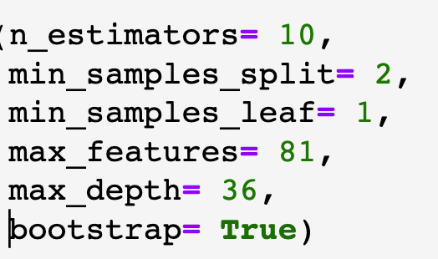
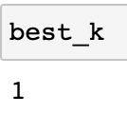

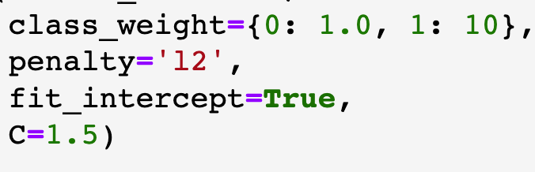
Models applied
 | Baseline (Logistic) | Random Forest | K Nearest Neighbors | Support Vector Machine | Logistic Regression (Ridge)
Pre-processing used in final model | - | - | Scaled data, applied SMOTE | One hot encoding | -
Technique used for hyper parameter tuning | - | 10-fold cross validation and Grid Search CV | Hold out cross validation | 10-fold cross validation | Grid Search CV
Hyper parameters tuned | - | Number of features, Number of trees, Maximum depth, Minimum samples required for splitting, Minimum samples required in leaf, Bootstrap | Number of neighbors | Cost | Class weights, Penalty (Ridge/Lasso), Intercept Fit, C (Inverse of regularization Strength)
Best parameters obtained | -
Notes:
Keeping the evaluation criteria in mind, the following models were fitted on the training data. The baseline model is a basic logistic regression which had an F score of 0.015. Then, I applied a random forest model. I decided the number of features by 10 fold cross validation. The number of trees, maximum depth, minimum samples for splitting and the minimum samples in leaf node were optimized by grid search CV. My second model was KNN, where the data was scaled and SMOTE to balance the imbalance classes. Using hold out cross validation, the hyper parameter ‘k’ was identified. My third model was SVM, for which the data was one hot encoded. I applied 10 fold cross validation to identify the optimal cost. The final model was logistic regression, in which I applied grid search to determine class weights, penalty, intercept fit and C. The chosen best parameters have been depicted.

Slide 6
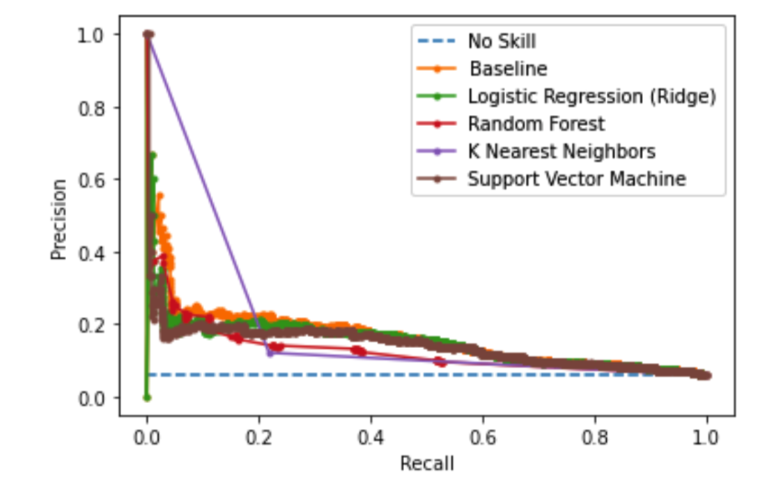
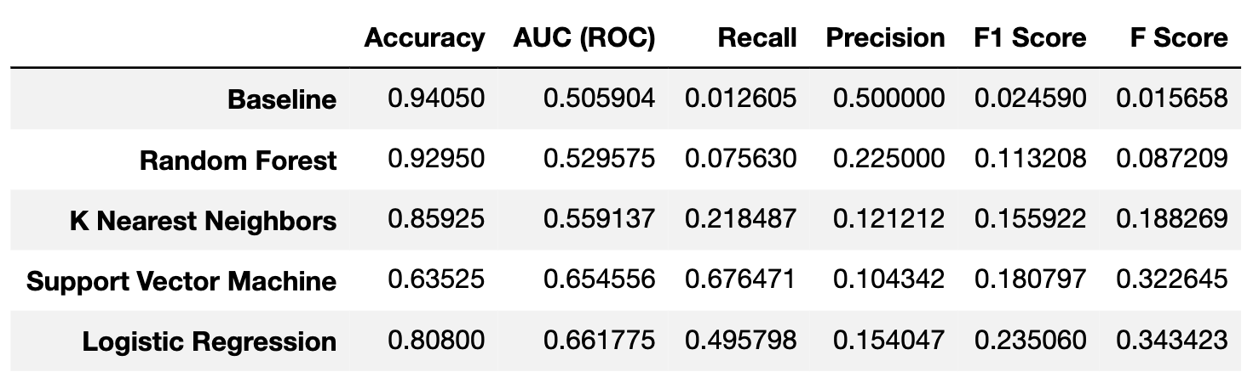
Evaluation
Majority models retrieve very high precision with low recall
At higher recall values, every model performs better than the baseline
Logistic Regression has the highest F Score, followed by SVM. SVM has a better recall than Logistic Regression
Notes:
The models were respectively used to make predictions on the test data. The PR curve comparing all the models is shown here. Majority models retrieve a very high precision with low recall at certain cut off points. As discussed, this is not a good fit. At higher recall values, every model performs better than the baseline.
Since our evaluation criteria is F-score, the table depicts the results more clearly. Logistic Regression has the highest F Score, followed by SVM. But SVM has a better recall than Logistic Regression. Either can be chosen as the best fit.

Slide 7
Take home messages
For imbalance data: assign higher weights to classes of high importance for better evaluation. General practice used by statisticians: 100/ (target class distribution proportion)
SMOTE may overfit your model and result in a better evaluation metric than a model fitted on train data. Cross validate the SMOTE fit model on train data before finalizing
Two new methods of cross validation- grid search CV and random search CV were used. Random search CV is faster, but Grid Search CV is more accurate. Since Grid Search CV can overfit, try using a generic broad range
Notes:
My major leanings from the project are as follows.
First, For imbalance data: assign higher weights to classes of high importance for better evaluation. General practice used by statisticians: 100/ (target class distribution proportion) For example, the target variable is distributed as a 95-5 split. The majority class will be weighted 100/95, 1.05 and minority class will be weighted 100/5, i.e. 20.
Second, if you are using SMOTE to balance your target variable, it may overfit your model. Cross validate the SMOTE fit model on train data before finalizing it as the best model.
Third, I used two new methods of cross validation in the project, namely Grid Search CV and Random Search CV. Even though Random search CV is faster, Grid Search CV is more accurate. Grid Search CV can overfit your model, hence try using a generic broad range for hyperparameters.
Thank you everyone. Please let me know if you have any questions or feedback.
10- 500 ntrees: don’t increment by 10, keep 2 random number of trees in each hundred

