Slide 1

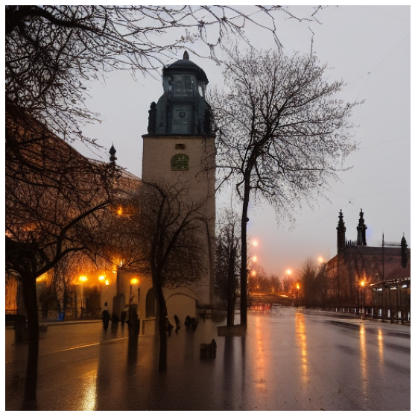

Diffused Live Weather Cams (24/7)
📍
Enter location
WikiData Request
Live Weather API
Prompt
“Leipzig”
- Coordinates 📌
- Weather ☀️🌨🌪
A picture of Leipzig at 17:00:00 with 10 degrees Celsius with Rain (light rain) in December
- Description 🏔
Enter location
WikiData Request
Live Weather API
Prompt
“Leipzig”
- Coordinates 📌
- Weather ☀️🌨🌪
A picture of Leipzig at 17:00:00 with 10 degrees Celsius with Rain (light rain) in December
- Description 🏔

