Slide 1
Incognito Efficient full domain k- anonymity
Report data protection & privacy
Enrico Boschi
Stefano Avola

Slide 2
introduction
K-anonymization is a technique that prevents joining at- tacks by generalizing and/or suppressing portions of the released microdata so that no individual can be uniquely distinguished from a group of size k.
Frequency Set Consider relation T and some set Q of n attributes. The frequency set of T with respect to Q is a mapping from each unique combination of values ⟨q0,...,qn⟩ of Q in T (the value groups) to the total number of tuples in T with these values of Q (the counts).
K-Anonymity Property Relation T is said to satisfy the k-anonymity property (or to be k-anonymous) with re- spect to attribute set Q if every count in the frequency set of T with respect to Q is greater than or equal to k.
We denote this domain generalization relationship by <D, and we use the notation Di ≤D Dj to denote that domain Dj is either identical to or a domain generalization of Di.

Slide 3
consider a vector of n domains with correspond- ing domain hierarchies H1 . . . Hn . A vector of n domains ⟨DA1 , ..., DAn ⟩ is said to be a direct multi-attribute domain generalization (also denoted <D) of another vector of n do- mains ⟨DB1 , ..., DBn ⟩ if the following conditions hold:
1. There exists a single value j in 1 . . . n such that domain hierarchy Hj contains the edge DAj −→ DBj (i.e., DBj is a direct domain generalization of DAj ).
2. Forallotheriin1...n,i.e.,fori̸=j,DAi =DBi
A multi-attribute generalization lattice over n single-attribute domain generalization hierarchies is a complete lattice of n- vectors of domains in which
1.Each edge is a direct multi-attribute domain general- ization relationship.
2.The bottom element is the n-vector ⟨DA1,...,DAn⟩, where, for all i, DAi is the source of the hierarchy chain Hi (i.e., the most specific domain associated with do- main hierarchy Hi).
3.The top element is the n-vector ⟨DA1 , ..., DAn ⟩, where, for all i, DAi is the sink of the hierarchy chain Hi (ie., the most general domain associated with domain hierarchy Hi).
The distance vector between two do- main vectors ⟨DA1 , .., DAn ⟩ and ⟨DB1 , .., DBn ⟩ is a vector DV = [d1, ..., dn], where each value di denotes the length of the path between the domain DAi and the domain DBi in domain generalization hierarchy Hi
The height of a multi-attribute generalization is the sum of the values in the corresponding distance vector. For example, the height of ⟨S1,Z1⟩ is 2.

Slide 4
Full-Domain Generalization Let T be a relation with quasi-identifier attributes Q1, ..., Qn. A full-domain gener- alization is defined by a set of functions, φ1 , ..., φn , each of the form φi : DQi → DAi, where DQi ≤D DAi. φi maps eachvalueq∈DQi tosomea∈DAi suchthata=qor a ∈ γ+(q). A full-domain generalization V of T is obtained by replacing the value q of attribute Qi in each tuple of T with the value φi(q).
“rollup” technique: the search pattern is also breath-first, and the algorithm com- putes the frequency set of the data table with respect to each domain generalization encountered. However, for all gener- alizations other than the root, this frequency set is computed based on the frequency set of (one of) the generalization(s) of which the node is a direct generalization.
A full-domain k-anonymization is produced by joining T with its dimension tables, and projecting the appropriate domain attributes.
Generalization Property: Let T be a relation, and let P and Q be sets of attributes in T such that DP <D DQ. If T is k-anonymous with respect to P, then T is also k- anonymous with respect to Q.
Rollup Property Let T be a relation, and let P and Q be sets of attributes such that DP ≤D DQ. If we have f1, the frequency set of T with respect to P, then we can generate each count in f2, the frequency set of T with respect to Q, by summing the set of counts in f1 associated by γ with each value set of f2 .
Subset Property Let T be a relation, and let Q be a set of attributes in T. If T is k-anonymous with respect to Q, then T is k-anonymous with respect to any set of attributes P such that P ⊆Q.

Slide 5
Basic incognito algorithm
Based on the subset property, the algorithm begins by checking single-attribute subsets of the quasi-identifier, and then iterates, checking k-anonymity with respect to increasingly large subsets
Each iteration consists of two main parts:
1.Each iteration considers a graph of candidate multi- attribute generalizations (nodes) constructed from a subset of the quasi-identifier of size i. We denote the set of candidate nodes Ci. The set of direct multi- attribute generalization relationships (edges) connect- ing these nodes is denoted Ei. A modified breadth-first search over the graph yields the set of multi-attribute generalizations of size i with respect to which T is k- anonymous (denoted Si).
2.After obtaining Si, the algorithm constructs the set of candidate nodes of size i + 1 (Ci+1), and the edges connecting them (Ei+1) using the subset property.

Slide 6
Breadth-first search
The ith iteration of Incognito performs a search that de- termines the k-anonymity status of table T with respect to all candidate generalizations in Ci.
when a node is found to be k-anonymous, all of its direct generalizations are marked, and not checked in subsequent iterations of the search.
The breadth-first search of the graph defined by Ci and Ei determines the k-anonymity status of T with re- spect to all i-attribute generalizations in Ci.

Slide 7
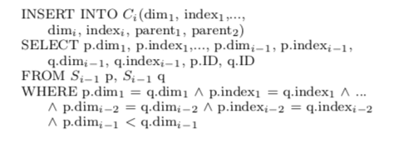
Graph generation
The graph generation component consists of three main phases.
First, we have a join phase and a prune phase for generating the set of candidate nodes Ci with respect to which T could potentially be k-anonymous given previous iterations
The final phase is edge generation, through which the di- rect multi-attribute generalization relationships among can- didate nodes are constructed.
The join phase creates a superset of Ci based on Si−1. The join query is as follows, and assumes some arbitrary ordering assigned to the dimensions. This ordering is intended purely to avoid generating duplicates:

Slide 8

The result of the join phase may include some nodes with subsets not in Si−1, and during the prune phase, we use a hash tree structure similar to that described in [2] to remove these nodes from Ci.

Slide 9
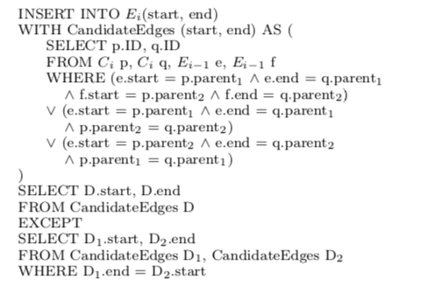
Ei is constructed using Ci and Ei−1 based on some sim- ple observations. Consider two nodes A and B ∈ Ci. We observe that if there exists a generalization relationship be- tween the first parent of A and the first parent of B, and the second parent of B is either equal to or a generaliza- tion of the second parent of A, then B is a generalization of A. In some cases, the resulting generalization relationships may be implied, but they may only be separated by a single node. We remove these implied generalization relationships explicitly from the set of edges.

Slide 10
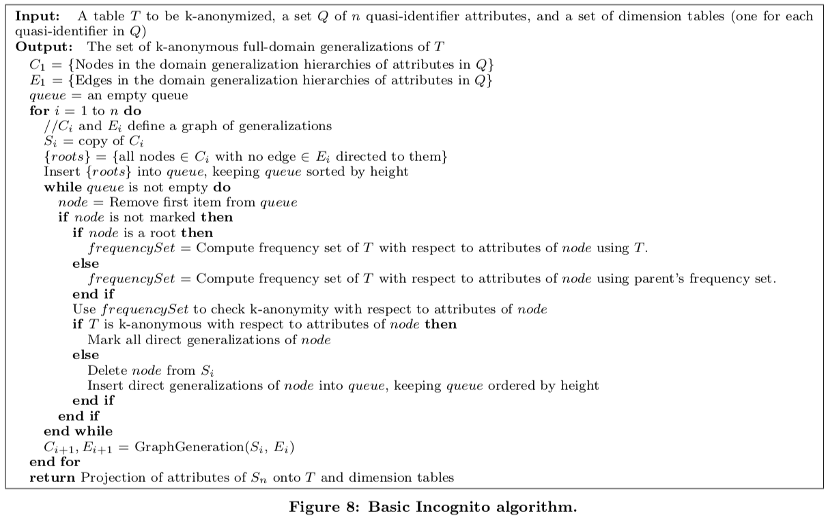

Slide 11
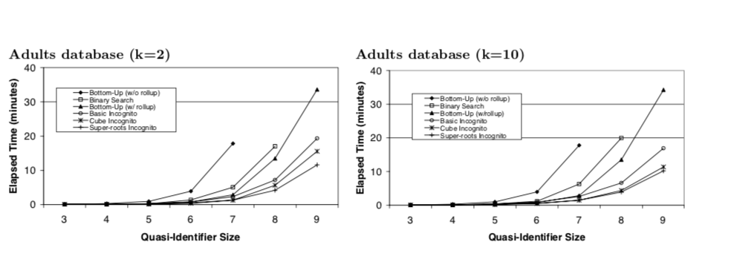
plots

Slide 12
plots

Slide 13
