Slide 1
HOME SURVEILLANCE
AN AVR SOLUTION FOR:
Aaron Volpone
CPE 301 – 1001 | Team #15
5/4/2017
Notes:
Did I really pick a simple surveillance method? We’ll see…

Slide 2
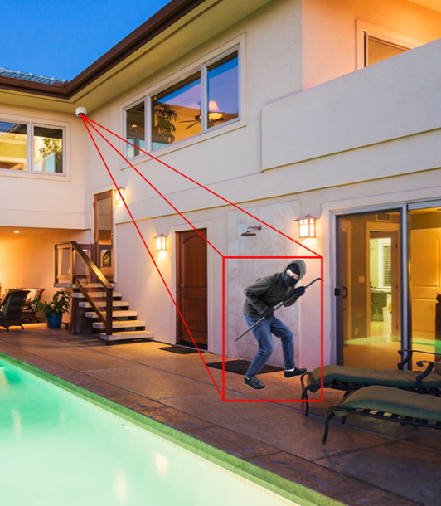
OVERVIEW
GOAL
To design a surveillance package for home use – competitively simple and cheap when challenged against mainstream products.
CONSTRAINTS
AVR platform
Small footprint
Ideally <$50
FIGURE 1 - Scary interpretation of a burglar being identified by home security.
Notes:
An exercise in AVR usage for home security

Slide 3
LOGISTICS
MICROCONTROLLER
ATmega328PB
INPUT
OUTPUT
TTL serial JPEG camera
Analog joystick
Breadboard switches
Micro servo motor (2x)
MicroSD card w/ breakout
Status LEDs (3x)
Active buzzer

Slide 4
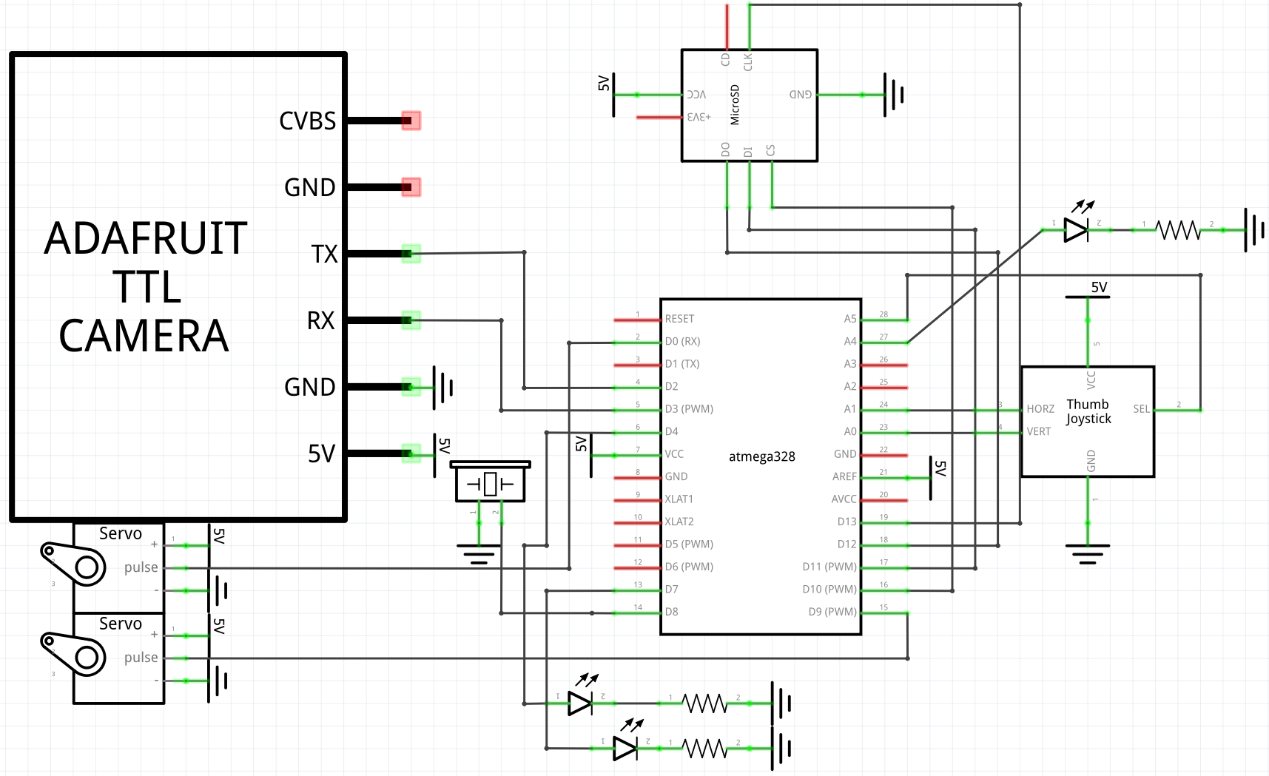
FIGURE 2 - Schematic of package.

Slide 5
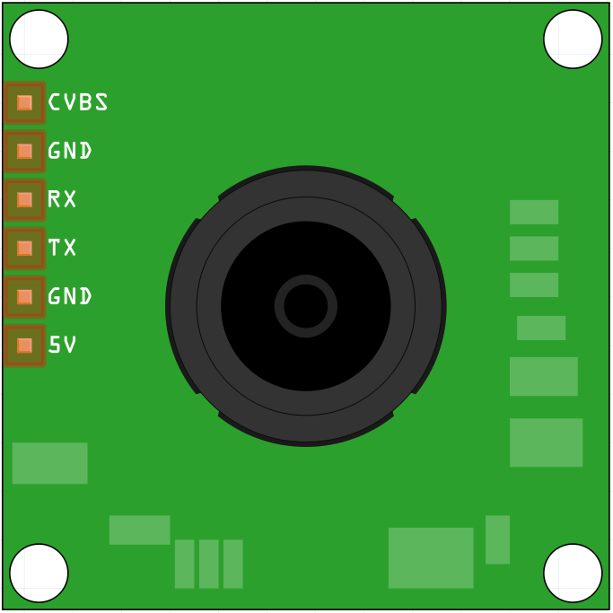
VC0706
DETAILS
- TTL serial camera
640x480 pixel resolution
JPEG format, automatic compression
Motion detecting
Automatic contrast/brightness balancing
FIGURE 3 - VC0706 breadboard picture
Notes:
RCA jack for CVBS (composite video) + CVBS GND. Displays with NTSC format

Slide 6
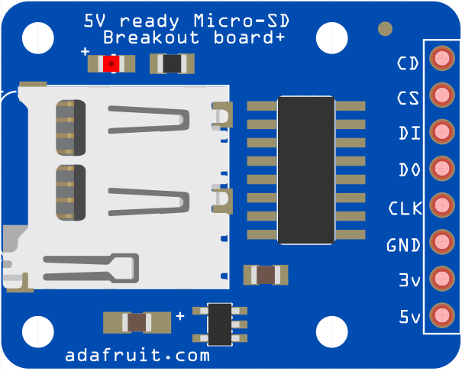
SD CARD BREAKOUT
DETAILS
Memory card reader/writer
Supports 2+GB SD cards
Operates on 3.3V, has an internal regulator
Digital pin for indicating if a card is detected
FIGURE 4 - SD card breakout breadboard picture
Notes:
RCA jack for CVBS (composite video) + CVBS GND. Displays with NTSC format

Slide 7
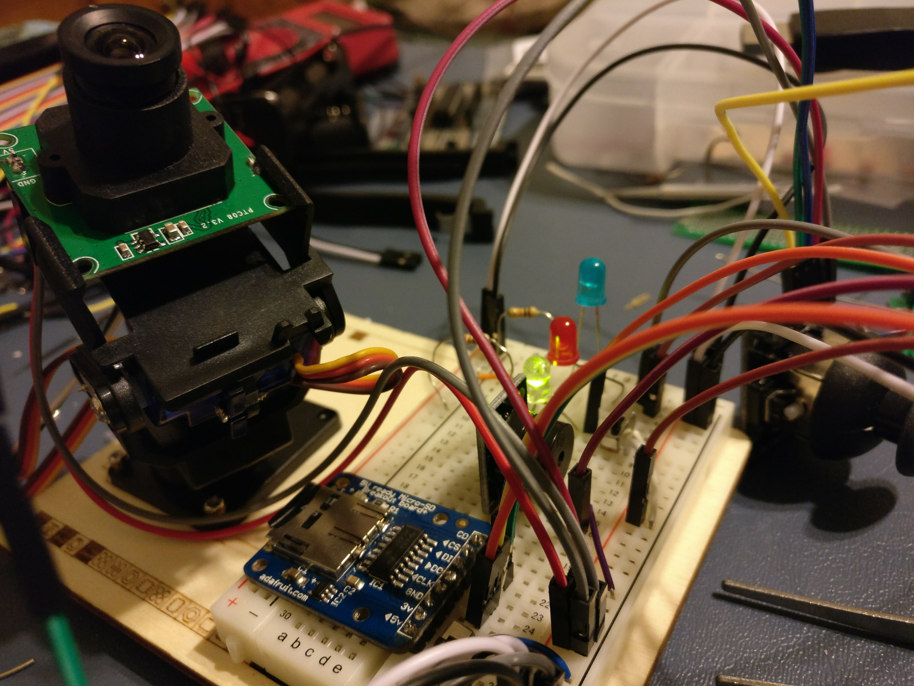
FIGURE 5 - Physical representation of package on breadboard.

Slide 8
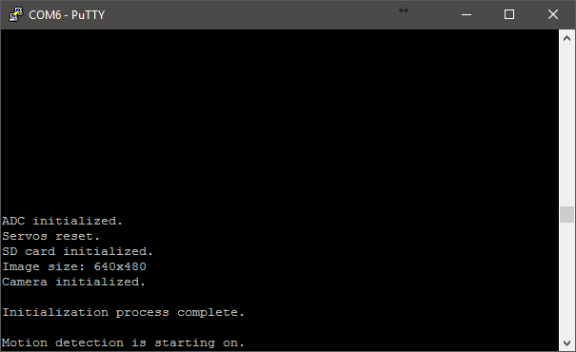
DEVELOPMENT FLOW
BREADBOARD
SETUP
INTERACTIVITY
FUNCTIONAL MODEL
Establish general item seating
Provide power to ATmega328PB and peripherals
UART / ADC configuration
Interpreting joystick voltages
Enable control of servo mount
Configure on-board switches
Ping camera, begin operation
SD card storage
Motion detection
Activity signaling
Buzzer
LEDs
FIGURE 6 - UART communication example. Initializing camera package shown.
Notes:
RCA jack for CVBS (composite video) + CVBS GND. Displays with NTSC format

Slide 9
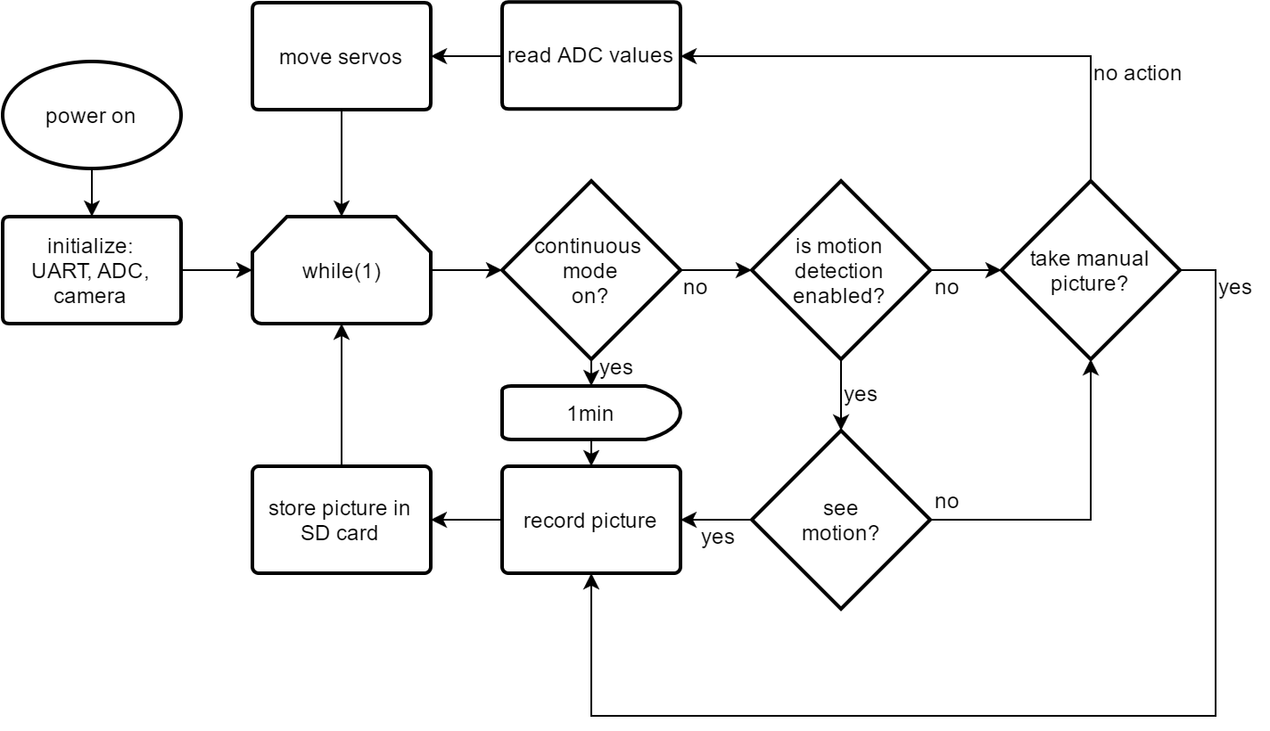
FIGURE 7 - Flow chart of package logic.
Notes:
RCA jack for CVBS (composite video) + CVBS GND. Displays with NTSC format

Slide 10
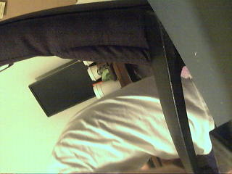

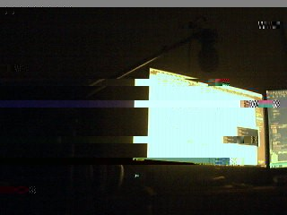
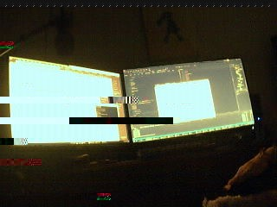
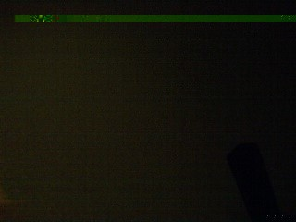
8
9
10
11
12
13

Slide 11
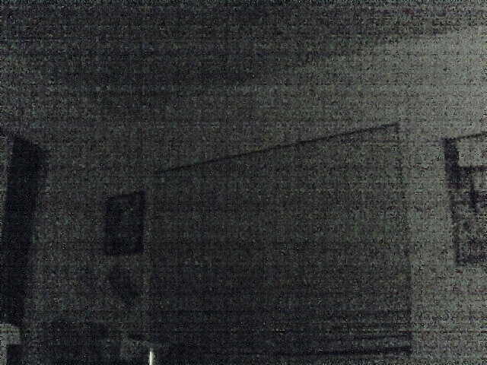
CONCLUSIONS
ABSTRACT COMPLICATIONS
Integration of third party libraries for components led to unforeseen incompatibilities with non-Arduino borne AVR chips.
PRICE TO PERFORMANCE
Project pushed around $70 total. The camera package fell short when comparing similarly priced cameras on the market. Also see: Pixy, RPi3
HOBBYIST LIMITATIONS
Limited flexibility of hardware without exploring data protocols abstracted in libraries and chipset programming.
14
FIGURE 15 - Example of electronic roller shutter issue.

Slide 12

FUTURE IMPROVEMENTS
INTERNET OF THINGS (IoT) EXPANSION
Enable a wireless connection to the camera and storage space through WiFi or Bluetooth.
Transmit a message over the web to notify user of activity seen through the camera – e.g. Email, text, or Tweet.
DATA PROCESSING
Offload data processing so the AVR chip can handle other tasks.
Enable shape identification and movement tracking.
Research other modes of data transfer like USB and also enable video recording.
Notes:
RCA jack for CVBS (composite video) + CVBS GND. Displays with NTSC format

Slide 13
VIDEO DEMONSTRATION
https://youtu.be/qWdbE6uHGSE

