Slide 1

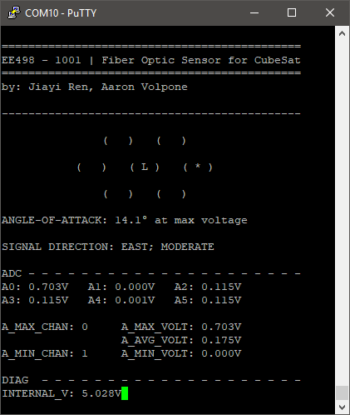
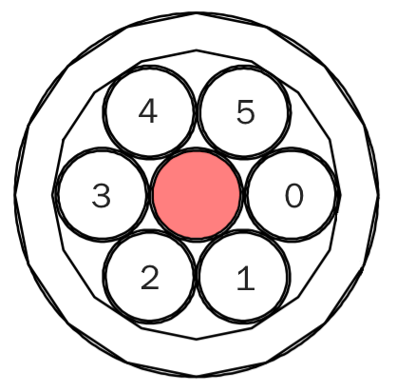
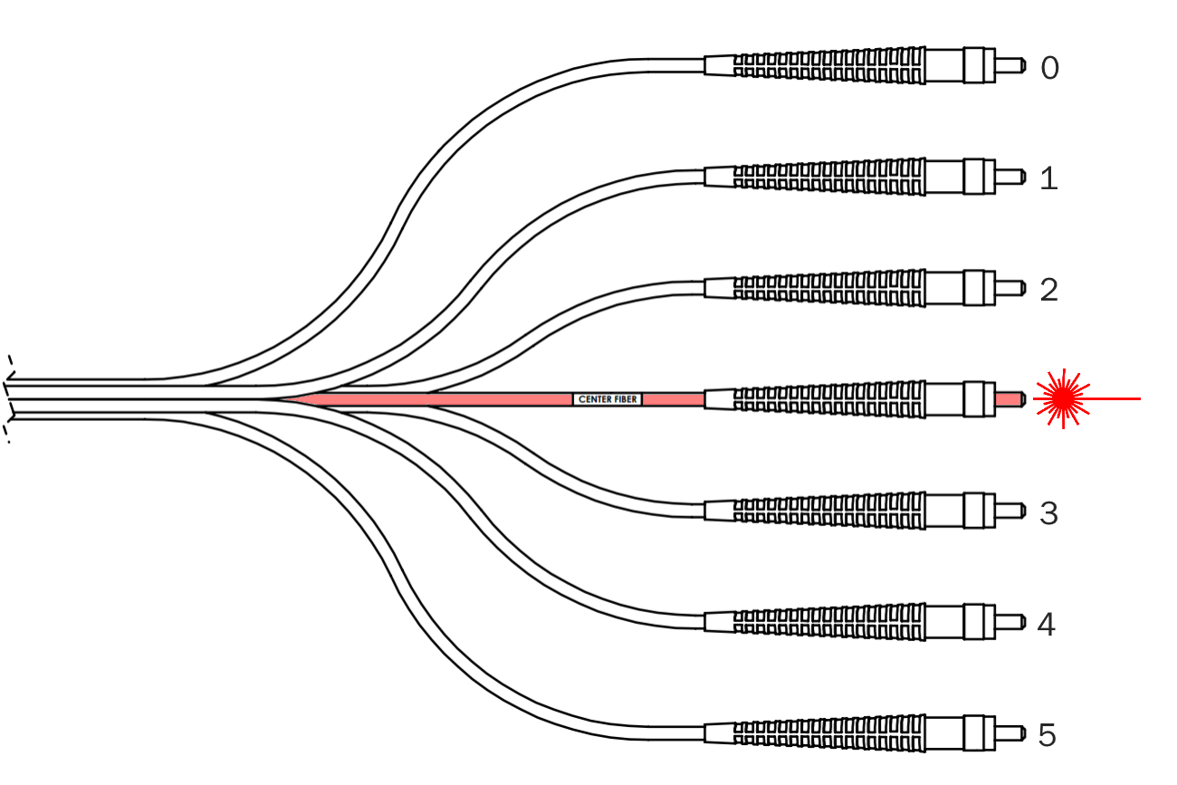
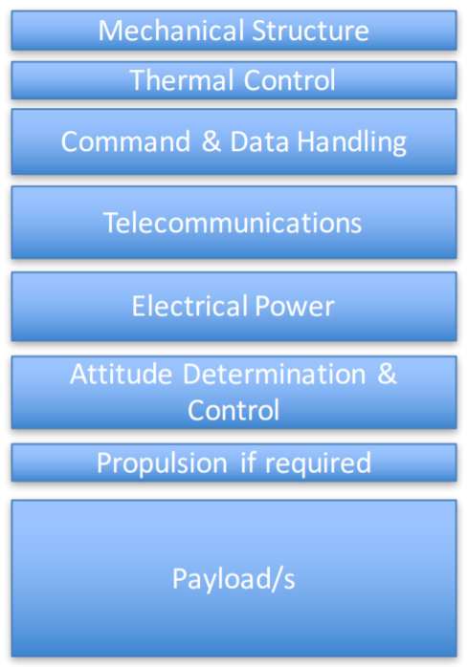
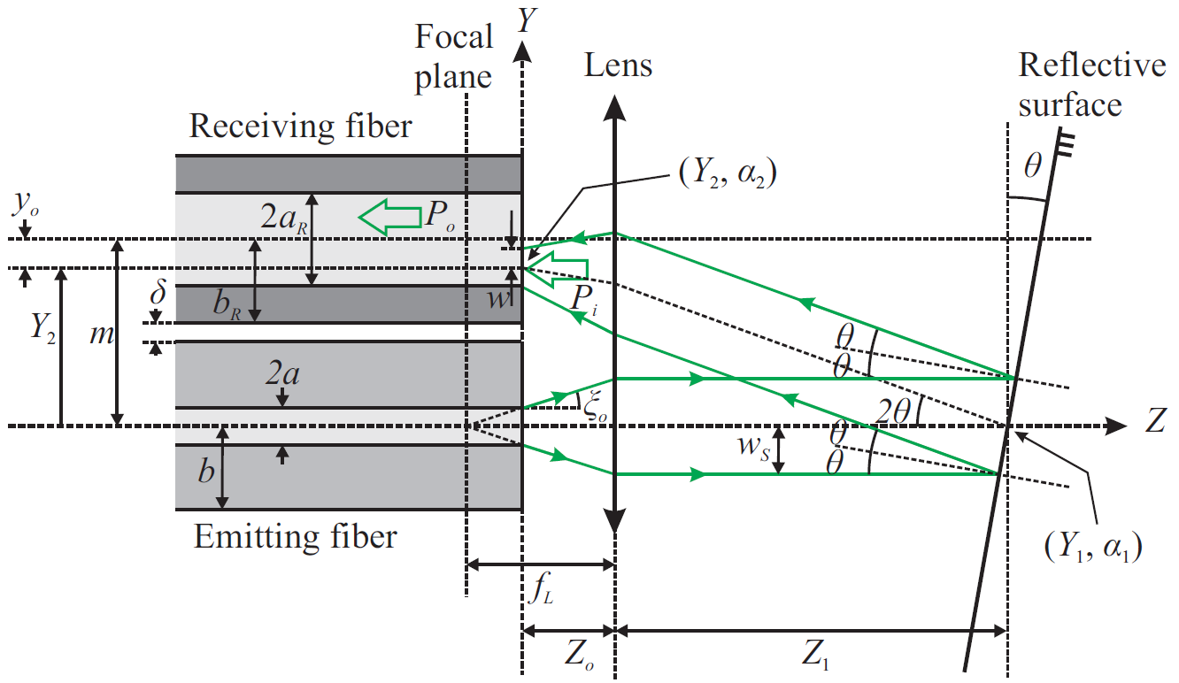
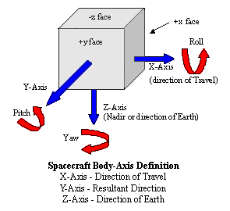
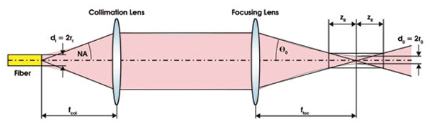
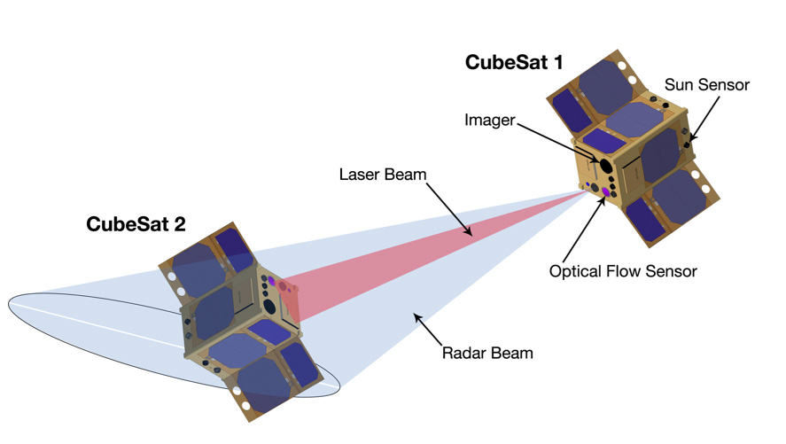
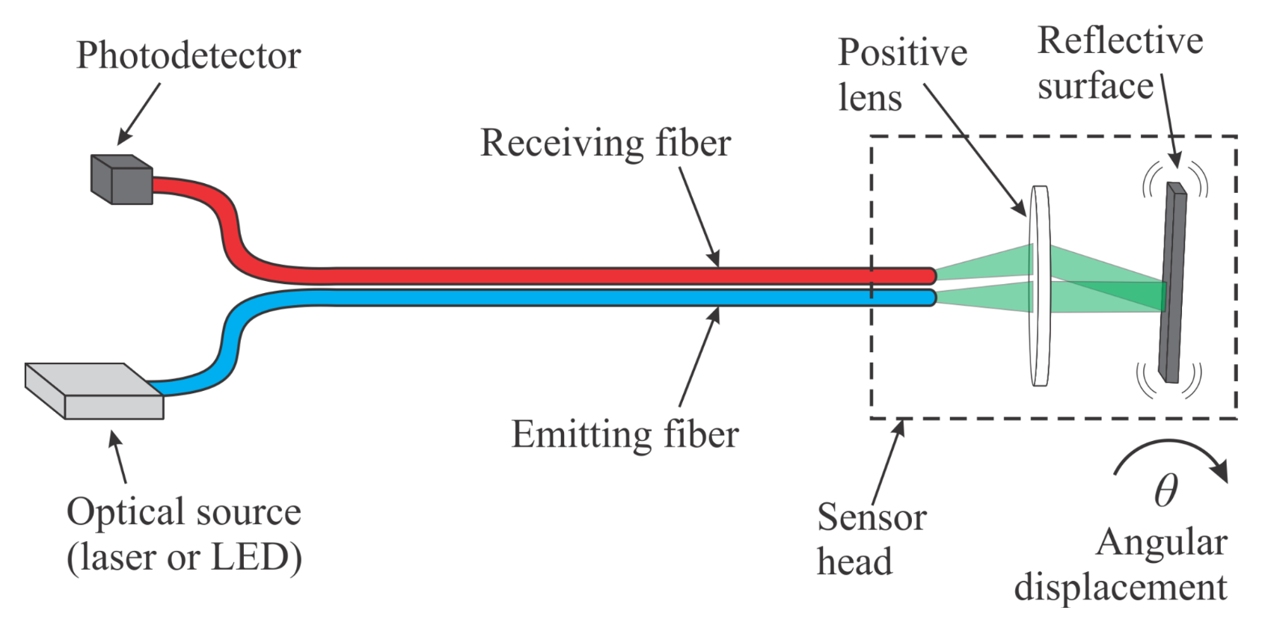
Fiber Optic Sensor for CubeSat
Instructor: Dr. Grzegorz Chmaj
Faculty Advisor: Dr. Ke-Xun Sun
Jiayi Ren, Aaron Volpone
University of Nevada, Las Vegas – Department of Electrical and Computer Engineering
Introduction
Fiber Optics
Software
The advent of CubeSats have enabled universities and space agencies alike to conduct research at much lower financial costs than conventional, bulky satellites CubeSats, on the other hand, boast notable features:
  10cm³ volume, weighting 1.33kg per unit (U)
  Modular and miniaturized, can be built in several unit sizes: 1U, 2U, 3U+
  Affordable, with the average launch price being around $40,000
Schools (along with private organizations) have taken interest in designing CubeSats due to their affordability and accessibility. As a result, they have become good tools for education related to various fields of engineering and sciences.
Fiber optic cables carry light instead of electricity. Through this simple trait, they provide several advantages in the field of data transmission and sensing over conventional copper wire communications. Some primary features of fiber optics are as following:
  Longer distance transmission – fiber optics benefit from minimal power loss, meaning they can be transmitted over great distances.
  High bandwidth capability – the volume of data that fiber optics can transmit per unit of time is far greater than copper wire.
  No moving parts – moving items create wear and can fail. In the realm of space, repairs are a nearly impossible (even unnecessary) task.
  Resistance to electromagnetic interference – fiber optic cables are not prone to radio interference caused by electrical circuitry.
The implementation of fiber optics in this CubeSat project opens the possibility for multiple uses in several future projects.
Interfacing with the sensor board is done through UART communication. With a computer, an operator is able to see the data being readout from the sensors and also communicate with the sensor board for debugging. It is capable of several features:
  Overview mode – displays all ADC sensor data along with a visualization of which photodiodes are receiving a laser signal.
  Testbench mode – designed for communicating with a CubeSat test platform. If connected to another processor, it could send signals to adjust its angle-of-attack and zero in on a received laser signal.
  ADC debug mode – allows the operator to see the ADC channels changing in real-time to check calibration and operating status of the board.
FIGURE 8
Project Goal
The sensor array is built into the same cable that the laser signal originates from. Angular displacement is found by bouncing the laser signal back into the array of photodiodes with a reflective surface.
Ultimately, the goal of this project was to design a displacement sensor board that would used in a future UNLV CubeSat project. The development process for components in a CubeSat require collaboration between various engineering disciplines. For the duration of this two semester Senior Design project, a foundational concept was derived and started for measuring angular displacement between two hypothetical CubeSats. The use of fiber optics over conventional sensors are elaborated in other modules.
In terms of the hierarchical structure of a CubeSat, the fiber optic sensor falls under Attitude Determination & Control. The intent of previous and future projects is to consolidate work into a fully functioning CubeSat. All parts are be designed with the intent to interface with other modules made by various teams. The MCU used in this project can also be applied in future projects.
FIGURE 1
FIGURE 4
FIGURE 8
FIGURE 4
Future Improvements
The theta value created by the reflective surface will determine which photodiodes receive the laser signal. Each receiving fiber sits a fixed distance from the emitting fiber - where the laser emitter shoots. In order for the pinpoint laser to be seen by adjacent photodiodes, its output beam must be manipulated in open space.
FIGURE 5
The Fiber Optic Sensor for CubeSat is still very much in a preliminary stage. That means it must go through several iterations for minimization and future development. Suggested improvements for the feature include:
  Integration with CubeSat testbench module with full autonomous operation. This includes mounting in a future designed CubeSat chassis.
  Reduction of sensor board surface area – switch to surface mounted parts.
  Reduction in number of photodiodes and replacement with smaller, more precise versions to save space.
  Reduction in fiber cable length to save space.
  Migration to a lower power, more precise microprocessor.
  Integration with other attitude sensors for more flexible angular control.
  Investigation into more robust software for the sensors.
FIGURE 1
FIGURE 9
FIGURE 5
Measurement
Six degrees of freedom is a future goal for attitude adjustment with equipped sensors and motors.
Angular Displacement
A laser passes through a lens to collimate into open space, and then another to refocus into a photodiode array. The open space is the implied distance between two CubeSats in space.
FIGURE 6
FIGURE 9
Measurement of angular displacement is to determine at what degree an object is facing toward a relative point-of-reference. In this case, the point of reference is a neighboring CubeSat in space. Adjustments in alignment are to be done until CubeSats face each other.
Angular adjustment between two paired CubeSats is done by firing an infrared laser at its neighbored satellite. At an angle, the laser signal will appear stronger on sensors that are angled more toward the center of the originating laser beam. The difference between laser intensities is how displacement is computed.
As shown in Figure 2 and 3, the displacement angle of a laser signal is used to determine how a CubeSat should orient itself in space. The detection of this laser is used with particular near-infrared photodiodes (NIR) tuned to a 1550nm wavelength. Photodiodes convert light into electric current. The electrical signal generated by these photodiodes is very small. However with a voltage amplifier, the photodiode signal can be processed by a microcontroller.
Results & Conclusion
FIGURE 2
The Fiber Optic Sensor for CubeSat demonstrated a challenging relationship between the complexity of optical equipment and its price. Though the equipment present during this project was capable of measuring angular displacement, the size of its future implementation is not possible given the constraints of a CubeSat. Thus, several considerations need to be taken to reach a more grand consolidation of equipment for the future of UNLV’s CubeSat project:
  Understanding of the relationship between minimization and growing costs. These need to be taken into account with the limited budget given with undergraduate senior design.
  Ensuring the continued multidisciplinary capabilities of future teams for projects. As CubeSat development continues, the facets of various member specializations begin to converge.
  Continuation of exposure to future students and the potential to carry these projects into graduate research.
The benefit of working through a long term project is enabling the ability for future teams to pick up a on an established foundation. With good documentation to cover the process that the project has gone through, it helps accelerate the rate that the CubeSat projects can begin consolidating their work.
FIGURE 7 - OPTICAL SETUP
FIGURE 2
By firing a laser into space and then refocusing its beam on the receiving end of a CubeSat, we can use the angle that it approaches to find where a neighboring satellite is facing. We accomplish this by reflecting the laser signal back into an array of photodiodes to compute their values.
FIGURE 3
FIGURE 3

