Slide 1

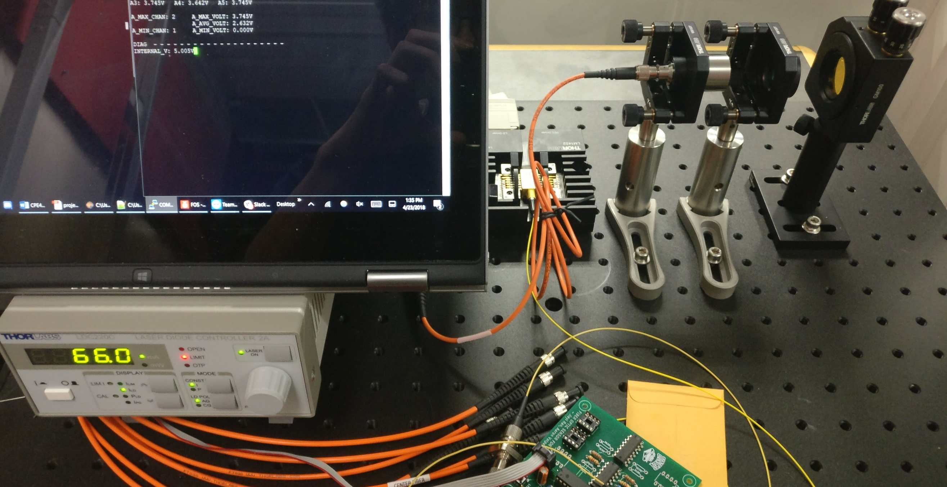
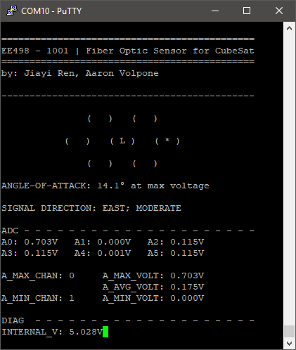
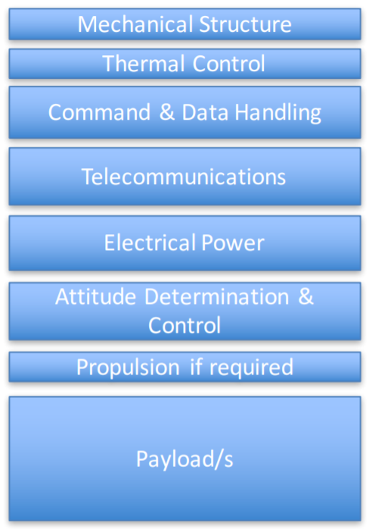
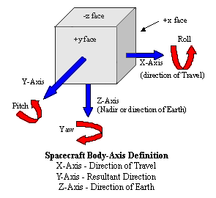
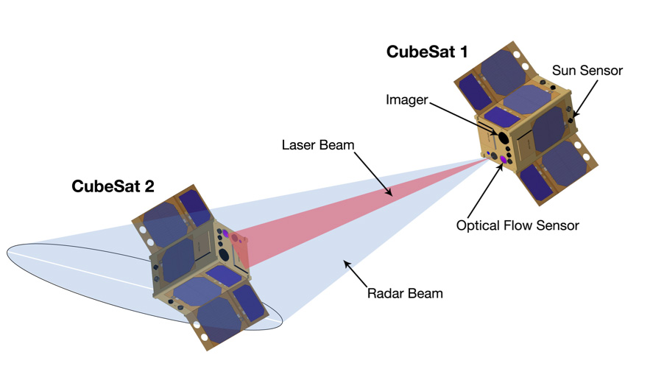
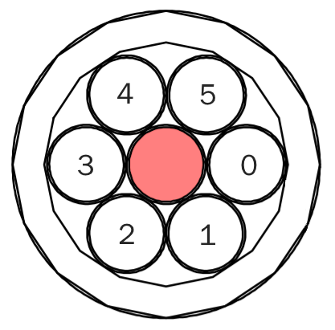
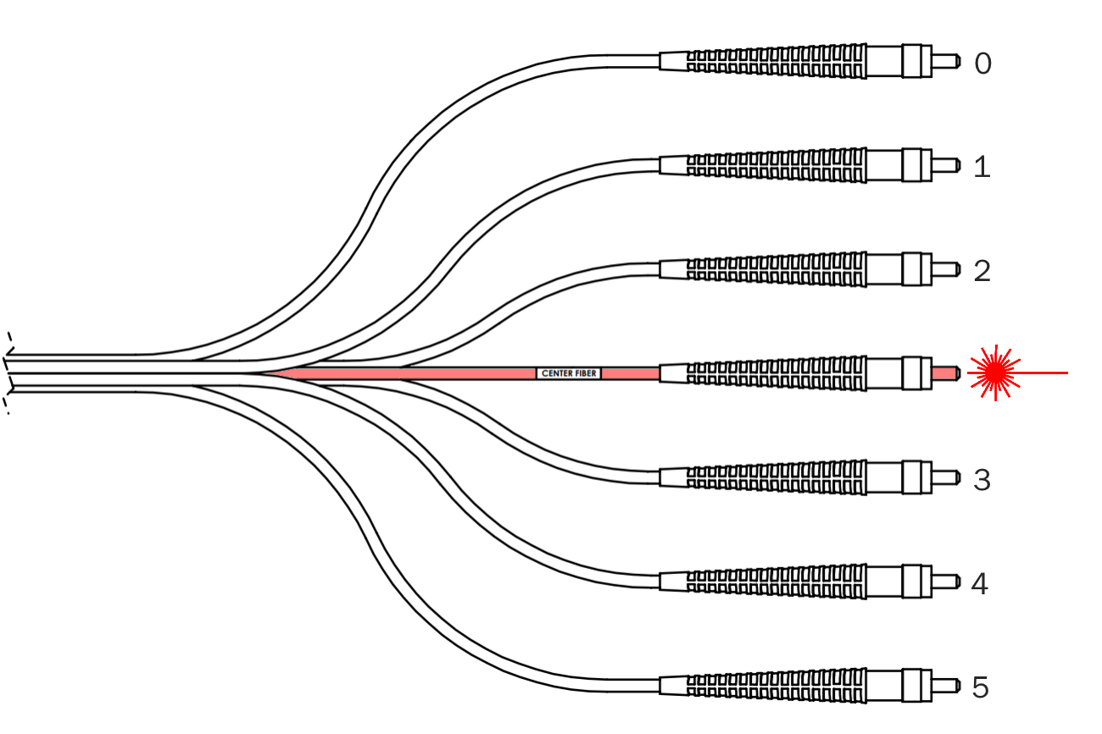
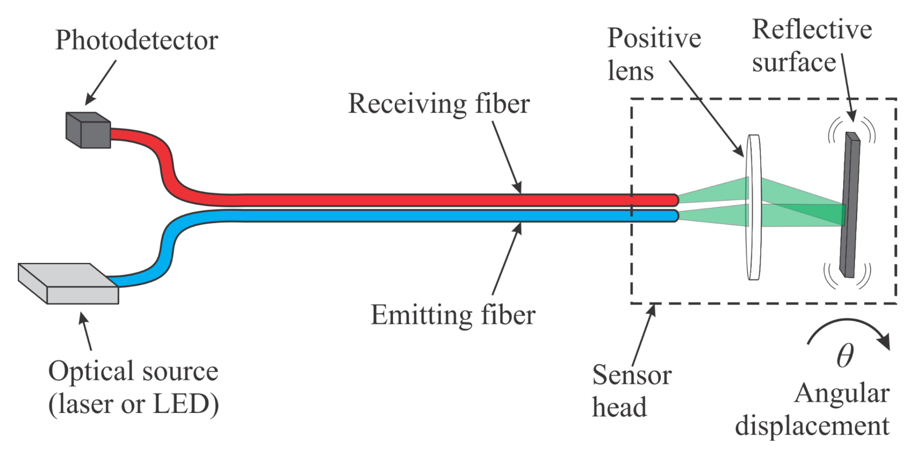
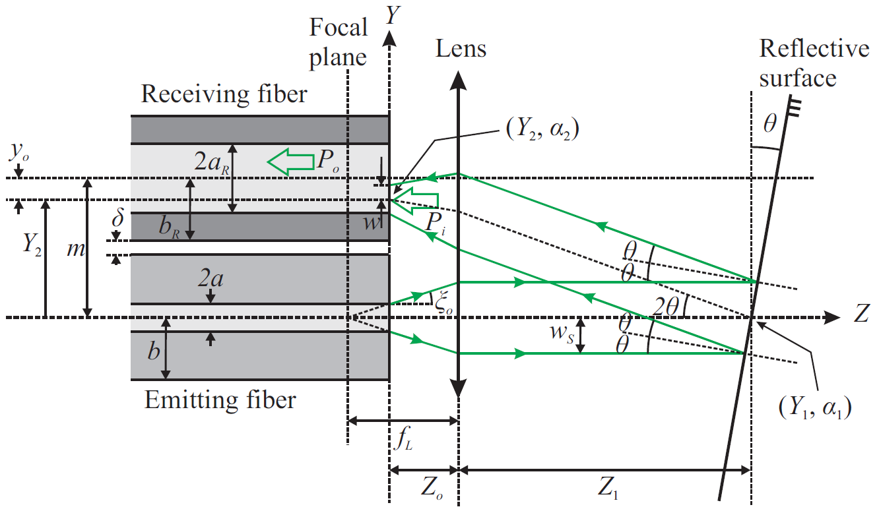
Fiber Optic Sensor for CubeSat
Instructor: Dr. Grzegorz Chmaj
Faculty Advisor: Dr. Ke-Xun Sun
Jiayi Ren, Aaron Volpone
University of Nevada, Las Vegas – Department of Electrical and Computer Engineering
Introduction
Optical Equipment
Software
The advent of CubeSats have enabled universities and space agencies alike to conduct research at much lower financial costs than conventional, bulky satellites CubeSats, on the other hand, boast notable features:
10cm³ volume, weighting 1.33kg per unit (U)
Modular and miniaturized, can be built in several unit sizes: 1U, 2U, 3U+
Affordable, with the average launch price being around $40,000
Schools (along with private organizations) have taken interest in designing CubeSats due to their affordability and accessibility. As a result, they have become good tools for education related to various fields of engineering and sciences.
Interfacing with the sensor board is done through a serial connection to a computer. Using a terminal, an operator can see data readouts from the photodiode sensors. Various modes of operation are available:
Overview mode – displays all sensor data along with a visualization of what the fiber is detecting.
Testbench mode – designed for sending data to a CubeSat test platform. If connected to another processor, it can give signals to test bench motors.
ADC debug mode – allows the operator to see the ADC channels changing in real-time to check calibration and operating status of the board.
FIGURE 7
Project Goals
Design a displacement sensor board for use in a future UNLV CubeSat project.
Use fiber optics in replacement of traditional integrated chip designs for the board.
Use near-infrared (NIR) photodiodes to detect and interpret a laser input for displacement.
Demonstrate the implementation of an optical setup used to drive a laser and receive its input across mounted photodiodes.
The fiber optic sensor falls under Attitude Determination & Control, ultimately designed to:
Identify and correct rotational displacement.
Maintain heading once aligned with its target.
FIGURE 1
FIGURE 4
The implementation of the displacement sensor is a macro version of how the future iteration will look. Significant parts shown are listed below:
Computer and laser driver supply for ensuring a steady signal.
Laser mount that houses a 14-pin butterfly package laser.
The fiber optic cable that links the laser, photodiodes, and collimator lens.
PCB board that holds the microprocessor, battery, and photodiode sensors.
Optical mounts for housing the lens and mirror equipment that allows the measurement of displacement.
FIGURE 7
Future Improvements
The Fiber Optic Sensor for CubeSat is still very much in a preliminary stage. That means it must go through several revisions before being considered operational. Some improvements for the future include:
Integration with CubeSat testbench module with full autonomous operation. This includes mounting in a future designed CubeSat chassis.
Reduction of sensor board surface area – switch to surface mounted parts.
Reduction in number of photodiodes and replacement with smaller, more precise versions to save space.
Reduction in fiber cable length to save space.
Migration to a lower power, more precise microprocessor.
Integration with other attitude sensors for more flexible angular control.
FIGURE 8
FIGURE 1
Fiber Optics
Fiber optic cables carry light instead of electricity. Through this simple trait, they provide several advantages in the field of data transmission and sensing over conventional copper wire communications. Some primary features of fiber optics are as following:
Longer distance transmission – fiber optics benefit from minimal power loss, meaning they can be transmitted over great distances.
High bandwidth capability – the volume of data that fiber optics can transmit per unit of time is far greater than copper wire.
No moving parts – moving items create wear and can fail. In the realm of space, repairs are a nearly impossible (even unnecessary) task.
Resistance to electromagnetic interference – fiber optic cables are not prone to radio interference caused by electrical circuitry.
Multiple uses – various forms of optical data can be transmitted back-and-forth across a fiber cable.
Six degrees of freedom is a future goal for attitude adjustment with equipped sensors and motors.
Angular Displacement
FIGURE 8
Measurement of angular displacement is to determine at what degree an object is facing toward a relative point-of-reference. In this case, the point of reference is a neighboring CubeSat in space. Adjustments in alignment are to be done until CubeSats face each other.
Angular adjustment between two paired CubeSats is done by firing an infrared laser at its neighbored satellite. At an angle, closer sensors will detect a stronger signal. The difference between laser intensities across all sensors is how displacement is computed.
Results & Conclusion
FIGURE 2
The sensor array is built into the same cable that the laser signal originates from. Angular displacement is found by bouncing the laser signal back into the array of photodiodes with a reflective surface.
FIGURE 5
The Fiber Optic Sensor for CubeSat demonstrated a challenging relationship between the complexity of optical equipment and its price. Though the equipment present during this project was capable of measuring angular displacement, the size of its future implementation is not possible given the constraints of a CubeSat. Thus, several considerations need to be taken to reach a more grand consolidation of equipment for the future of UNLV’s CubeSat project:
Understanding of the relationship between minimization and growing costs. These need to be taken into account with the limited budget given with undergraduate senior design.
Ensuring the continued multidisciplinary capabilities of future teams for projects. As CubeSat development continues, the facets of various member specializations begin to converge.
Continuation of exposure to future students and the potential to carry these projects into graduate research.
The benefit of working through a long term project is enabling the ability for future teams to pick up a on an established foundation.
FIGURE 2
FIGURE 5
By firing a laser into space and then refocusing its beam on the receiving end of a CubeSat, we can use the angle that it approaches to find where a neighboring satellite is facing. We accomplish this by reflecting the laser signal back into an array of photodiodes to process.
FIGURE 3
The angle created by the reflective surface determines which photodiodes receive a more intense laser signal. Each receiving fiber sits a fixed distance from the emitting fiber, so the angle-of-attack can be determined given the specifications of the fiber, lens, and reflective surface.
FIGURE 6
FIGURE 3
FIGURE 6

