Slide 2
Lipid-related Genetic Variants And Lipid Outcomes In A Cohort Of Chilean Children

Slide 3
Introduction: Dyslipidemia in children
Dyslipidemia is an important risk factor for chronic cardiometabolic diseases.
Dsylipidemia represents any abnormal levels of lipid, lipoprotein, or apolipoprotein factors [@kwiterovich_clinical_2008], including:
total cholesterol (TC)
low density lipoprotein cholesterol (LDL-C)
triglycerides (TG)
high density lipoprotein choleseterol (HDL-C)

Slide 4
Introduction: Heritability of dyslipidemia
Lipid traits are heritable (h$^2$ can exceed 0.50) [@goode_heritability_2007] and strongly associated with cardiovascular disease sustaining strong interest in genetic research.
By 2013, researchers have identified more than 150 established loci influencing lipid levels in adults [@willer_discovery_2013].

Slide 5
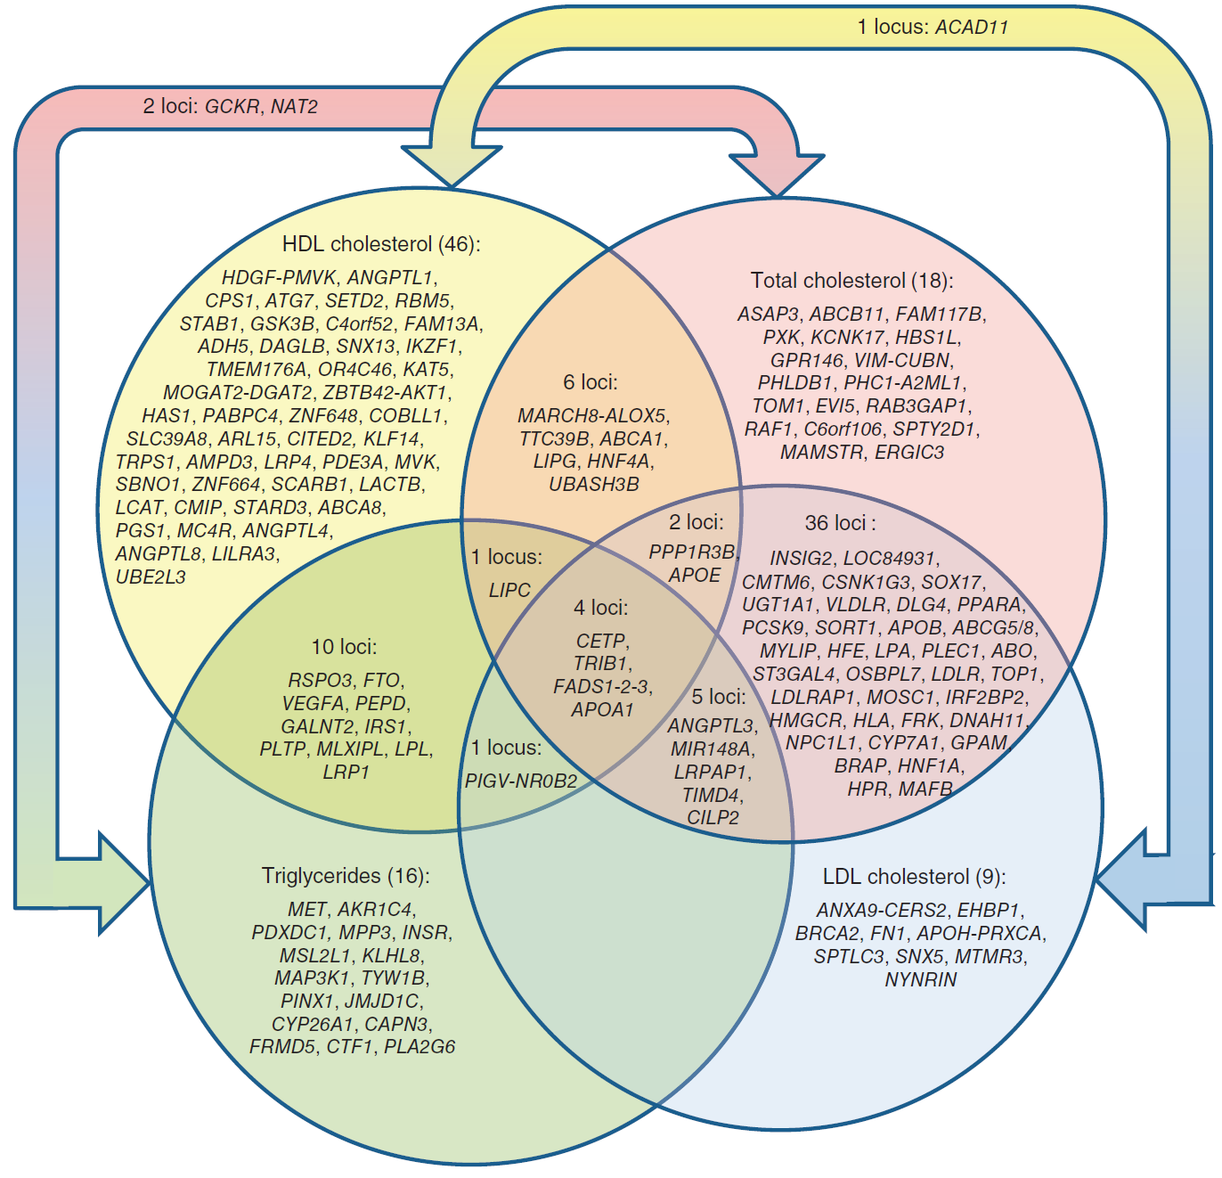
Introduction: Lipid Variants

Slide 6
Introduction: Generalizability across ancestral groups
Results found for adults have been found to generalize to children in a Finnish population [@tikkanen_association_2011; @buscot_combined_2016].
Certain variants that associate with a trait such as dyslipdemia in one ancestral group may not associate in other groups [@carlson_generalization_2013].
Why? Differences across ancestral groups include:
Variant frequencies
Linkage disequilibrium
No research exists examining the association between genetic variants and dyslipidemia studies in Hispanic/Latino (HL) children

Slide 7
Introduction: Primary Aim
Examine the association of known lipid variants with lipid traits identified in large study of adult participants from a Chilean infancy cohort of primarily European-descent.
Compare results to those found in a Finnish population.

Slide 8
Methods: Association tests
We assessed single variant associations using linear regression for high density lipoprotein cholesterol (HDL-C), low density lipoprotein cholesterol (LDL-C) and triglycerides (TG), assuming an additive genetic model, adjusted for sex and ancestry (via principal components).
Sample Model for HDL
HDL_i = b0 + SNP_i b1 + sex_i b2 + ANCESTRY_i B + e_i
SNP_i represents one SNP with “genotypes were coded as 0, 1, or 2 when directly genotyped or as a predicted allele dosage (range, 0–2) when imputed.” [@tikkanen_association_2011]
Only six variants from the Chilean sample met the a priori threshold of power > 0.8 to detect an association based on effect sizes from GWAS [@teslovich_biological_2010].

