Slide 1
Lipid-related Genetic Variants And Lipid Outcomes In A Cohort Of Chilean Children

Slide 2
Introduction: Dyslipidemia in children
Dsylipidemia represents any abnormal levels of lipid, lipoprotein, or apolipoprotein factors [@kwiterovich_clinical_2008], including:
total cholesterol (TC)
low density lipoprotein cholesterol (LDL-C)
triglycerides (TG)
high density lipoprotein choleseterol (HDL-C)

Slide 3
Introduction: Heritability of dyslipidemia
Lipid traits are heritable (h$^2$ can exceed 0.50) [@goode_heritability_2007] and strongly associated with cardiovascular disease sustaining strong interest in genetic research.

Slide 4
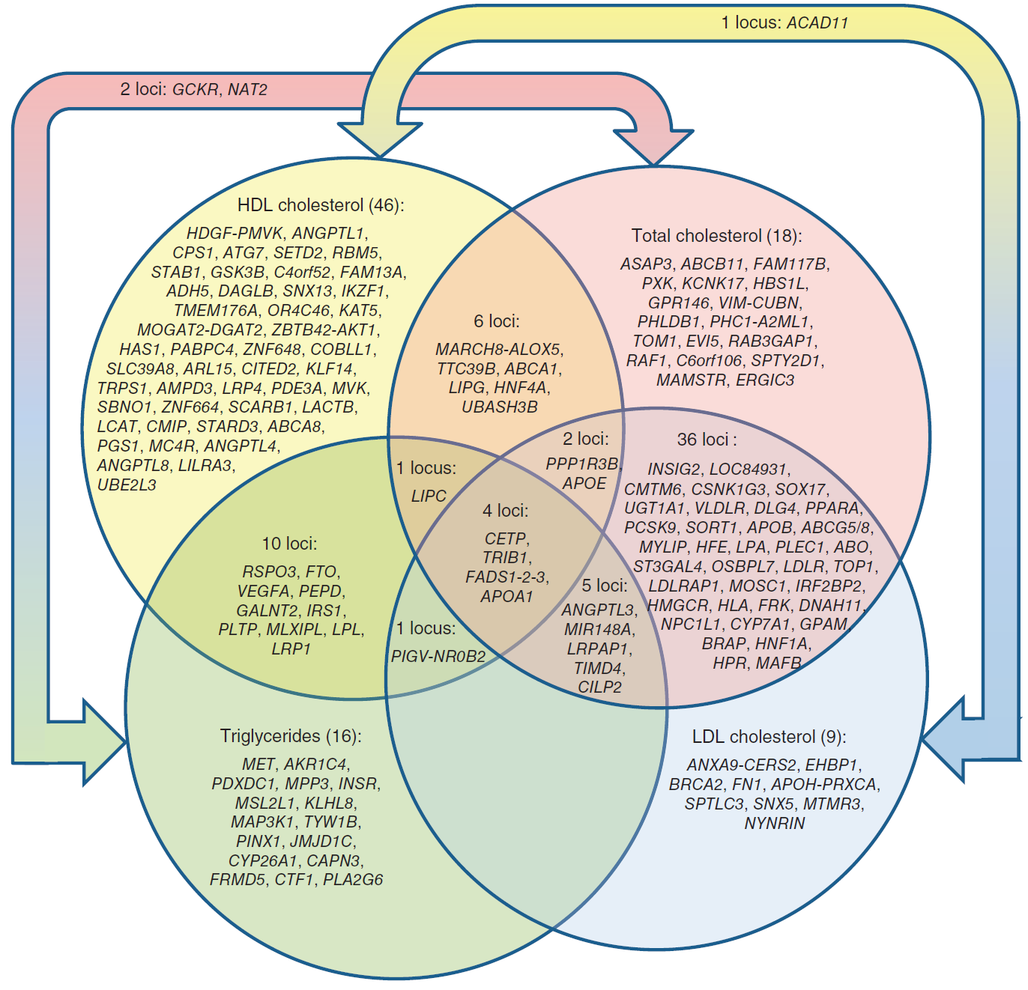
Introduction: Lipid Variants

