Slide 1
Implementing the Internet of Things using Windows Azure
Brady Gaster
INO203

Slide 2

Introductions
It’d help if you had some context on who I am and what I do
Program Manager
Windows Azure SDK
@bradygaster
bradygaster.com
bradyg@microsoft.com
1 Wife, 2 Sons, 2 Chihuahuas
2 Guitars, 3 Microcontrollers

Slide 3
Agenda
Environment Setup
Real-time Temperature and Humidity Monitoring with Gadgeteer, SignalR, & Web API
Security Camera with Gadgeteer, SignalR & Windows Azure Blob Storage
Accessing the Windows Azure Storage API Directly with Netduino & Gadgeteer
Agent Watch SDK Possibilities
Cloud-to-Device Communication using
Windows Azure

Slide 4
Environment Setup
Software you’ll need | Where to get it
Windows 8 | http://www.windows.com
Visual Studio 2010, 2012, 2013 | http://bit.ly/getvstudio
.NETMF SDK 4.1 | http://bit.ly/netmf41download
.NETMF SDK 4.2 | http://bit.ly/netmf42download
.NETMF SDK 4.3 | http://bit.ly/netmf43download
Netduino SDK | http://netduino.com/downloads/
Gadgeteer Core & Builder Templates | http://gadgeteer.codeplex.com/releases
Sytech Gadgeteer SDK | http://bit.ly/sytechsdk
Agent Watch SDK | http://bit.ly/agentsdk
Windows Azure SDK | http://bit.ly/wazsdkdownload

Slide 5
Demo
Real-time Temperature and Humidity Monitoring with Gadgeteer, SignalR, & Web API

Slide 6
Demo
Security Camera with Gadgeteer, SignalR & Windows Azure Blob Storage

Slide 7
Demo
Accessing the Windows Azure Storage API Directly with Netduino & Gadgeteer

Slide 8
Demo
Agent Watch SDK Possibilities

Slide 9
Demo
Cloud-to-Device Communication using Windows Azure

Slide 10
Additional Resources
Pete Brown 10rem.net
GHI Forum https://www.ghielectronics.com/community/forum
Gadgeteer Official Site http://www.netmf.com/gadgeteer/
Netduino Forums http://forums.netduino.com/
Channel 9 Coding for Fun http://channel9.msdn.com/coding4fun
G. Andrew Duthie http://devhammer.net
Agent Watch Official Site http://agentwatches.com
Hanselman Tinkering with the Agent SDK http://bit.ly/scottagent

Slide 11
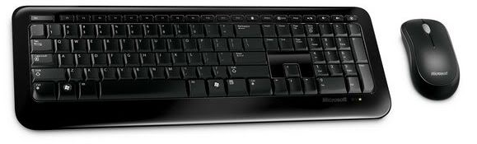
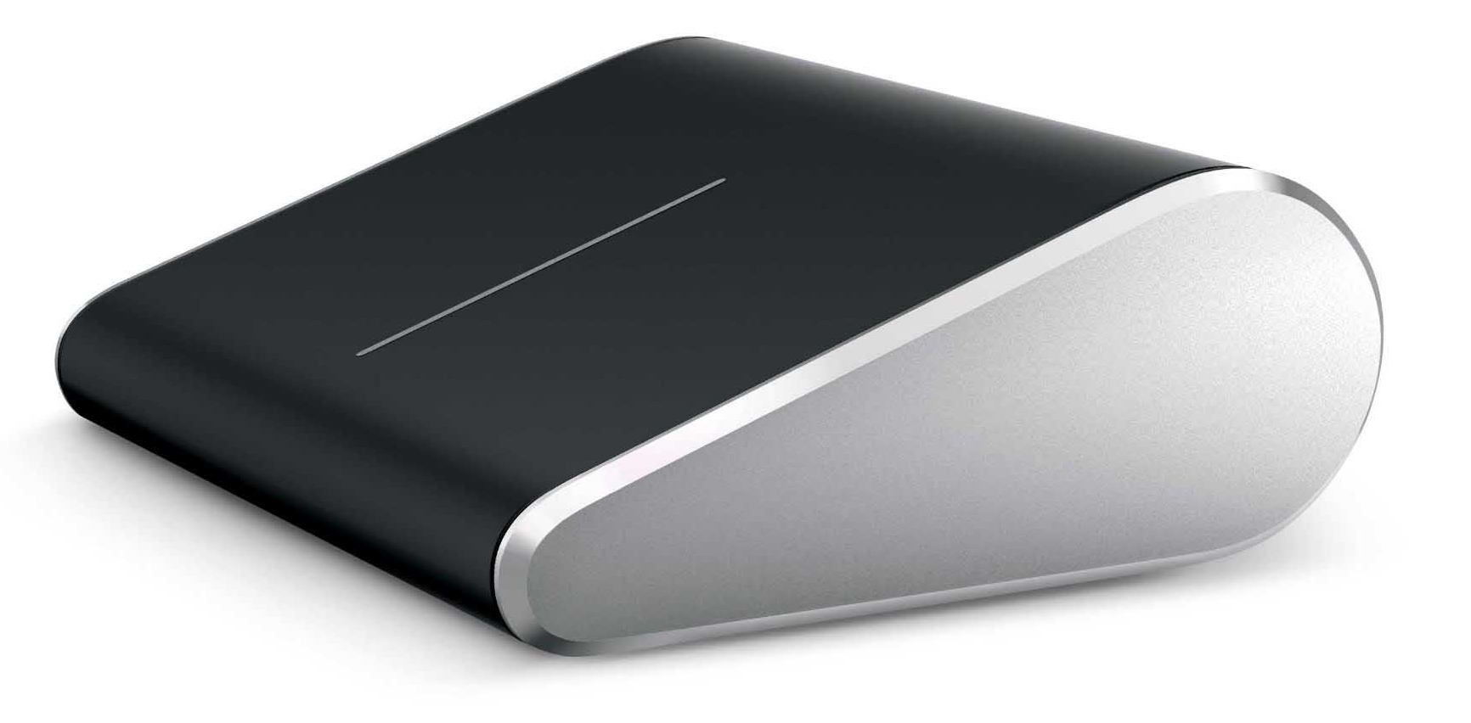
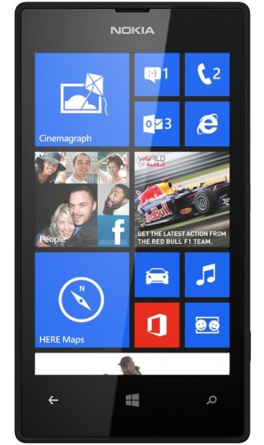
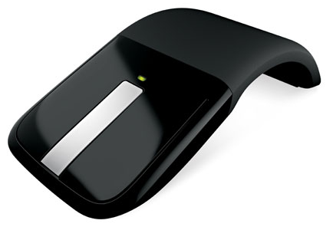
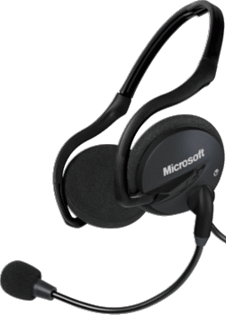
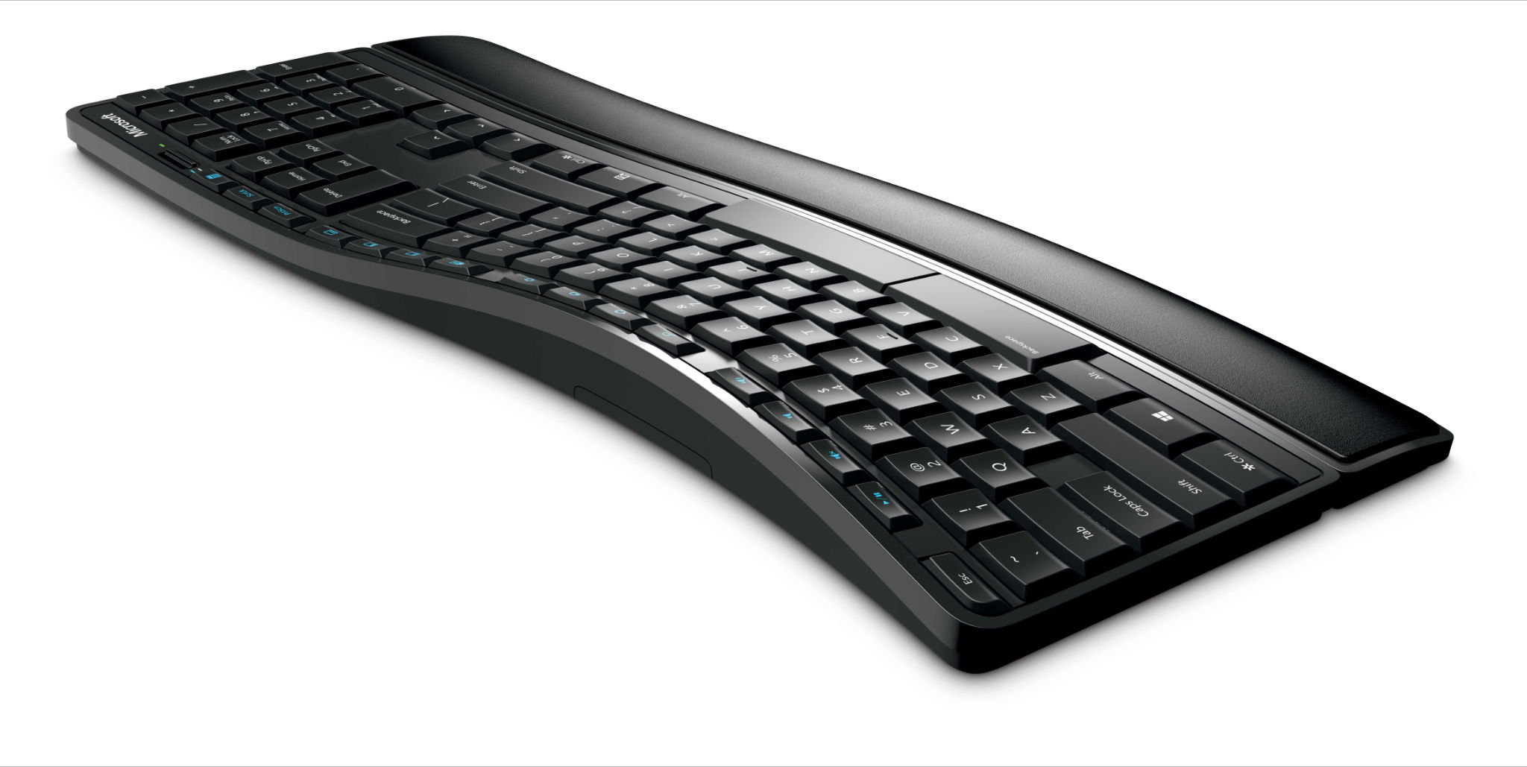
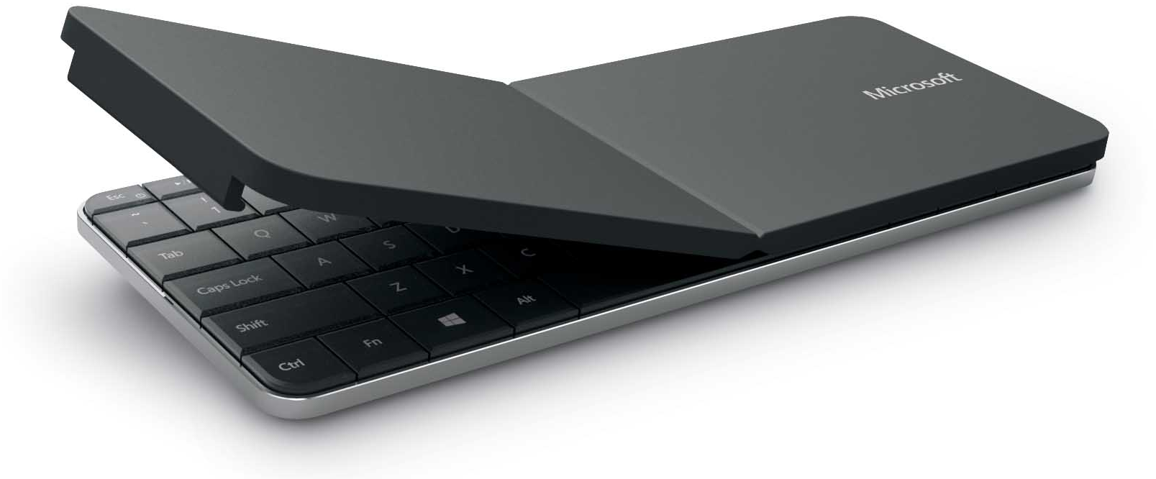
Evaluate this session and you could win instantly!
Head to...
aka.ms/te

Slide 12

© 2013 Microsoft Corporation. All rights reserved.
Microsoft, Windows and other product names are or may be registered trademarks and/or trademarks in the U.S. and/or other countries.
MICROSOFT MAKES NO WARRANTIES, EXPRESS, IMPLIED OR STATUTORY, AS TO THE INFORMATION IN THIS PRESENTATION.

