Slide 1


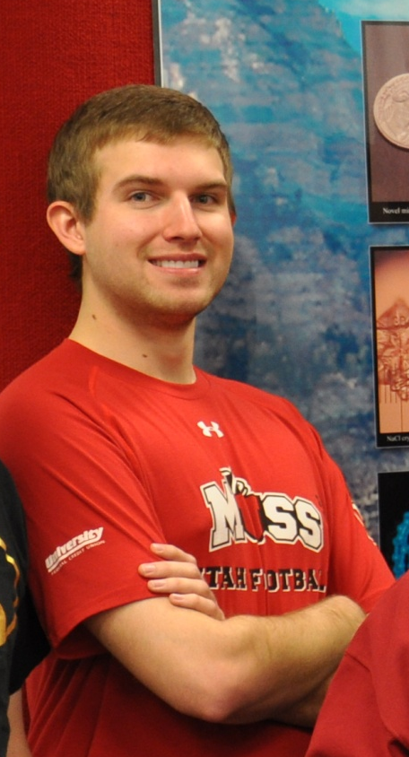
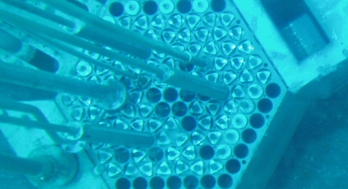
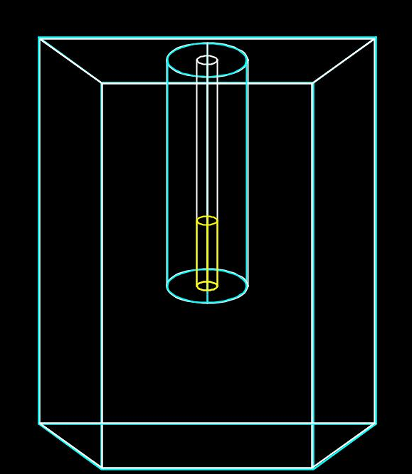
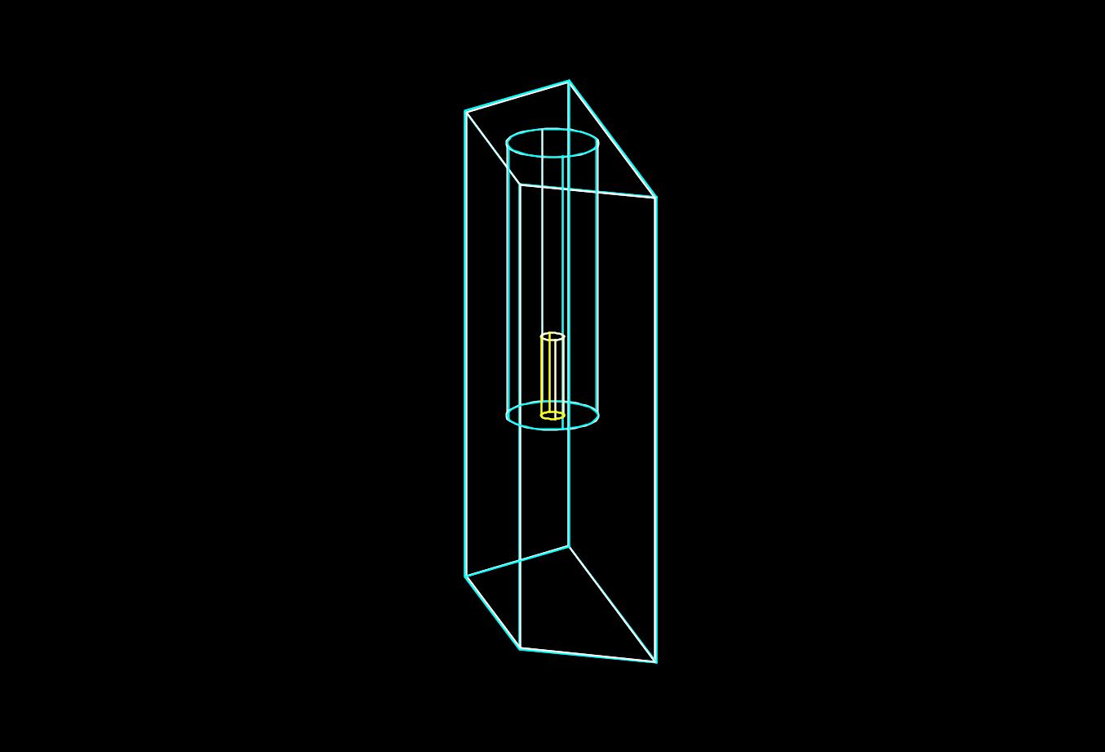
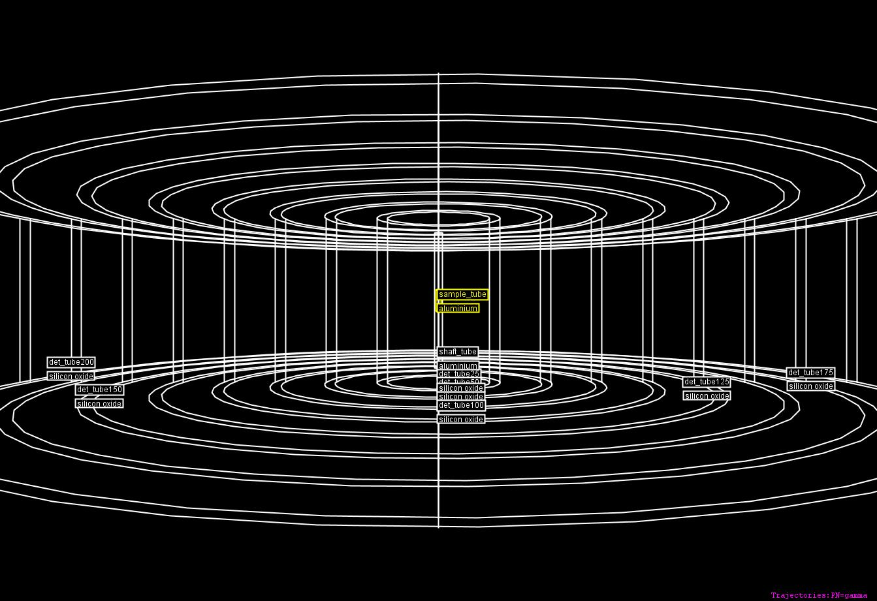
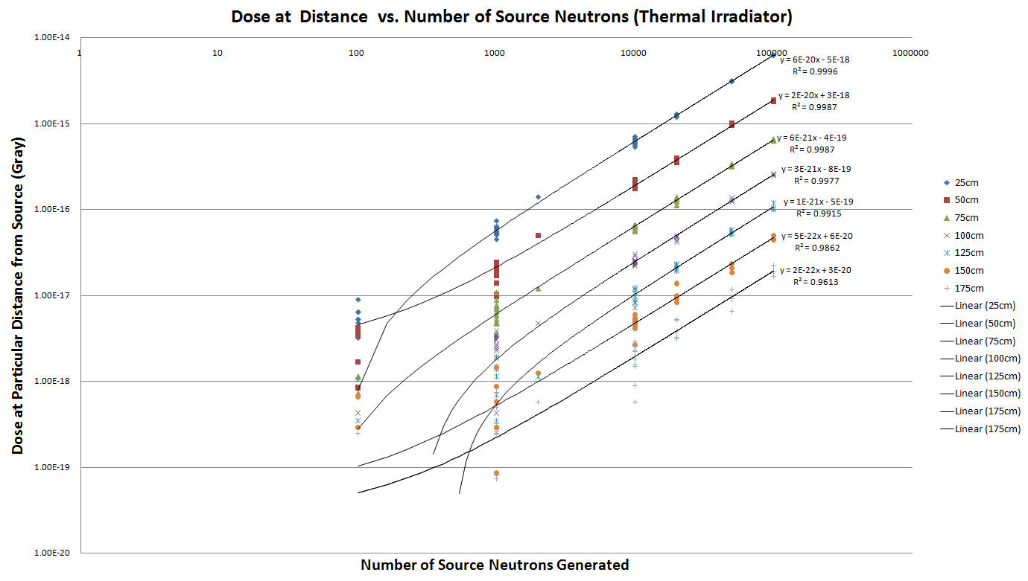
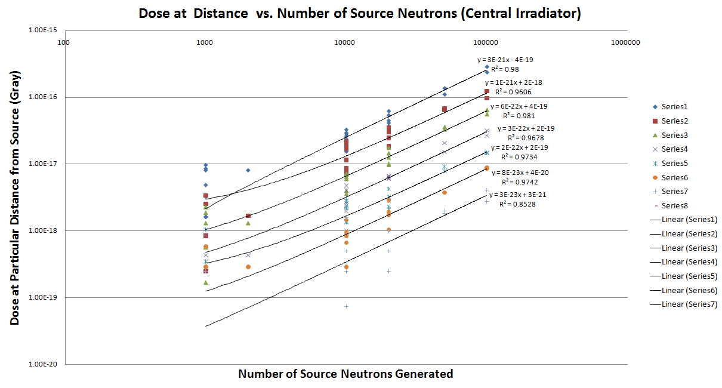
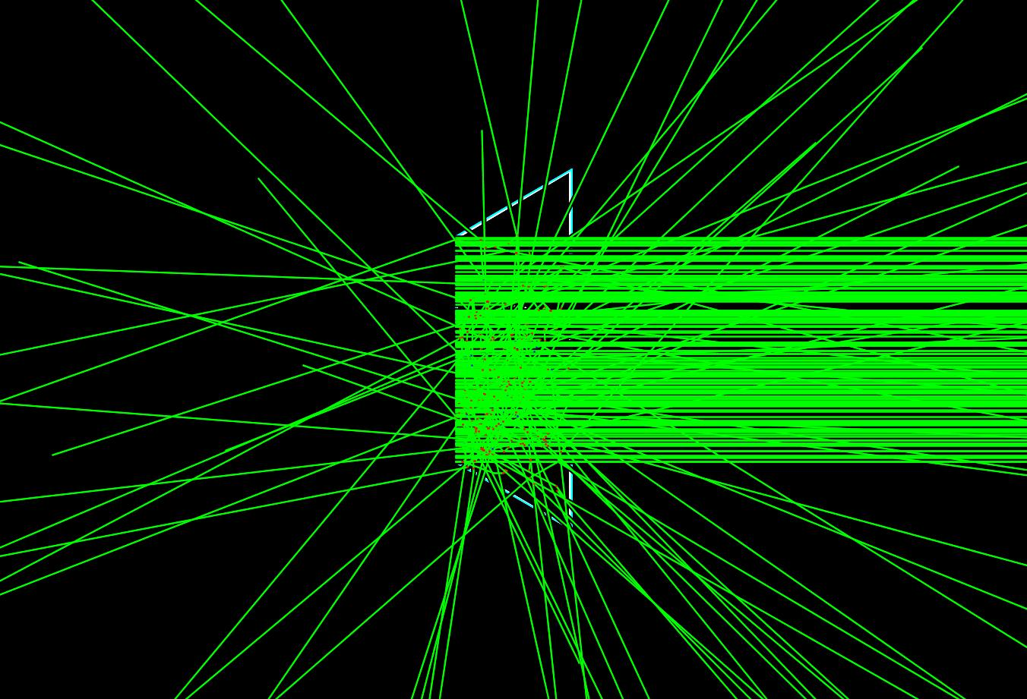
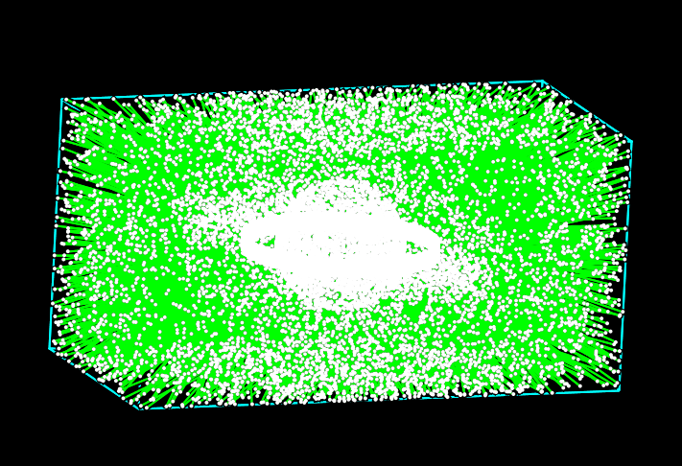
GEANT4 Simulation of Irradiation Facilities and Neutron Sources at University of Utah TRIGA for Nuclear Forensics and Detection
¹Andrew Steven Voyles, ²Haori Yang, and ³Tatjana Jevremovic
Utah Nuclear Engineering Program (UNEP), The University of Utah,
¹Undergraduate student in Nuclear Engineering Minor, ²Assistant Professor, ³Chair Professor and UNEP Director
BACKGROUND
OBJECTIVES
NEUTRON SOURCE DETECTION
Andrew Voyles
Major: Chemical Engineering
Minors: Nuclear Engineering, Chemistry
As a young child, my only wish for my future was to someday be in a history textbook. Now, I have the opportunity to be able to actually succeed in this effort: I want to be able to improve the world through nuclear technologies, and my current dream is to be able to help develop sustainable fusion as a viable power source for the future.
Model UUTR irradiation facilities, using GEANT4 simulation toolkit
Calculate dose from irradiated sample at various distances
Provide method of benchmarking experiments at irradiation facilities
Simulate shielding of neutron source
THEREFORE, create nuclear signatures for nuclear forensics involving UUTR
Detector (Geometries, position, etc.
Program Flow Diagram for Generalized GEANT4 Simulation. Only mandatory user-defined classes noted
Physics Interactions
“******.cc” file
Compile
“********” Executable
Particle Generation
Execute
Particle Stepping
Visualization
Interactive Mode
Batch Mode
File
HepRep
OpenGL
File
University of Utah TRIGA
Screen
HepRApp rendered model of GEANT4 neutron source. Innermost shell (white) is paraffin shell, next outer shell (yellow) is lead shell, next outer shell (purple) is sensitive gamma and neutron detector. The neutron source is approximated as a point source.
GEANT4 MODELS
GEANT4 DOSE CALCULATIONS
HepRApp-rendered model of thermal TRIGA irradiator facility
Air shaft nested at the center shaft of heavy water.
Shafts embedded in aluminum trapezoidal prism filled with heavy water.
Sample is subjected to a planar flux of 3.6 *10¹¹ ^{neutrons}/_{cm^2*sec}
HepRApp-rendered model of central TRIGA irradiator facility
1”-diameter, 5”-tall aluminum cylinder in the center of aluminum air shaft
Subjected to a homogeneous cylindrical flux of 3.9 *10¹² ^{neutrons} /_{cm^2*sec}.
MCNP5 used to simulate geometry, to calculate neutron flux-per-source-particle, to calculate the number of neutrons necessary to be generated in order to simulate a desired flux.
Same concentric tube detector assembly for thermal model shown
Dose plot for the thermal TRIGA irradiator model, as a function of distance from the source, for 0.154 μs irradiation time
Dose plot for the central UUTR irradiator model, as a function of distance from the source, for 0.0141 μs irradiation time
Top-down view of GEANT4 neutron source model for 6.700 · 10⁶ neutrons /cm² *sec, with particle tracks. Green rays indicate neutron and gamma tracks; red tracks indicate negatively-charged particles; blue tracks indicate positively-charged particles; white points mark stepping points for particles.
Note how vast majority of neutrons and gammas are contained within the paraffin shell, and nearly all within lead shell.
GEANT4 PARTICLE MODELS
Dose Estimates
Neutron Flux (^{neutrons} /_{cm^2*sec}) | Thickness of Paraffin Shell (cm) | Thickness of Lead Shell (cm) | Absorbed dose at 30 cm (^{mrem}/_{hr})
6.700 · 10⁶ | 15 | 15 | 0.00183
3.350 · 10⁶ | 15 | 15 | 0.00091
1.675 · 10⁶ | 15 | 15 | 0.00046
At 25cm from sample, absorbed dose for 0.154 μs irradiation time of aluminum sample from thermal irradiator is 5.995 · 10⁻¹⁵ Gray
For 2 hour irradiation time common for NAA, this equals a dose rate of 0.139 ^{Sv}/_{hr} = 1.39 · 10⁴ ^{mrem}/_{hr}
At University of Utah TRIGA, Area Radiation Monitors SCRAM reactor for detection of > 10 ^{mrem}/_{hr} dose rates
In this case, samples are suspended at half depth in reactor pool to cool until < 10 ^{mrem}/_{hr}
For 1 ^{mrem}/_{hr} < dose rates < 10 ^{mrem}/_{hr} , samples are cooled inside 4”-thick lead box until < 1 ^{mrem}/_{hr}
Samples < 1 ^{mrem}/_{hr} are deemed safe
GEANT4 simulation of thermal irradiator planar flux irradiation of aluminum sample. Green rays indicate neutron tracks; red tracks indicate negatively-charged particles; blue tracks indicate positively-charged particles; white points mark stepping points for particles.
GEANT4 simulation of central irradiator cylindrical flux irradiation of aluminum sample. Green rays indicate neutron tracks; red tracks indicate negatively-charged particles; blue tracks indicate positively-charged particles; white points mark stepping points for particles.

