Slide 1
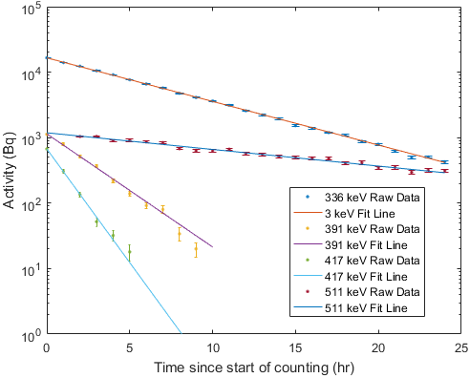
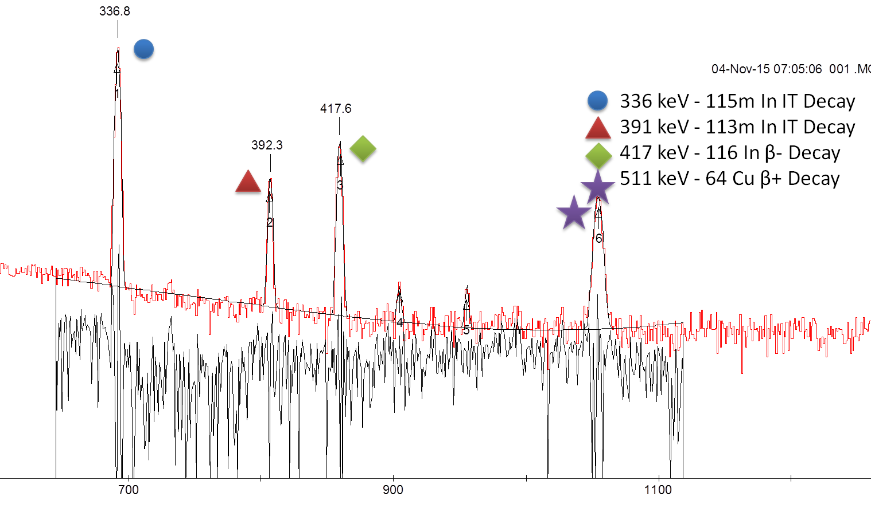
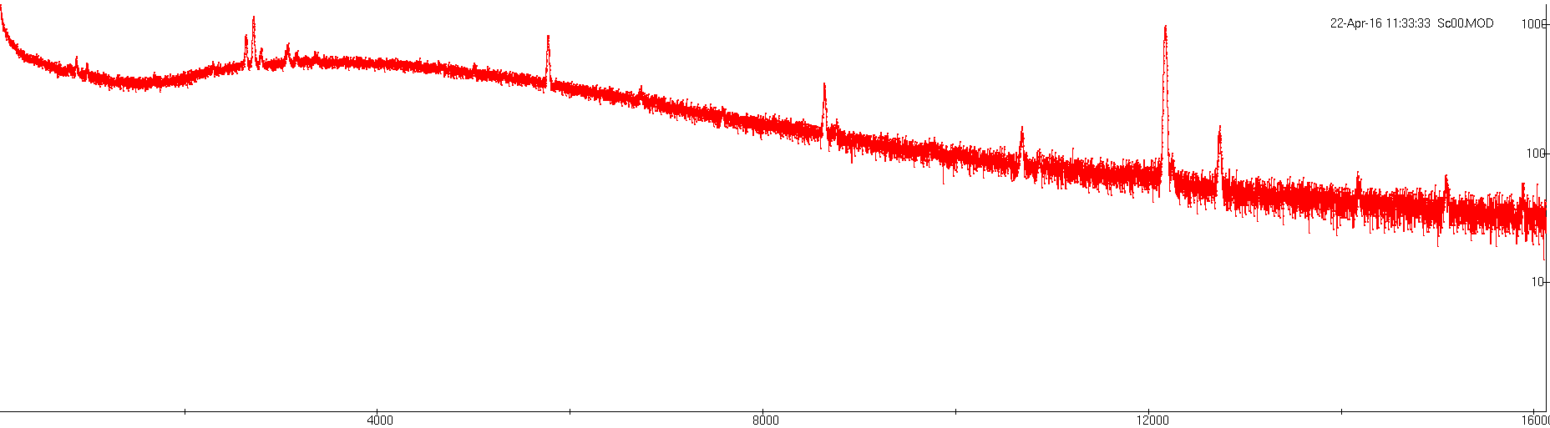

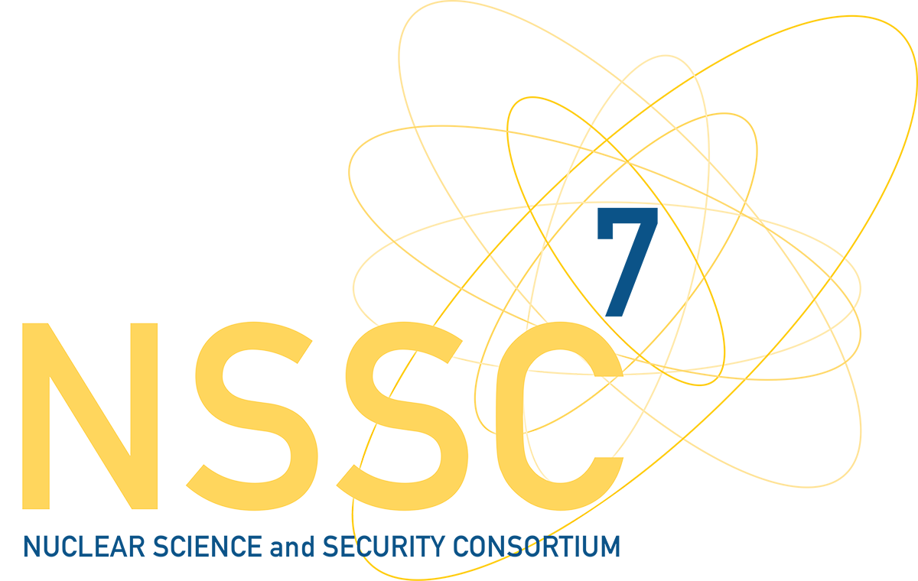
Neutron Cross-Sections for Medical Radionuclide Production
Principal Investigator: Lee Bernstein
Supporting Investigators: Andrew Voyles
Abstract
A series of experiments are being conducted at UC Berkeley to measure low-energy neutron-induced production cross sections for a range of emerging medical radioisotopes. One potential method for producing these isotopes is the use of the (n,p) reaction at compact D-D neutron generators. However, these cross sections currently have significant uncertainties. Direct neutron activation, using a 2.45-MeV D-D neutron generator, allows for more precise cross section measurements than time-of-flight methods, and potentially offers a proliferation-resistant pathway for radioisotope production.
Goals, Objectives, and Deliverables
Goal: To improve existing nuclear data capabilities by expanding cross section libraries for neutron-induced production reactions.
Objective: Measure production cross sections for emerging medical isotopes and radiochemical tracers, via neutron activation. Decay spectroscopy will provide reaction cross sections with lower uncertainty than time-of-flight measurements.
Deliverable: Improved low-energy production cross sections for neutron-induced reactions. Cross section measurements improve the fidelity of reaction modeling codes, used for estimating nuclear data when empirical data is unavailable.
Results/Technical Challenges
(n,p) production cross sections have successfully been measured to within 7% uncertainty for ⁶⁴Cu and ⁴⁷Sc.
Planned Accomplishments
Continue measurements of neutron-induced production cross sections for emerging medical radioisotopes.
Expand production cross section measurements to charged-particle induced reactions.
Development of an intense, variable quasi-monoenergetic neutron source capability, to expand cross section measurements to higher energies.
Research Team
________________________________
________________________________
________________________________
________________________________
________________________________
________________________________
________________________________
Principal Investigator Contact Information:
Dr. Lee Bernstein
Lawrence Livermore National Laboratory; University of California, Berkeley
bernstein2@llnl.gov
(510) 486-4951
Supporting Investigators:
Andrew Voyles
• NSSC–Consortium for Nuclear Security
Notes

