Slide 1


GEANT4 Simulation of Irradiation Facilities and Neutron Sources at University of Utah TRIGA for Nuclear Forensics and Detection
ANDREW VOYLES
University of Utah Nuclear Engineering Program:
Advanced Radiation Simulation Laboratory
Presented at 2nd National Conference in Advancing Tools and Solutions for Nuclear Material Detection
Salt Lake City, UT, 2 May 2011

Slide 2
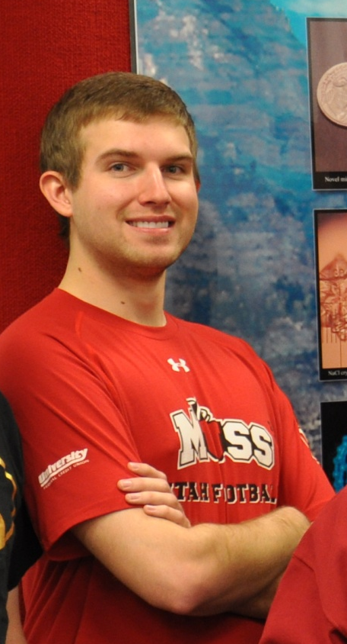
Andrew Voyles
Major: Chemical Engineering
Minors: Nuclear Engineering, Chemistry
As a young child, my only wish for
my future was to someday be in a history
textbook. Now, I have the opportunity to be able to actually succeed in this effort:
I want to be able to improve the world through nuclear technologies,
and my current dream is to be able to help develop sustainable fusion as a viable power source for the future.

Slide 3
Goals for Project:
Model UUTR irradiation facilities and neutron sources, using GEANT4 simulation toolkit
Calculate dose from irradiated samples at various distances
Provide method of benchmarking experiments at irradiation facilities
Simulate shielding of neutron source
THEREFORE, create nuclear signatures for nuclear forensics involving UUTR

Slide 4
GEANT4 (GEometry ANd Tracking)
“Toolkit for the simulation of the passage of particles through matter” (http://geant4.cern.ch)
Developed at CERN for studying particle interactions
Utilizes Monte Carlo methods for simulations
Freely distributed open source code
Written in C++
All Object-Oriented Programming concepts are utilizable
Application areas include:
High energy physics
Nuclear experiments
Nuclear medicine studies
Particle accelerator studies
Space physics studies

Slide 5
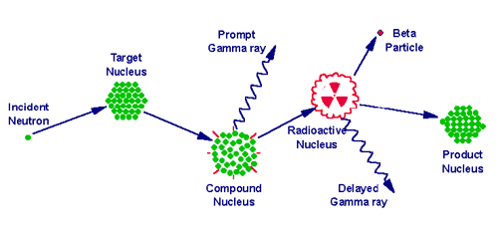
Neutron Activation Analysis
Nondestructive method to find
Sample composition and concentrations
Sample is exposed to neutrons
Becomes activated
Isotopes decay to become more stable
Decay emission paths used to determine the composition of the sample
Sample
Plastic Vial
Sample Mass
Irradiation
HV Power Supply
Nuclide Identification
Gamma Acquisition & Analysis
PC
HPGE Crystal

Slide 6
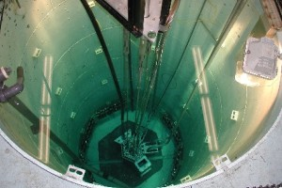
University of Utah TRIGA
GEANT4 –
Modeling of TRIGA Central Irradiation Facility

Slide 7
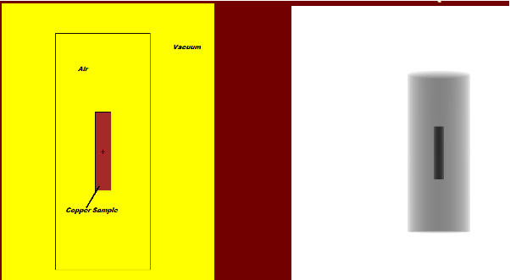
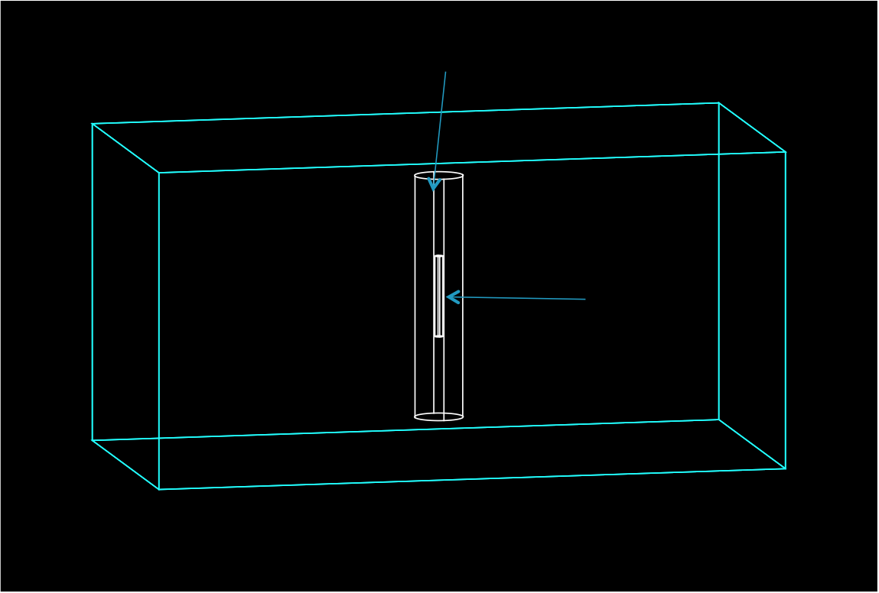
MCNP5 & GEANT4 Synergism for TRIGA Central Irradiator Model
Air-filled shaft
Sample cylinder
World Volume
To calculate flux-per-source-neutron, for scaling results to actual flux values for TRIGA

Slide 8
MCNP5 to GEANT4 Scaling of Flux
In GEANT4, a homogeneous flux is simulated by selecting massive number of particles
MCNP5 simulation of irradiator used to calculate flux per source particle
Central facility →1.07745 * 10⁻³ ^{neutrons} / _{cm^2 * sec} per particle
Dividing known flux for irradiator by flux per particle yields number of particles necessary for GEANT4 modeling

Slide 9
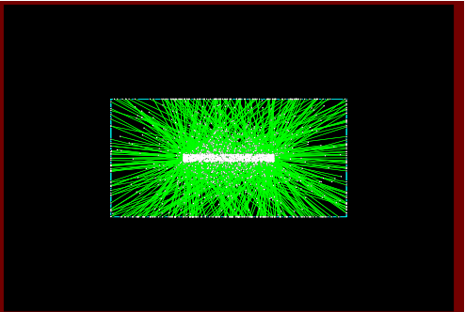
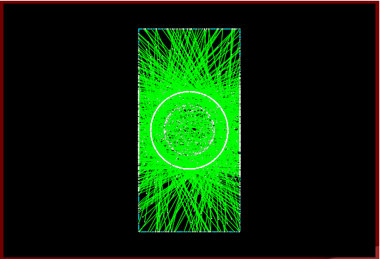
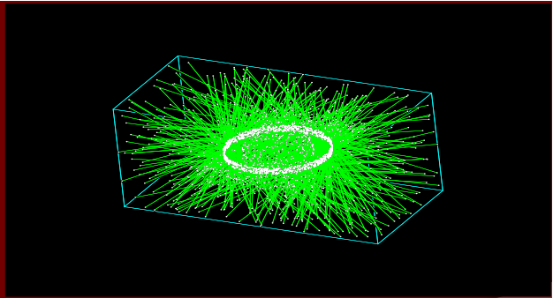
TRIGA Central Irradiator GENAT4 Model
Top view, 1000 neutrons
Side view, 1000 neutrons
Isometric view, 1000 neutrons

Slide 10
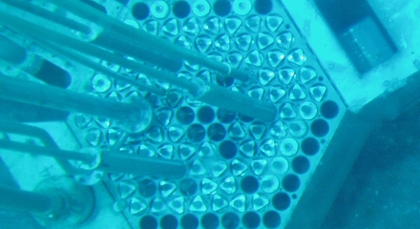
University of Utah TRIGA
GEANT4 –
Modeling of TRIGA Thermal Irradiation Facility

Slide 11
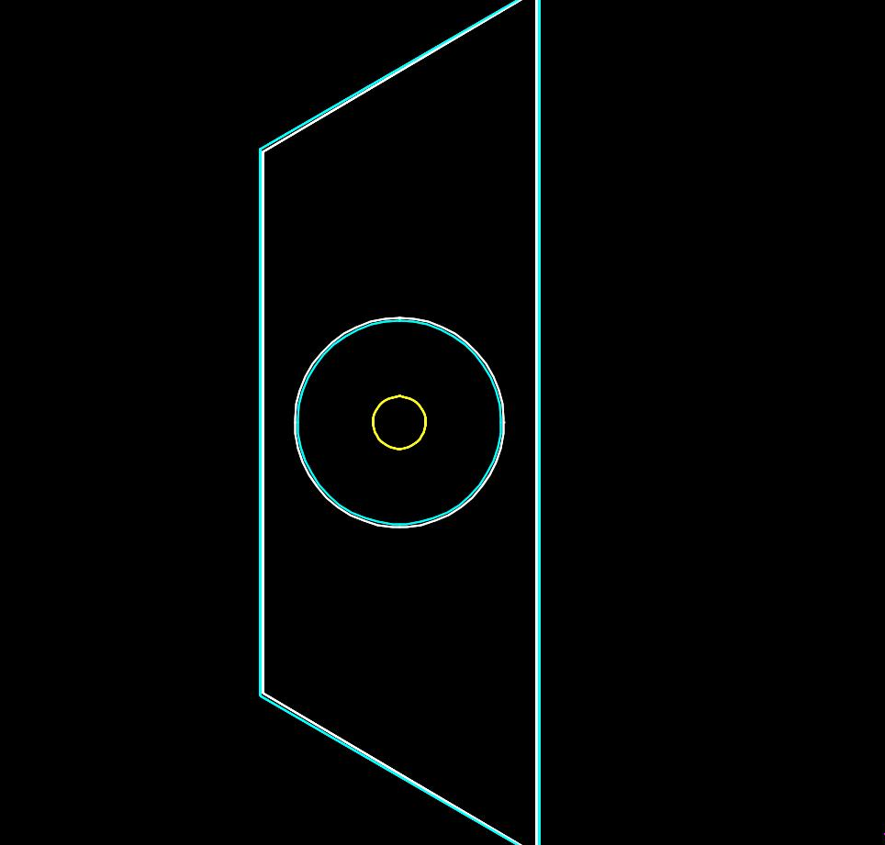
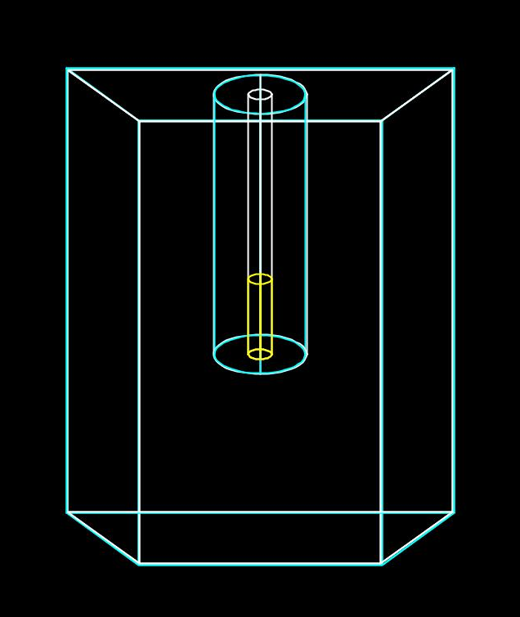
TRIGA Thermal Irradiator Facility - GEANT4 Model
Top view of thermal irradiator facility

Slide 12
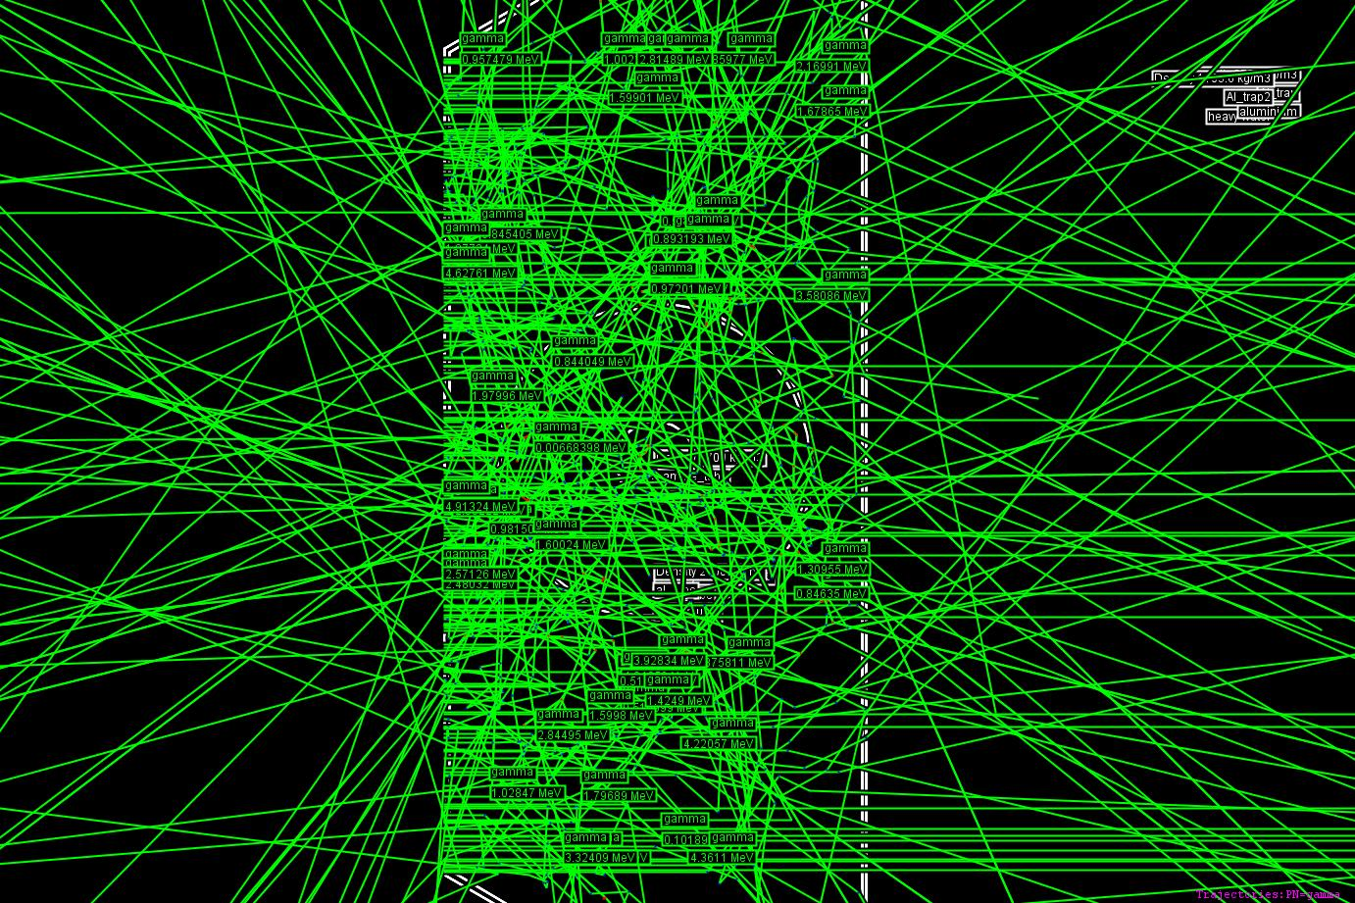
TRIGA Thermal Irradiator Facility - GEANT4 Model Particle Tracks
Achieved planar neutron source

Slide 13
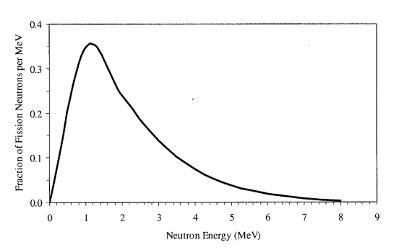
Neutron Energy Distributions in GEANT4 Models for CI and TI in TRIGA
Watt model of thermal fission neutron energy spectrum.
Source: Tatjana Jevremovic, “Nuclear Principles in Engineering”

Slide 14
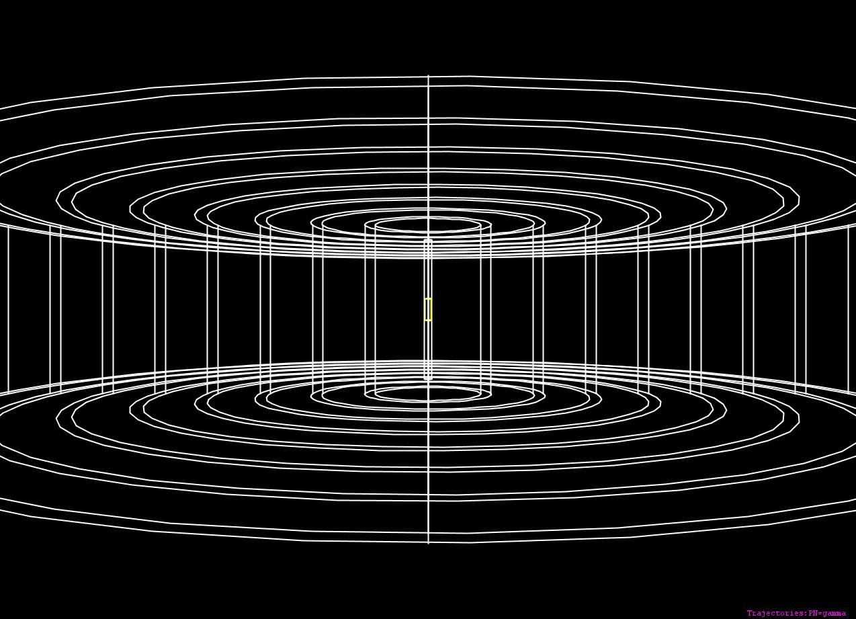
GEANT4 Detectors: Scoring / Dose Deposition
Using sensitive detectors (sensitive to only gammas) to calculate dose deposition at various distances from sample
Set up concentric tube detectors at various distances from center of sample, to calculate dose at various distances
Example detector array, for central irradiator model
Array is same for thermal model, other than geometry of the actual irradiation facility

Slide 15
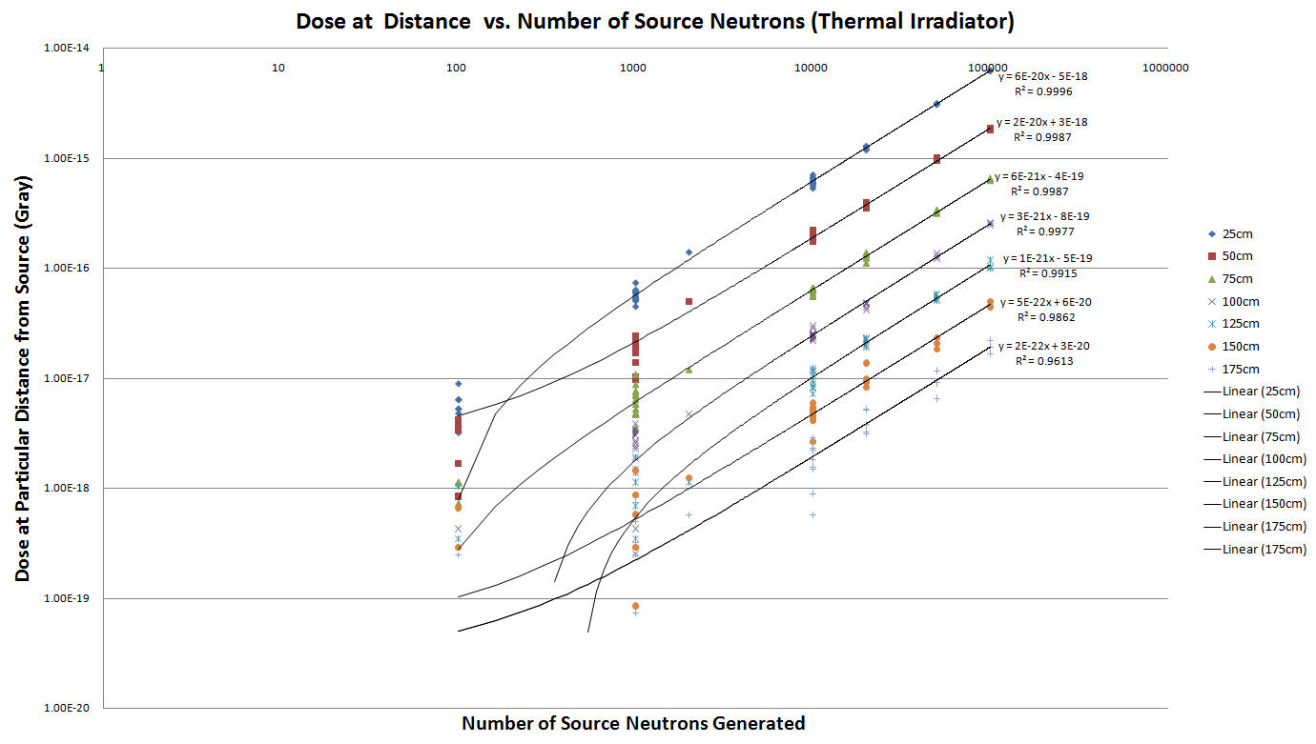

Slide 16
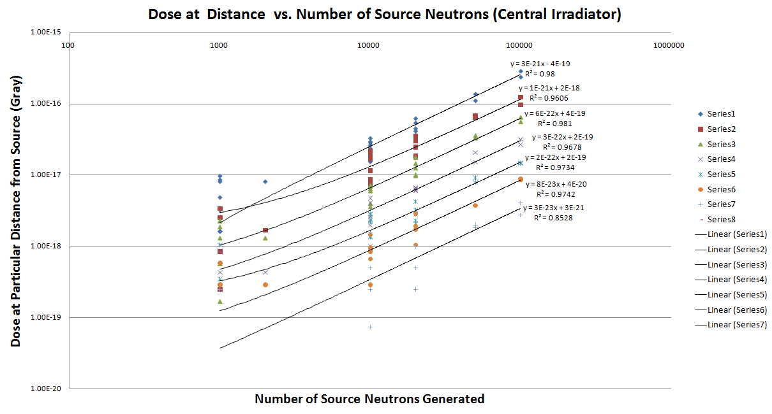

Slide 17
GEANT4 Dose plot for central irradiator
GEANT4 dose plot for thermal irradiator

Slide 18
Example Dose Results
At 25cm from the irradiated sample, absorbed dose for 0.154 μs irradiation time of aluminum sample from thermal irradiator is 5.995 · 10⁻¹⁵ Gray.
For a 2 hour irradiation time common for NAA, this equals a dose rate of 0.139 ^{Sv}/_{hr} = 1.39 · 10⁴ ^{mrem}/_{hr}.
At University of Utah TRIGA, Area Radiation Monitors SCRAM reactor for detection of > 10 ^{mrem}/_{hr} dose rates
In this case, samples are suspended at half depth in reactor pool to cool until < 10 ^{mrem}/_{hr}
For 1 ^{mrem}/_{hr} < dose rates < 10 ^{mrem}/_{hr} , samples are cooled inside 4”-thick lead box until < 1 ^{mrem}/_{hr}
Samples < 1 ^{mrem}/_{hr} are deemed safe

Slide 19
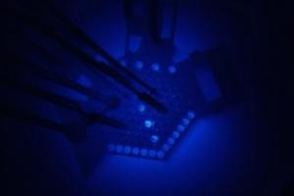
University of Utah TRIGA
GEANT4 –
Shielding Modeling of a Pu-Be Neutron Source

Slide 20
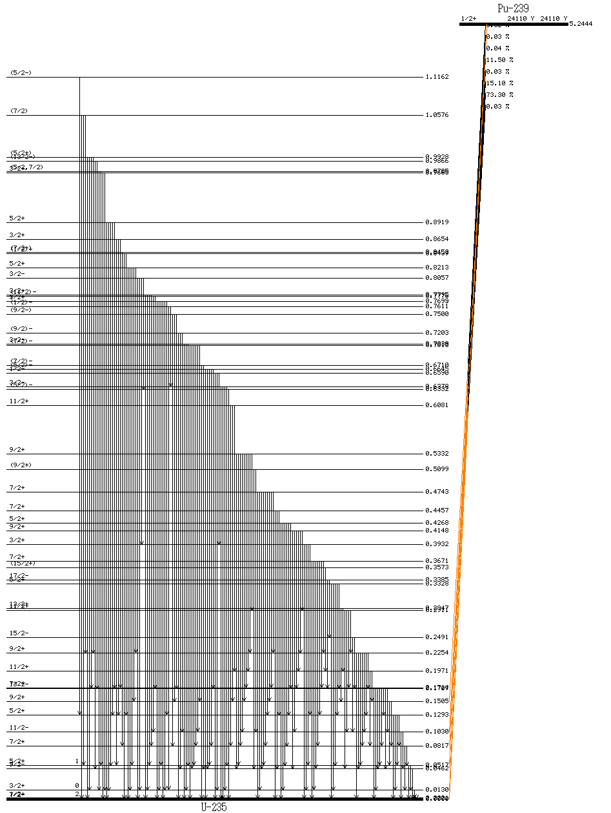
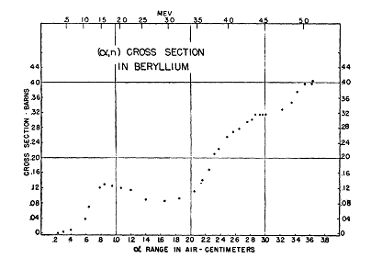
Pu-Be Source
²³⁹Pu → ²³⁵U + α
⁹Be + α → ¹²C + n + γ
Pu-Be neutron source at UNEP exhibits three different neutron flux values:
6.700 · 10^{6 neutrons} / _{cm^2 * sec}
3.350 · 10^{6 neutrons} / _{cm^2 * sec}
1.675 · 10^{6 neutrons} / _{cm^2 * sec}
The simulation is performed for each of these flux values, and the resulting absorbed doses are reported.

Slide 21
GEANT4 Simulation Geometry
HepRApp wireframe rendering of simulation geometry. Innermost shell (white) is paraffin shell, next outer shell (yellow) is lead shell, next outer shell (purple) is sensitive gamma and neutron detector

Slide 22
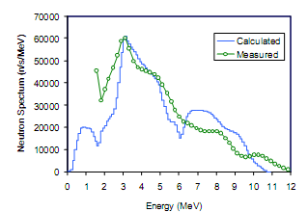
Neutron Energy Distributions
Used monoenergetic 3 MeV neutron source, as per project specifications
Pu-Be neutron energy spectrum
Source: New Neutron Source Algorithms In the ORIGEN-S Code, http://ornl.gov/sci/scale/papers/RPSD2002_Origen_Sources.pdf

Slide 23
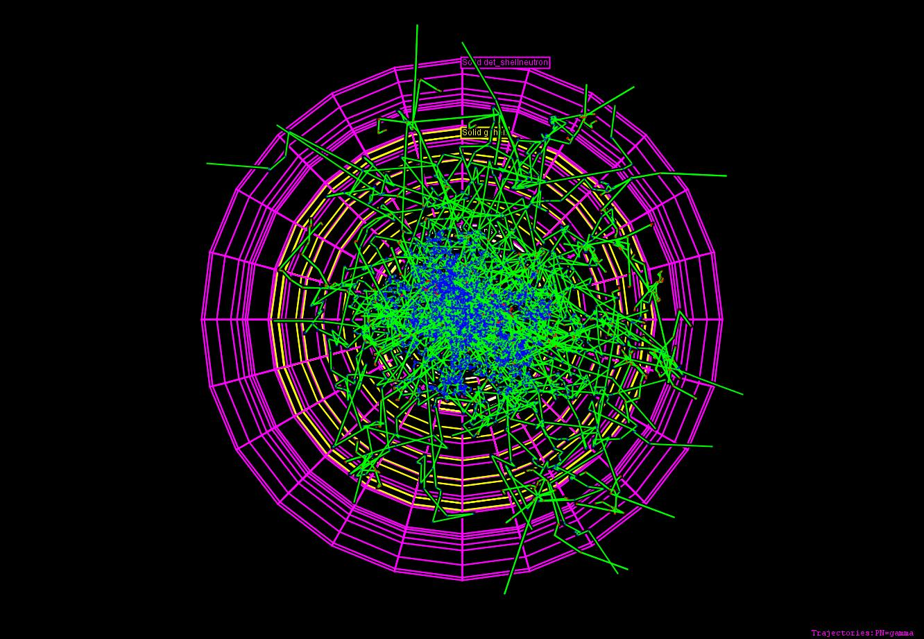
Results
Top-down view of experimental setup for 6.700 · 10^{6 neutrons} / _{cm^2 * sec} , with particle tracks for 10,000 neutrons generated. Red lines indicate negatively-charged particle trajectory, green lines indicate neutrally-charged particle trajectory, blue lines indicate positively-charged particle trajectory, yellow dots indicate the actual step points used by Geant4.
Note how vast majority of neutrons and gammas are contained within the paraffin shell, and nearly all within lead shell.

Slide 24
Results (cont.)

Slide 25
Results (cont.)
Neutron Flux (^{neutrons} / _{cm^2 * sec} ) | Thickness of Paraffin Shell (cm) | Thickness of Lead Shell (cm) | Absorbed dose at 30 cm (^{mrem}/_{hr})
6.700 · 10⁶ | 15 | 15 | 0.00183
3.350 · 10⁶ | 15 | 15 | 0.00091
1.675 · 10⁶ | 15 | 15 | 0.00046
At University of Utah TRIGA, Area Radiation Monitors SCRAM reactor for detection of > 10 ^{mrem}/_{hr} dose rates
In this case, samples are suspended at half depth in reactor pool to cool until < 10 ^{mrem}/_{hr}
For 1 ^{mrem}/_{hr} < dose rates < 10 ^{mrem}/_{hr} , samples are cooled inside 4”-thick lead box until < 1 ^{mrem}/_{hr}
Samples < 1 ^{mrem}/_{hr} are deemed safe

Slide 26
Future Work
Expand the current model to include the fast neutron irradiation facility at Utah TRIGA facility.
Examine and assess assumptions and simplifications made in this first version of the simulation
Will make simulation as realistic and versatile as possible
I intend to accomplish this task this summer, and, ideally, get published when finished.
Implement histograms of gamma energies, to deliver energy spectra of gamma energies
Create nuclear signatures for nuclear forensics
Benchmark simulation results against experimental results
Make this application suitable for export, to provide method of benchmarking experiments at irradiation facilities.

