Slide 1



Andrew Voyles, Haori Yang and Tatjana Jevremovic
University of Utah Nuclear Engineering Program:
Advanced Radiation Simulation Laboratory
Presented at 2011 AIChE Annual Meeting
Minneapolis, MN, 19 October 2011

Slide 2
Goals for Project:
Model UUTR irradiation facilities and neutron sources, using GEANT4 simulation toolkit
Calculate dose from irradiated samples at various distances
Provide method of benchmarking experiments at irradiation facilities
Simulate shielding of neutron source
    THEREFORE, create nuclear signatures for nuclear forensics involving UUTR

Slide 3
GEANT4 (GEometry ANd Tracking)
“Toolkit for the simulation of the passage of particles through matter” (http://geant4.cern.ch)
  Developed at CERN for studying particle interactions
Utilizes Monte Carlo methods for simulations
Freely distributed open source code
Written in C++
  All Object-Oriented Programming concepts are utilizable
Application areas include:
  High energy physics
  Nuclear experiments
  Nuclear medicine studies
  Particle accelerator studies
  Space physics studies

Slide 4
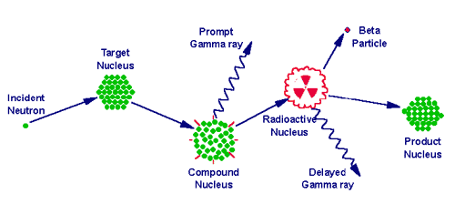









Neutron Activation Analysis
Nondestructive method to find
  Sample composition and concentrations
Sample is exposed to neutrons
  Becomes activated
  Isotopes decay to become more stable
  Decay emission paths used to determine the composition of the sample
Sample
Plastic Vial
Sample Mass
Irradiation
HV Power Supply
Nuclide Identification
Gamma Acquisition & Analysis
PC
HPGe Crystal

Slide 5
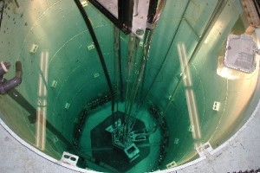
University of Utah TRIGA
GEANT4 –
Modeling of TRIGA Central Irradiation Facility

Slide 6
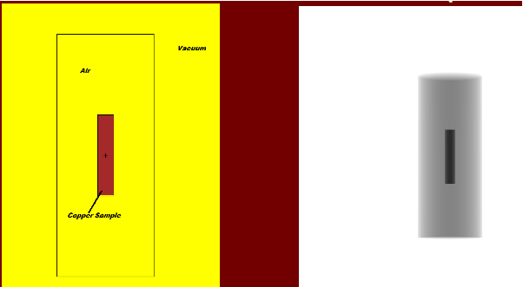

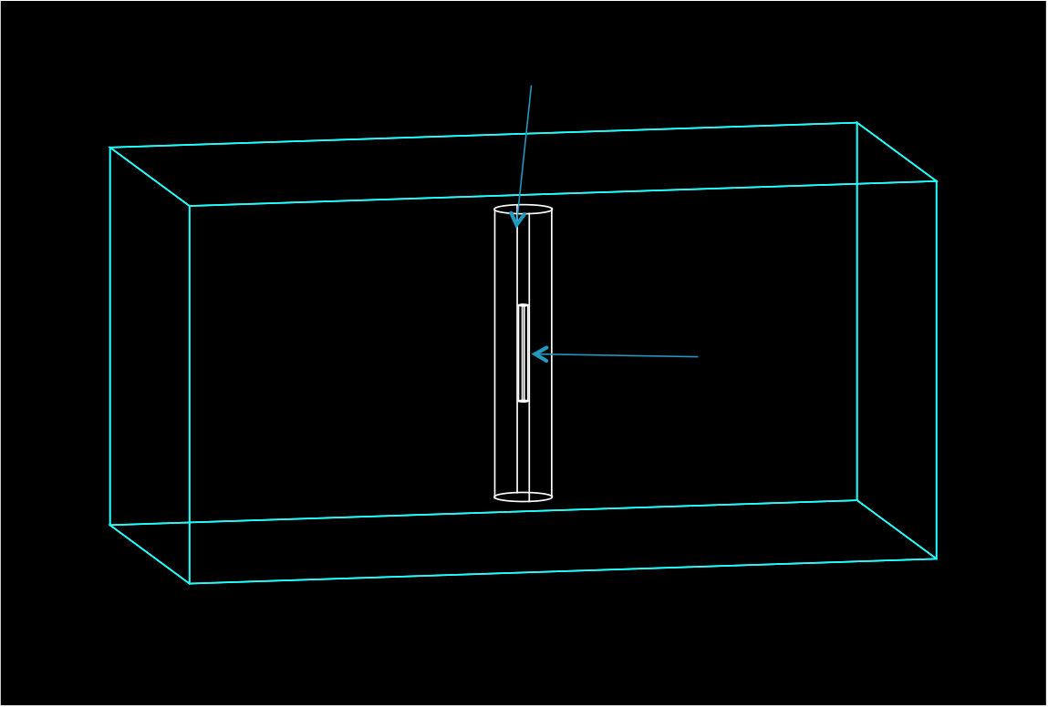

MCNP5 & GEANT4 Synergism for TRIGA Central Irradiator Model
Air-filled shaft
Sample cylinder
World Volume
To calculate flux-per-source-neutron, for scaling results to actual flux values for TRIGA

Slide 7
MCNP5 to GEANT4
Scaling of Flux
In GEANT4, a homogeneous flux is simulated by selecting massive number of particles
MCNP5 simulation of irradiator used to calculate flux per source particle
  Central facility →1.07745 * 10⁻³ ^{neutrons} / _{cm^2 * sec} per particle
  Dividing known flux for irradiator by flux per particle yields number of particles necessary for GEANT4 modeling

Slide 8
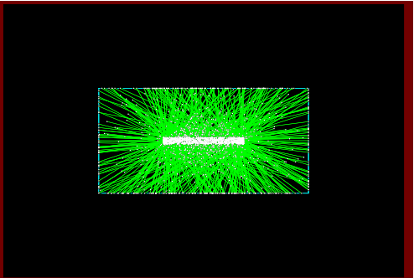
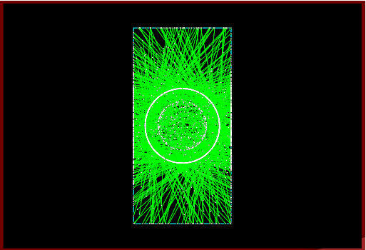
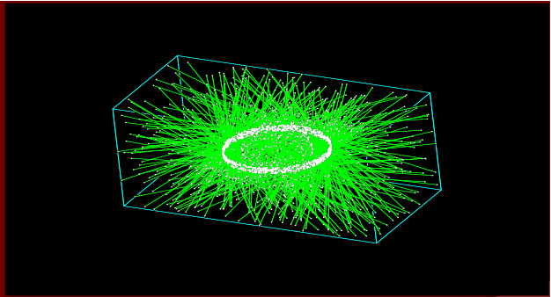
TRIGA Central Irradiator GEANT4 Model
Top view, 1000 neutrons
Side view, 1000 neutrons
Isometric view, 1000 neutrons

Slide 9

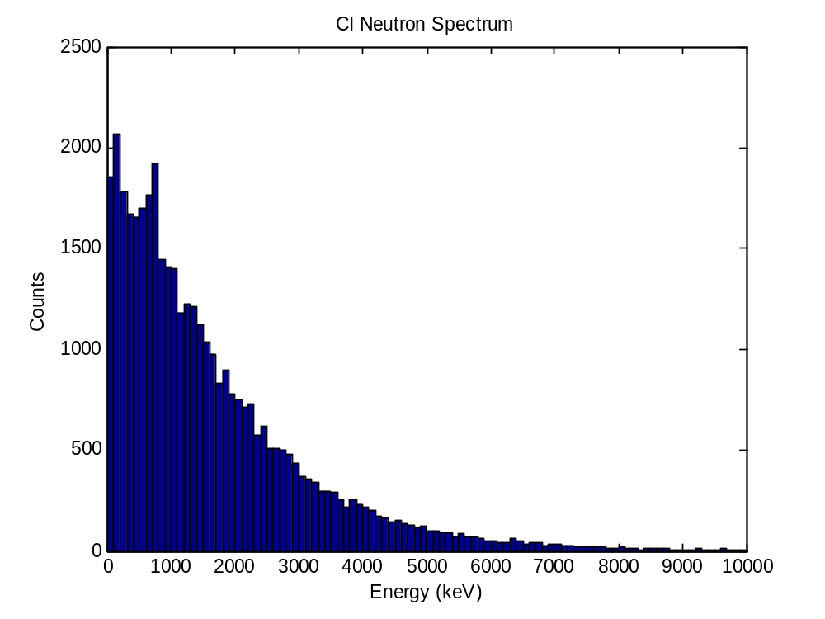
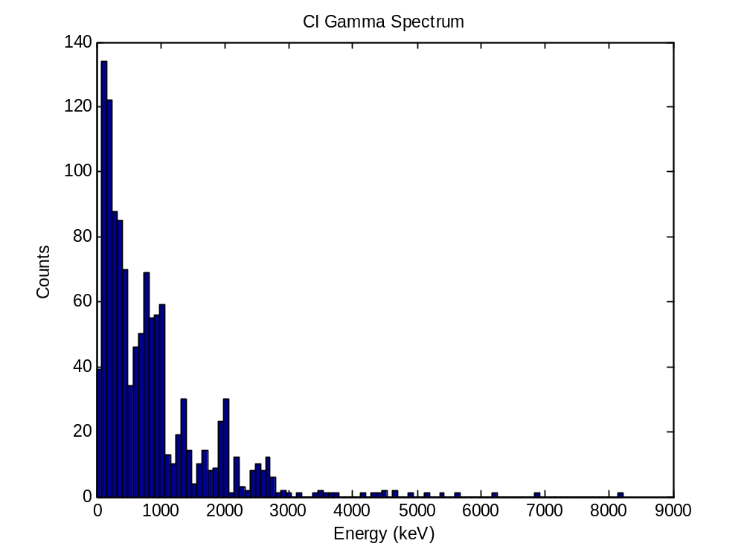
Central Facility Spectra
1”-diameter, 5”-tall aluminum cylinder in the center of aluminum air shaft
Subjected to a homogeneous cylindrical flux of
3.9 *10¹² ^{neutrons} /_{cm^2*sec}.

Slide 10
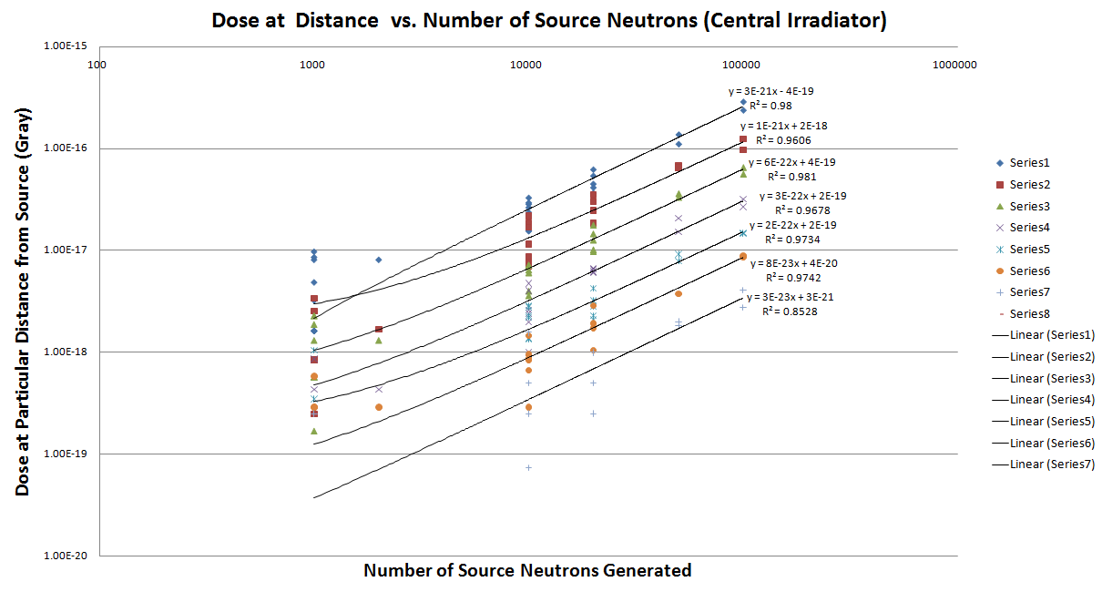
25 cm from source
50 cm from source
75 cm from source
100 cm from source
125 cm from source
150 cm from source
175 cm from source
1”-diameter, 5”-tall aluminum cylinder in the center of aluminum air shaft
Subjected to a homogeneous cylindrical flux of
3.9 *10¹² ^{neutrons} /_{cm^2*sec}.

Slide 11
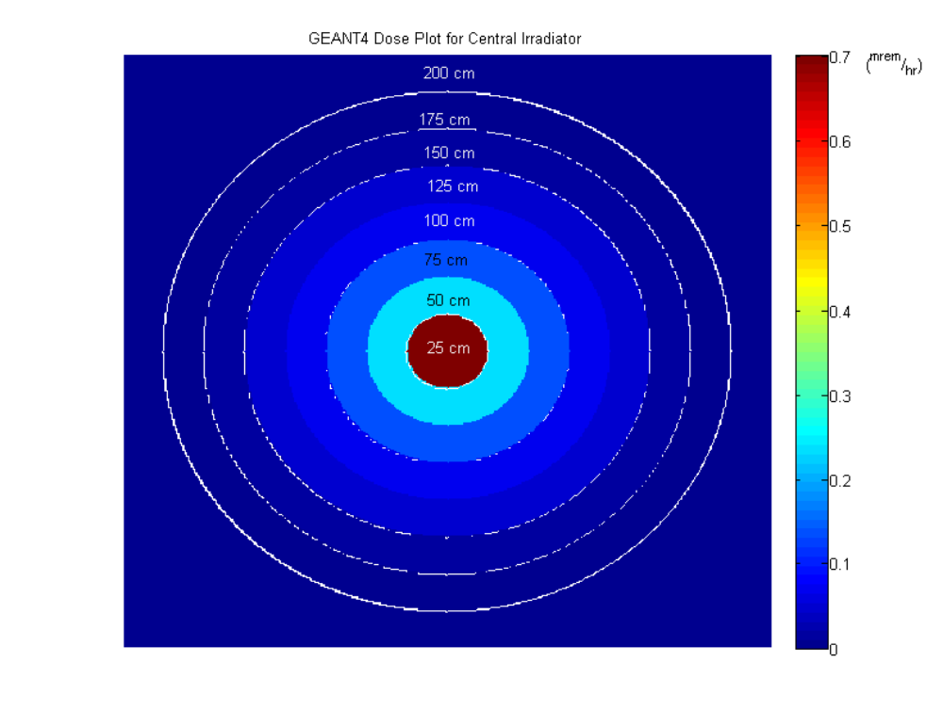
Central Facility Dose Plot
1”-diameter, 5”-tall aluminum cylinder in the center of aluminum air shaft
Subjected to a homogeneous cylindrical flux of
3.9 *10¹² ^{neutrons} /_{cm^2*sec}.
Distances indicate distances from center of source

Slide 12
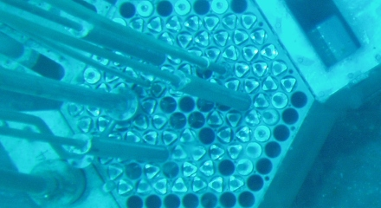
University of Utah TRIGA
GEANT4 –
Modeling of TRIGA Thermal Irradiation Facility

Slide 13
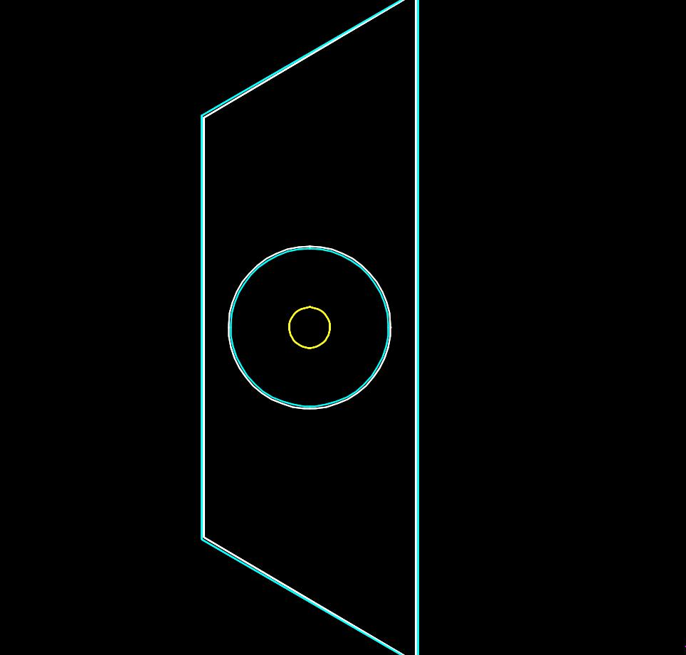
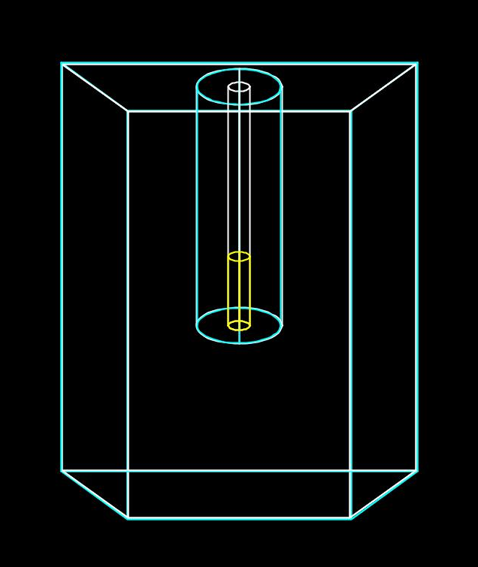
TRIGA Thermal Irradiator Facility - GEANT4 Model
Top view of thermal irradiator facility

Slide 14
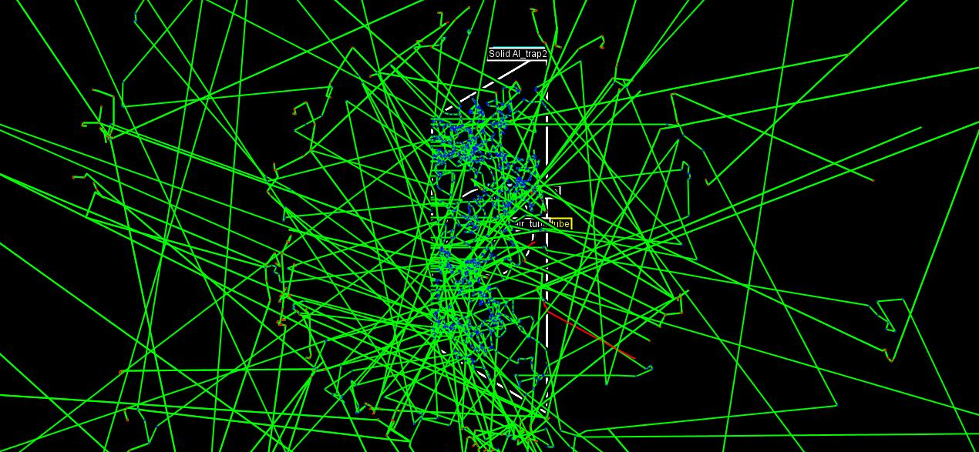
TRIGA Thermal Irradiator Facility - GEANT4 Model
Particle Tracks
Achieved planar neutron source

Slide 15
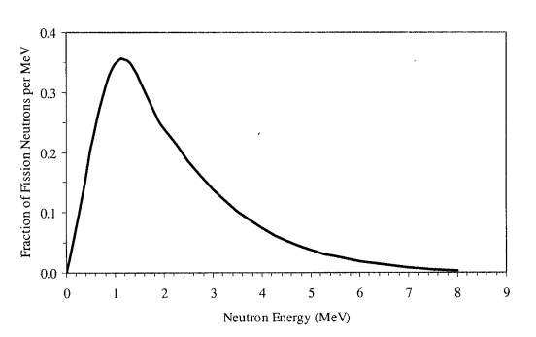
Neutron Energy Distributions in GEANT4
Models for CI and TI in TRIGA
Watt model of thermal fission neutron energy spectrum.
Source: Tatjana Jevremovic, “Nuclear Principles in Engineering”

Slide 16
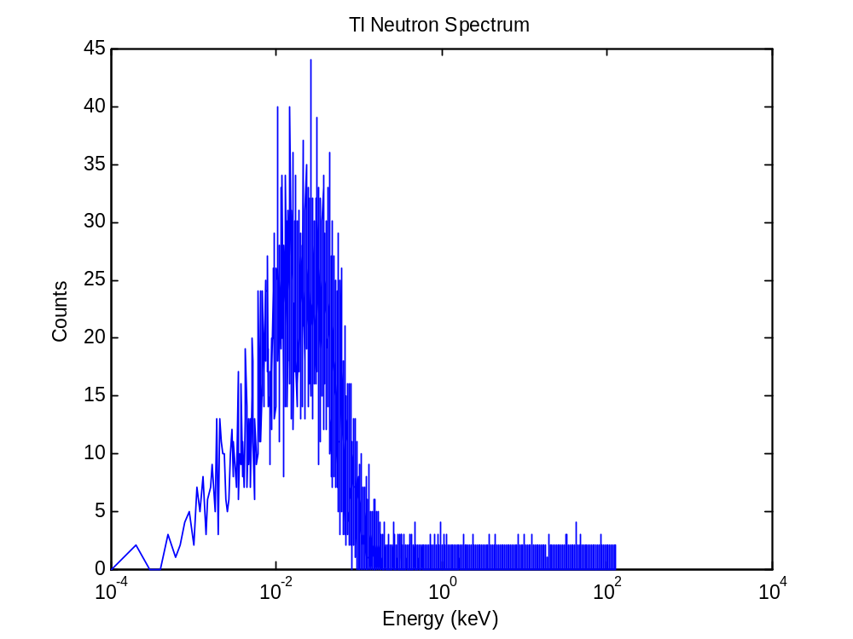
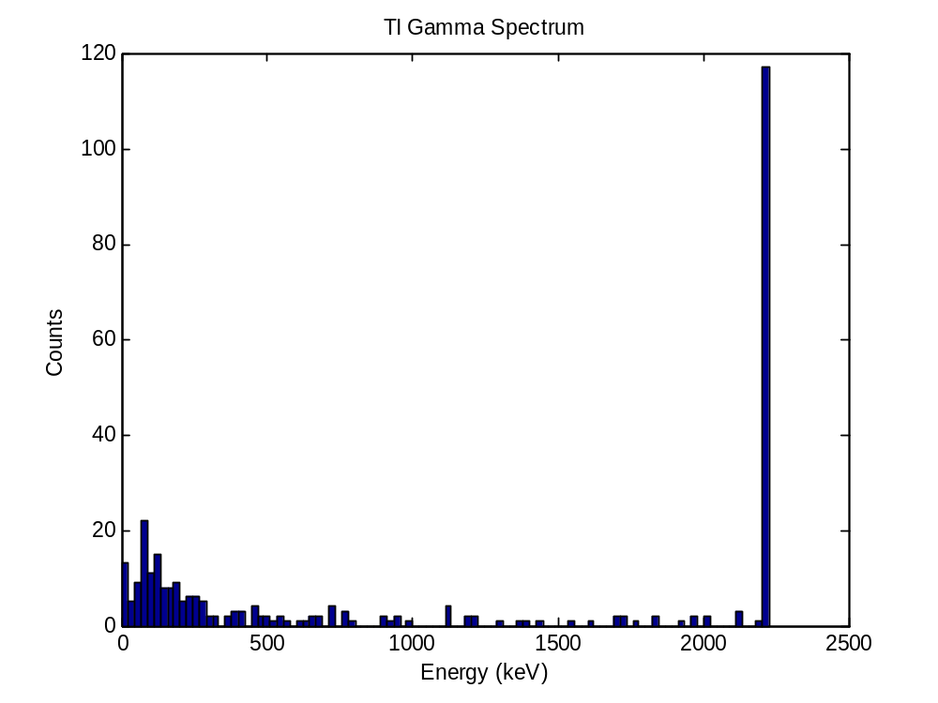
Thermal Facility Spectra
1”-diameter, 5”-tall aluminum cylinder in the center of aluminum air shaft
Subjected to a homogeneous planar flux of
3.6 *10¹¹ ^{neutrons} /_{cm^2*sec}.

Slide 17
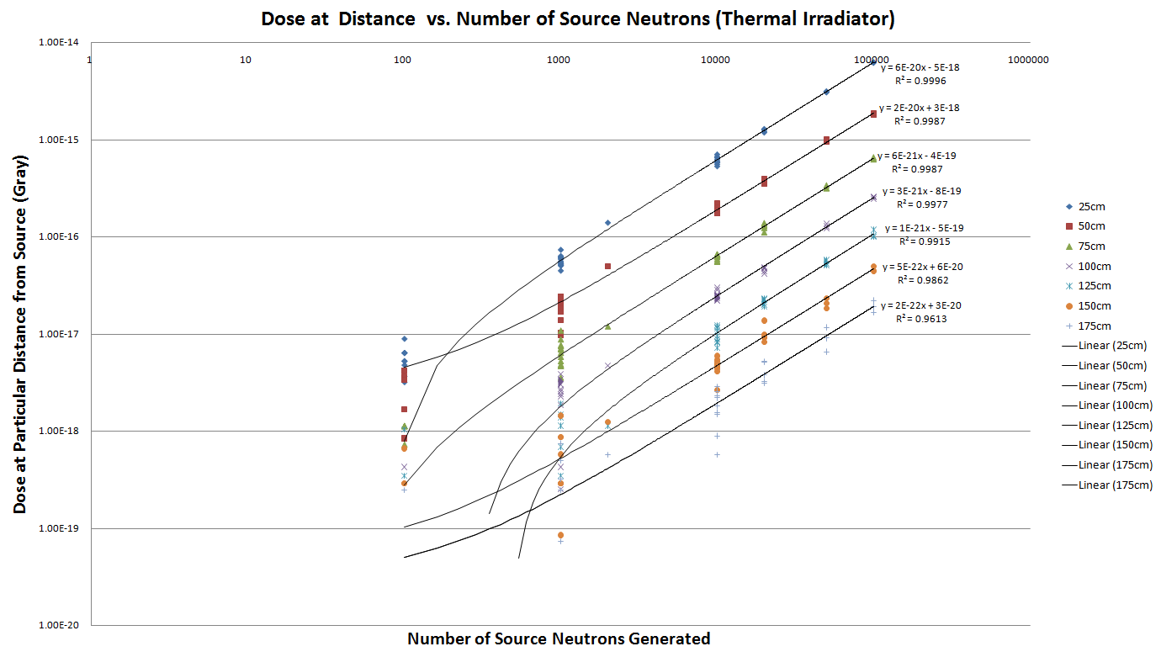
25 cm from source
1”-diameter, 5”-tall aluminum cylinder in the center of aluminum air shaft
Subjected to a homogeneous planar flux of
3.6 *10¹¹ ^{neutrons} /_{cm^2*sec}.
50 cm from source
75 cm from source
100 cm from source
125 cm from source
150 cm from source
175 cm from source

Slide 18
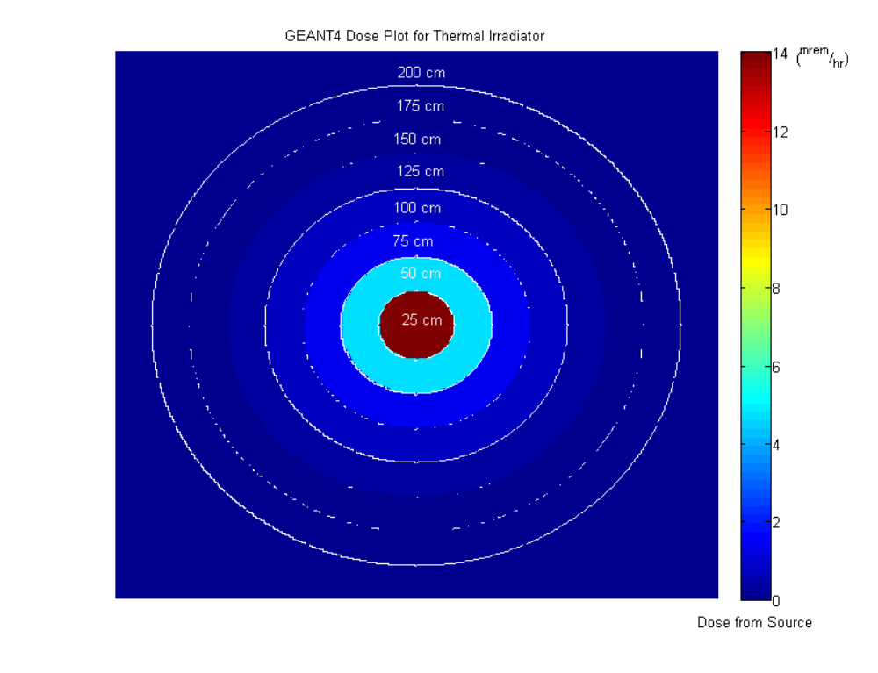
Thermal Facility Dose Plot
1”-diameter, 5”-tall aluminum cylinder in the center of aluminum air shaft
Subjected to a homogeneous planar flux of
3.6 *10¹¹ ^{neutrons} /_{cm^2*sec}.
Distances indicate distances from center of source

Slide 19
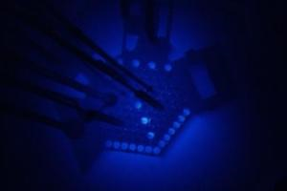
University of Utah TRIGA
GEANT4 –
Modeling of a Shielded and Unshielded Pu-Be Neutron Source

Slide 20
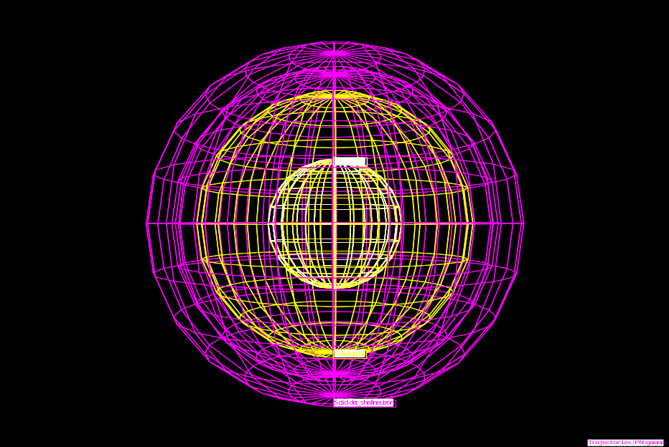
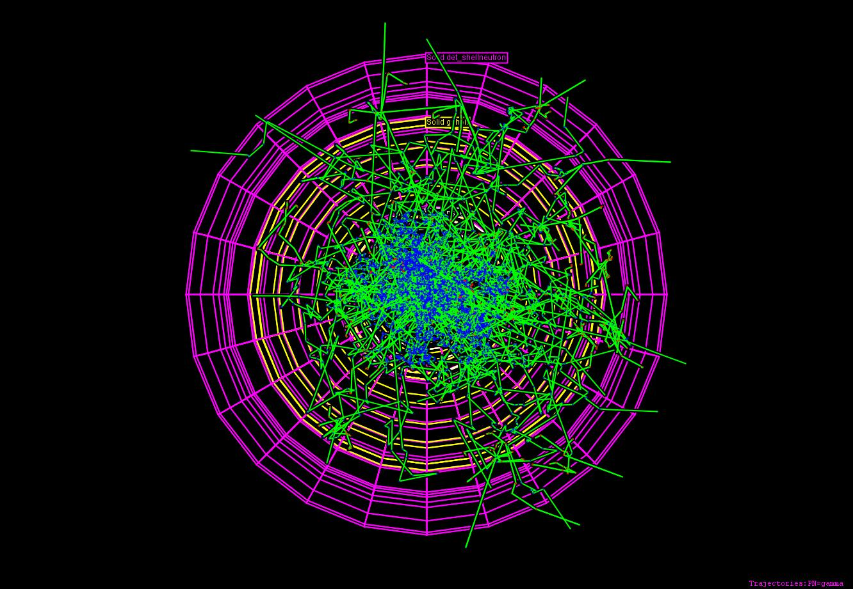
GEANT4 Simulation Geometry
HepRApp wireframe rendering of simulation geometry. Innermost shell (white) is paraffin shell, next outer shell (yellow) is lead shell, next outer shell (purple) is sensitive gamma and neutron detector
Top-down view of experimental setup for 6.700 · 10^{6 neutrons} / _{cm^2 * sec} , with particle tracks for 10,000 neutrons generated. Red lines indicate negatively-charged particle trajectory, green lines indicate neutrally-charged particle trajectory, blue lines indicate positively-charged particle trajectory, yellow dots indicate the actual step points used by Geant4.
Note how vast majority of neutrons and gammas are contained within the paraffin shell, and nearly all within lead shell.

Slide 21
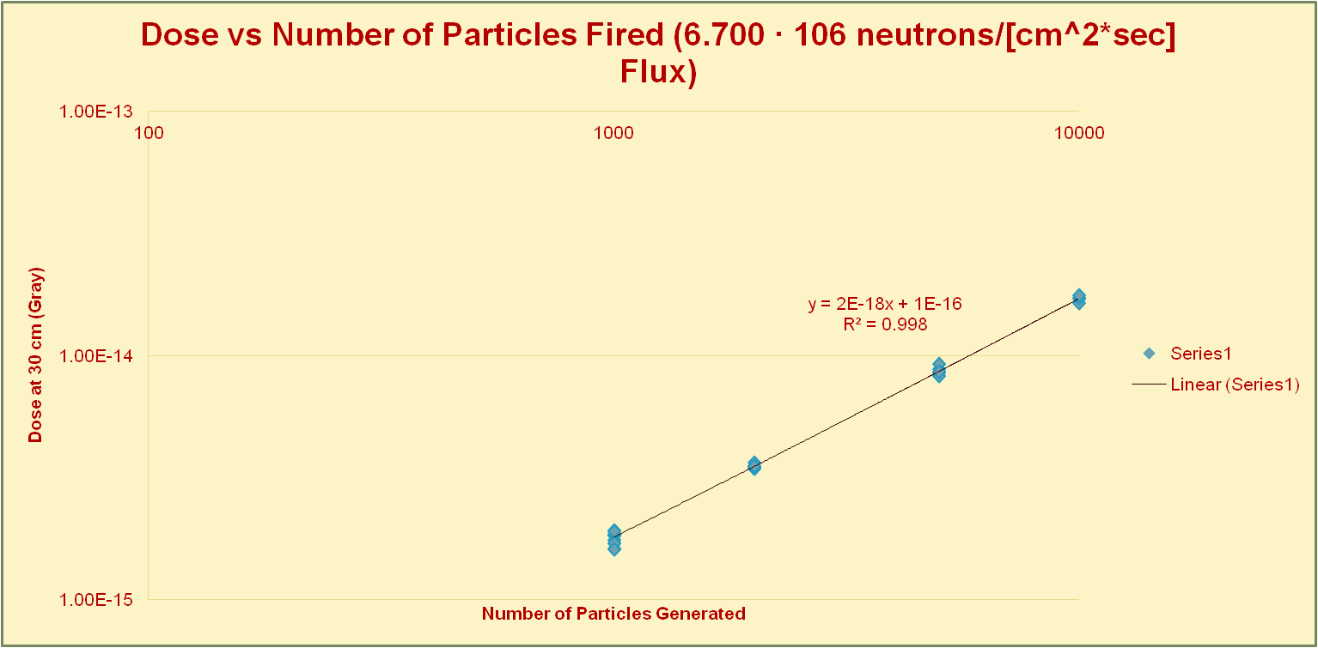
Results (Shielded Source Model)

Slide 22
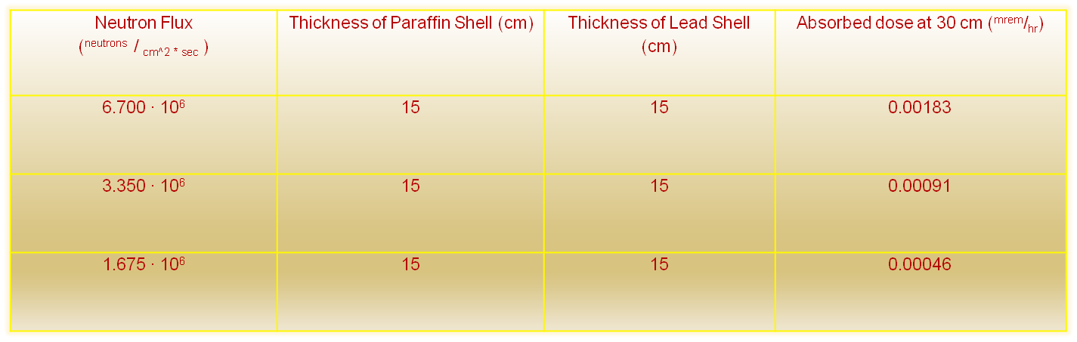
Results (Shielded Source Model) (cont.)
At University of Utah TRIGA, Area Radiation Monitors SCRAM reactor for detection of > 10 ^{mrem}/_{hr} dose rates
  In this case, samples are suspended at half depth in reactor pool to cool until < 10 ^{mrem}/_{hr}
  For 1 ^{mrem}/_{hr} < dose rates < 10 ^{mrem}/_{hr} , samples are cooled inside 4”-thick lead box until < 1 ^{mrem}/_{hr}
  Samples < 1 ^{mrem}/_{hr} are deemed safe

Slide 23
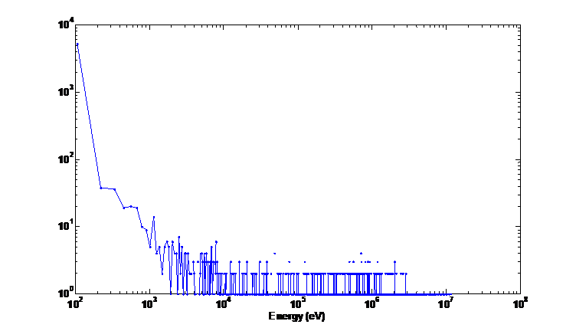
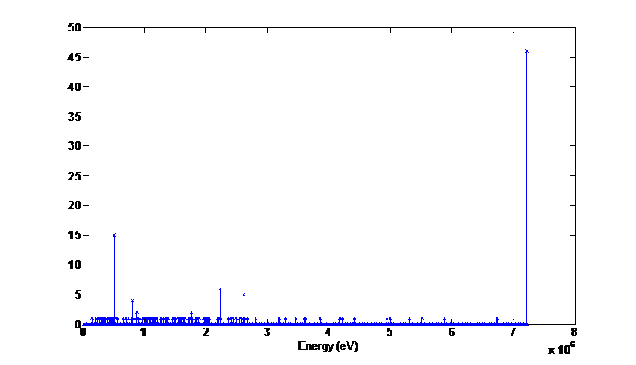
Shielded Pu-Be Source Spectra
Shielded Pu-Be Neutron Energy Spectrum
Shielded Pu-Be Gamma Energy Spectrum
Counts
Counts

Slide 24
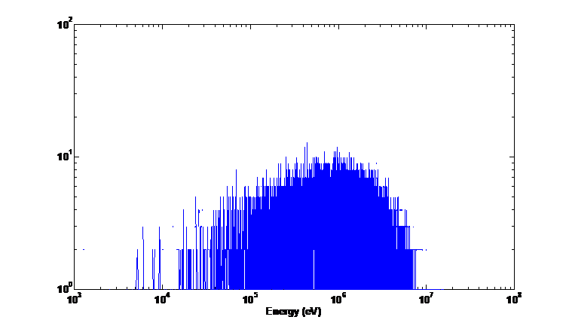
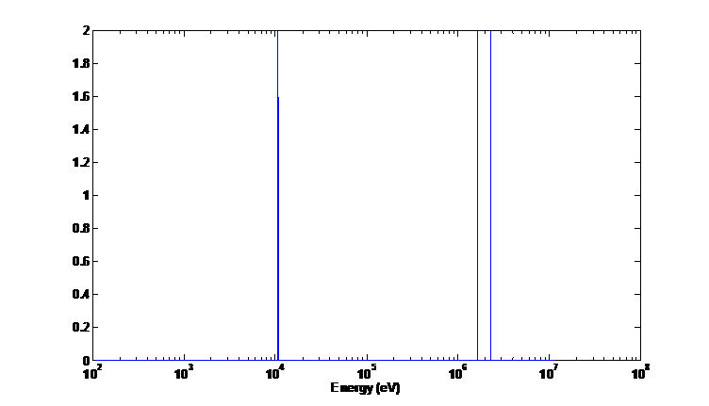
Unshielded Pu-Be Source Spectra
Unshielded Pu-Be Neutron Energy Spectrum
Unshielded Pu-Be Gamma Energy Spectrum
Counts
Counts

Slide 25
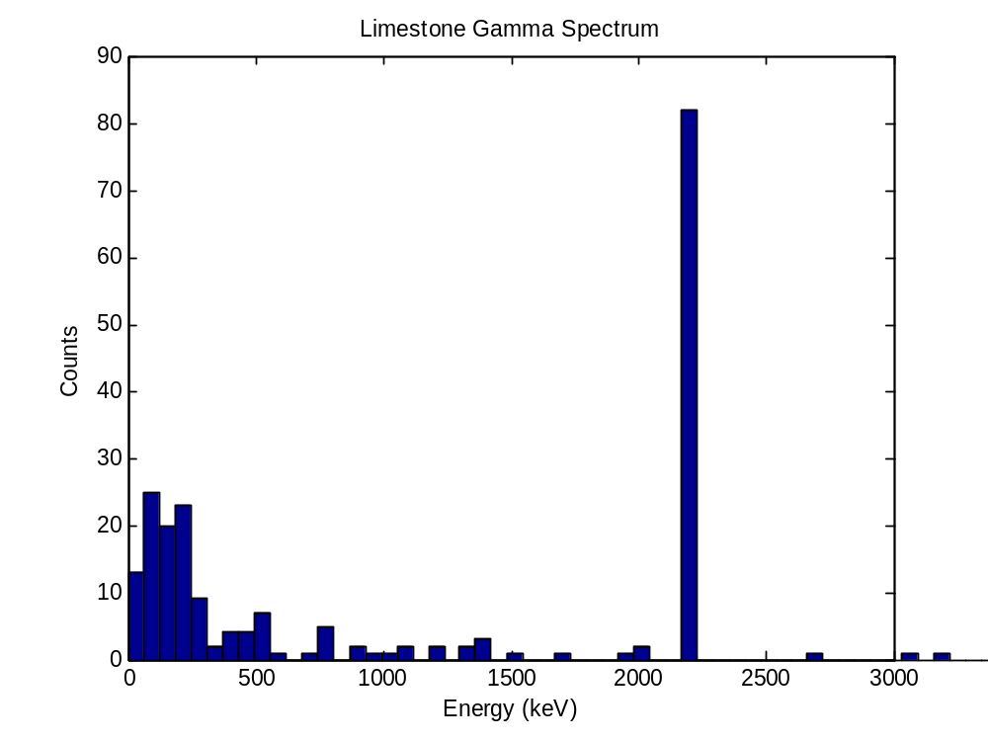
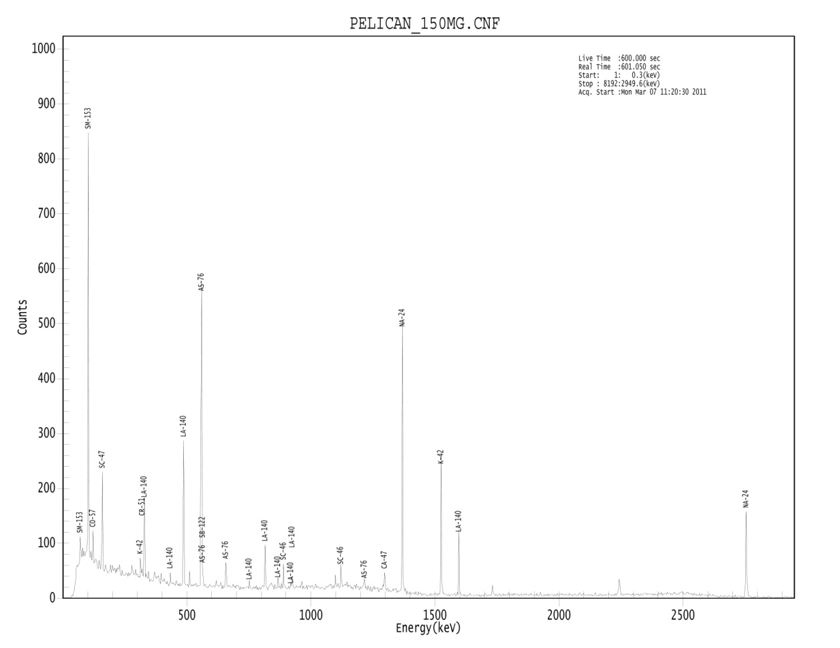
Limestone Sample Benchmarking

Slide 26
Future Work
Expand the current model to include the fast neutron irradiation facility at Utah TRIGA facility.
Examine and assess assumptions and simplifications made in this first version of the simulation
  Will make simulation as realistic and versatile as possible
Continue benchmarking simulation results against experimental results
  Make this application suitable for export, to provide method of benchmarking experiments at irradiation facilities.
  We are still in the process of generating signatures, as no other facilities have these yet.

