Slide 1
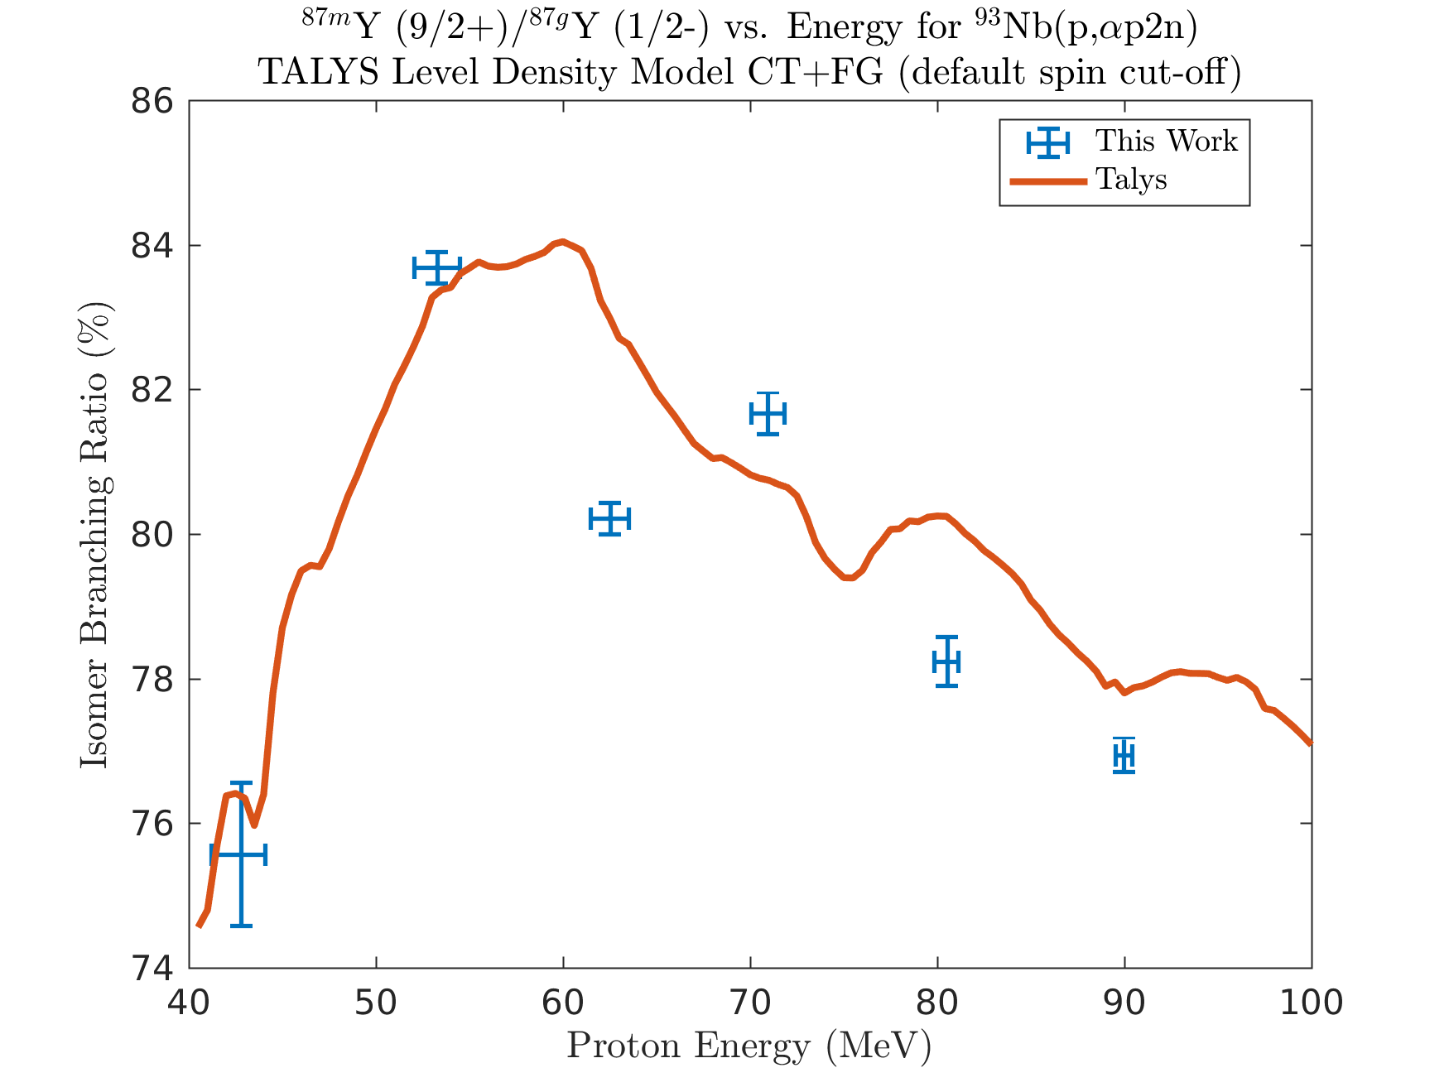
The USNDP is addressing the need for moderate-energy proton dosimetry standards
^{nat}Nb(p,x)⁹⁰Mo is a desirable dosimetry standard for > 40 MeV protons.
Only 1 measurement exists, with 3 points for 40 MeV < E_{p} < 100 MeV*.
We measured the cross section for 40 MeV < E_{p} < 90 MeV at LANSCE-IPF, and have extracted 31 additional cross sections in the process:
^{nat}Nb(p,x): ⁸²Rb,⁸³Sr,^{85m}Y,⁸⁵Y,⁸⁶Y,⁸⁶Zr,⁸⁷Zr,^{87m}Y,⁸⁷Y,⁸⁸Y,⁸⁸Zr,^{89m}Nb,⁸⁹Nb,⁸⁹Zr,⁹⁰Mo,⁹⁰Nb,^{91m}Nb,^{92m}Nb,^{93m}Mo
^{nat}Cu(p,x): ⁵¹Cr,^{52g}Mn,⁵⁴Mn,⁵⁵Co,⁵⁶Co,⁵⁶Ni,⁵⁷Co,⁵⁷Ni,^{58m}Co,^{58g}Co,⁵⁹Fe,⁶⁰Co,⁶¹Cu,⁶²Zn,⁶⁴Cu,⁶⁵Zn
* Measurement and simulation of the cross sections for nuclide production in ⁹³Nb and ^{nat}Ni targets irradiated with 0.04- to 2.6-GeV protons » Yu.E.Titarenko (2011)

Slide 2
The USNDP is addressing the need for moderate-energy proton dosimetry standards
^{nat}Nb(p,x)⁹⁰Mo is a desirable dosimetry standard for > 40 MeV protons.
Only 1 measurement exists, with 3 points for 40 MeV < E_{p} < 100 MeV*.
We measured the cross section for 40 MeV < E_{p} < 90 MeV at LANSCE-IPF, and have extracted 31 additional cross sections in the process:
ε+β⁺ |  |  | ⁹⁰Mo |  |  | ^{93m}Mo | ⁹⁴Mo
IT |  |  | ^{89m}Nb ⁸⁹Nb | ⁹⁰Nb | ^{91m}Nb | ^{92m}Nb | ⁹³Nb
 | ⁸⁶Zr | ⁸⁷Zr | ⁸⁸Zr | ⁸⁹Zr
 | ^{85m}Y ⁸⁵Y | ⁸⁶Y | ^{87m}Y ⁸⁷Y | ⁸⁸Y
⁸³Sr
⁸²Rb |  |  |  |  |  |  |  | β⁺⁻
ε+β⁺ |  |  |  |  | ⁶²Zn |  | ⁶⁴Zn | ⁶⁵Zn | ⁶⁶Zn
 |  |  |  |  | ⁶¹Cu |  | ⁶³Cu | ⁶⁴Cu | ⁶⁵Cu
 | ⁵⁶Ni | ⁵⁷Ni
 | ⁵⁵Co | ⁵⁶Co | ⁵⁷Co | ^{58m}Co ⁵⁸Co |  | ⁶⁰Co
 |  |  |  |  |  | ⁵⁹Fe
⁵²Mn |  | ⁵⁴Mn |  |  |  |  |  | β⁺⁻
⁵¹Cr
* Measurement and simulation of the cross sections for nuclide production in ⁹³Nb and ^{nat}Ni targets irradiated with 0.04- to 2.6-GeV protons » Yu.E.Titarenko (2011)

Slide 3
Measurements @ LANL – Nb(p,x)

