Slide 1

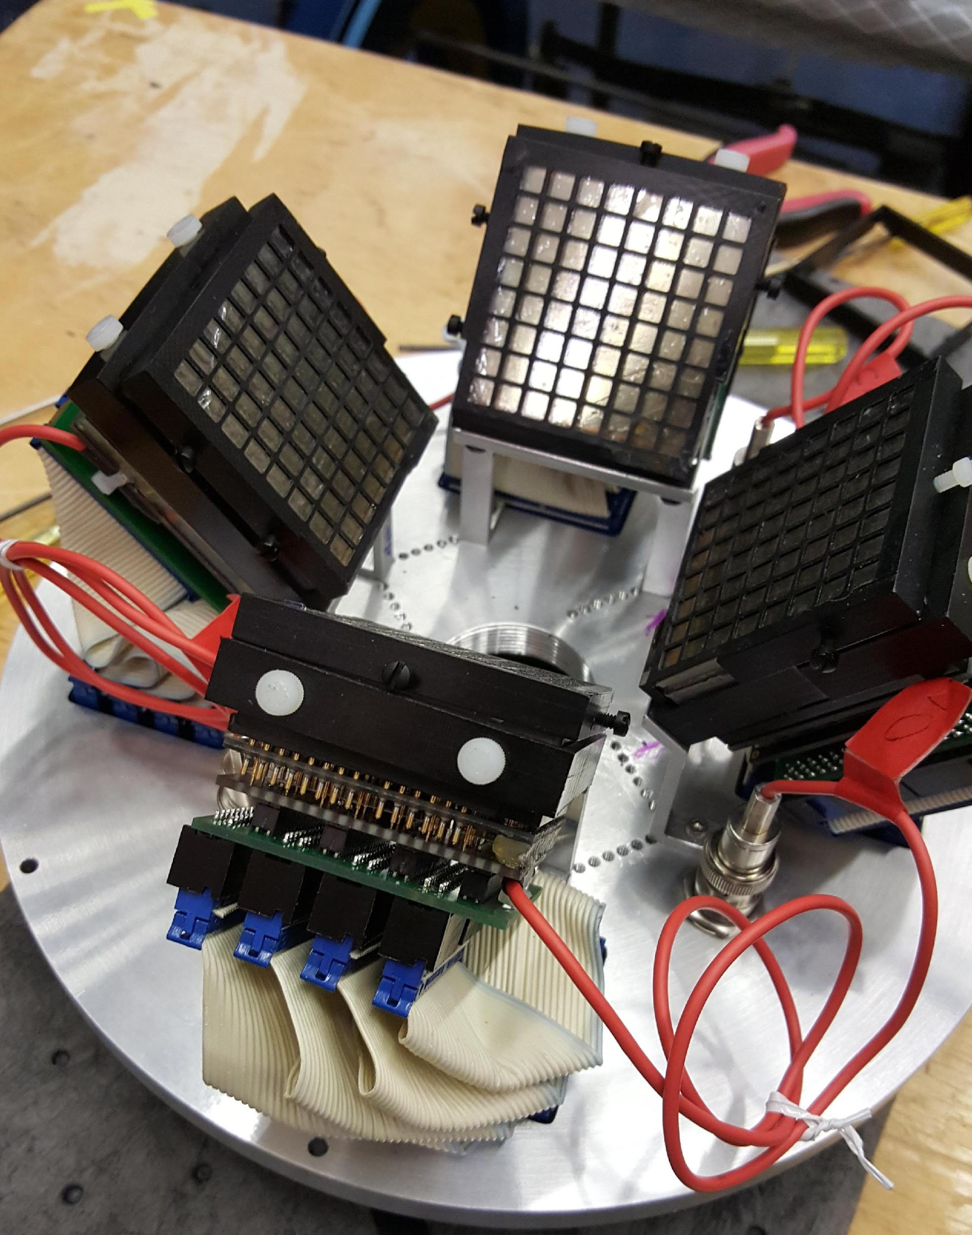
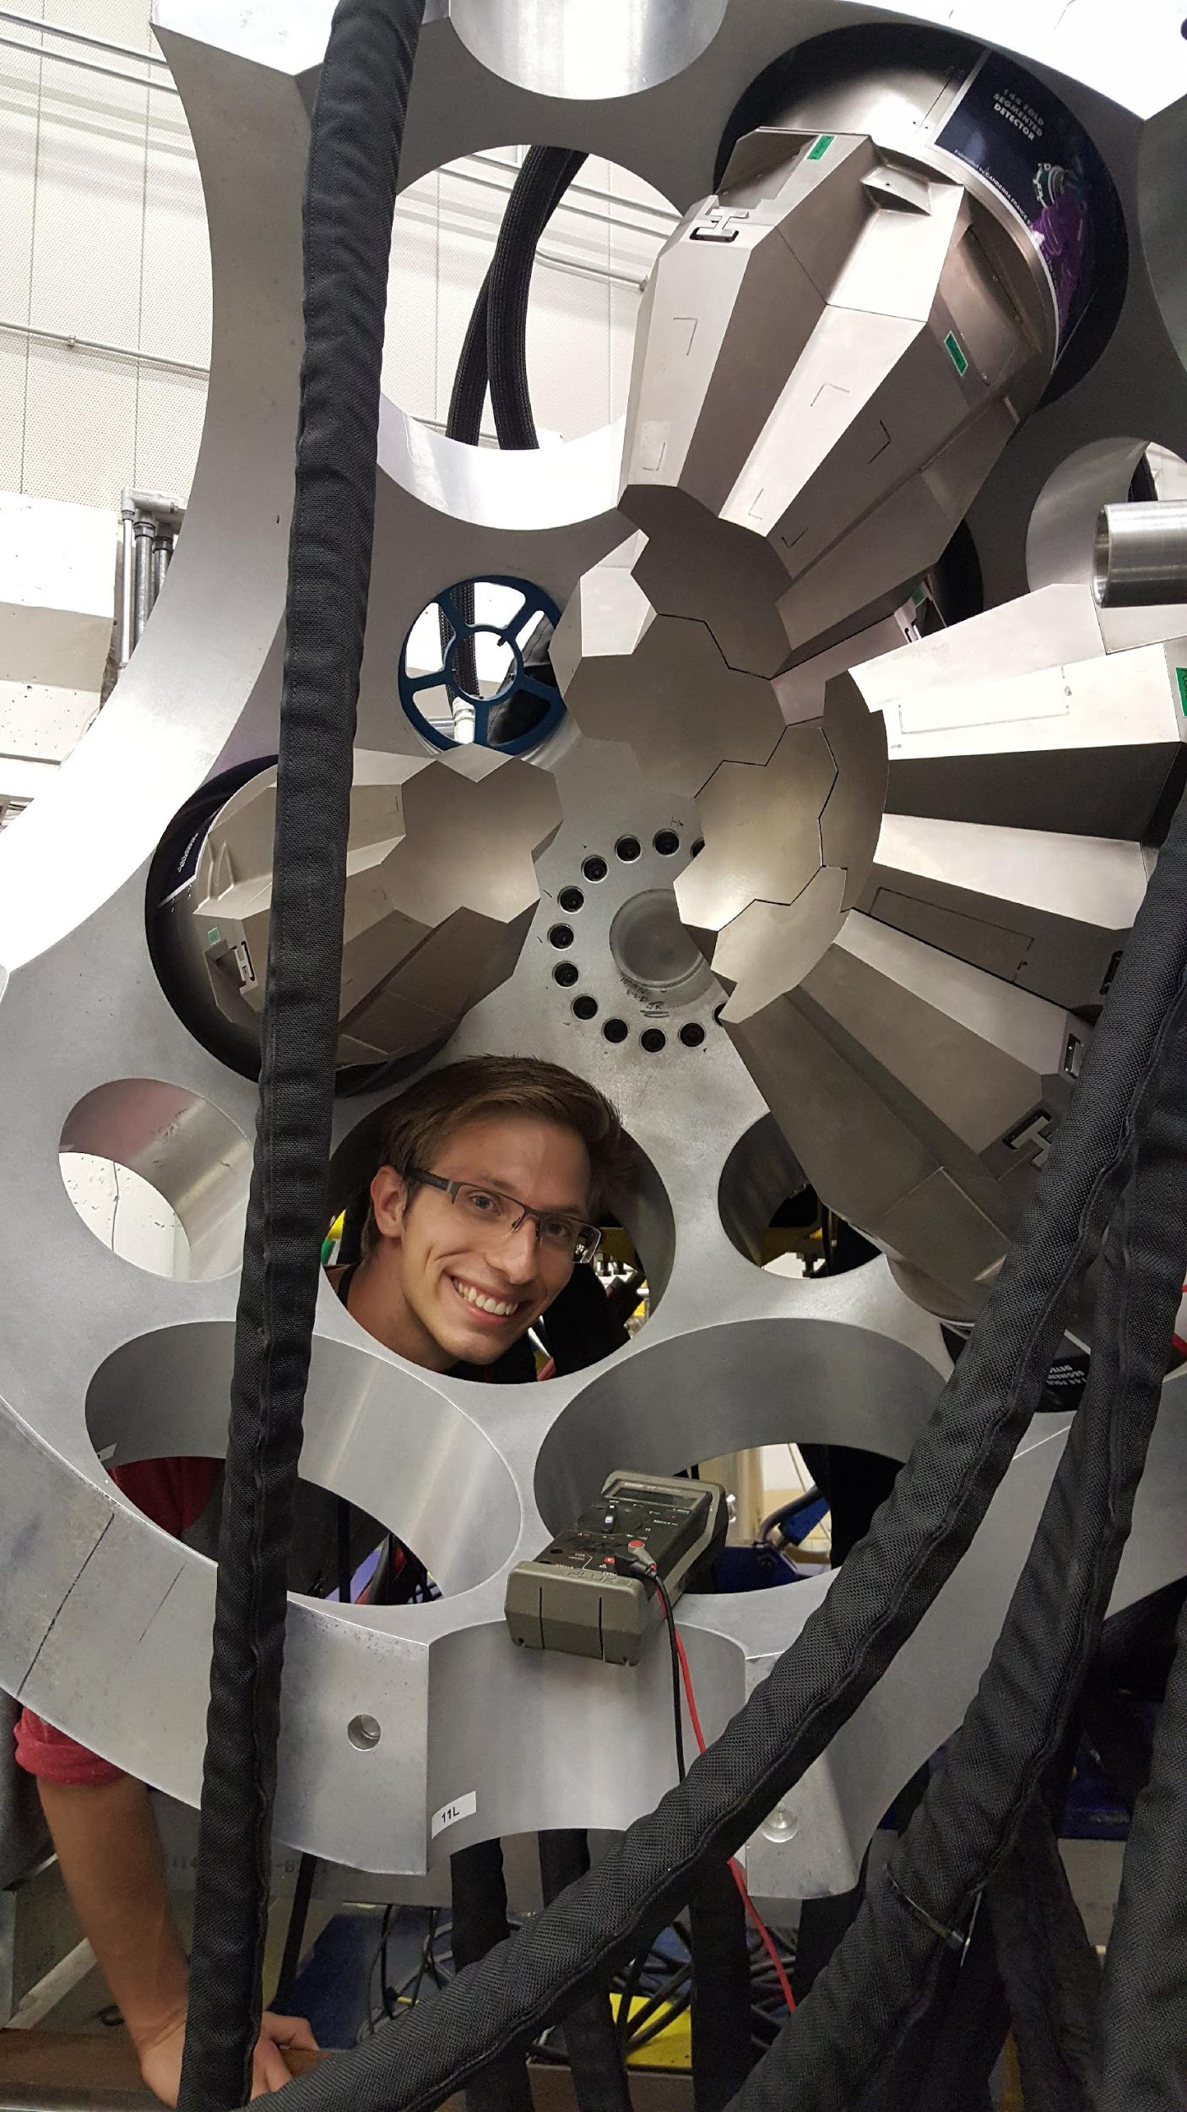
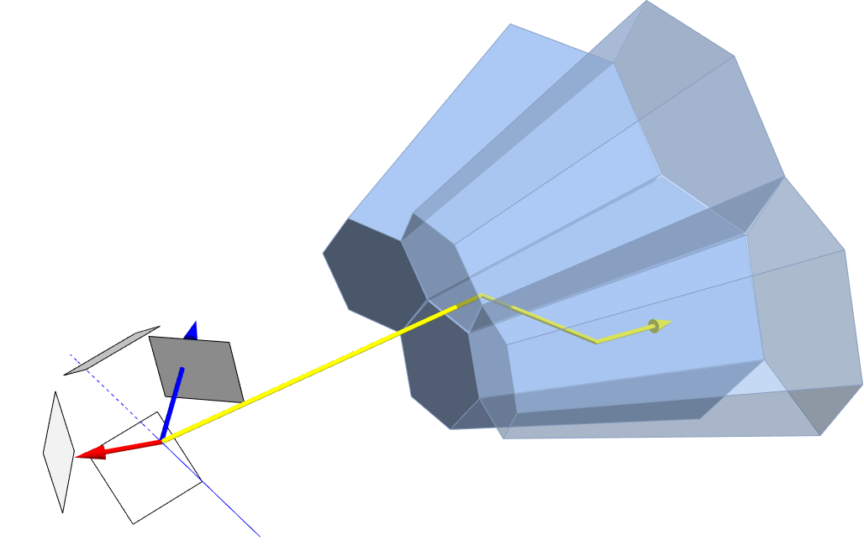
Leo Kirsch
UC Berkeley
4th year PhD student
LBNL GRETINA Team
⁵⁶Fe(p,p'ɤ) @ Argonne
Level Scheme
Low lying lifetimes
Phoswich Wall:
E_{p}, θ_{p}
p'
ɤ
⁵⁶Fe
GRETINA: E_{ɤ}, θ_{ɤ}
p_{i}
Notes:
16 MeV proton inelastic scattering on 56Fe. 6 days of beam in June 2015.
Top Middle: Phoswich Wall Particle Detector. Designed for inverse kinematic reactions, repurposed for normal kinematics in this experiment.
Right: Leo dismantling GRETINA after experimental campaign completion at Argonne.
Bottom: Illustration of the reaction: Incident proton (blue) inelastically scatters into Phoswich Wall (white) causing excited 56Fe (red) to recoil and emit gamma ray (yellow) detected by GRETINA.
Phoswich detects angle and energy of proton. GRETINA detects angle and energy of gamma.

Slide 2
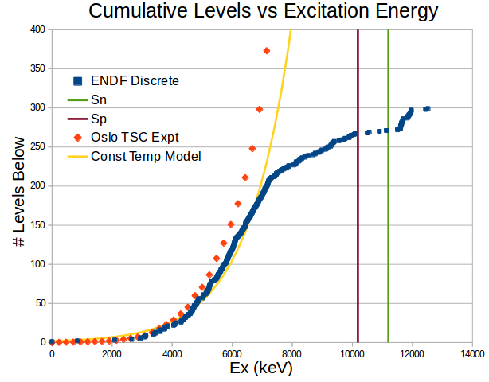
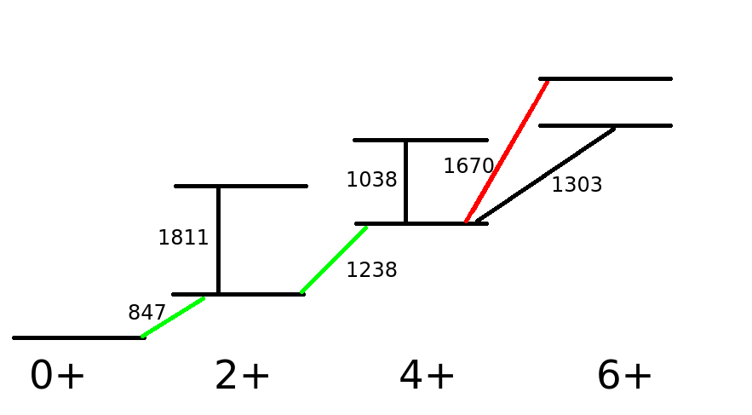
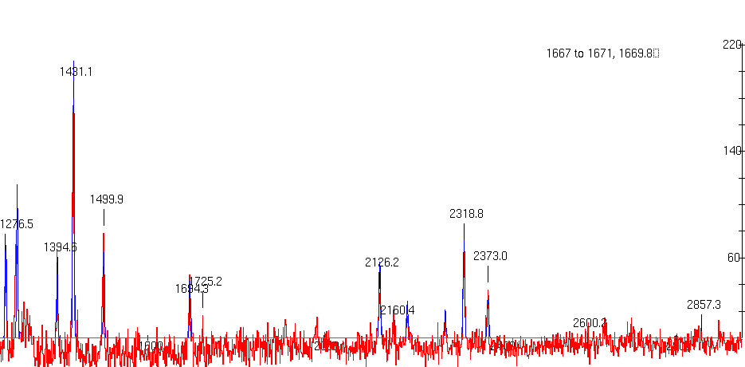
J^{π} undetermined for these 6 new levels
6264
6129
2373
New Levels:
6074
5945
2318
2190
5740
Fill in ENSDF discrete level deficit
compared to continuum measurements
5692
Shown
below
1303 coincidence
not shown
Data coincident
with 1670 keV ɤ's
New ɤ's
2190
Notes:
Top left: current knowledge of the cumulative levels of 56Fe. Continuum measurements from Oslo Cyclotron Lab show missing levels in ENSDF above 5.5 MeV, well below the proton and neutron separation energies.
Bottom: background subtracted data (red) coincident with known 1670 gamma ray from level 3389 keV. Low energy gamma coincidences confirmed. New gammas emerge from unmeasured levels 5.5 MeV and above. Theses levels emerge right where the ENSDF data shows a deficit compared to Oslo.
Right: Partial level scheme of 56Fe. The 1670 gate for bottom plot highlighted in red, new levels from bottom plot highlighted in blue. More new gammas and levels coincident with 1303 gamma highlighted in pink. Data for the 1303 coincidence not shown. Spins and parities of new levels undetermined.

Slide 3
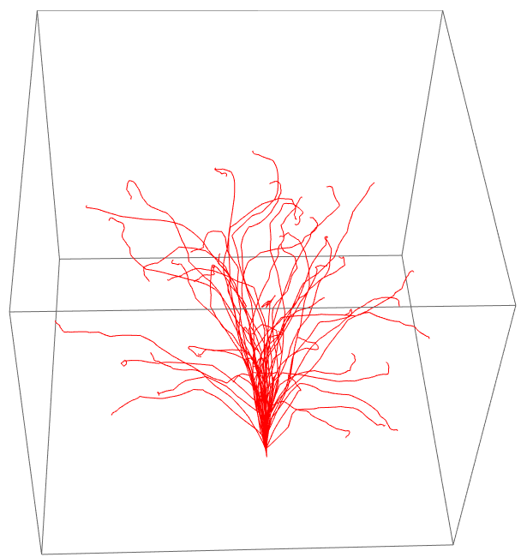
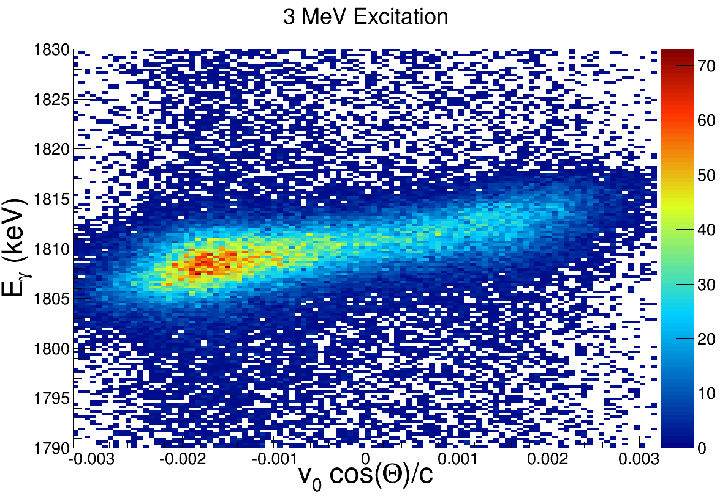
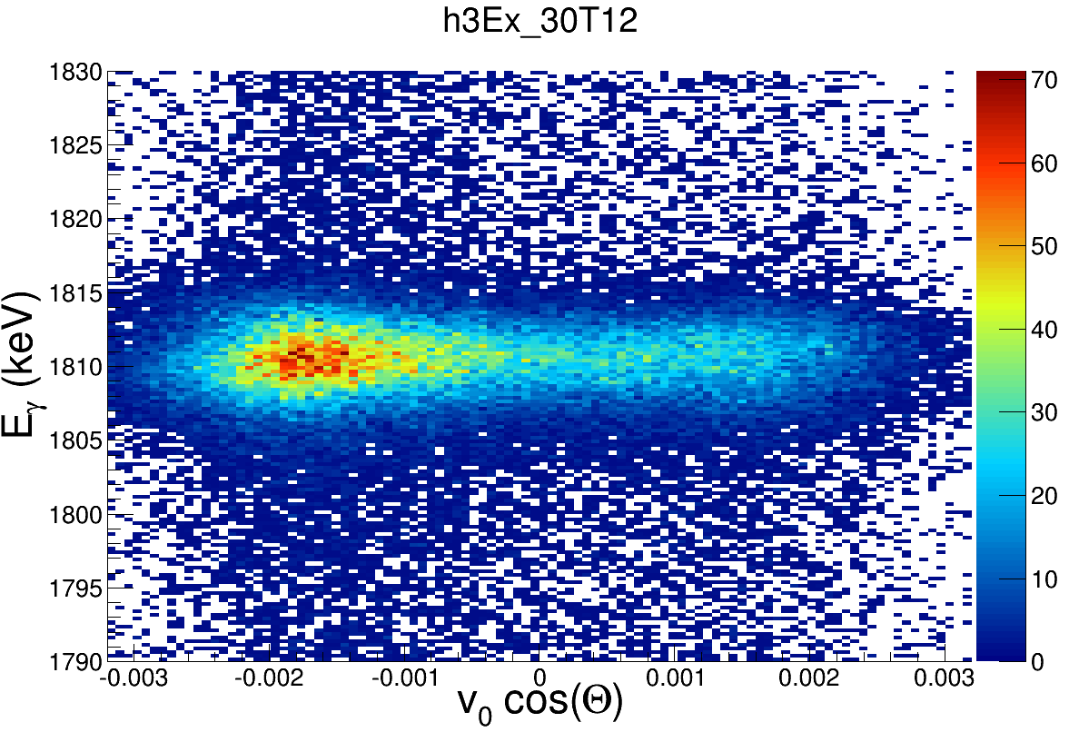
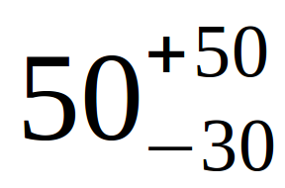
Doppler Shift
⁵⁶Fe 2⁺₂ → 2⁺₁
Recoil Simulation
Recoil toward
emission: high E_{ɤ}
Recoil away from
emission: low E_{ɤ}
counts
⁵⁶Fe
p'
After t_{1/2}=30 fs correction
This
Work
ENSDF
Comparison
Lvl(keV) E_{γ}(keV) Transition t_{1/2} (fs) (n,n') (p,p')
2657 1810 2⁺₂→ 2⁺₁ 33(2) 21(1) 28(7)
2960 2113 2⁺₃→ 2⁺₁ 20(4) 28(3) 27(9)
3120 2273 1⁺₁→ 2⁺₁ 20(8) 19(1) 24(11)
3123 1037 4⁺₂→ 4⁺₁ 51(4) 47(12)
3370 2523 2⁺₄→ 2⁺₁ 19(2) 17(3) 18(7)
3445 2598 3⁺₁→ 2⁺₁ <52 29(5) <28
counts
Outgoing particle
not observed
Notes:
Top Left: Doppler shifted data of the 2+2 → 2+1 transistion of 56Fe. The x-axis is the initial recoil velocity of 56Fe in the direction of the detector that observes the gamma ray energy on the y-axis. Color axis is number of counts. 56Fe moving away from gamma emission direction have gamma energy ~5keV less energy than 56Fe moving toward gamma emission direction.
Top Right: 56Fe recoil simulations with SRIM. Used to apply an average correction on an event by event basis to flatten the doppler shift. Simulation based on one parameter: t_{1/2} of the level.
Bottom Left: data after lifetime correction. Error on lifetime comes from how well residual slope can be measured.
Bottom Right: Results from this work compared to ENSDF. Partial agreement with certain levels, discrepancies arise from the fact that (n,n') measurements do not observe outgoing particle and need to model reaction as well as recoil slowing down.

