Slide 1
Sell-Fort
Sell with comfort!!
TEAM : 41
Avinash Ratnavel Maharaj
Monika Tak
Srivishnu Alvakonda

Slide 2
Goal
Design a Object Oriented Java Desktop Application using which sellers can find buyers and vice versa.
Sellers will post their used products with a desirable cost, buyers will then have the ability to put a bid on the products.
Based on the highest bid, the product will be sold to the respective buyer.
Buyer can also request seller for a barter exchange.

Slide 3
Main Use cases Implemented:
US-03 : Seller should be able to post an item for sale.
US-10 : Buyer should be able to view items by category.
US-11 : Buyer should be able to add an item to his wish list.
US-14 : Buyer should be able to post a bid price for an item.
US-07 : Seller should be able to select the winner of the bid.
US-16 : Buyer should be able to pay for the item(Card or Barter).

Slide 4
Technology Used
Eclipse – IDE
MySQL- Backend database
Windows builder – GUI
We have implemented MVC Architectural Pattern.
We have implemented around 37 Classes.

Slide 5
DEMO
Demo of the before mentioned use cases can be seen in the following video.
https://github.com/avra0601/CSCI-5448-OOAD-project/blob/master/41_Sell-Fort_Part6.mp4

Slide 6
Design patterns implemented
Observer Design Pattern
Factory Design Pattern

Slide 7
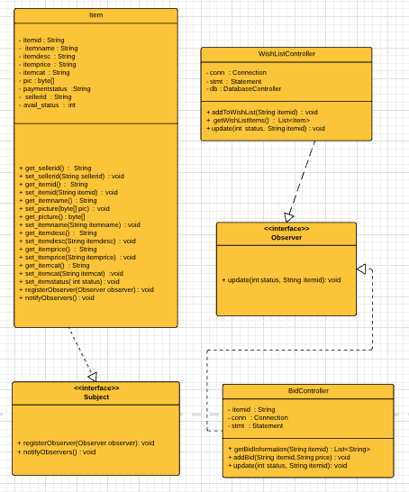
Observer design pattern
Subject << Interface >>
Observer << Interface >>
WishListController implements Observer
BidController implements Observer
Item implements Subject

Slide 8
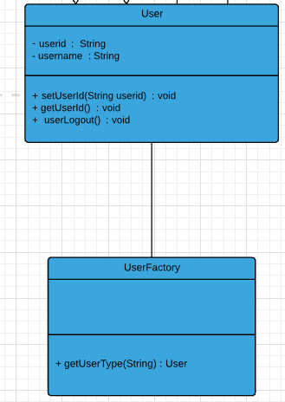
Factory design pattern
Creating of an object without
exposing the logic for creation.
We use factory pattern to create different
user objects.

Slide 9
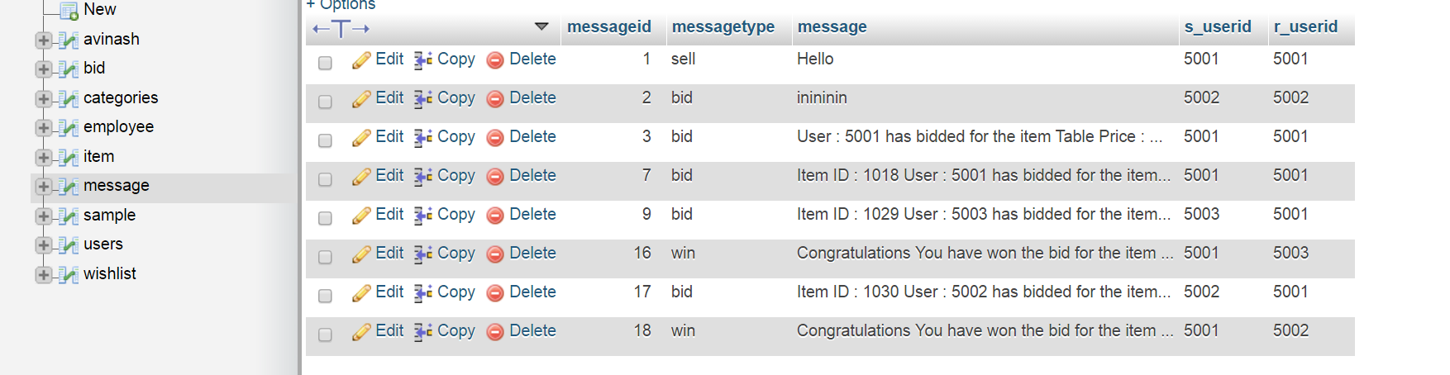
Database
JDBC
MySql

Slide 10
External References
https://www.tutorialspoint.com/design_pattern/factory_pattern.htm
http://www.newthinktank.com/2013/02/mvc-java-tutorial/
https://www.tutorialspoint.com/design_pattern/observer_pattern.htm
https://www.tutorialspoint.com/jdbc/
What have we learnt?
Refactoring: helped us to implement in a better way
MVC: helped us to reuse the code effectively.
Design Patterns

Slide 11
THANK YOU

