Slide 1
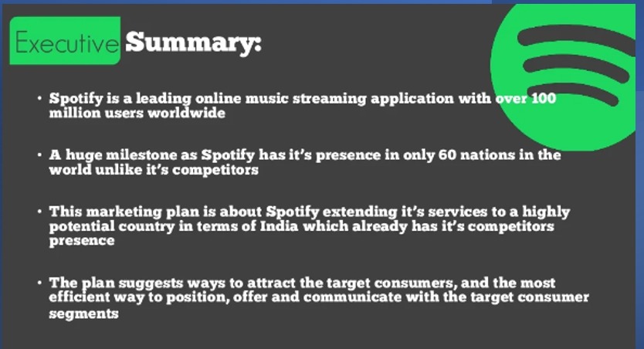

Slide 2
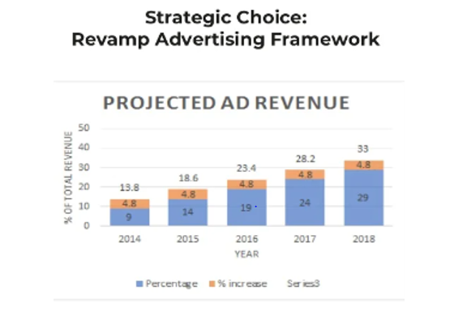

Slide 3
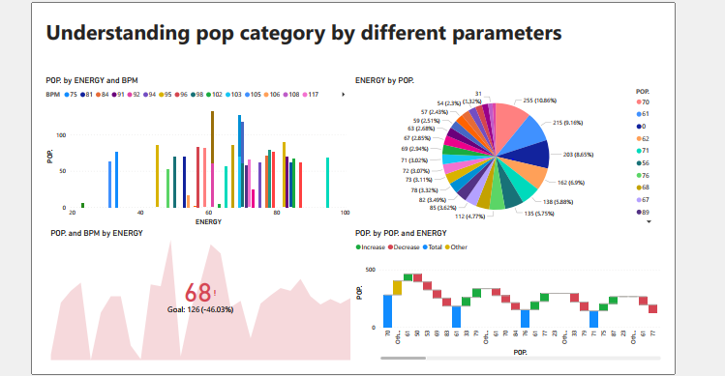
We can see from this pop dashboard the first individual from sheet 1 interested in pop kind of music as compared to Acoustic and Dance.

Slide 4
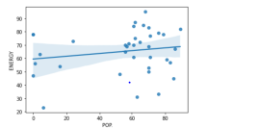
In this regression line we can see the trend line shows positive movement.

Slide 5
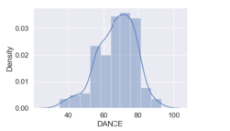
we see in the graph. The customer from dataset sheet 2 is more interested in dance category .

Slide 6
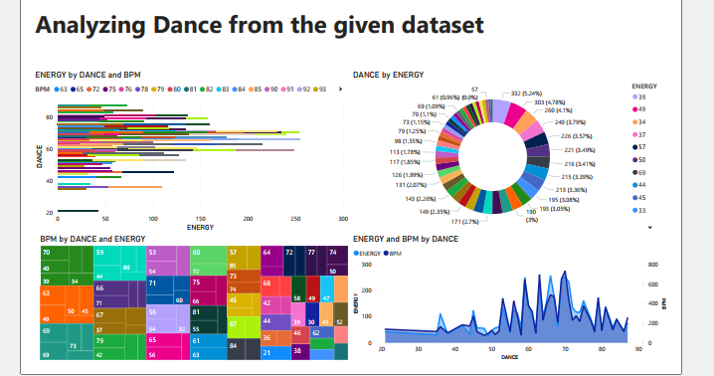
This Dance dashboard shows from sheet 2 shows the customer is interested in Dance category as compared to pop and Acoustic.

Slide 7
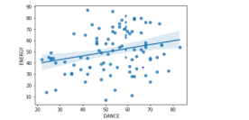
From sheet 3 dataset we can see the customer is more likely interested on Dance as compared to pop or Acoustic

Slide 8
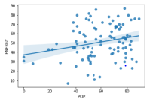
Even we can see from the dataset sheet 3 the customer also interested on listening to pop king of music but with comparison to Dance category we see more interest on dance .

Slide 9
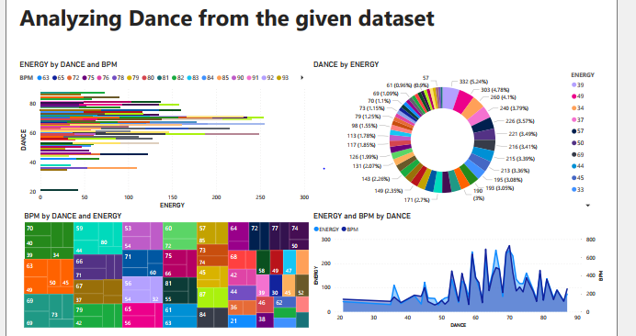
We can see with the spike in dance category the individual clearly interested in dancing kind of music from sheet 3 .

Slide 10
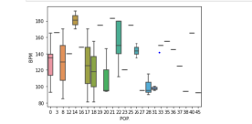
We can see the individual from dataset sheet 4 more tilled toward pop kind of music .

Slide 11
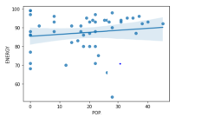
This regression line shows how individual is interested on pop music more in compared to Acoustic or Dance category

Slide 12
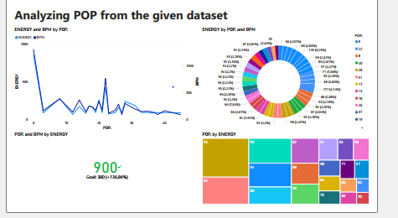
With this pop dashboard from sheet 4 we can understand the individual is interested toward pop music

Slide 13
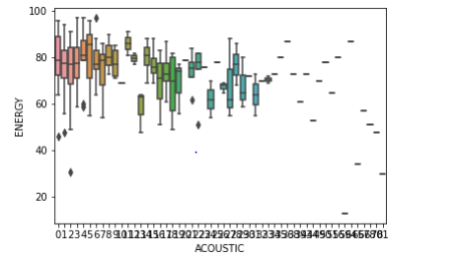
When we see Acoustic category from dataset sheet 5 the individual

Slide 14
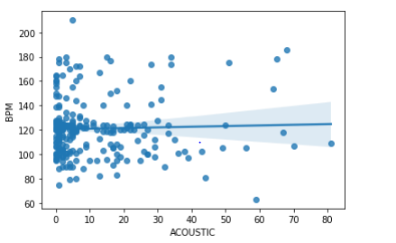
In this regression line we see slightly positive movement which shows the individual is interested in Acoustic kind of music

Slide 15
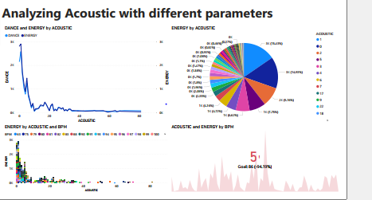
In this Acoustic dashboard we can see this individual more interested toward Acoustic kind of music as compared to pop or Dance category

Slide 16
CONCLUSION
We can say from this Spotify dataset every individual has their own kind of favorite categories.
The project has been done with 5 different kind of dataset from every individuals to analyze the music pattern of the customer .

Slide 17

THANK YOU

