Slide 1
MA 2233 Data Structures and Application Lab
Team Project 7 – Optimal Caching
Anjali (MA20BTECH11002)
Ruthwika (MA20BTECH11004)
Raghav (MA20BTECH11022)

Slide 2
Cache
Cache is a hardware or software component that stores data so that future requests for that data can be served faster.
The main memory in a computer is called Random Access Memory (or RAM).
The RAM is where the computer stores processes temporarily so the Central Processing Unit (or CPU) can access it faster.

Slide 3
Cache hit and Cache Miss
A cache hit (or page hit) occurs when an application or software requests data. First, the CPU looks for the data in its closest memory location, which is usually the primary cache. If the requested data is found in the cache, it is considered a cache hit.
A cache miss (or page fault) is an event in which a system or application makes a request to retrieve data from a cache, but that specific data is not currently in cache memory. A cache miss occurs either because the data was never placed in the cache, or because the data was removed (or evicted) from the cache.

Slide 4
Cache replacement algorithms
Cache replacement algorithms are used to optimize the time taken by processor to process the information by storing the information needed by processor at that time and possibly in future so that if processor needs that information, it can be provided immediately.
Caching improves performance by keeping recent or often-used data items in memory locations that are faster or computationally cheaper to access than normal memory stores. When the cache is full, the algorithm must choose which items to discard to make room for the new ones.

Slide 5
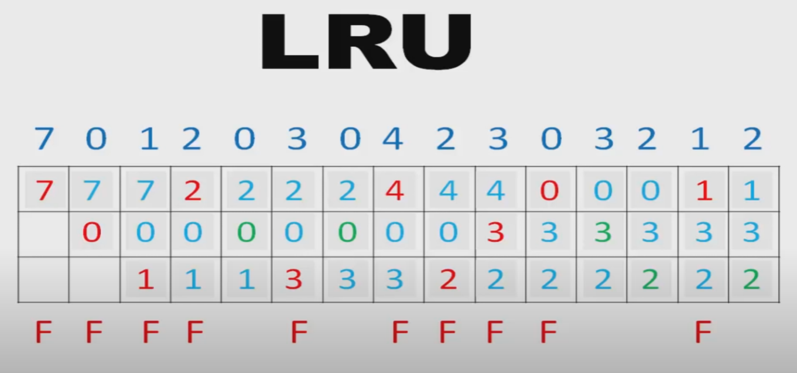
Least Recently Used (LRU)
In the Least Recently Used cache replacement algorithm, the page that had not been accessed for the longest period out of all the pages present in the cache is evicted first.
F = number of page faults (cache misses)

Slide 6
Least Recently Used contd.
In general, a low-level LRU cache algorithm can be implemented using a Doubly Linked List to simulate the cache and a Hashmap to simulate the memory.
Our algorithm uses a hashmap to store the addresses of the pages and whenever a page is referenced, it checks for the address in the hashmap pulls it from the list (cache) the entries and a double linked list to keep track of the access order.
When a page is referenced, if it is present in the cache then it is moved to the front of the queue. If it isn’t present, then the least recently used page is dequeued. A counter is kept and incremented every time this happens to count the number of misses.
The least recently used page is pushed back to the rear and when we need to reference a new page, the page at rear is dequeued.

Slide 7
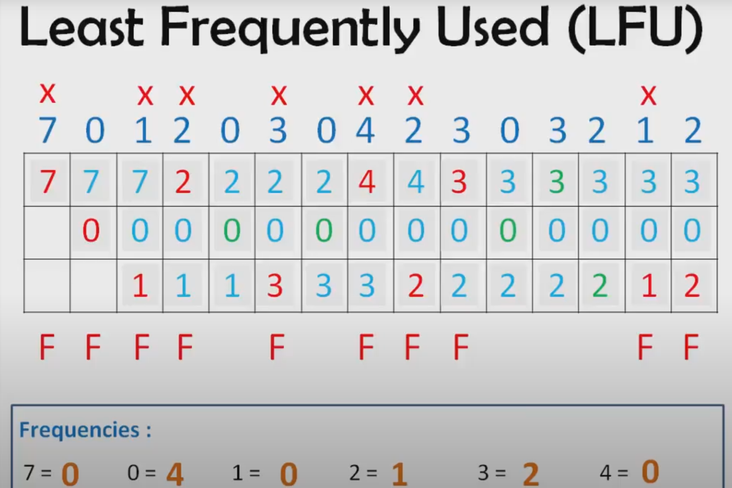
Least Frequently Used (LFU)
In the Least Frequently Used caching algorithm, the page that has the least number of calls by the processor is replaced first. Tie-breakers are usually done randomly but using the Look-Ahead Caching Algorithm in tandom, it can be made more efficient.
F = Page Faults

Slide 8
Least Frequently Used contd.
This algorithm (in our case) uses the same data structures as our LRU algorithm, but with a small but significant difference – the queue is replaced with a priority queue instead with a ‘frequency’ element.
Instead of using Dequeue like we did earlier to remove the rear page from the queue as earlier, we have to delete the page based on its frequency.
Helper functions are used to keep count of frequency, calculate the index of the least frequently used node and delete the least frequently used node when we refer a new page have been implemented over the LRU code.

Slide 9
Comparing efficiencies of both the algorithms
It is reasonable to conclude when Look-Ahead is implemented, LFU will be more efficient as the ‘random’ tie-breakers won’t be random anymore and the cache can decide because it knows what is coming up in the sequence.
When the size of the main memory was significantly less than the length of sequence of page requests (i.e, there are a lot of duplicate pages in the sequence), then LFU had performed better than LRU in our algorithms. (example given in the next page).

Slide 10
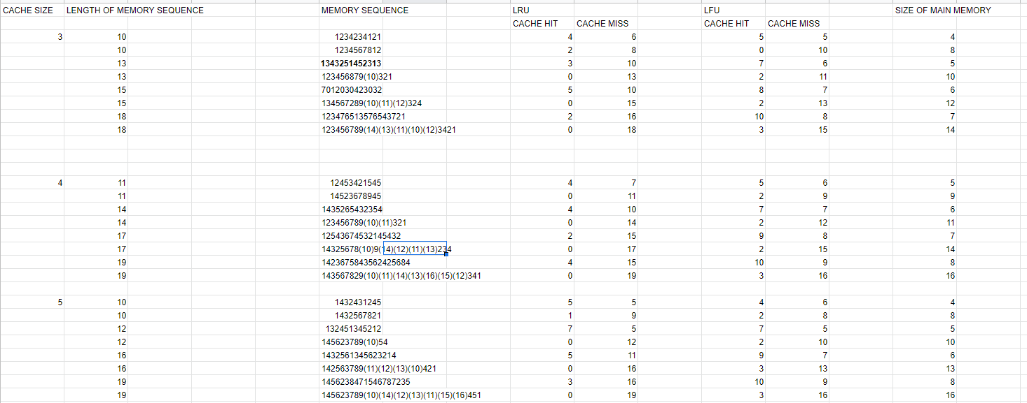
Comparing efficiencies of both the algorithms (data)
It is reasonable to conclude when Look-Ahead is implemented, LFU will be more efficient as the ‘random’ tie-breakers won’t be random anymore and the cache can decide because it knows what is coming up in the sequence.
When the size of the main memory was significantly less than the length of sequence of page requests (i.e, there are a lot of duplicate pages in the sequence), then LFU had performed better than LRU in our algorithms. (example given in the next page).

Slide 11
Comparing efficiencies contd.
Let's consider the constant stream of cache requests with a cache capacity of 3 below –
A, B, C, A, A, A, A, A, A, A, A, A, A, A, B, C, D
[A] [A, B] [A, B, C]
[B, C, A] <- a stream of As keeps A at the head of the list.
[C, A, B] [A, B, C]
[B, C, D] <- here, we evict A, but we can do better!
When you look at this example, you can easily see that we can do better - given the higher expected chance of requesting an A in the future, we should not evict it even if it was least recently used. Below are the frequencies listed.
A – 12, B – 2, C – 2 D – 1
LFU takes advantage of this information by keeping track of how many times the cache request has been used in its eviction algorithm.

Slide 12
Some practical results
One of the main drawbacks of LRU is that many workloads use some elements more frequently than others and LRU does not make use of frequency information at all.
LRU is also vulnerable to a scan of data, i.e., a sequence of requests to elements that are not requested again so a scan may replace all the elements in the cache regardless of whether the elements will be used again or not. LFU is not vulnerable to scans of requests and captures the frequency of workloads.

Slide 13
Concluding remarks
With the plethora of cache algorithms out there and contradictory claims on which algorithm is the best, it is worthwhile to run an independent performance analysis of these algorithms.
For instance, despite all our results being biased towards LFU, all the practical evidence implies that LRU is the more efficient algorithm with no theoretical backing the practical info.
It must be kept in mind that since ours is a small-scale program, as our sample sizes are expectedly smaller, the practical results are found to be different and have a lot more moving pieces and contributing factors.
Therefore, it is difficult to come to a conclusion as there is a lot of ambiguity with the fact that there are a lot of ways you can change around the page reference sequence – which in the end, is the deciding factor.

