Slide 1
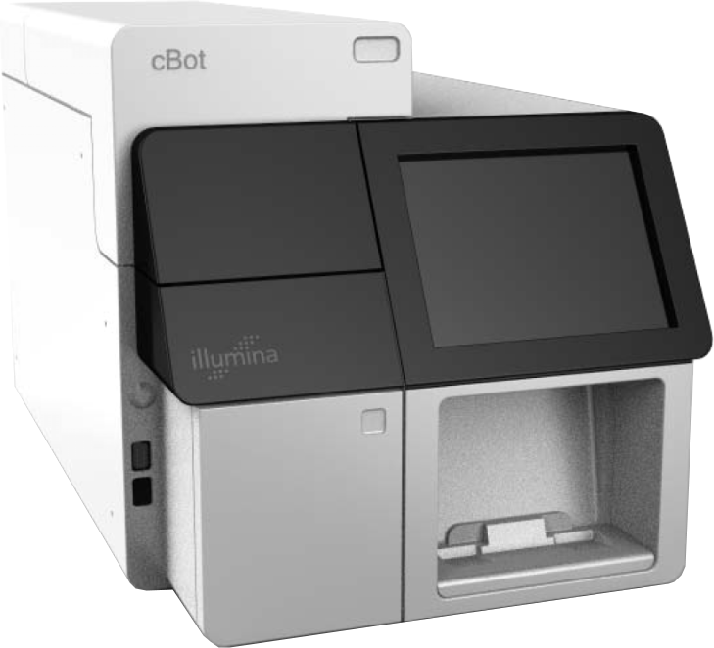
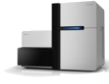
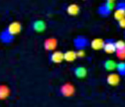
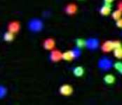

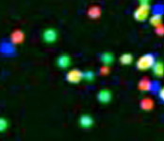
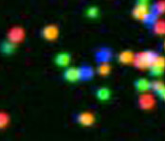

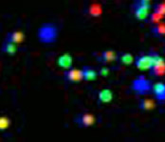
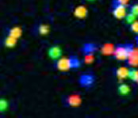
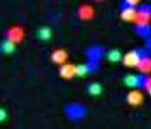
3’
5’
DNA
A
T
C
G
T
C
G
T
G
A
C
C
A
G
A
T
G
C
A
A
T
C
G
C
C
C
G
A
Single molecule array
T
C
G
A
5’
A
Library Preparation
Cluster Growth
Sequencing
1
2
3
4
5
6
7
8
9
T G C T A C G A T …
Image Acquisition
Base Calling
https://www.youtube.com/watch?v=fCd6B5HRaZ8&t=3s
Illumina: Sequencing by Synthesis

Slide 2
Number of clusters ~= Number of reads
Number of sequencing cycles ~= Length of reads
Illumina: Sequencing by Synthesis

