Slide 1
AI-Based Email Parsing & Summarization
Automated email processing using AI, OCR, and NLP

Slide 2
Project Overview
• Parses incoming emails (.eml format)
• Extracts text, metadata, and attachments
• Uses AI (NLP) to summarize email content
• Processes attachments (PDF, images, DOCX, JSON, XML)
• Forwards structured data to external APIs

Slide 3
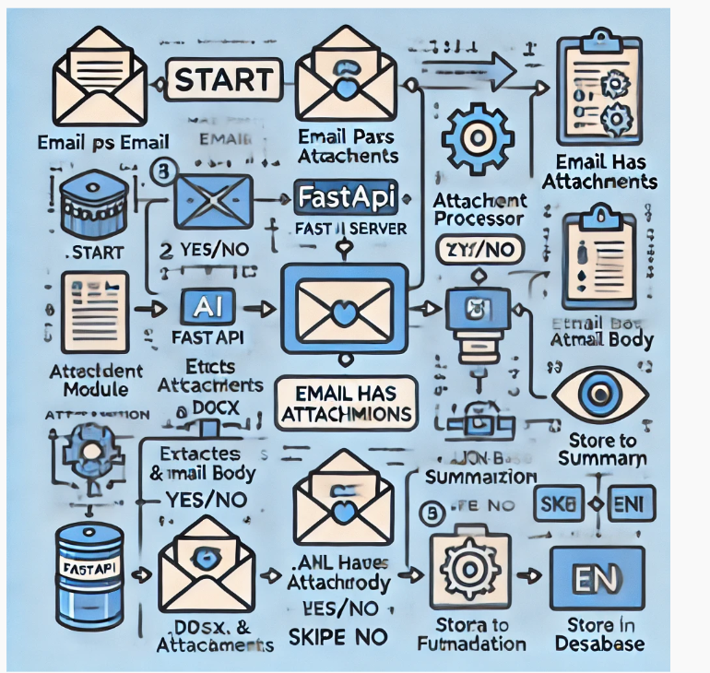
System Architecture

Slide 4
Components Breakdown
1️⃣ FastAPI Server - Handles API requests
2️⃣ Email Parser - Extracts metadata & body
3️⃣ AI Summarization - Uses NLP for key insights
4️⃣ Attachment Processing - OCR, PDF, DOCX
5️⃣ Forwarding Service - Sends structured data

Slide 5
Deployment & Scalability
• Can be deployed on Docker, Kubernetes, PCF
• FastAPI + Uvicorn for high performance
• Scales horizontally with multiple instances
• Caching (Redis) for improved AI response times

