Slide 1
Predicting car collisions
Anirudh ramesh

Slide 2
Predicting car crashes is valuable for all
Predicting car crashes is valuable for consumers as well as auto manufacturers
Being able to examine certain conditions and predicting the likelihood of an accident
This will save consumers money on auto repairs, saves insurance companies money on payouts, saves peoples lives.

Slide 3
Data acquisition and cleaning
The data was acquired from the csv provided in week 2
The data was run through multiple levels of cleaning
Several thousand rows were deleted in order to balance data
Data was cleaned and deleted scanning for drivers under the influence
Finally transformed into a Pandas Data Frame

Slide 4

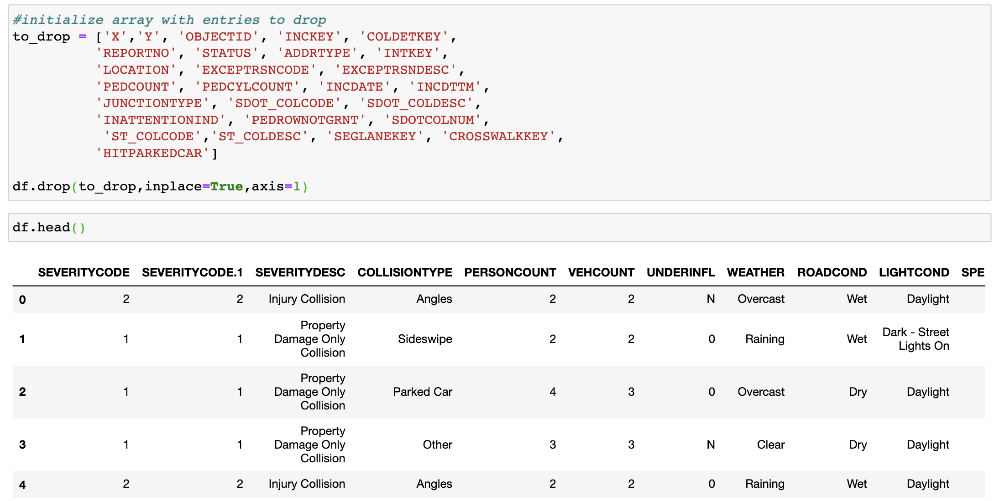
Columns needed to be dropped
Several columns that were not needed are shown dropped here
This is one step in the data cleaning process

Slide 5

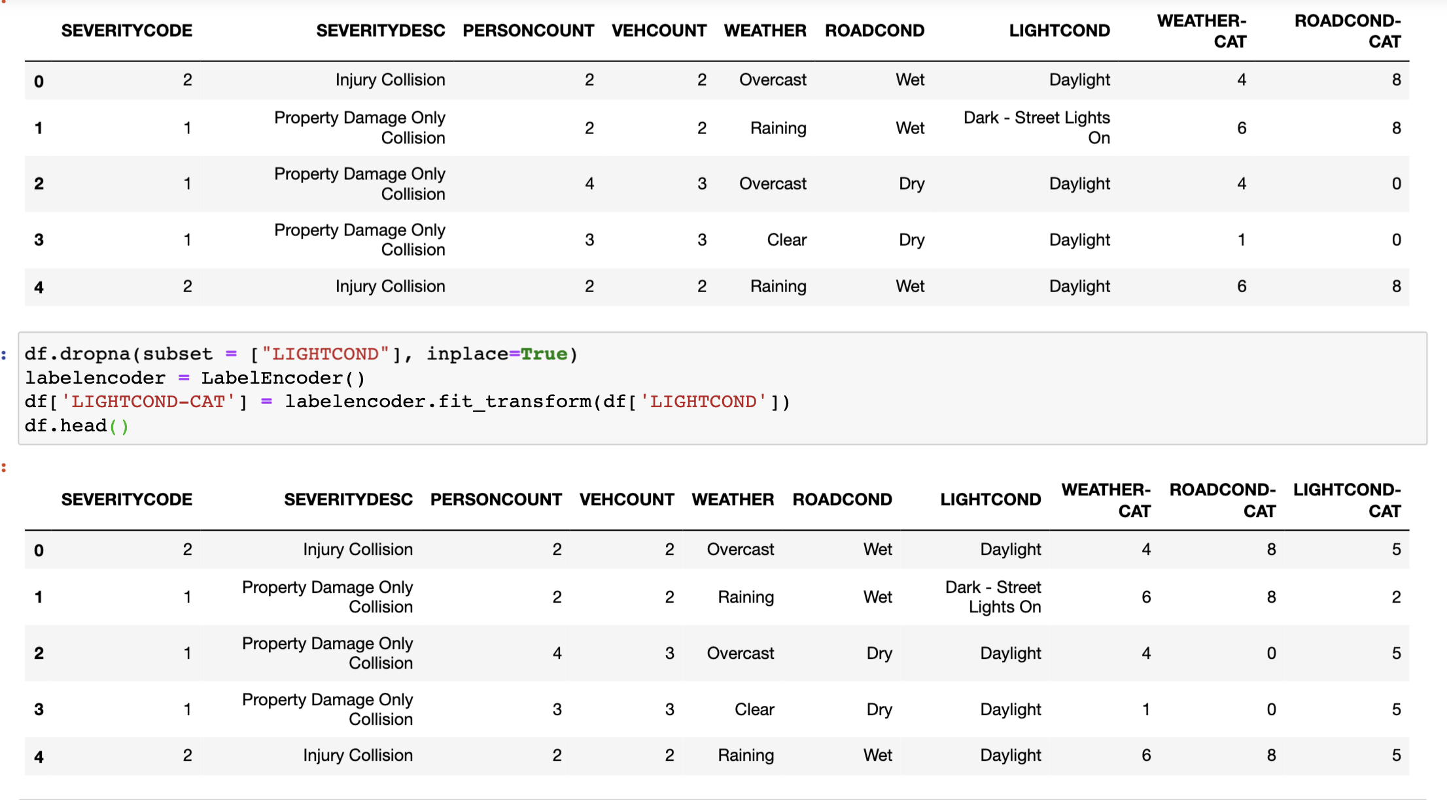
Data needs to become categorical
This is done to assign categorical values to columns
Values like ‘dark’, ‘light’, ‘rainy’, are all transformed to integer
This makes it easier for ML algorithms

Slide 6
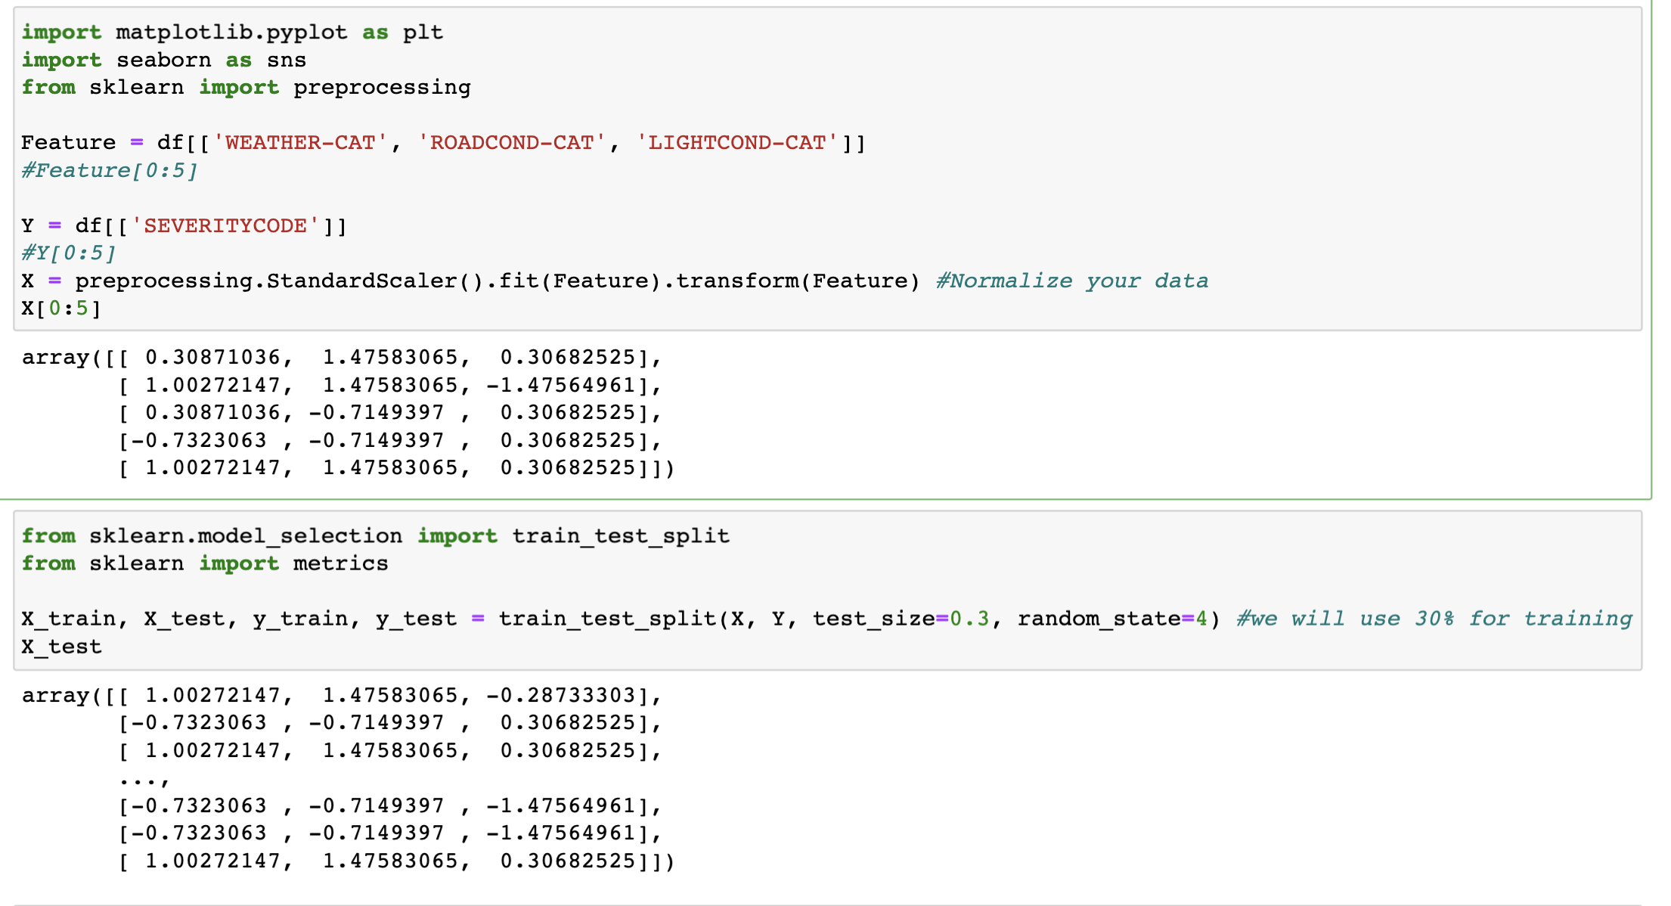
Preprocessing of data

Slide 7
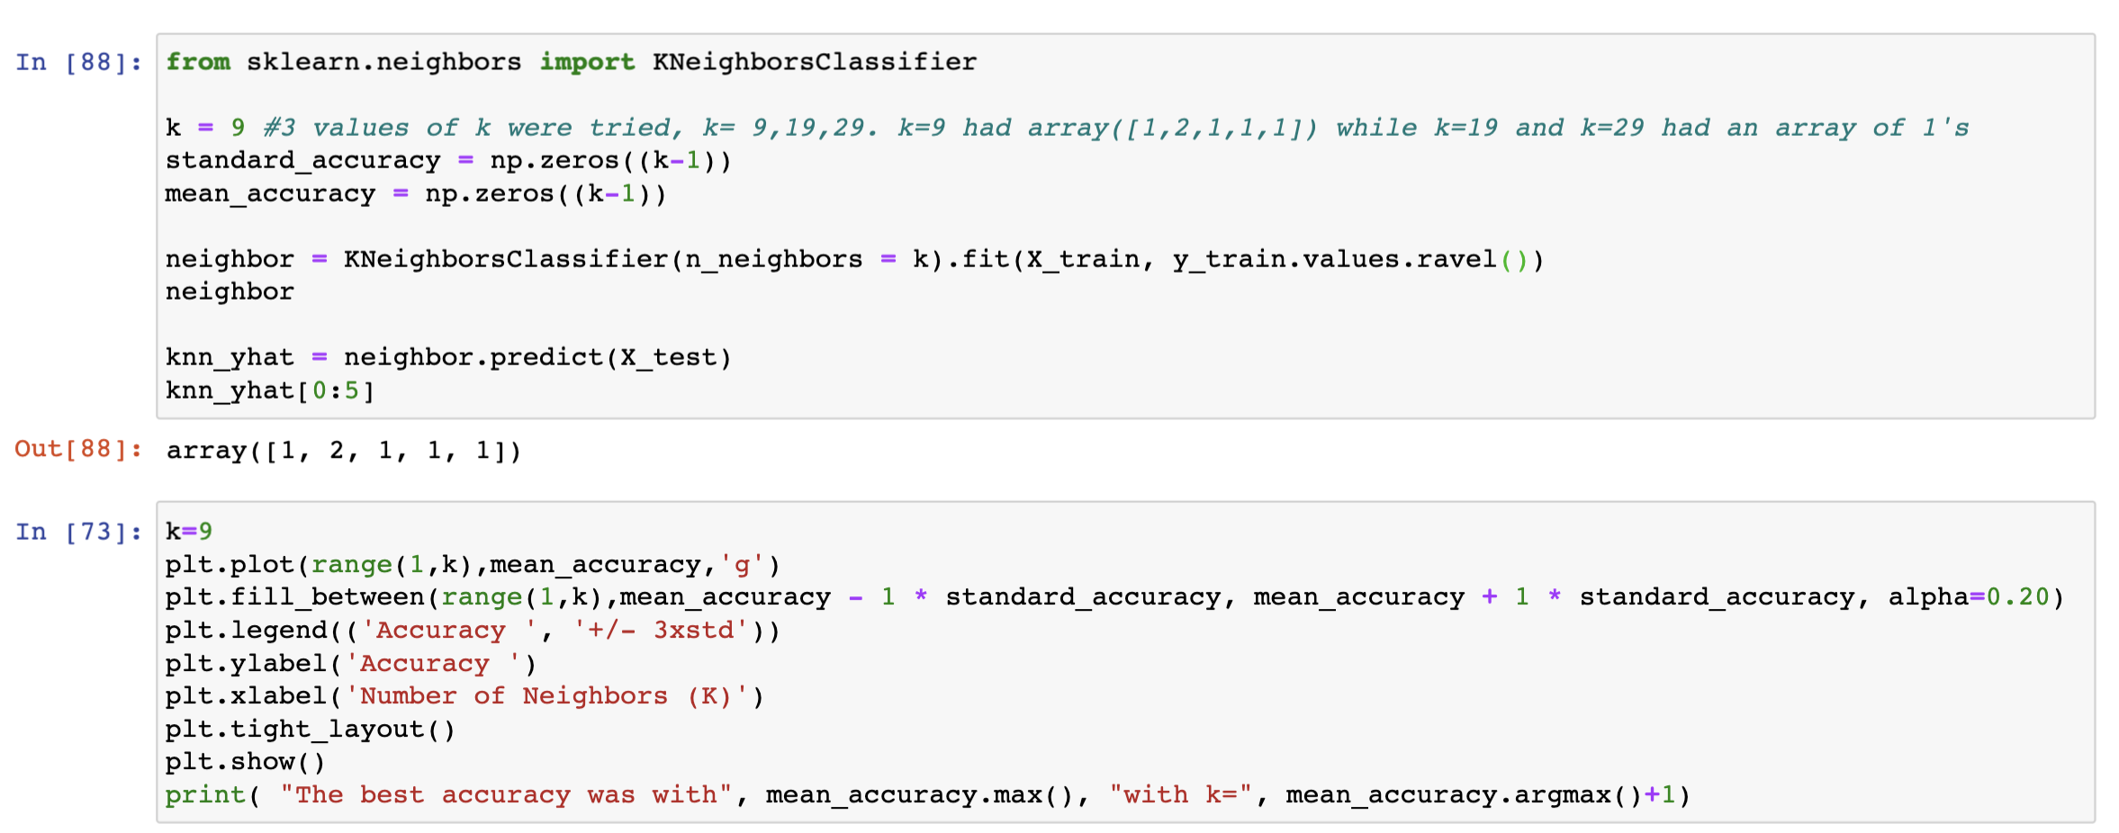
KNN is run
K-Nearest Neighbors Algorithm is run on the data

Slide 8
Decision Tree
We will also run the data through a decision tree model
This is useful because every driving situation is different
These differences can be mapped out in the model via decision tree
e.g. light->yes rain->yes gravel-> no etc.

Slide 9
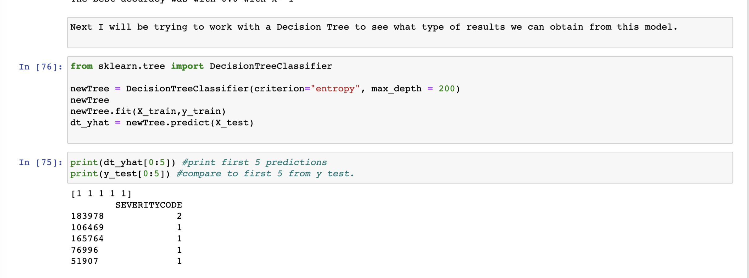
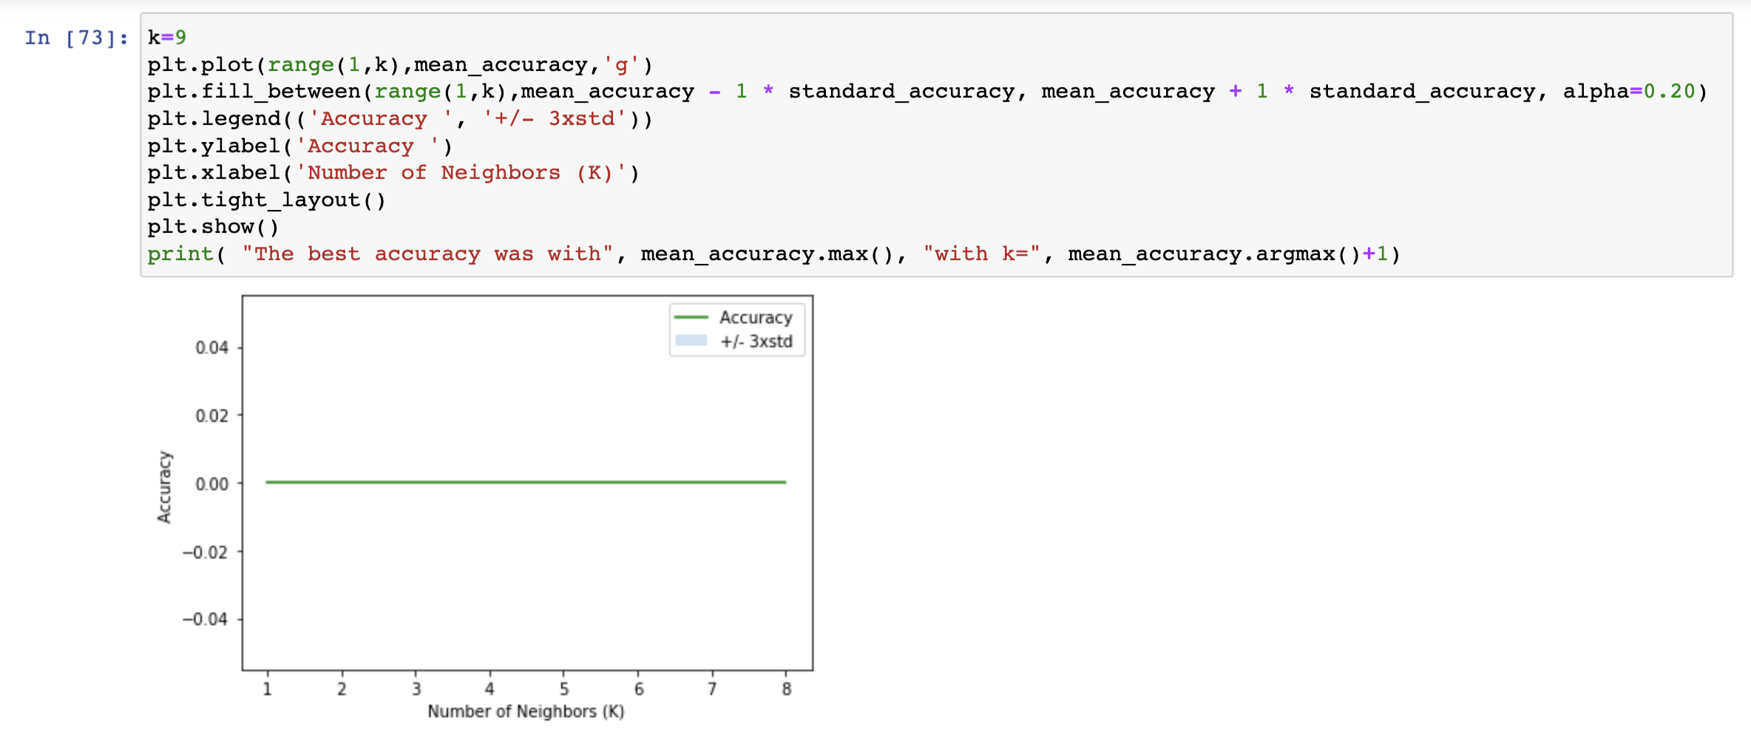
Decision tree
We also run the data through the Decision Tree model
The result is a linear graph

Slide 10
LR test
The final test to run on the data is Logistic Regression test
This is the most useful test because it gives us a definite integer result
Data is in a categorical format, not continuous
LR Test works extremely well when data is in Categorical format

Slide 11
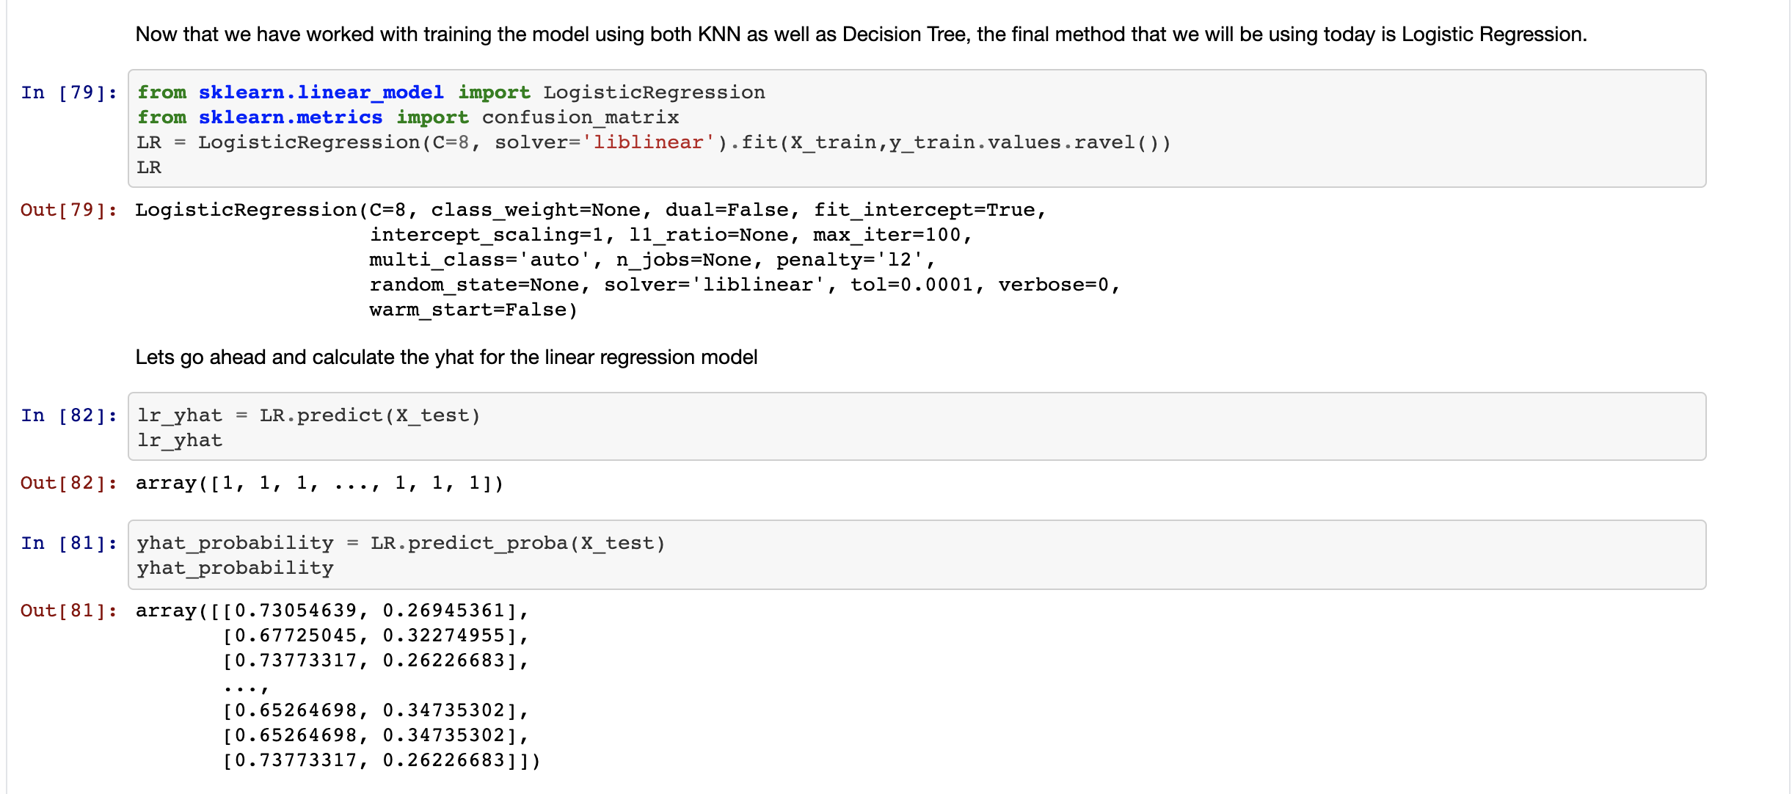
lr test
We have the LR test here

Slide 12
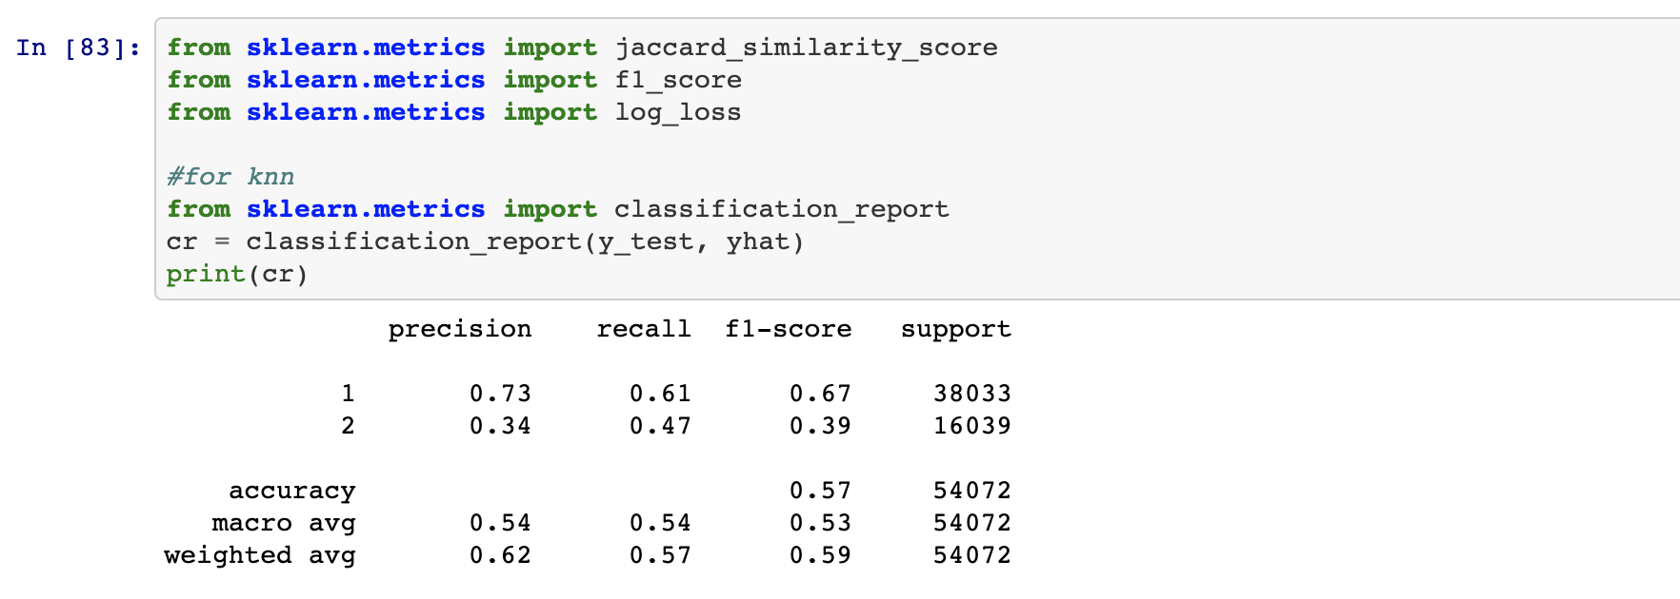
Results - knn
The KNN results were not as high as expected
A way to improve would be to increase the number k and balance the sets

Slide 13
Results - decision tree
Decision Tree had aaccuracy of 71%
This was good and a result of the high amount of data we had to work with
Lots of potential decisions and the categorical data led to high precision and accuracy.

Slide 14
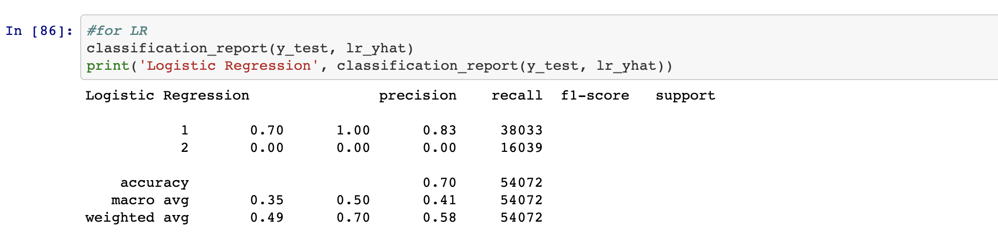
Results – lr test
LR tests had high accuracy as well as precision.
LR tests proved the most effective
This was because it works best on categorical data, and data was in categorical format

Slide 15
Conclusion
There is an ability to predict likelihood of car collision
This is a result of a combination of light conditions, road conditions, and weather conditions
With more data on more roads over extended periods of time, car collisions can be reduced and overall averted
Car collisions are not necessarily more likely in adverse conditions and can be predicted and prevented

