Slide 1
Advance Database Management Systems

Slide 2
EXPERIMETN 02: JOINS
Organizational Hierarchy Explorer (medium)
You are a Database Engineer at TalentTree Inc., an enterprise HR analytics platform that stores employee data, including their reporting relationships. The company maintains a centralized Employee relation that holds: Each employee’s ID, name, department, and manager ID (who is also an employee in the same table).
Your task is to generate a report that maps employees to their respective managers, showing:
The employee’s name and department
Their manager’s name and department (if applicable)
This will help the HR department visualize the internal reporting hierarchy.

Slide 3
Input Table: Employee
OUTPUT
EmpID | Ename | Department | ManagerID
1 | Alice | HR | NULL
2 | Bob | Finance | 1
3 | Charlie | IT | 1
4 | David | Finance | 2
5 | Eve | IT | 3
6 | Frank | HR | 1
EmployeeName | EmployeeDept | ManagerName | ManagerDept
Alice | HR | NULL | NULL
Bob | Finance | Alice | HR
Charlie | IT | Alice | HR
David | Finance | Bob | Finance
Eve | IT | Charlie | IT
Frank | HR | Alice | HR

Slide 4
Financial Forecast Matching with Fallback Strategy (hard)
You are a Data Engineer at FinSight Corp, a company that models Net Present Value (NPV) projections for investment decisions. Your system maintains two key datasets:
Year_tbl: Actual recorded NPV’s of various financial instruments over different years:
ID: Unique Financial instrument identifier.
YEAR: Year of record
NPV: Net Present Value in that year
Queries_tbl: A list of instrument-year pairs for which stakeholders are requesting NPV values:
ID: Financial instrument identifier
YEAR: Year of interest.
Find the NPV of each query from the Queries table. Return the output order by ID and Year in the sorted form.
However, not all ID-YEAR combinations in the Queries table are present in the Year_tbl. If an NPV is missing for a requested combination, assume it to be 0 to maintain a consistent financial report.

Slide 5
Year_tbl
ID | YEAR | NPV
1 | 2018 | 100
7 | 2020 | 30
13 | 2019 | 40
1 | 2019 | 113
2 | 2008 | 121
3 | 2009 | 12
11 | 2020 | 99
7 | 2019 | 0
OUTPUT:
ID | YEAR | NPV
1 | 2019 | 113
2 | 2008 | 121
3 | 2009 | 12
7 | 2018 | 0
7 | 2019 | 0
7 | 2020 | 30
13 | 2019 | 40
ID | YEAR
1 | 2019
2 | 2008
3 | 2009
7 | 2018
7 | 2019
7 | 2020
13 | 2019
Queries_tbl

Slide 6
EXPERIMENT 03: SUB-QUERIES
Department Salary Champions
In a bustling corporate organization, each department strives to retain the most talented (and well-compensated) employees. You have access to two key records: one lists every employee along with their salary and department, while the other details the names of each department. Your task is to identify the top earners in every department.
If multiple employees share the same highest salary within a department, all of them should be celebrated equally. The final result should present the department name, employee name, and salary of these top-tier professionals arranged by department.

Slide 7
Input Table: Employee
Department
ID | NAME | SALARY | DEPT_ID
1 | JOE | 70000 | 1
2 | JIM | 90000 | 1
3 | HENRY | 80000 | 2
4 | SAM | 60000 | 2
4 | MAX | 90000 | 1
ID | DEPT_NAME
1 | IT
2 | SALES
OUTPUT
DEPT_NAME | NAME | SALARY
IT | MAX | 90000
IT | JIM | 90000
SALES | HENRY | 80000

Slide 8
Merging Employee Histories: Who Earned Least? (Hard)
Two legacy HR systems (A and B) have separate records of employee salaries. These records may overlap. Management wants to merge these datasets and identify each unique employee (by EmpID) along with their lowest recorded salary across both systems. Objective 1. Combine two tables A and B.
2. Return each EmpID with their lowest salary, and the corresponding Ename.
Table A
Table B
EmpID | Ename | Salary
1 | AA | 1000
2 | BB | 300
EmpID | Ename | Salary
2 | BB | 400
3 | CC | 100

Slide 9
OUTPUT:
EmpID | Ename | Salary
1 | AA | 1000
2 | BB | 300
3 | CC | 100

Slide 10
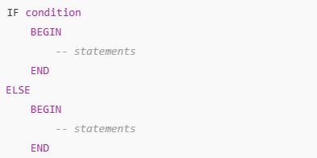
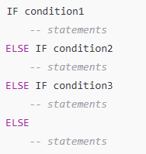
IF-ELSE & ELSE-IF LADDER (SQL SERVER)

Slide 11
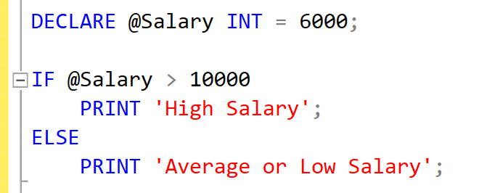
Examples:

Slide 12
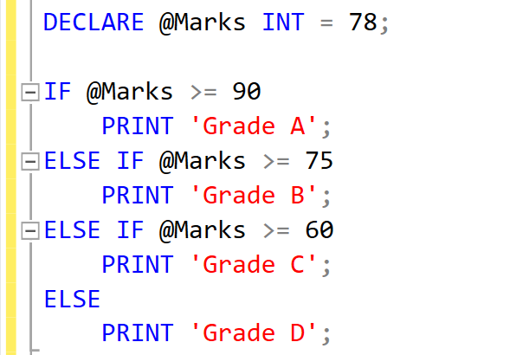
Examples:

Slide 13
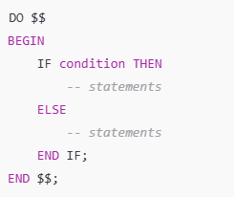
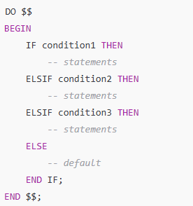
IF-ELSE & ELSE-IF LADDER (POSTGRES)

Slide 14
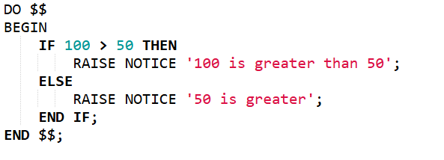
Examples:

Slide 15
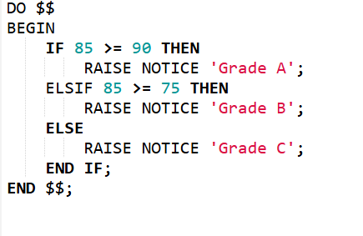
Examples:

Slide 16
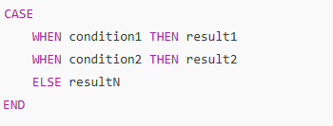
CASE STATEMENTS (SQL SERVER)

Slide 17
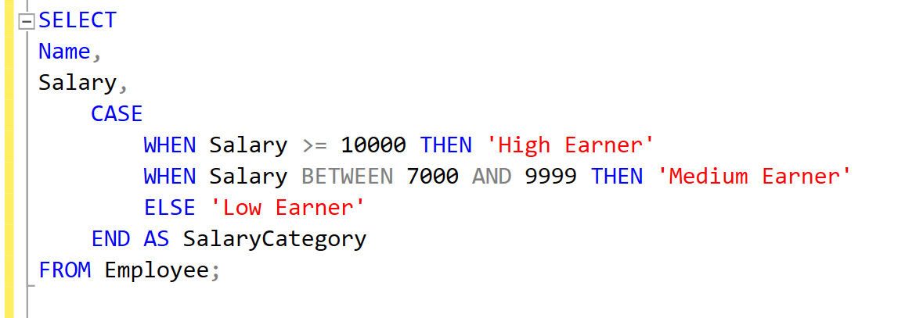
Example:

Slide 18
Practice Set:
CREATE TABLE Department (
DeptID INT PRIMARY KEY,
DeptName VARCHAR(50)
);
CREATE TABLE Employee (
EmpID INT PRIMARY KEY,
Name VARCHAR(50),
DeptID INT,
Salary INT,
Marks INT
);
INSERT INTO Department VALUES
(1, 'IT'), (2, 'HR'), (3, 'Finance');
INSERT INTO Employee VALUES
(1, 'John', 1, 12000, 88),
(2, 'Alice', 2, 9000, 72),
(3, 'Bob', 1, 6000, 55),
(4, 'Sarah', 3, 15000, 95),
(5, 'David', 2, 7000, 65),
(6, 'Tom', 1, 8000, 45);

Slide 19
Practice Set:
Sno | Problem Statement
1 | Write an IF-ELSE block to check if the average salary of all the employees is greater than 1000. (SQL SERVER + POSTGRES) If yes, print ‘Highest Salary Company’, else ‘Average Salary Company’
2 | Use IF-ELSE Ladder to classify marks of a given employee (second class => 50/ first class >= 70/ distinction > 85)
3 | Write a query to classify employees based on salary using CASE statements: 1. >=12000 – Platinum 2. 8000 – 11999 – Gold 3. Else Silver

Slide 20
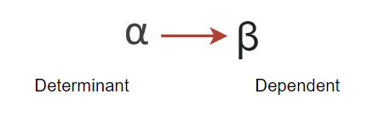
Functional Dependency
If we know the value of α, we can get the value of β from the relation.
α | β
a | 1
b | 2
c | 3
d | 4
For each value of α we should have same value of β.
α | β
a | 1
a | 2
C | 3
d | 4
Here in this case, on same value of α we have different value of β.
t1 ->
t2 ->
If t1[α] = t2[α] then t1[β] = t2[β]
should be equal
tn ->

Slide 21
Practice Q/A
A | B | C | D | E
a | 2 | 3 | 4 | 5
2 | a | 3 | 4 | 5
a | 2 | 3 | 6 | 5
a | 2 | 3 | 6 | 6
Which of the following functional dependency holds true as per the rule and why?
A-> BC
DE -> C
C -> DE
BC -> A

Slide 22
Closure of Functional Dependencies
Closure method helps in finding all the CANDIDATE KEYS in a relation.
While dealing with the normalization concept and functional dependencies, this is the most important and crucial concept.
With the help of candidate keys, we can identify PRIME and NON PRIME attributes which further helps in dealing with the normal forms.
E.g. R(A, B, C, D) F.D. Set – { A->B, B->C, C->D }
A+ = ABCD
B+ = BCD
C+ = CD
D+ = D
A can determine each attribute of relation R, Hence it is a candidate key.
B can not determine each attribute of relation R, Hence it is not candidate key.
C can not determine each attribute of relation R, Hence it is not candidate key.
D can not determine each attribute of relation R, Hence it is not candidate key.

Slide 23
Also have to check the combination, with ‘A’
(AB)+ = ABCD Hence, it is also a candidate key
But according to rule, candidate key is minimal in nature. So we cannot take AB as candidate key.
Hence , only ‘A’ will be the only candidate key.
PRIME ATTRIBUTE – {A}
NON-PRIME ATTRIBUTE – {B,C,D}
Tips and Tricks (Finding Candidate Key in Seconds) Check the attribute which is not on the RHS, that attribute will sure be the part of candidate key.

Slide 24
Problem Statements
1. Consider a relation R having attributes as R(ABCD), functional dependencies are given below:
AB->C, C->D, D->A
Identify the set of candidate keys possible in relation R. List all the set of prime and non prime attributes.
3. Consider a relation R having attributes as R(ABCDE), functional dependencies are given below:
B->A, A->C, BC->D, AC->BE
Identify the set of candidate keys possible in relation R. List all the set of prime and non prime attributes.
4. Consider a relation R having attributes as R(ABCDEF), functional dependencies are given below:
A->BCD, BC->DE, B->D, D->A
Identify the set of candidate keys possible in relation R. List all the set of prime and non prime attributes.
2. Relation R(ABCDE) having functional dependencies as :
A->D, B->A, BC->D, AC->BE
Identify the set of candidate keys possible in relation R. List all the set of prime and non prime attributes.

Slide 25
Problem Statement
Designing a student database involves certain dependencies which are listed below:
X ->Y
WZ ->X
WZ ->Y
Y ->W
Y ->X
Y ->Z
The task here is to remove all the redundant FDs for efficient working of the student database management system.

Slide 26
Problem Statement
Debix Pvt Ltd needs to maintain database having dependent attributes ABCDEF. These attributes are functionally dependent on each other for which functionally dependency set F given as:
{A -> BC, D -> E, BC -> D, A -> D} Consider a universal relation R1(A, B, C, D, E, F) with functional dependency set F, also all attributes are simple and take atomic values only. Find the highest normal form along with the candidate keys with prime and non-prime attribute.

Slide 27
Normalization
When we define a large database as a single relation, there are chances of data redundancy and inconsistency.
This leads to various problems such as maintaining the huge amount of data, improper utilization of disk space and resources and many more.
In-order to handle these issues, NORMALIZATION comes into the picture.
Normalization helps us to reduce the redundancy from relations, divides the larger table into smaller tables and helps in dealing with insertion, deletion and updatation anomalies.

Slide 28

Data Anomalies

Slide 29
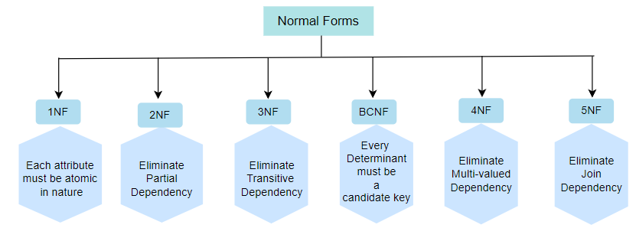
Normalization

Slide 30
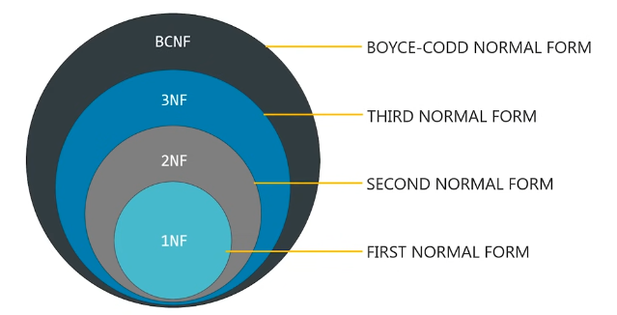

Slide 31
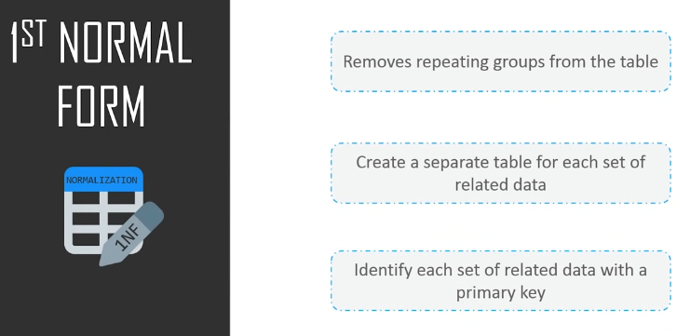

Slide 32
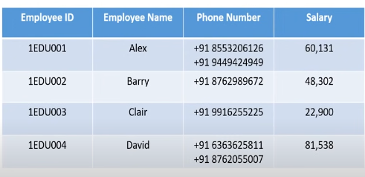
1NF

Slide 33
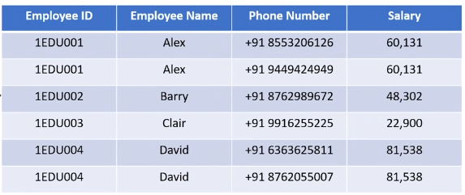
1NF - Decomposition

Slide 34
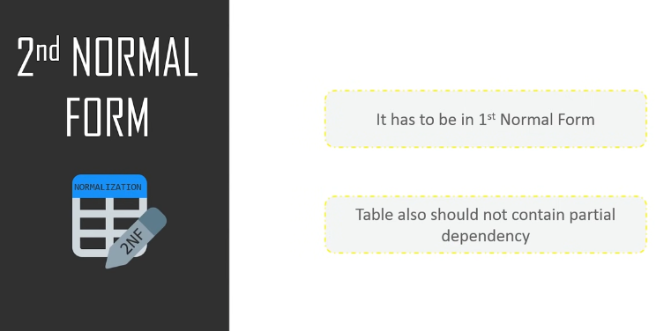

Slide 35
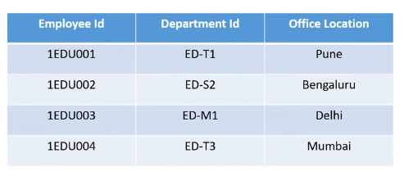
2-NF
Employee ID and Department ID forms the P.K in this case.
Department ID determines Office Location – Clear cut case of Partial Dependency

Slide 36
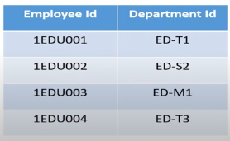
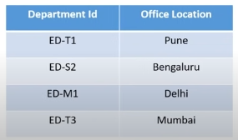
2-NF - Decomposition

Slide 37
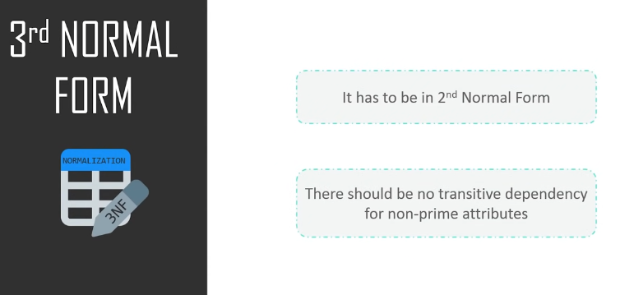
Transitivity?

Slide 38
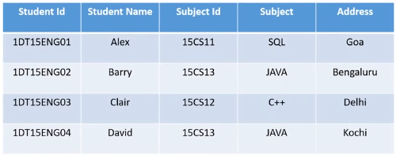
3-NF
Student ID → Subject ID → Subject --- Transitive Dependency

Slide 39
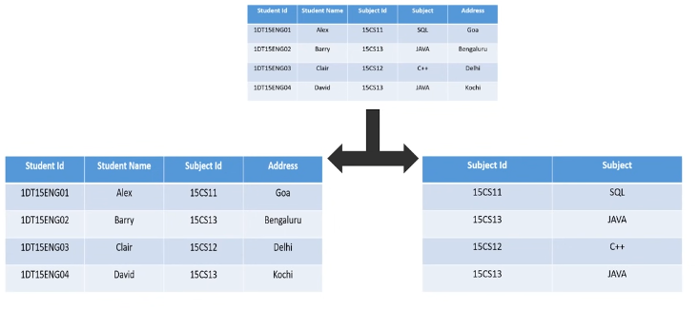
3-NF - Decomposition

Slide 40
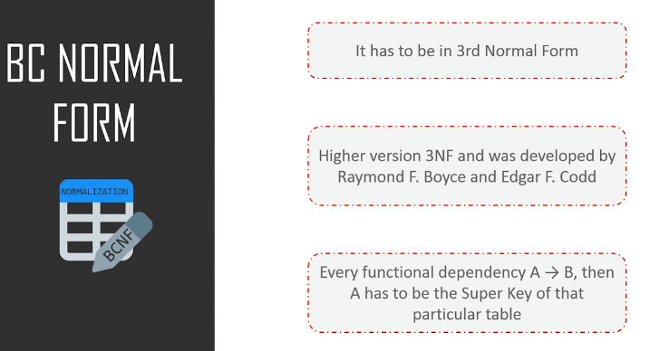

Slide 41
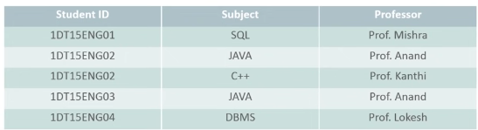
BCNF
One student can enroll for multiple subjects, there can be multiple professors teaching one subject, For each subject professor has been assigned to the student.
Student ID and Subject are the PA here and Professor is NPA.
Professor → Subject – Clear cut case for BCNF

Slide 42
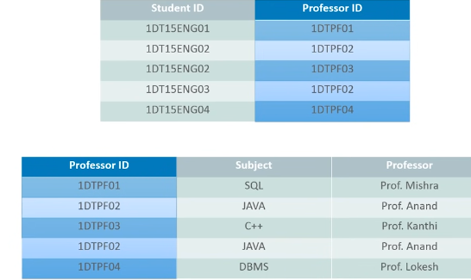
BCNF - Decomposition
Why we added new column as Professor ID?
By doing this we are removing the NPA → PA dependency.
Professor ID will be the primary key or super key for the second table for identifying the records uniquely.

Slide 43
Normalization
Tips and Tricks: How to identify quickly that relation is in which form.
2NF (when is it not): if there is dependency from X -> Y
(X is a subset of candidate key AND Y is non-prime attribute) – then R is not in 2NF
3NF (when is it): if there is a dependency from X -> Y
(X is a super key or candidate key OR Y is a prime attribute)
(If all attributes comes out to be prime – R is in 3NF)
BCNF (when is it): if there is a dependency from X -> Y
(X is super key or candidate key)

Slide 44
Views: Performance Benchmarking : Normal View vs. Materialized View
(Medium)
1. Create a large dataset:
- Create a table names transaction_data (id , value) with 1 million records.
- take id 1 and 2, and for each id, generate 1 million records in value column
- Use Generate_series () and random() to populate the data.
2. Create a normal view and materialized view to for sales_summary, which includes total_quantity_sold, total_sales, and total_orders with aggregation. 3. Compare the performance and execution time of both.

Slide 45
Views: Securing Data Access with Views and Role-Based Permissions
(Hard)
The company TechMart Solutions stores all sales transactions in a central database. A new reporting team has been formed to analyze sales but they should not have direct access to the base tables for security reasons. The database administrator has decided to:
Create restricted views to display only summarized, non-sensitive data.
2. Assign access to these views to specific users using DCL commands (GRANT, REVOKE).

Slide 46
Normal View vs Materialized View
Feature | Normal View | Materialized View
Storage | No storage, computed on-the-fly | Stores the result physically on disk
Query Execution | Slow for complex queries | Fast, because data is precomputed
Always Up-to-date | Yes, reflects latest table data | No, needs REFRESH to update
Use Case | Lightweight queries | Heavy aggregations, analytics, dashboards

Slide 47
When to go for Materialized Views?
Analytics Dashboards / BI Reports
Example: Sales dashboard showing total sales by product/category.
Data refresh interval: nightly, hourly, or on-demand.
Why: Aggregations like SUM, AVG on millions of rows are expensive to compute every request.
Caching Frequently Accessed Data
Example: Leaderboard for a gaming app or trending posts in a social media app.
Refresh periodically (e.g., every 10 minutes) instead of recomputing every time.
Complex Joins or Aggregations
Example: Multiple large tables joined with filters for reporting.
Materialized view stores precomputed results, speeding up front-end API calls.
ETL / Data Warehousing
Precompute summary tables for faster downstream analytics.
Refresh after batch data load.

Slide 48
Stored Procedures
HR-Analytics: Employee count based on dynamic gender passing (Medium)
TechSphere Solutions, a growing IT services company with offices across India, wants to track and monitor gender diversity within its workforce. The HR department frequently needs to know the total number of employees by gender (Male or Female) .
To solve this problem, the company needs an automated database-driven solution that can instantly return the count of employees by gender through a stored procedure that: 1. Create a PostgreSQL stored procedure that:
2. Takes a gender (e.g., 'Male' or 'Female') as input.
3. Calculates the total count of employees for that gender.
4. Returns the result as an output parameter.
5. Displays the result clearly for HR reporting purposes.

Slide 49
Stored Procedures
SmartStore Automated Purchase System (Hard)
SmartShop is a modern retail company that sells electronic gadgets like smartphones, tablets, and laptops. The company wants to automate its ordering and inventory management process.
Whenever a customer places an order, the system must: 1. Verify stock availability for the requested product and quantity.
2. If sufficient stock is available: - Log the order in the sales table with the ordered quantity and total price.
- Update the inventory in the products table by reducing quantity_remaining and increasing quantity_sold.
- Display a real-time confirmation message: "Product sold successfully!“ 3. If there is insufficient stock, the system must:
- Reject the transaction and display: Insufficient Quantity Available!"

