Slide 1

Decision Trees
A decision tree is a method of classification similar to a “Choose Your Own Adventure” book. As we traverse the tree, we made a series of decisions (based on the data) that leads us to the conclusion (outcome)

Slide 2
Decision Tree Model
Our decision tree model is a “Choose Your Own Adventure” – but for data! Instead of making decisions about walking down a dark alley or leaving your flashlight at home, the decision tree model make decisions based on the values of the predictor data.
For example: Based on height, weight, and HR data, can we classify individuals as football players, basketball players, runners, or non-athletes?

Slide 3
How a Decision Tree Model Works
Start with an empty node – this will become the ROOT of the tree
Split the data, based on the threshold value of one attribute
Each split is based on the OPTIMAL attribute – which attribute has the best predictive power at this point?
Think: If we can only do one split, which attribute classifies the most data correctly?
Now look at the resulting subsets at the new INTERNAL NODES.
Analyze each internal node, and split the data again based on the next most optimal/predictive attribute
Continue splitting until a stopping criteria is met
The final split, which determines class assignment, are the LEAVES of the tree

Slide 4
Decision Tree Model
Our decision tree model is a “Choose Your Own Adventure” – but for data! Instead of making decisions about walking down a dark alley or leaving your flashlight at home, the decision tree model make decisions based on the values of the predictor data.
Resting HR > 55 BMP?
Yes
Not an athlete
Weight > 225 lbs?
Yes
No
Football player
Resting HR > 50 BPM?
Yes
Not an athlete
Yes
No
Height > 6 feet?
No
Basketball player
Resting HR > 50 BMP?
Yes
Not an athlete
No
Weight > 150 lbs?
Yes
No
Basketball player
No
Resting HR > 45 BMP?
Yes
Not an athlete
No
Runner

Slide 5
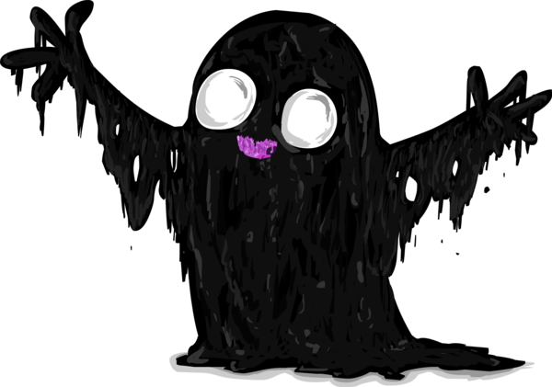
Decision Trees
A decision tree is a method of classification similar to a “Choose Your Own Adventure” book. As we traverse the tree, we made a series of decisions (based on the data) that leads us to the conclusion (outcome)
Will you get attacked by the Slime Monster?
Do you go inside?
Yes
Do you and your friend drive to the abandoned barn?
Yes
No
YOU’RE SAFE!
Do you go down a dark alley instead?
Yes
Yes
No
Do you sneak out of the house?
No
YOU’RE SAFE!
Are the lights off?
Yes
No
Do you go watch TV in the basement?
Yes
No
No
Are the lights off?
Yes
YOU’RE SAFE!
No
YOU’RE SAFE!

