Slide 1

A project presentation on
Texture Based Image Classification using Gray Level Co-Occurrence Matrix (GLCM)
Based Statistical Features
Presented By : Utkarsh Mani Tripathi (20158027) Vrinda Agarwal (20158103) Ankit Garg (20153069) Vivek Kumar Jha (20158073) Kushagra Shukla (20158075)
COMPUTER SCIENCE AND ENGINEERING DEPARTMENT MOTILAL NEHRU NATIONAL INSTITUTE OF TECHNOLOGY ALLAHABAD
April, 2018
Group 11 (Information Technology) B.Tech 6th Semester

Slide 2
INDEX
Overview
Introduction
Motivation
Related Work
Proposed Work
Experimental Setup
Results Analysis
Conclusion
Future Work
References

Slide 3
OVERVIEW
In this Project, a texture classification system based on Gray Level Co-occurrence Matrix (GLCM) is presented. Classification of images into various categories is being realized by extracting six statistical features, namely - Contrast, Correlation, Energy, Dissimilarity, ASM and Homogeneity from each image and using this feature database to train the K Nearest Neighbor (k-NN) classifier. Upon feeding the trained k-NN classifier with the Test Images from various categories, a decent classification accuracy was achieved.

Slide 4
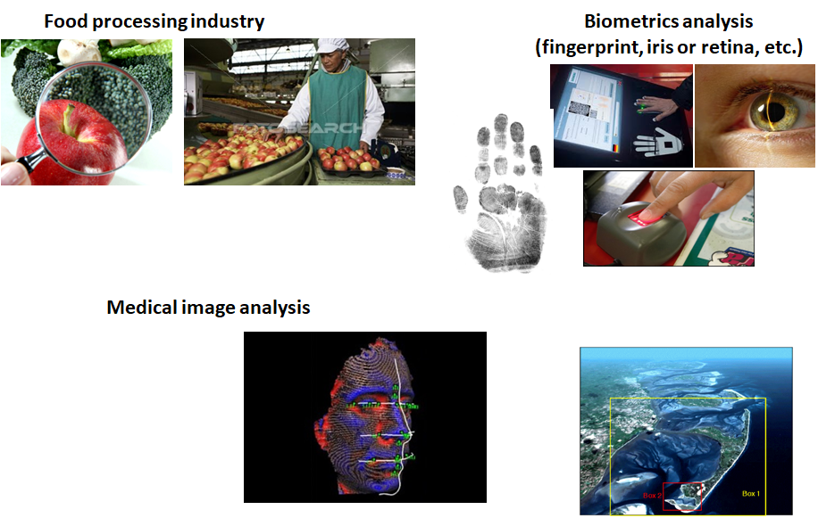
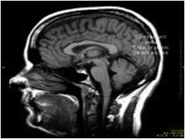
APPLICATIONS OF TEXTURE ANALYSIS
Global information system (GIS) (for land, etc. analysis

Slide 5
INTRODUCTION
WHAT IS TEXTURE?
Texture is that inborn property of all surfaces that describes visual patterns and contains important information about its arrangement. It describes the distinctive physical composition of a surface. Since an image is made up of pixels, texture can be defined as an entity consisting of mutually related pixels and group of pixels.
IT’S IMPORTANCE
Texture is a prominent and crucial feature for content-based image retrieval applications, image shape identification and image segmentation through pattern recognition and similarity matching. Periodicity, scalability, coarseness, inherent direction and pattern complexity are considered as the most perceptually distinct properties of texture.

Slide 6
INTRODUCTION
Since an image is made up of pixels, texture can be defined as an entity consisting of mutually related pixels and group of pixels. This group of pixels is called as texture primitives or texture elements. Texture depends on the distribution of intensity over the image rather than being defined for a separate pixel. Hence, texture based techniques can be applied only on a group of pixels and not a single pixel.
A lot of work has been done on analysis, classification and segmentation of texture but still it is considered as an active research topic. Numerous algorithms are being developed based on different techniques of image classification, and a lot of research is ongoing to improve their accuracy or in developing better, hybrid algorithms for image classification.

Slide 7
MOTIVATION
Texture is very important cue in region based segmentation of images. Texture features play a very important role in computer vision, pattern recognition. Apart from these, texture has been widely involved in many real life applications such as Remote Sensing, Biomedical Image Processing, Content-based Image Retrieval, and Rock and Wood Species Classification.
It is essential to find a set of texture features with good discriminating power to design an effective algorithm for texture Classification. Although there are various texture analysis methods, Gray Level Co-occurrence Matrix (GLCM) Algorithm (1986) is the most commonly adopted, among them all.
GLCM is very suitable for finding texture information in images of natural scenes and performs well in classification. Various features can be extracted from the GLCM and with a suitably chosen set of features to be extracted, texture classification with satisfactory accuracy can be easily achieved.

Slide 8
PROPOSED WORK
A texture based Image classification system using Gray Level Co-Occurrence Matrix (GLCM) based Statistical Features
Using GLCM as an input to the K Nearest Neighbor (k-NN) Classifier.
Extraction of six statistical features, namely - Correlation, Contrast, Energy, Dissimilarity, Angular Second Moment (ASM) and Homogeneity from each image of each category in the Training Data Set.
Training the k-NN Classifier with these feature vectors from the Training Data Set.
Feeding the classifier with the GLCM of each test difference image
Classification into trained image category, finding nearest 2 neighbours.
Improving the achieved accuracy of classification.

Slide 9
Gray Level Co-Occurrence Matrix (GLCM)
The Gray Level Co-occurrence Matrix (GLCM) is a square matrix, with dimension Ng, where Ng is the number of gray levels in the image.
GLCM paves the way of extracting second order statistical texture features, which can be used in Image Classification.
Element [i,j] of the GLCM matrix is generated by counting the number of times a pixel with value i is adjacent to a pixel with value j and then dividing the entire matrix by the total number of such comparisons made.
Each entry is therefore considered to be the probability P(i,j) that represents the probability of occurrence of a pixel with value i adjacent to a pixel of value j.

Slide 10
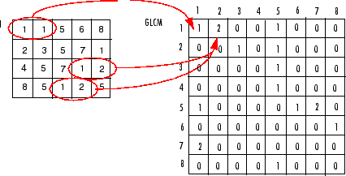
Creating the GLCM Matrix
To create a GLCM, we used the graycomatrix function in Python 3. The function creates a gray-level co-occurrence matrix (GLCM) by calculating how often a pixel with the intensity (gray-level) value i occurs in a specific spatial relationship to a pixel with the value j.
Each element (i,j) in the resultant glcm is simply the sum of the number of times that the pixel with value i occurred in the specified spatial relationship to a pixel with value j in the input image. This is later normalized to probabilities.
The gray-level co-occurrence matrix can reveal certain properties about the spatial distribution of the gray levels in the texture image. For example, if most of the entries in the GLCM are concentrated along the diagonal, the texture is coarse with respect to the specified offset. You can also derive several statistical measures from the GLCM.

Slide 11
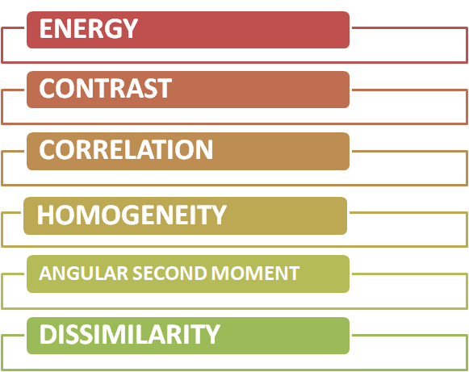
FEATURE EXTRACTION
We have extracted six major features from the Gray Level Co-Occurence Matrix (GLCM) to create the feature Vector Database for Image Classification

Slide 12
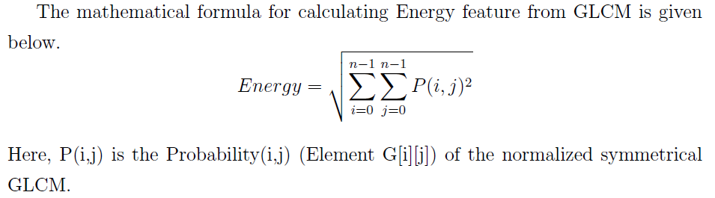
Energy
The texture energy measures are considered as one of the first filtering approaches to texture analysis. Energy can be defined as the measure of the extent of pixel pair repetitions. It measures the uniformity of an image.

Slide 13
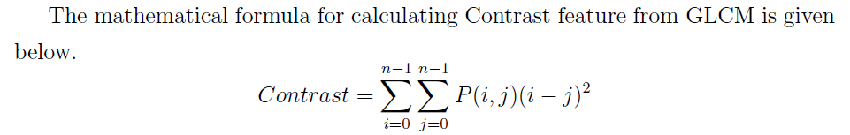
Contrast
Contrast reflects the sharpness of images and the depth of texture grooves. Contrast is determined by the difference in the colour and brightness of the object and other objects within the same field of view.

Slide 14
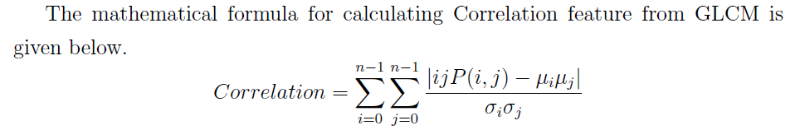



Correlation
Correlation measures the linear dependency of grey levels of neighboring pixels. This is often used to measure deformation, displacement, strain and optical flow, but it is widely applied in many areas of science and engineering.

Slide 15
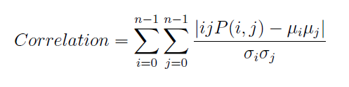
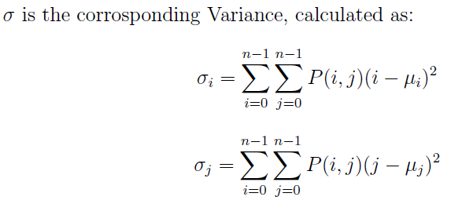
Correlation (cond.)
First-order statistics (e.g. Mean and Variance) estimate properties of individual pixel values, ignoring the spatial interaction between image pixels, whereas second order and higher-order statistics estimate properties of two or more pixel values occurring at specific locations relative to each other.

Slide 16
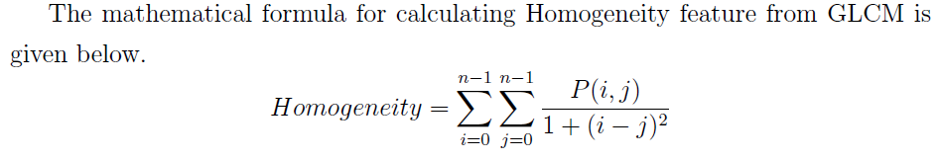
Homogeneity
Homogeneity measures the closeness of the distribution of elements in the gray level matrix. The image is thus partitioned into a set of homogeneous texture regions, and then the texture features associated with the regions are indexed in the image data. GLCM Homogeneity are calculated for four directions (i.e. = 0 ◦ , 45 ◦ , 90 ◦ or 135 ◦ ).

Slide 17
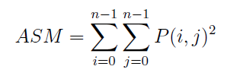
Angular Second Moment (ASM)
Angular Second Moment (also known as Uniformity) is the sum of squares of pixel entities in the GLCM. Angular Second Moment (ASM) is closely related to image homogeneity. Energy is the square root of ASM.

Slide 18
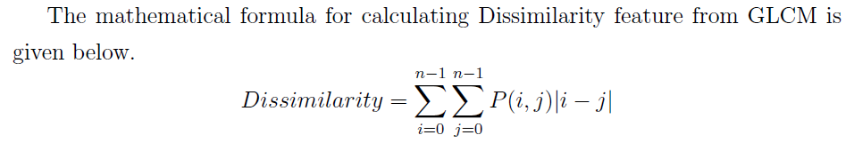
Dissimilarity
The measure of dissimilarity allows principled comparisons between segments created by different algorithms, as well as the segmentation on different images. Texture features are used on the basis of dissimilarity between the two feature vectors which represents relative frequency distribution.

Slide 19
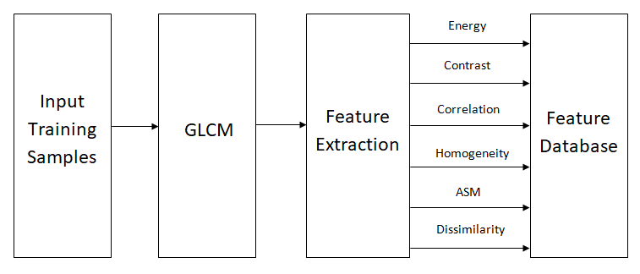
FEATURE EXTRACTION STAGE

Slide 20
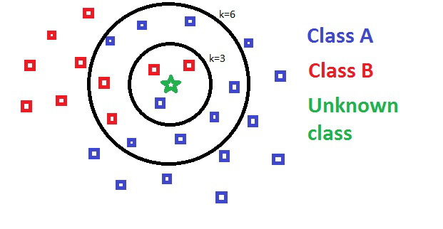
k-NN CLASSIFIER
In k-NN classification, the output is a class membership.
An object is classified by a majority vote of its neighbors, with the object being assigned to the class most common among its k nearest neighbors.
If k = 1, then the object is simply assigned to the class of that single nearest neighbor.
If k = 2…...
If k = 3…….
If k = 6…....

Slide 21
IMAGE CLASSIFICATION BASED ON GLCM TEXTURE FEATURES
Training the k-NN Classifier
TESTING : Classification
Classification Analysis
The k-NN Classifier is fed with the Training Data Set firstly. For all the Image categories, it calculates the GLCM for each image in them, and the extracted 6 texture features are stored for each image in each category in the Feature Database.
The system using a k-NN Classifier is fed with a randomly chosen input test image. Again, for this image GLCM and the corresponding feature vector is obtained, and is then compared to the features stored for each image category, from the Feature Database
The k-NN Classifier finds the nearest neighbours (in terms of distance) of the image category for the test image and in the output, a maximum of 2 Image Classification results based on the Distance Threshold are displayed.

Slide 22
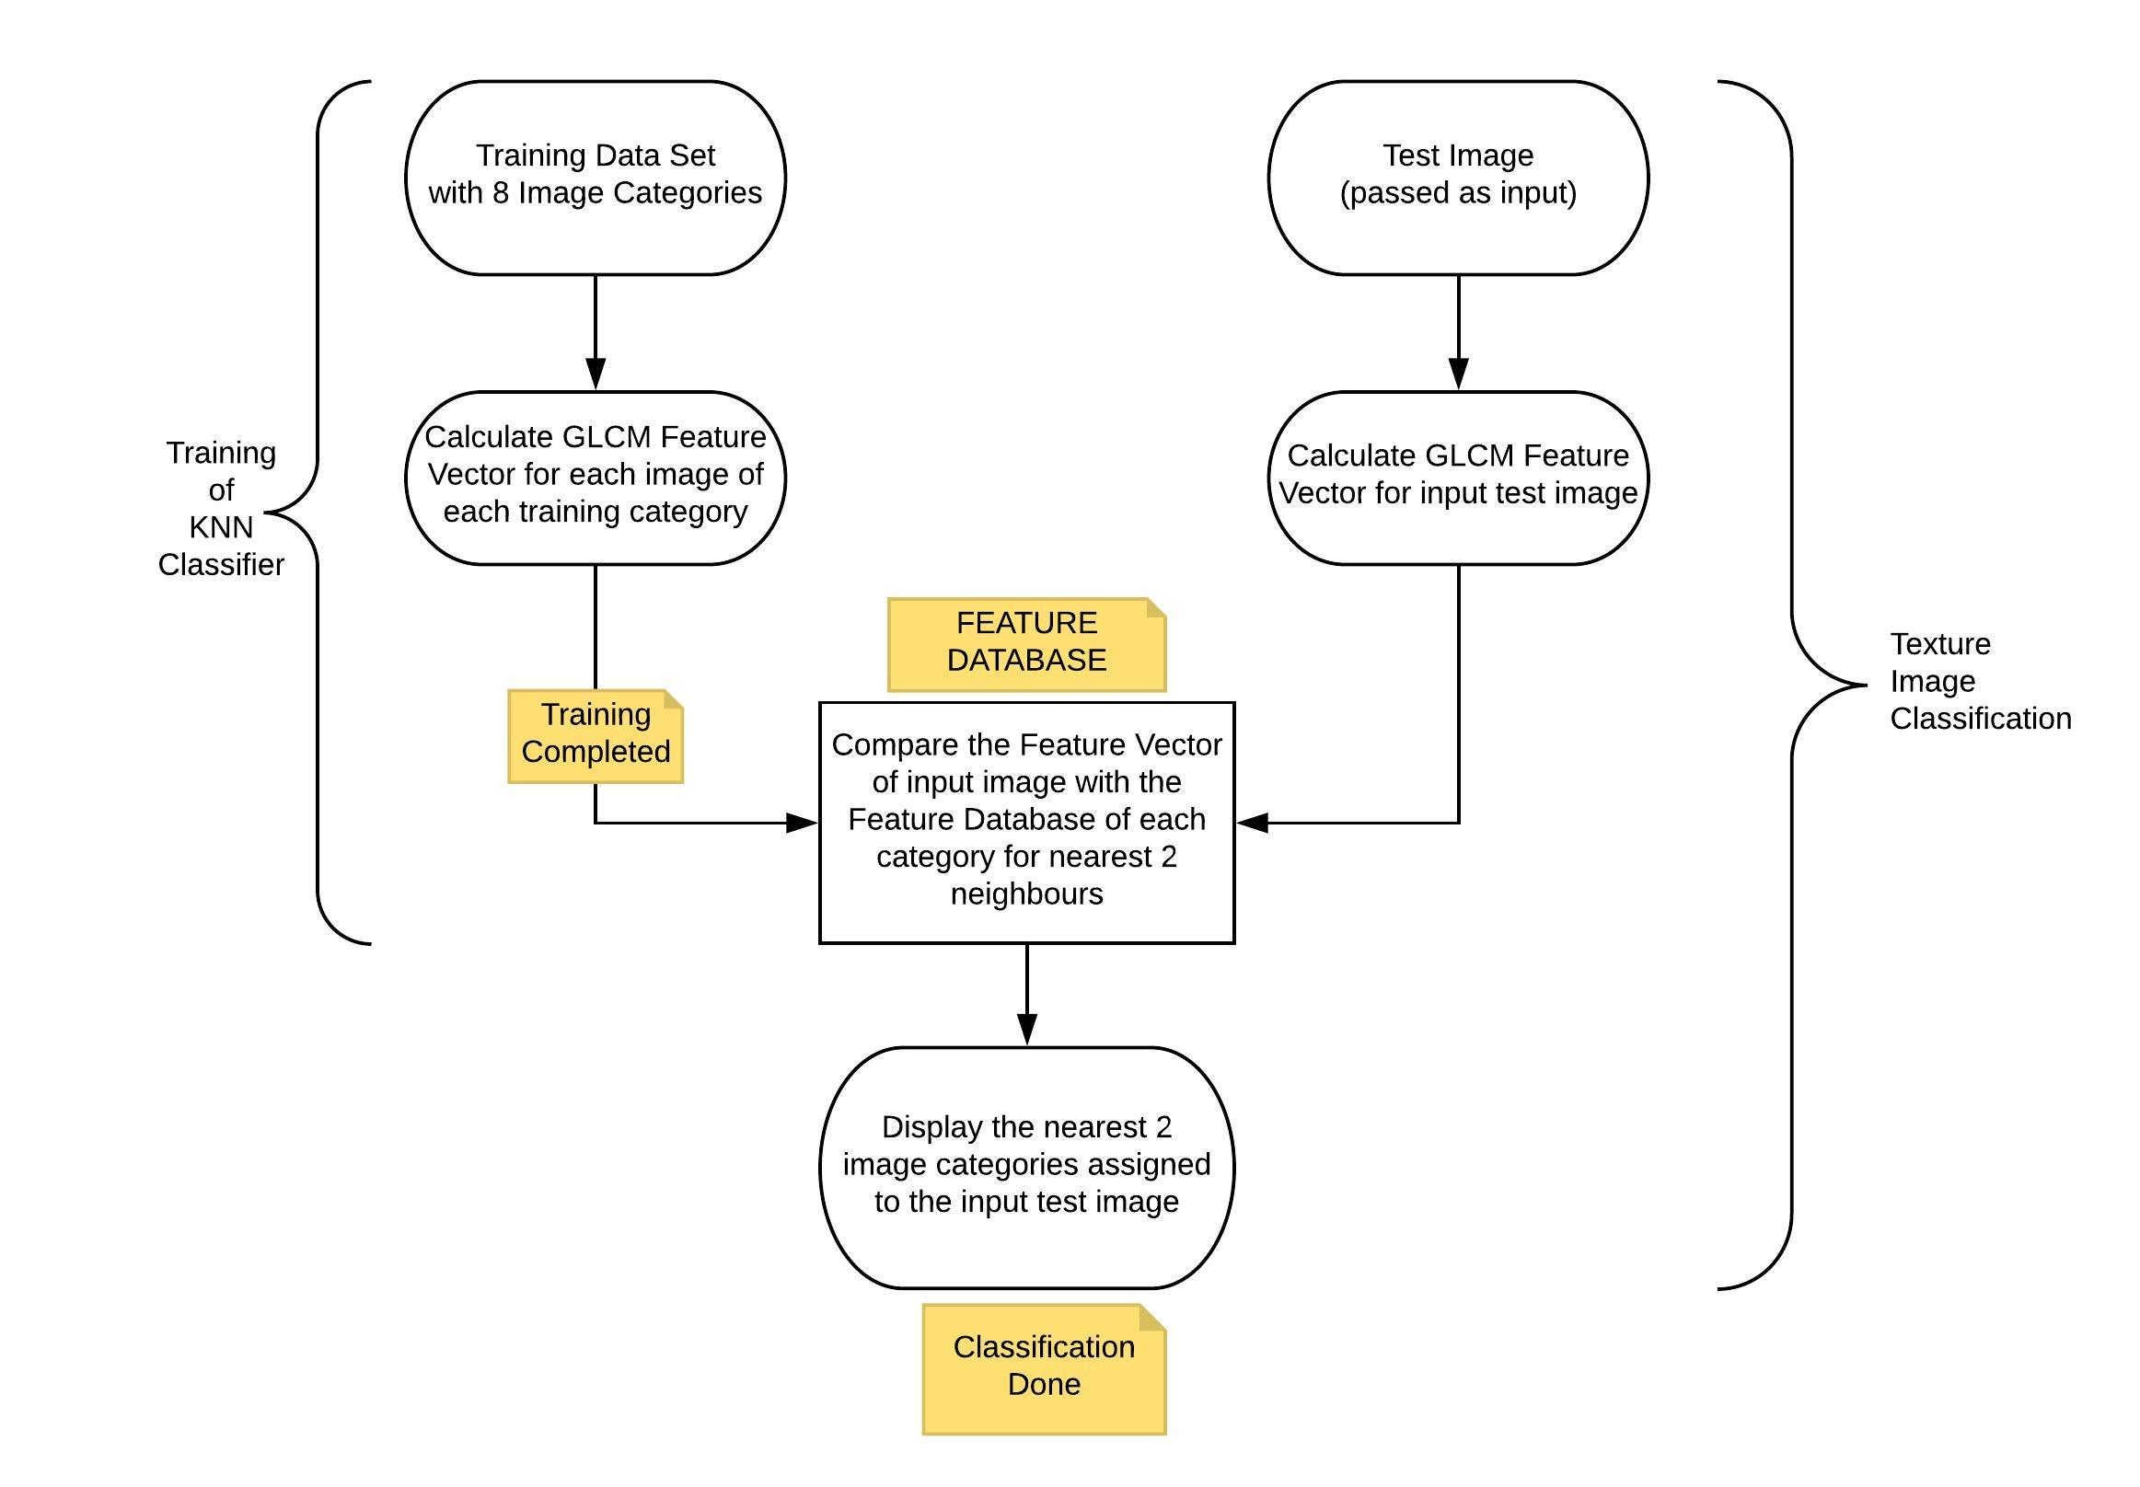

Slide 23
Experimental Setup
In the classification phase, firstly a set of randomly chosen images (about 40-100 images per category) is used as the Training data set. Each image is of size 640 x 640 pixels with 256 gray levels. We used the “Caltech 101 Object Categories” Data Set [1] for the training of our classifier, from where 8 image Categories were chosen from the Training Data Set, which are :
1. Ant
2. Butterfly
3. Face
4. Laptop
5. Pigeon
6. Scissors
7. Soccer Ball
8. Starfish

Slide 24
Benefits of The UNKNOWN Image Category
Upon successfully training the k-NN classifier, we get the Feature Database, which acts as one of the inputs given to the k-NN classifier, for each of the test images. Upon passing a randomly chosen Test Image (not existing in the Training Data Set) to the trained k-NN classifier, classification of the test image into one of the 8 Training Image categories, or simply an “Unknown” image category is achieved.
It is noteworthy to mention that when the distance approximation for the nearest image category exceeds a chosen “threshold distance" limit, the test image is said to be belonging to the “Unknown" image Category.
With the inclusion of the provision of “threshold distance" and and thus another (9th) image Category, the “Unknown" image Category, a Reverse Analysis for each of the 8 Image Categories is also easily done.

Slide 25
Results Analysis
Also, for the 20 images taken from the Unknown category, 13 (i.e. 65%) were correctly classified to be belonging to the “unknown" category by the GLCM features based k-NN Classifier, in the first match itself, and the accuracy rose to 75% if we consider the first two image categorizations.
Upon training the k-NN Classifier with a total of 811 images belonging to the chosen 8 different categories.
The feature database obtained was used to test 100 randomly chosen images (not belonging in the training set), wherein 10 images from each of the 8 image categories (10 x 8 = 80 images) along with 20 other images from the “unknown" custom image category were fed to the k-NN Classifier for classification analysis.
03
02
Upon classification of 100 images in the Test Data Set, we observed the algorithm
providing an accuracy of 71.667% upon the first classification prediction, which increases upto an accuracy of 89.44% upon considering the first 2 predictions of Image categories.
01

Slide 26
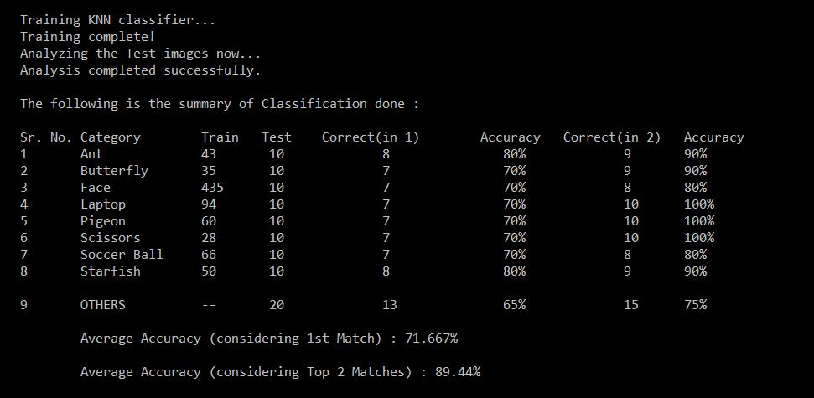
Results Analysis

Slide 27
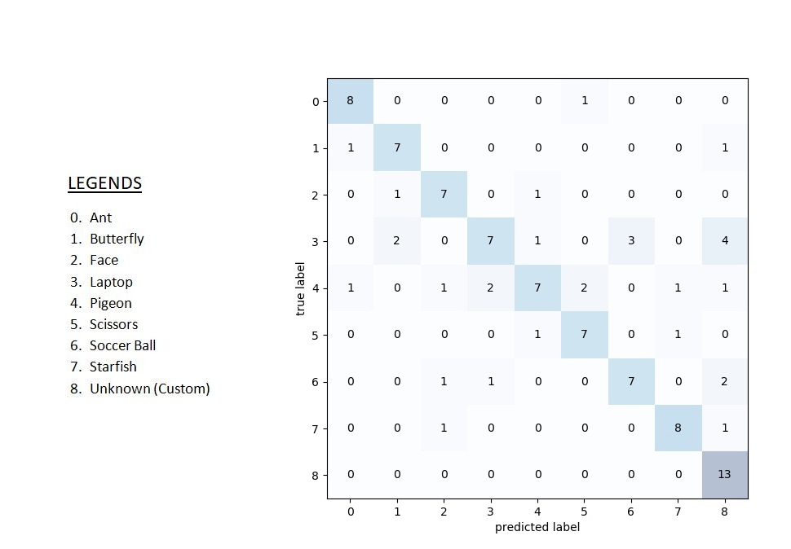
Confusion Matrix

Slide 28
CONCLUSION
Upon Analysis with a properly trained set of 8 Image Categories along with an added Image category, the “unknown" image category, quite accurate classification for the test images was achieved. Several improvements in the model were done and finally an accuracy of 71.667% upon the first classification prediction was achieved, which increased upto an accuracy of 89.44% upon considering the first 2 predictions of Image categories.

Slide 29
FUTURE WORK
This project of ours is an integral stepping stone towards the development of our final year project, which involves the use of an accurate Image Classifier. Once classification of images is successfully done, we can work upon improving its accuracy using a better, modified algorithm and thus getting fast retrieval for content segregation.
Although different people may interpret the same image in different ways, we still can build a universal classification for different emotions. The Emotion Based Image Search is a new concept in an innovative field of Image Processing domain. Image processing domain has always proven to be a challenging criterion in field of research and development.
Our proposed work which is Texture Based Image Classification using Gray Level Co Occurrence Matrix (GLCM) Based Statistical Features is an important subpart of our final year project which is Emotion based Image Search System.

Slide 30
REFERENCES
[1] Data Set Used : Caltech 101 “101 ObjectCategories.tar.gz" (131Mbytes) :
http://www.vision.caltech.edu/Image Datasets/Caltech101/101 ObjectCategories.tar.gz
[2] A. Suresh and K. L. Shunmuganathan, “Image Classification using GLCM Based Texture Features”, European Journal of Scientific Research, Vol.75 No.4 (2012), pp. 591-597
[3] Mansi Saraswat, Anil Kumar Goswami and Aastha Tiwari, “Object Recognition Using Texture Based Analysis”, (IJCSIT) International Journal of Computer Science and Information Technologies, Vol. 4 (6) , 2013, 775-782

Slide 31
THANK YOU

