Slide 1
S
SimplyStore — Week 3 Feature Additions
3rd Weekly Review — Comprehensive Showcase of Newly Added Features & Services
Presenter: Avrojit Saha (Intern) | Role: Full-Stack Developer
Date: July 2026 | Focus: Week 3 Sprint Feature Visuals & Demonstration

Slide 2
WEEK 3 NEW FEATURES & SPRINT DELIVERABLES
Week 3 Sprint Overview & Completed Deliverables
5 New Services
Added in Week 3 Sprints
100% Tax Compliant
Indian GST Invoicing Engine
Vendor KYC Queue
Admin Document Verification
B2B Wholesale
Price Quote Negotiation
✨ Week 3 New Feature Additions
• 1. Indian GST Calculation Engine (CGST, SGST, IGST 18%)
• 2. Sequential Legal Invoicing System (INV-2026-00001)
• 3. Gamified Loyalty Rewards & Custom Referral Links
• 4. B2B Wholesale Price Quote Negotiation Portal
• 5. Vendor Sales Velocity & Inventory Reorder Forecasting
• 6. Admin Vendor KYC Verification Queue (GSTIN/PAN/Bank)
🔧 Infrastructure & Bug Fixes This Week
✔ Express 5 compatibility fix in express-mongo-sanitize
✔ Atomic Mongoose $inc stock decrement preventing overselling
✔ Zero-config MongoMemoryServer fallback with auto-seeding
✔ GDPR data export and account deletion API endpoints
✔ Razorpay payment signature validation & verification
✔ PWA service worker offline support & push notifications

Slide 3
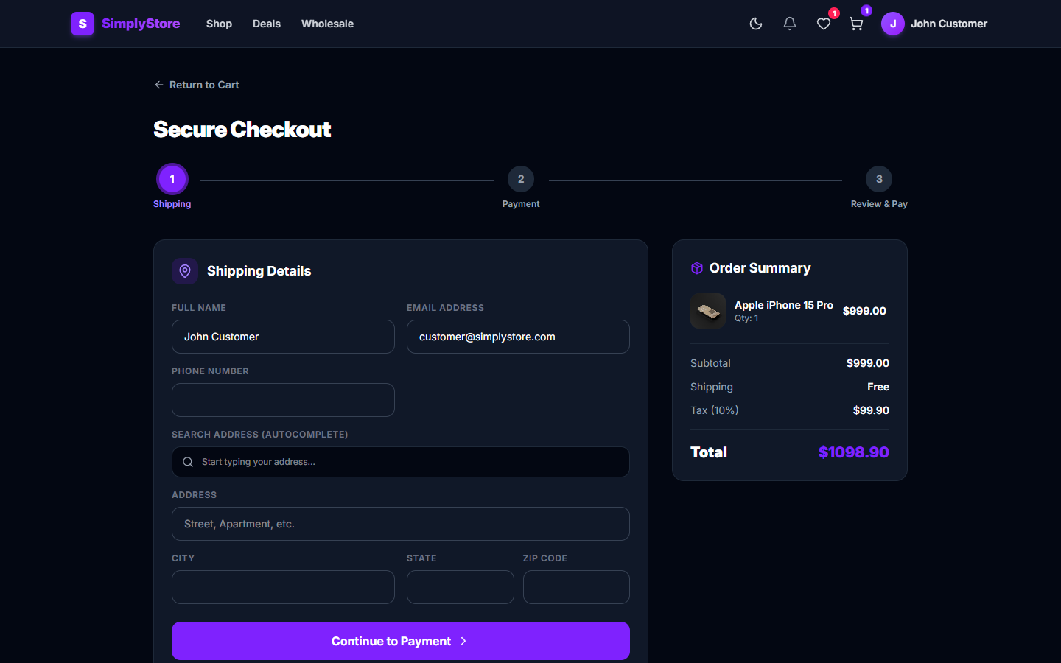
WEEK 3 NEW FEATURES & SPRINT DELIVERABLES
Week 3 Feature 1: Indian GST Tax Engine & Invoicing
New Service Added This Week
• Automated GST Breakdown: Calculates CGST (9%) + SGST (9%) for intra-state transactions or IGST (18%) for inter-state buyer addresses.
• Free Shipping Threshold: Dynamic progress bar targeting $150 free shipping eligibility.
• Sequential Invoicing: Generates legally compliant invoice numbers (e.g., INV-2026-00001) backed by an atomic counter.
• Atomic Stock Lock: Reserves inventory atomically during checkout to eliminate race conditions.

Slide 4
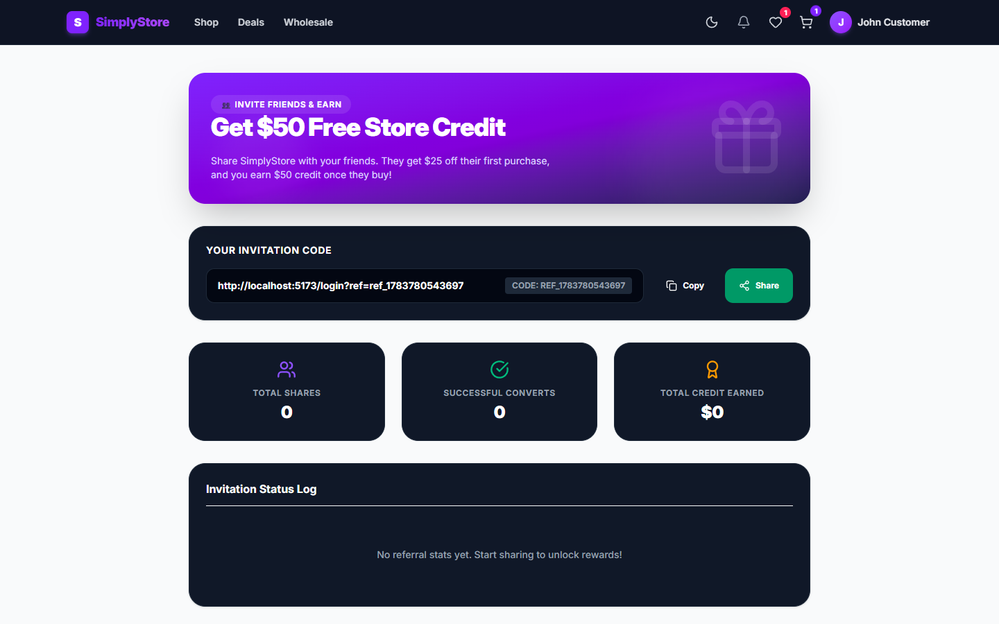
WEEK 3 NEW FEATURES & SPRINT DELIVERABLES
Week 3 Feature 2: Loyalty Rewards & Referral Program
New Service Added This Week
• Gamified Tier Badges: Tiered user progression (Bronze, Silver, Gold, Platinum) with custom badges.
• Points Earning & Credit Redemption: Customers earn 1 point per $10 spent; redeem points for instant checkout credits.
• Shareable Referral Links: Generates unique user referral URLs (e.g. ref_user123).
• Referral Cashback: Credits bonus reward points upon successful referred friend purchases.

Slide 5
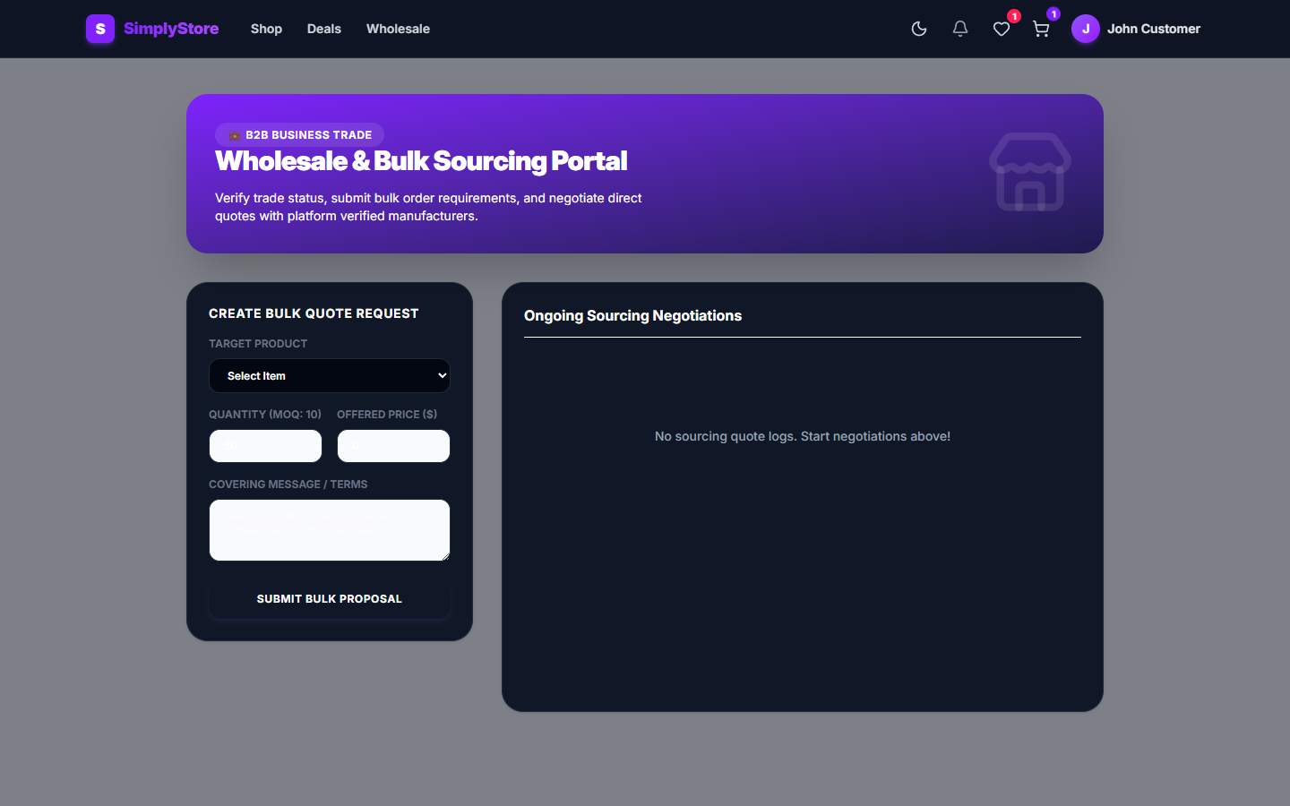
WEEK 3 NEW FEATURES & SPRINT DELIVERABLES
Week 3 Feature 3: B2B Wholesale Quote Negotiation
New Service Added This Week
• Bulk Buyer Quote Submission: Dedicated wholesale portal enabling bulk quantity purchase requests.
• Custom Price Negotiation: Buyers submit custom unit price offers and messaging notes to vendors.
• Vendor Quote Management: Vendors review, accept, reject, or counter-offer wholesale quotes.
• Direct Cart Conversion: Approved quotes convert into one-click bulk checkout orders.

Slide 6
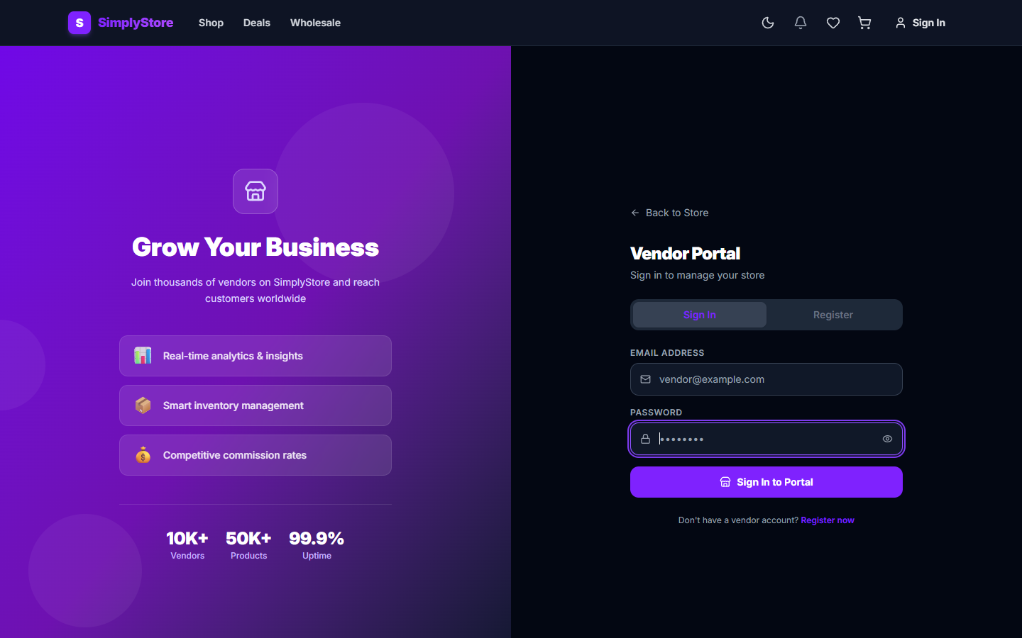
WEEK 3 NEW FEATURES & SPRINT DELIVERABLES
Week 3 Feature 4: Vendor Velocity & Reorder Forecast
New Service Added This Week
• Product Sales Velocity: Real-time velocity tracking for top 5 selling vendor items.
• Automated Reorder Forecasting: Predicts stock depletion dates and recommends reorder quantities.
• Rule-Based Dynamic Pricing: Enables vendors to set automated stock-level and time-based discount rules.
• Vendor SLA Performance Score: Evaluates fulfillment accuracy, return rate, and stock reliability.

Slide 7
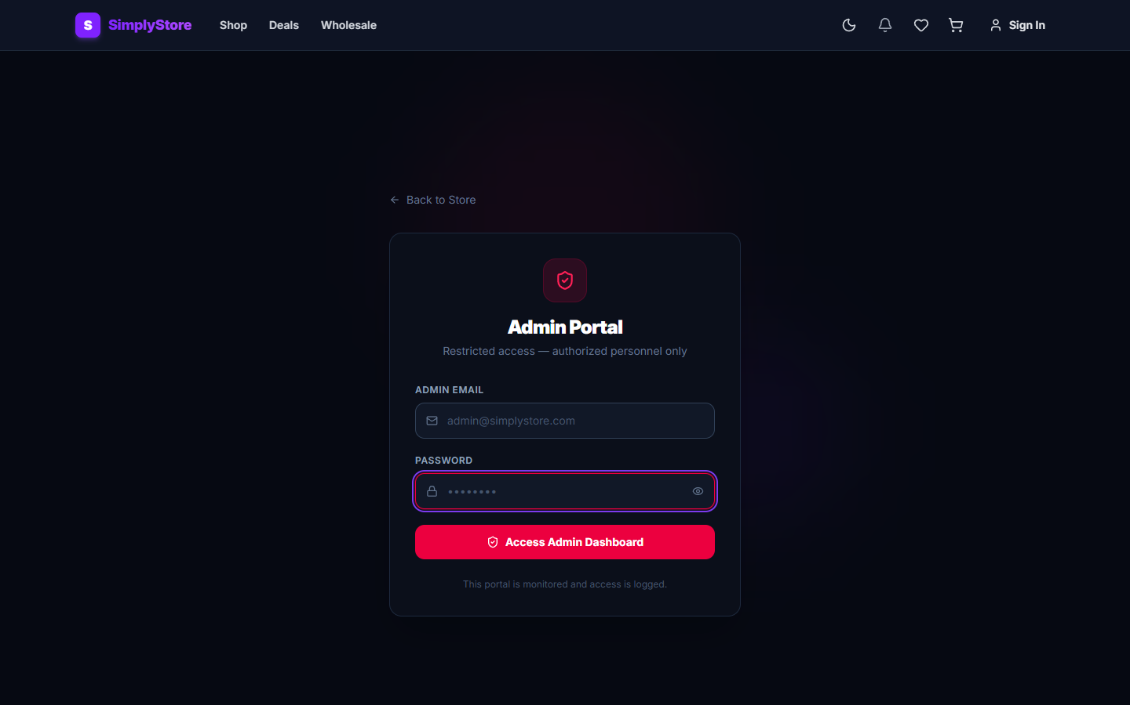
WEEK 3 NEW FEATURES & SPRINT DELIVERABLES
Week 3 Feature 5: Admin Vendor KYC Verification Queue
New Service Added This Week
• KYC Document Queue: Dedicated verification queue (/admin) reviewing vendor GSTIN, PAN, and Bank details.
• One-Click Compliance Actions: Admins can approve or reject vendor onboarding with reason notes.
• Global Inventory Supervision: Monitor product stock across all active marketplace vendors.
• CSV Order Exporter: One-click export of complete order history for reporting and accounting.

Slide 8
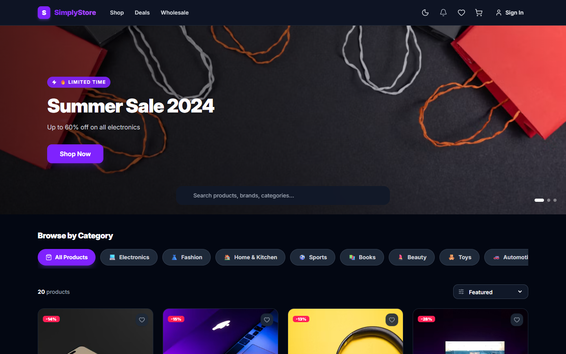
WEEK 3 NEW FEATURES & SPRINT DELIVERABLES
Customer Storefront — Catalog & Product Discovery
Storefront Experience
• Dynamic Filtering: Instant category filtering across Electronics, Fashion, Home & Kitchen.
• Regex Search Engine: Client and server-side text search with instant results.
• Real-Time Stock Alerts: Badges indicating low stock ('Only 5 left') and discount chips.
• Dark / Light Mode: Seamless theme toggle for enhanced accessibility.

Slide 9
WEEK 3 NEW FEATURES & SPRINT DELIVERABLES
Quality Assurance, Security & Concurrency Engineering
Atomic Concurrency Locks
Prevented negative inventory race conditions by utilizing Mongoose atomic $inc operations with $gte stock verification during checkout.
Express 5 Compatibility
Resolved req.query getter property conflict in express-mongo-sanitize middleware by implementing safe in-place body sanitization.
Resilient DB Fallback
Created zero-config MongoMemoryServer fallback in connectDB that automatically spins up an in-memory MongoDB instance with auto-seeding.
GDPR & Security Audit
Implemented GDPR data-export and account deletion APIs. Enforced rate limiting, password hashing (bcrypt), and JWT role verification.

Slide 10
WEEK 3 NEW FEATURES & SPRINT DELIVERABLES
Internship Review 3 Summary & Upcoming Roadmap
✅ Week 3 Review Accomplishments
✔ 100% Clean Build: Vite 8 compiled 2835 frontend modules cleanly
✔ Runtime Verification: Verified Customer, Vendor, and Admin authentication & workflows
✔ Week 3 Feature Suite: Indian GST, Loyalty/Referrals, B2B Wholesale, Vendor Intelligence, Admin KYC Queue
✔ Comprehensive Deliverables: Updated widescreen PPT deck, detailed PDF report, and 3-minute master video walkthrough
🚀 Future Development Roadmap
➔ AI Shopping Assistant: Recommendation agent for personalized discovery
➔ Visual Search: AI image recognition product search
➔ Native Mobile Apps: React Native / Expo iOS & Android builds
➔ Internationalization: Multi-currency & multi-language support

