Slide 1


COCO Convertor
.XML, .TXT, .CSV
TO
COCO FORMAT ( .JSON )

Slide 2

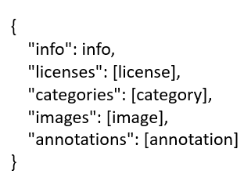


COCO FORMAT

Slide 3
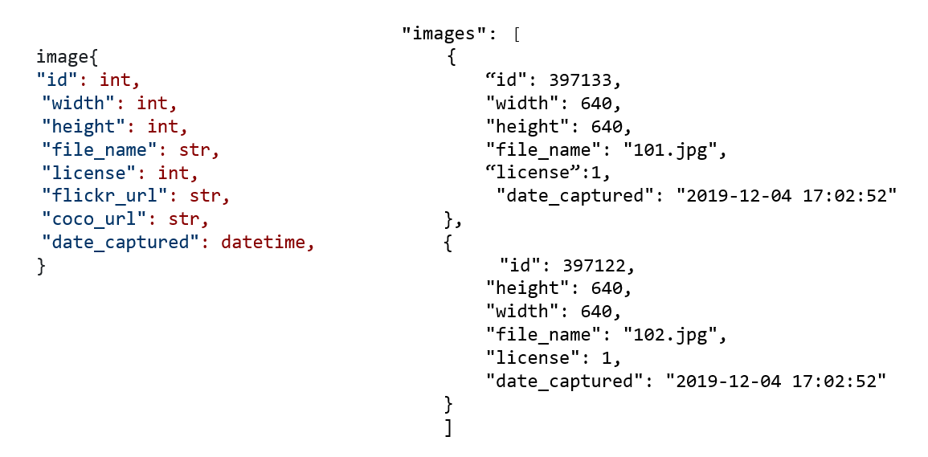

Slide 4
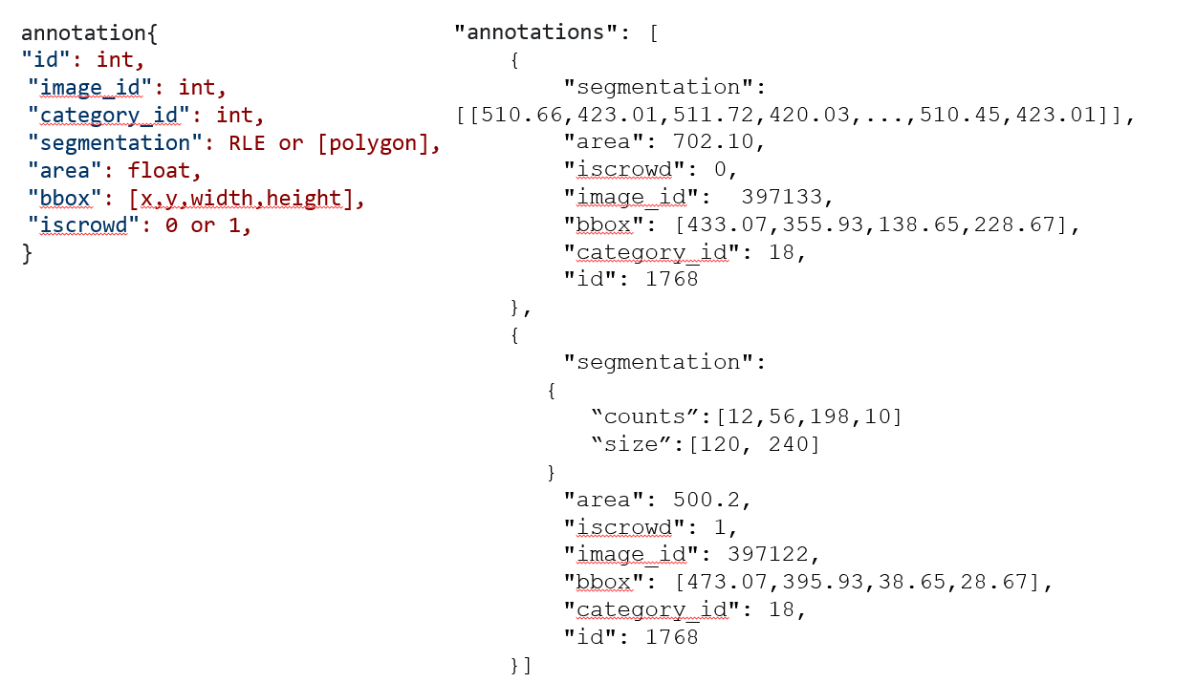

Slide 5

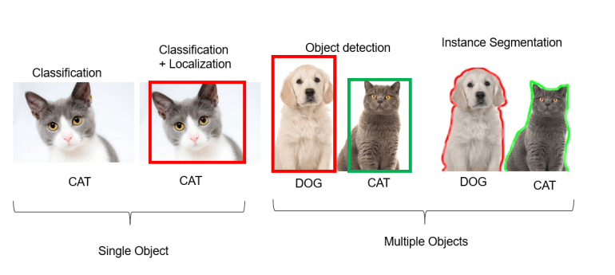


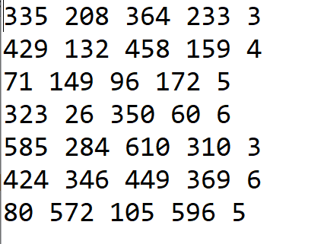

Slide 6

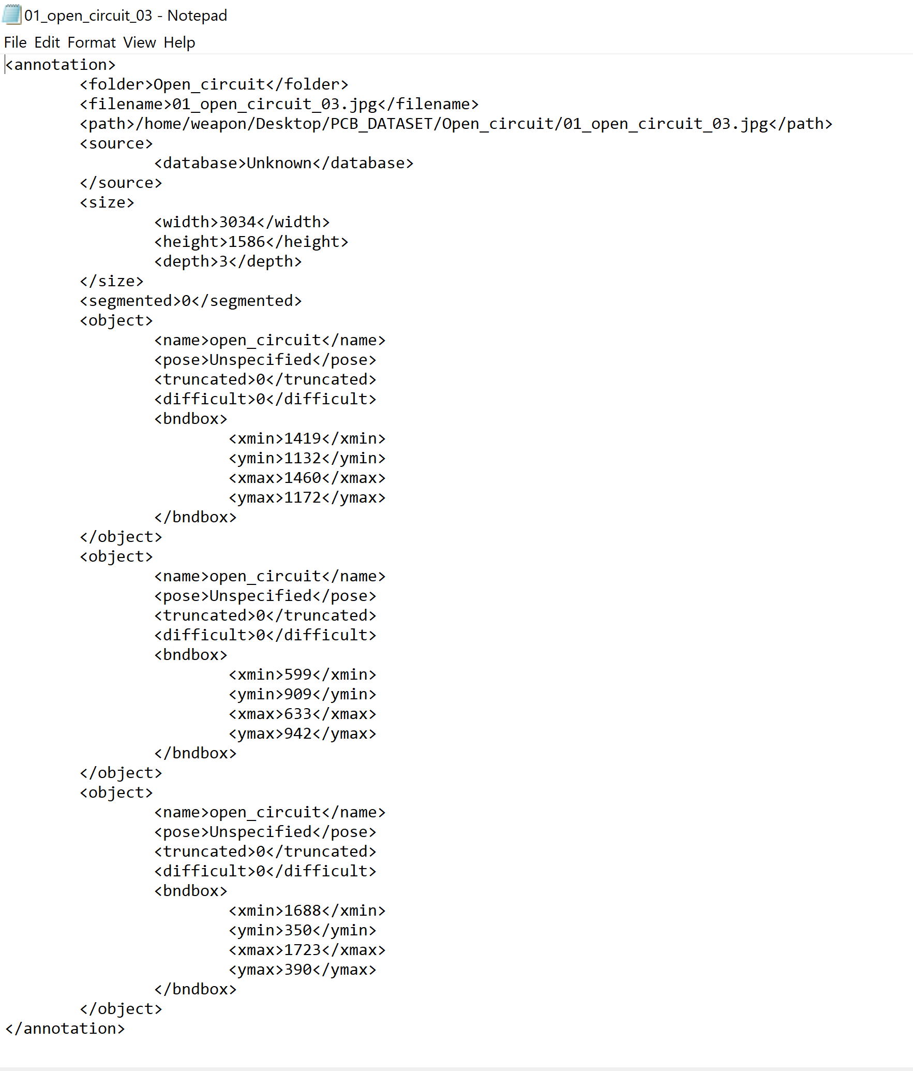
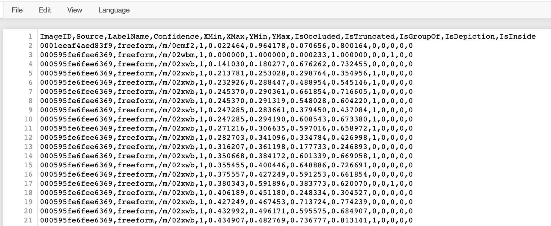
NOTEPAD
EXCEL
XML
CSV

