Slide 1


DEEP PCB TO COCO Convertor
ALLENA VENKATA SAI ABHISHEK
Dept of Computer Science and Engineering

Slide 2
ABSTRACT
The MS COCO (Microsoft Common Objects in Context) dataset is a large-scale object detection, segmentation, key-point detection, and captioning dataset. It is widely used for various models.
The dataset consists of 328K images. Coco defines 91 classes but the data only uses 80 classes. So, we are trying to convert the other dataset format into COCO format.
Deep PCB is a manufacturing defect data set. It has 1500 image pairs. Each has a template image & a test image. The template image has no defects & corresponding test image that has some defects with the annotations in a text file.
We are trying to convert the deep PCB Manufacturing defect into MS COCO Format and create metadata about the converted dataset COCO format..

Slide 3
LITERATURE SURVEY
 | Journal Type and year | Authors | Title | Summary
1 | IEEE, 2019 | Weibo Huang, Peng Wei | A PCB Dataset for Defects Detection and Classification | Given the brief introduction about the Deep PCB Manufacturing Defectdataset
2 | IEEE, 2015 | Tsung-Yi Lin Michael Maire Serge Belongie Lubomir Bourdev Ross Girshick, James Hays Pietro Perona Deva Ramanan C. Lawrence Zitnick Piotr Dollar | Microsoft COCO: Common Objects in Context | Gathered images of complex everyday scenes containing common objects in their natural context & made the COCO dataset. Dataset contains photos of 91 objects types that would be easily recognizable by a 4-year-old. With a total of 2.5 million labeled instances in 328k images.
3 | IEEE, 2017 | Lin et al. in Microsoft COCO: Common Objects in Context | COCO (Microsoft Common Objects in Context) | The COCO dataset format was explained in this

Slide 4
Deep PCB Manufacturing defect dataset is an existing dataset. MS COCO Format is an existing dataset format. Reading a text file using python
Existing System

Slide 5
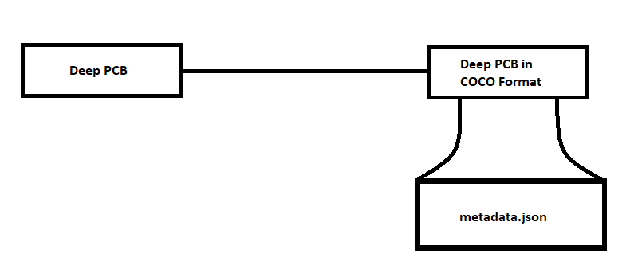
Converting the Deep PCB manufacturing defect dataset into MS COCO format
Proposed System

Slide 6
Problem Definition
Input: Deep PCB Dataset - 1. Image directories , 2. Annotation Text files
Output: MS COCO JSON

Slide 7
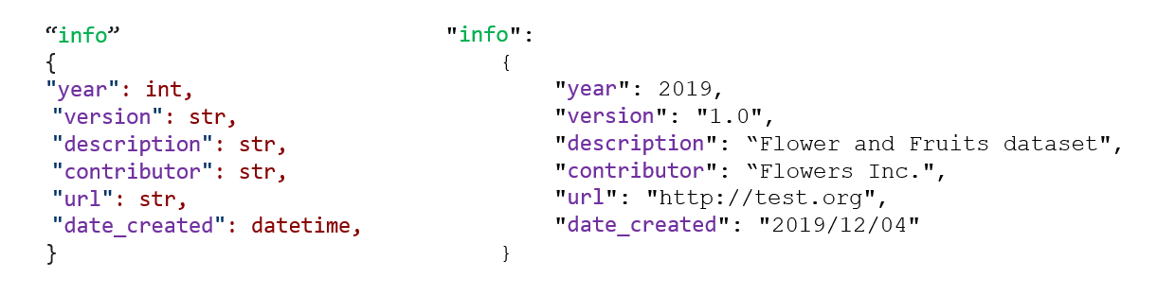
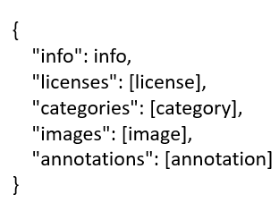
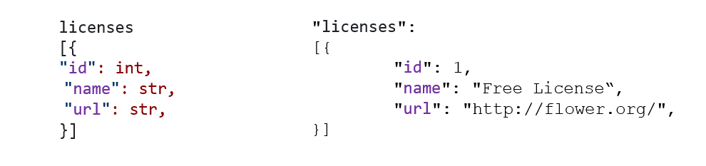
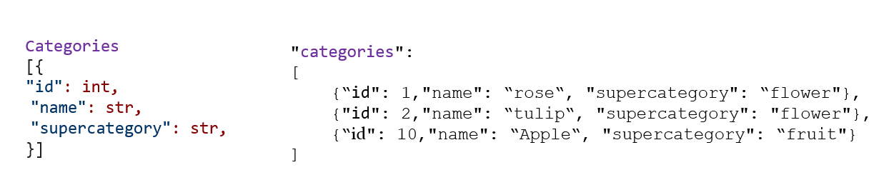
COCO FORMAT

Slide 8
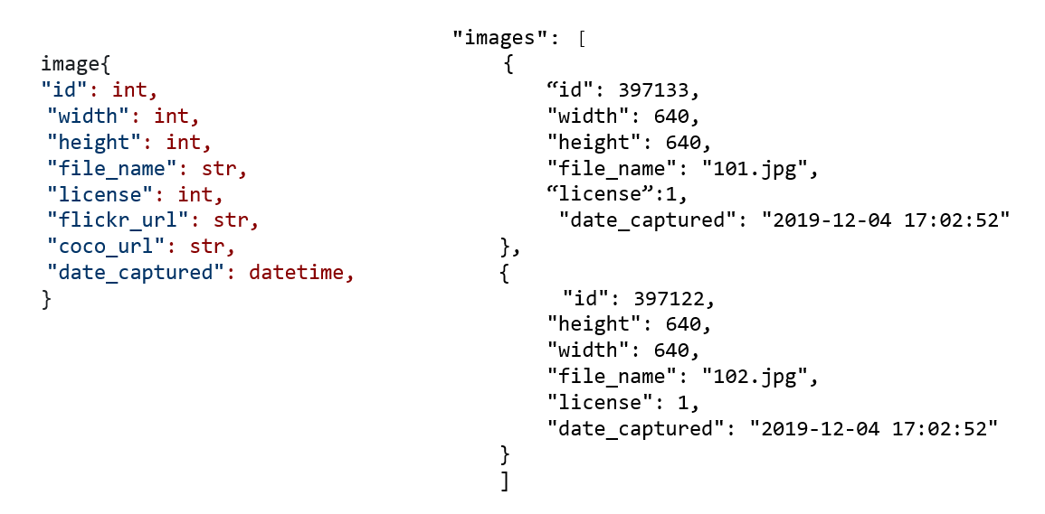

Slide 9
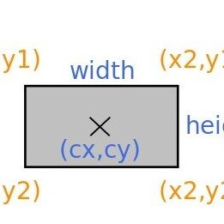
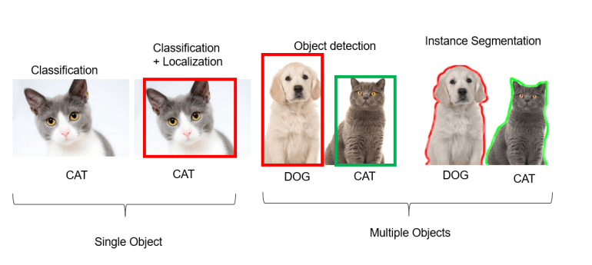

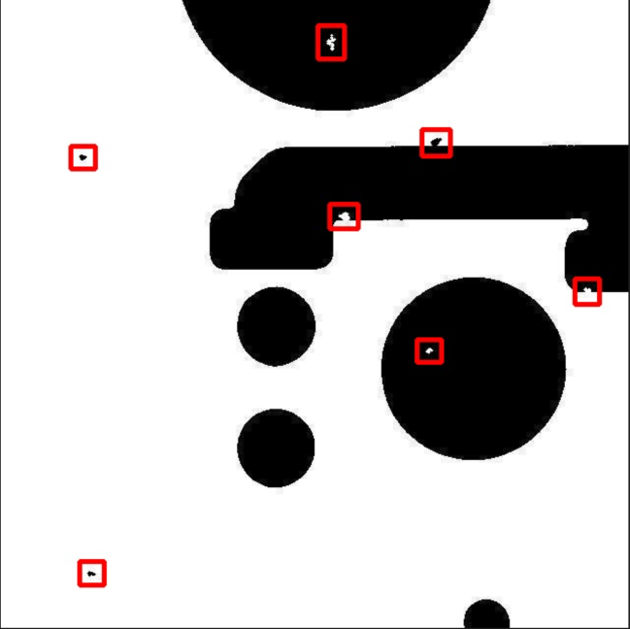
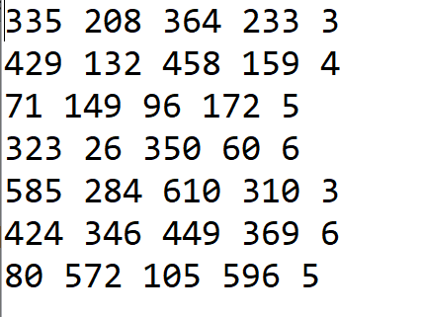

Slide 10
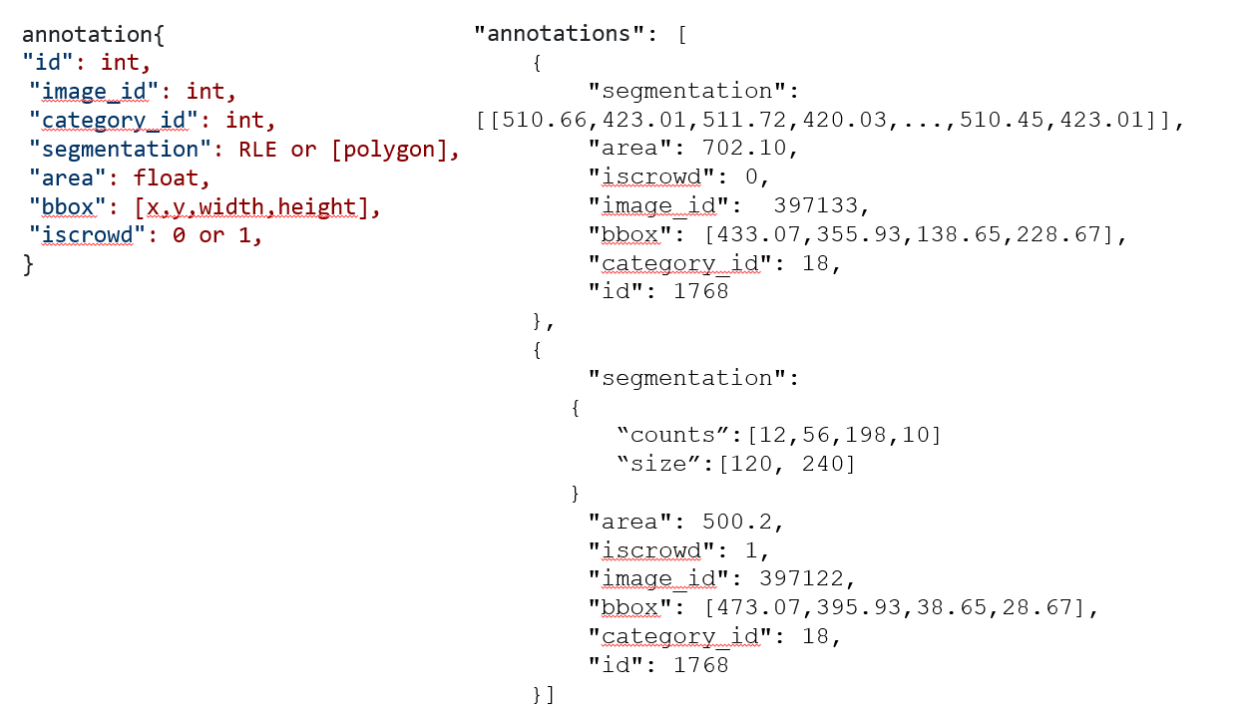

Slide 11
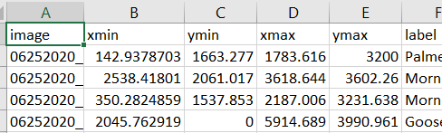
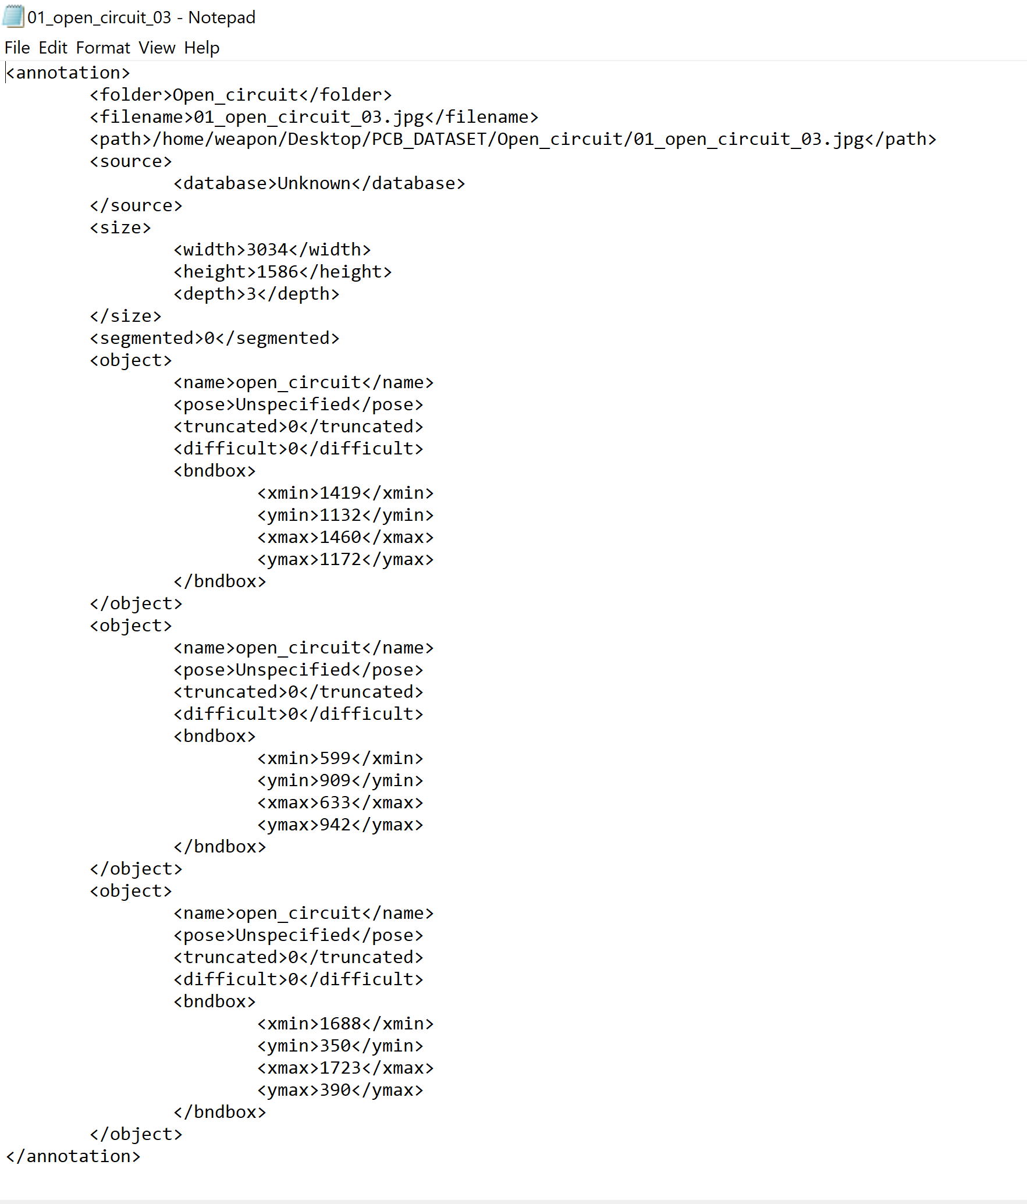
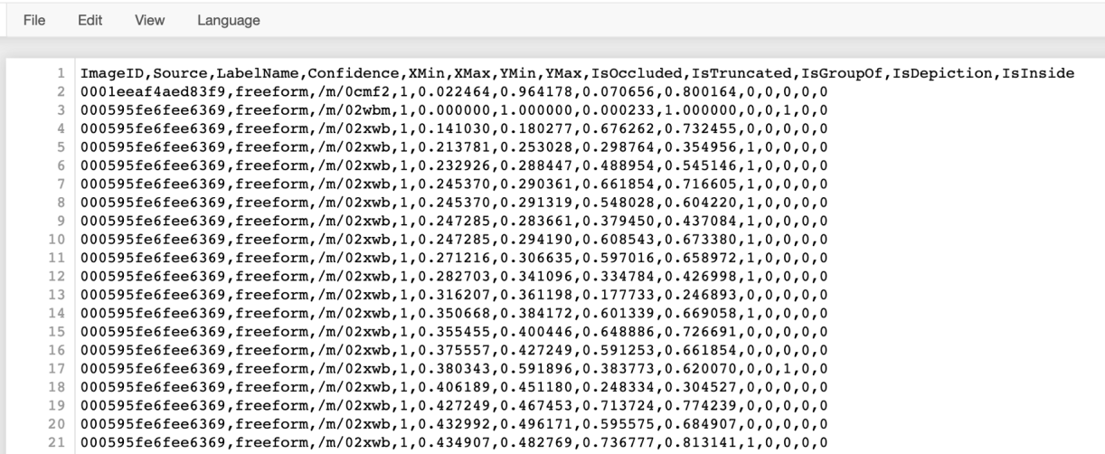
NOTEPAD
EXCEL
XML
CSV

Slide 12
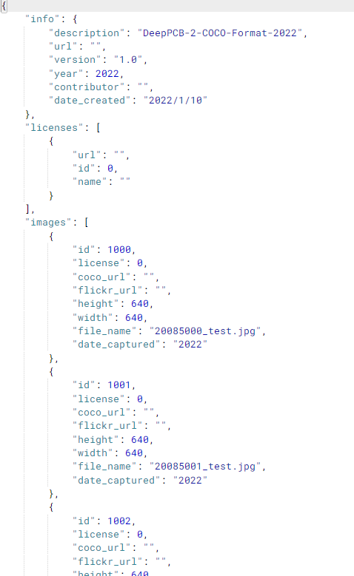
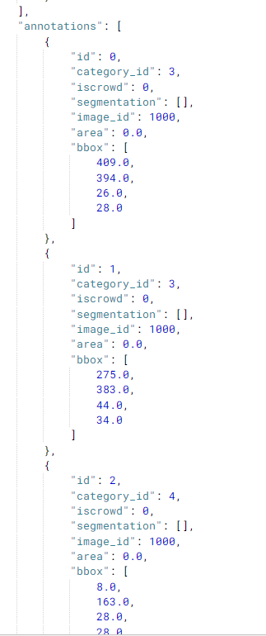
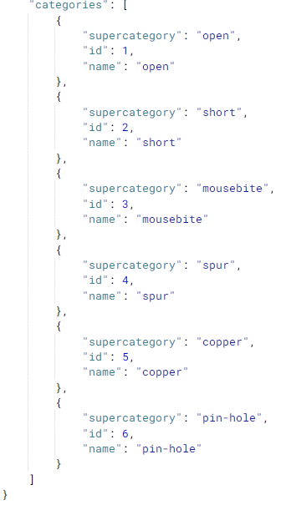
RESULTS
Deep PCB in COCO format ANNOTATION JSON

Slide 13
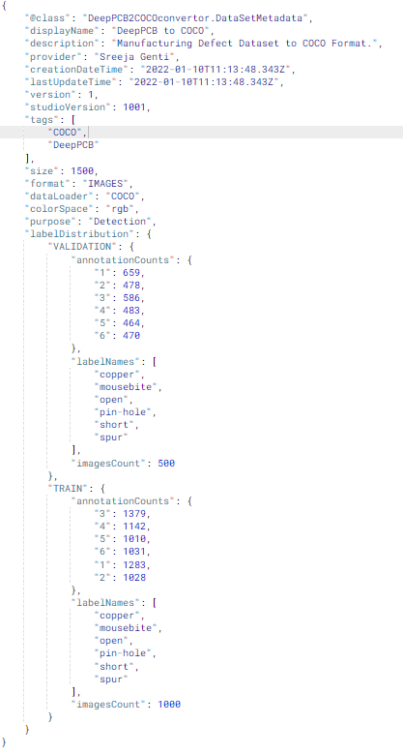
METADATA
Information About The Data. It Guides
Used In Corporate Sector
It Saves Time And Manpower

Slide 14
CONCLUSION
The PCB datasets is converted into COCO format.
Files are shared throughout the corporate in this format structure
Images ( which has all the images ).
Annotations ( which has the train and test set COCO Json files.
Metadata

Slide 15
References
1. A PCB Dataset for Defects Detection and Classification - Mateusz Buda, Atsuto Maki, Maciej A. Mazurowski ( https://arxiv.org/pdf/1901.08204v1.pdf )
2. Microsoft COCO: Common Objects in Context Lin et al. in Microsoft COCO ( https://arxiv.org/pdf/1405.0312.pdf )
3. COCO (Microsoft Common Objects in Context) Lin et al. in Microsoft COCO ( https://paperswithcode.com/dataset/coco )
4. Sanli Tang, Fan He, Xiaolin Huang, Jie Yang (2019) “Online PCB Defect Detector On A New PCB Defect Dataset” arXiv:1902.06197 [cs.CV] [5] Lv, Teng & Yan, Ping & He, Weimin. (2018). Survey on JSON Data Modelling. Journal of Physics: Conference Series. 1069. 012101. 10.1088/1742-6596/1069/1/012101.
5. Lv, Teng & Yan, Ping & He, Weimin. (2018). Survey on JSON Data Modelling. Journal of Physics: Conference Series. 1069. 012101. 10.1088/1742-6596/1069/1/012101.
6. Allena Venkata Sai Abhishek, Venkateswara Rao Gurrala "AugStatic - A Light-Weight Image Augmentation Library", International Journal of Emerging Technologies and Innovative Research (www.jetir.org), ISSN: 2349-5162, Vol.9, Issue 5, page no.b735-b742, May-2022, Available :http://www.jetir.org/papers/JETIR2205199.pdf

Slide 16
THANK YOU

