Slide 1
The Problem, Short-term Memory
The Solution, LSTMs & GRUs
DL SEMINAR
Anusha Kanukolanu (HCSE-01)

Slide 2
Problem
Recurrent Neural Networks suffer from short-term memory.
If a sequence is long enough, they’ll have a hard time carrying information from earlier time steps to later ones.
During back propagation, recurrent neural networks suffer from the vanishing gradient problem. Gradients are values used to update a neural networks weights.

Slide 3
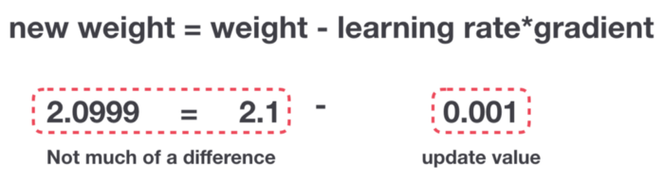
Problem
So in recurrent neural networks, layers that get a small gradient update stops learning.
Those are usually the earlier layers.
So because these layers don’t learn, RNN’s can forget what it seen in longer sequences, thus having a short-term memory.

Slide 4
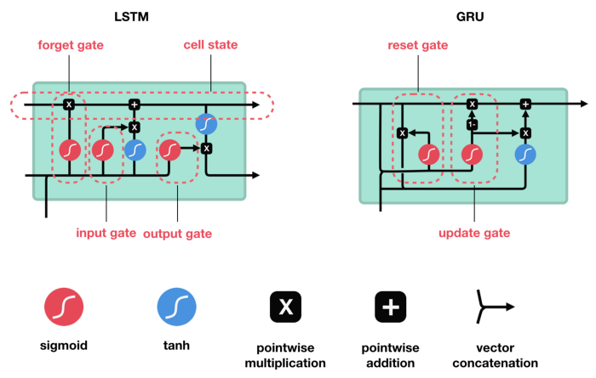
LSTM’s and GRU’s as a solution
LSTM ’s and GRU’s were created as the solution to short-term memory.
They have internal mechanisms called gates that can regulate the flow of information.
LSTM’s and GRU’s can be found in speech recognition, speech synthesis, and text generation. You can even use them to generate captions for videos.

Slide 5
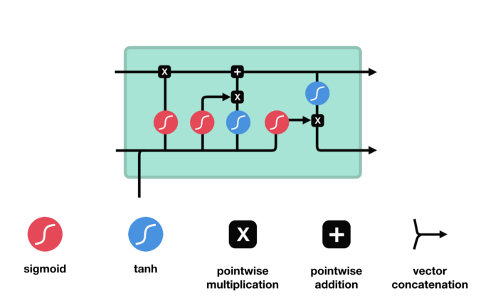
LSTM

Slide 6
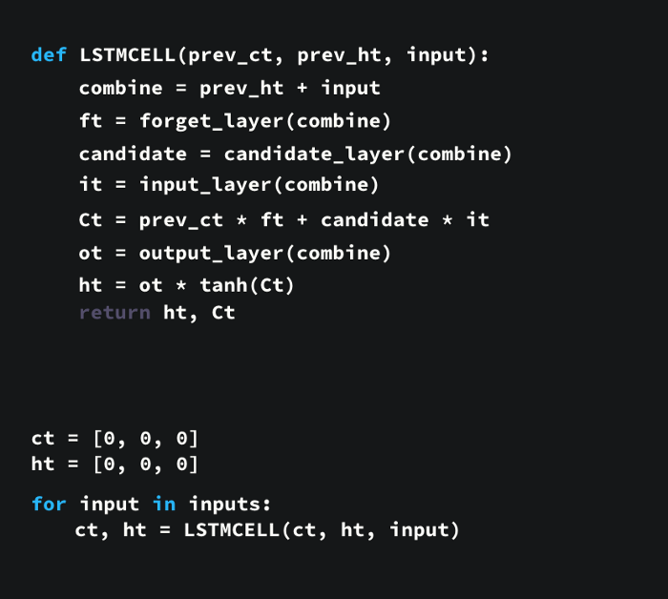
LSTM PSEUDOCODE

Slide 7
THANK YOU

