Slide 1

TuxPipes michael.hierl@avnet.eu
Notes:
Avnet is a global technology company with an extensive ecosystem delivering design, product, marketing and supply chain expertise for customers at every stage of the product lifecycle. We transform ideas into intelligent solutions, reducing the time, cost and complexities of bringing products to market.
For nearly 100 years, we have continued to expand the breadth and depth of our capabilities through solid supplier relationships, expansion and acquisition. Today, we are headquartered in Phoenix, Arizona, with 15,000+ employees worldwide, 1,400 technology suppliers and 2.1 million customers across the globe.
Our 2,500+ engineers and nearly a million engineering community members are here to help anyone turn their idea into a product through education, collaboration and high-quality design services.
Then, we’ll help you get that product to market by helping you solve your technology sourcing, manufacturing, supply chain and logistics challenges. We work with customers of every size, in every corner of the world, to guide today’s ideas into tomorrow’s technology.

Slide 2
What is TuxPipes?
A python script for …
saving
editing
executing
… complete GStreamer pipelines or just parts of it.
It works like and alias program that …
gives long pipelines a short name
can be used with variables and default values
can combine pipelines
… to execute a desired GStreamer command.

Slide 3
How to use it? – commands
Run the script like any other python script $ python tuxpipes.py
You can use different command line arguments
--add to add a new pipeline to be used later
--delete will remove a pipeline with a provided name
--rename will change the name of a pipeline
--list will show all available pipelines (can be filtered)
--run this will try to execute a pipeline
For a complete list, type --help or check the docs.

Slide 4
How to use it? – Add a pipeline (example)
Call the script with the “add“ argument $ python tuxpipes.py --add
Give the new pipeline a name $ python tuxpipes.py --add “gst
Every part of a pipeline is seperated by a single “:“ $ python tuxpipes.py --add “gst:gst-launch-1.0 v4l2src device=/dev/video
Variables start with a “#“ followed by the variable name and “=“ and a default value $ python tuxpipes.py --add “gst:gst-launch-1.0 v4l2src device=/dev/video#NUM=0 Note: Default values are not needed.
The pipeline will be stored inside the “pipes.json“ file

Slide 5
How to use it? – Run a pipeline
Call the script with the “run“ argument and ask for the “gst“ pipeline we added before $ python tuxpipes.py --run “gst
To set the variables of a given pipe, do it as follows $ python tuxpipes.py --run “gst:(#NUM=3) Brackets define a variable element. Single variables are separated by a comma You can specify the variable to replace (here: #NUM) or just the “FIFO“ way. (First variable gets replaced by the first value etc.)
Combine the stored pipeline with needed parts to display the camera stream $ python tuxpipes.py --run “gst:(#NUM=3):videoconvert ! autovideosink“

Slide 6
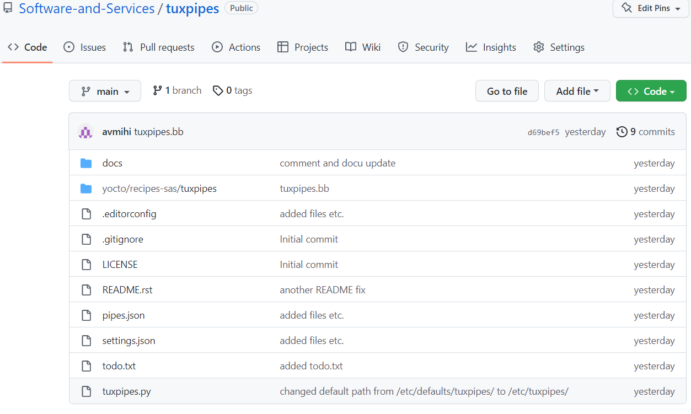
How to get it?
The project can be found on Github on the Software and Service team's organization account
https://github.com/Software-and-Services/tuxpipes

Slide 7
Future plans?
Config files
Store settings
Different sets of pipelines for testing etc.
Add pipeline checks
Finding errors
Automatic replacements/insertions
Commandline tutorial (WIP)
A guided tutorial in a bash script

