Slide 1

TuxPipes michael.hierl@avnet.eu
Notes:
Avnet is a global technology company with an extensive ecosystem delivering design, product, marketing and supply chain expertise for customers at every stage of the product lifecycle. We transform ideas into intelligent solutions, reducing the time, cost and complexities of bringing products to market.
For nearly 100 years, we have continued to expand the breadth and depth of our capabilities through solid supplier relationships, expansion and acquisition. Today, we are headquartered in Phoenix, Arizona, with 15,000+ employees worldwide, 1,400 technology suppliers and 2.1 million customers across the globe.
Our 2,500+ engineers and nearly a million engineering community members are here to help anyone turn their idea into a product through education, collaboration and high-quality design services.
Then, we’ll help you get that product to market by helping you solve your technology sourcing, manufacturing, supply chain and logistics challenges. We work with customers of every size, in every corner of the world, to guide today’s ideas into tomorrow’s technology.

Slide 2
What is TuxPipes?
A python script for …
saving
editing
executing
… complete GStreamer pipelines or just parts of it.
It works like and alias program that …
gives long pipelines a short name
can be used with variables and default values
can combine pipelines
… to execute a desired GStreamer command.

Slide 3
How to use it? – commands
Run the script like any other python script $ python tuxpipes.py
You can use different command line arguments
--add to add a new pipeline to be used later
--delete will remove a pipeline with a provided name
--rename will change the name of a pipeline
--list will show all available pipelines (can be filtered)
pipename this will try to execute a pipeline
For a complete list, type --help or check the docs.

Slide 4
How to use it? – Add a pipeline (example)
Call the script with the “add“ argument $ python tuxpipes.py --add
Give the new pipeline a name $ python tuxpipes.py --add “gst
Every part of a pipeline is seperated by a single “:“ $ python tuxpipes.py --add “gst:gst-launch-1.0 v4l2src device=/dev/video
Variables start with a “#“ followed by the variable name and “=“ and a default value $ python tuxpipes.py --add “gst:gst-launch-1.0 v4l2src device=/dev/video#NUM=0 Note: Default values are not needed.
The pipeline will be stored inside the “pipes.json“ file

Slide 5
How to use it? – Run a pipeline
Calling the script just with pipeline name like “gst“ will try to run it $ python tuxpipes.py “gst
To set the variables of a given pipe, do it as follows $ python tuxpipes.py --run “gst(#NUM=3) Brackets define a variable element. Single variables are separated by a semiconlon You can specify the variable to replace (here: #NUM) or just the “FIFO“ way. (First variable gets replaced by the first value etc.)
Combine the stored pipeline with needed parts to display the camera stream $ python tuxpipes.py --run “gst(#NUM=3):videoconvert ! autovideosink“

Slide 6
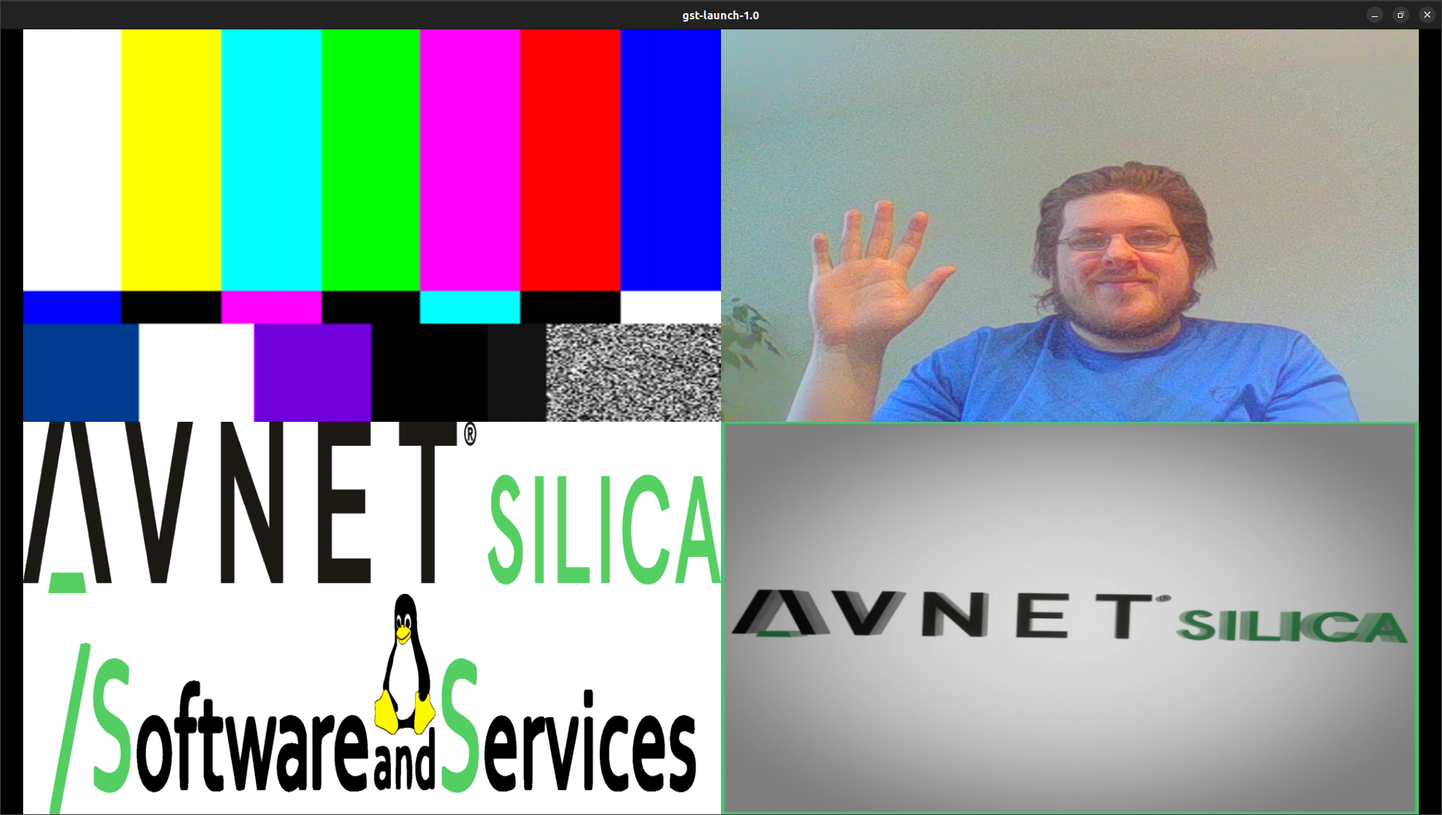
Example – tutorial.sh
Goal is to create a composition/split-screen deviding the display into four regions. The GStreamer command would look like this:
gst-launch-1.0 compositor name=c sink_0::xpos=0 sink_0::ypos=0 sink_0::width=960 sink_0::height=540 sink_0::keep-ratio=true sink_1::xpos=960 sink_1::ypos=0 sink_1::width=960 sink_1::height=540 sink_1::keep-ratio=true sink_2::xpos=0 sink_2::ypos=540 sink_2::width=960 sink_2::height=540 sink_2::keep-ratio=true sink_3::xpos=960 sink_3::ypos=540 sink_3::width=960 sink_3::height=540 sink_3::keep-ratio=true ! autovideosink videotestsrc ! c.sink_0 videotestsrc ! c.sink_1 videotestsrc ! c.sink_2 videotestsrc ! c.sink_3
Add the above pipeline using variables so we can add in the sources:
tuxpipes -a tut_compositor:compositor name=c sink_0::xpos=0 sink_0::ypos=0 sink_0::width=960 sink_0::height=540 sink_0::keep-ratio=true sink_1::xpos=960 sink_1::ypos=0 sink_1::width=960 sink_1::height=540 sink_1::keep-ratio=true sink_2::xpos=0 sink_2::ypos=540 sink_2::width=960 sink_2::height=540 sink_2::keep-ratio=true sink_3::xpos=960 sink_3::ypos=540 sink_3::width=960 sink_3::height=540 sink_3::keep-ratio=true ! autovideosink #SRC0= ! sink_0 #SRC1= ! sink_1 #SRC2= ! sink_2 #SRC3= ! sink_3"

Slide 7
Example – tutorial.sh
Create a pipeline for a video test source
gst-launch-1.0 videotestsrc ! Autovideosink
tuxpipes –a “tut_testsrc:video/x-raw,width=640,height=480“
Create a pipeline for a filesrc (video)
gst-launch-1.0 filesrc location=./files/avs720qb.avi ! decodebin ! video/x-raw,width=640,height=480 ! videoconvert ! autovideosink
tuxpipes -a "tut_video:filesrc location=./files/avs720qb.avi:decodebin:videoconvert"
Create a pipeline for a filesrc (image)
gst-launch-1.0 filesrc location=./files/Avnet_Silica_SaS.png ! pngdec ! imagefreeze ! videoconvert ! autovideosink
tuxpipes -a "tut_image:filesrc location=./files/Avnet_Silica_SaS.png:pngdec:imagefreeze:videoconvert“

Slide 8
Example – tutorial.sh
Create a pipeline for a video device (camera)
gst-launch-1.0 v4l2src device=/dev/video0 ! video/x-raw,width=640,height=480 ! videoconvert ! Autovideosink
tuxpipes -a “tut_camera:v4l2src device=/dev/video0:video/x-raw,width=640,height=480:videoconvert “
Do a compose to display all of them at the same time
tuxpipes “tut_compositor(tut_testsrc;#SRC2=tut_camera;tut_image;tut_video)“

Slide 9
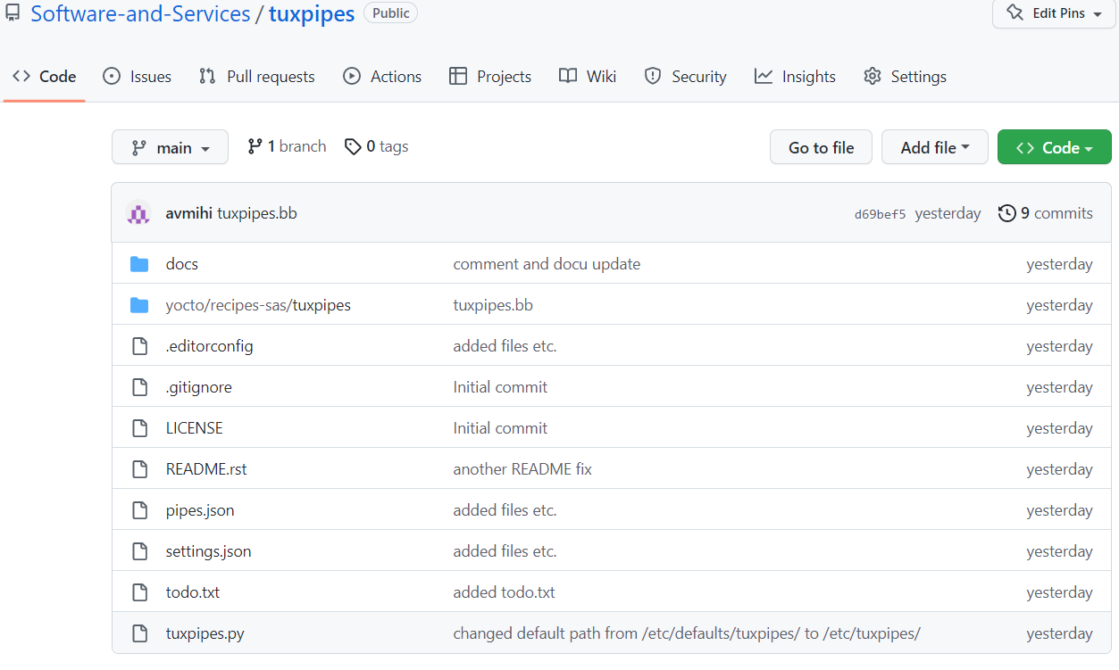
How to get it?
The project can be found on Github on the Software and Service team's organization account
https://github.com/Software-and-Services/tuxpipes

Slide 10
Future plans?
Config files
Store settings
Different sets of pipelines for testing etc.
Add pipeline checks
Finding errors
Automatic replacements/insertions
Variable update
More robust way to insert variables
Not all cases work yet
Might need a second level of insertion
Your requests!!!
Via email: michael.hierl@avnet.eu
Via GitHub: https://github.com/avs-sas/tuxpipes/issues

