Slide 1

Bot for
Shirode, Deshkar, Ghadiya, Jayathirtha
Notes:
https://upload.wikimedia.org/wikipedia/en/1/19/Agar.io_appstore_logo.png

Slide 2
ABOUT AGAR.IO
Browser based multiplayer, real-time strategy game
Players start of as a single solitary cell in a map consisting enemy players’ cells and other game objects
Objective is to grow your cell by swallowing food pellets and smaller cells, while avoiding bigger cells to stay alive for as long as possible
Playing the game is the best way to understand the game mechanics
Notes:
Video

Slide 3
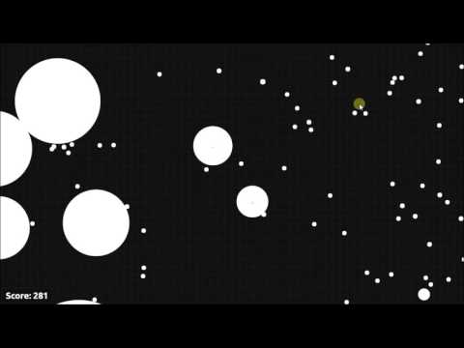
GAMEPLAY
Notes:
https://www.youtube.com/watch?v=trDB7xSwvcc

Slide 4
SCOPE OF THE BOT
Bot assesses game environment by taking screenshots and analysing it
Applies image processing to get the position and size information about the player and opponents
Perform flee behavior after finding a weighted flee vector from eminent threats
Perform seek behavior in a seek-range based on the direction of flee vector
Perform Virus avoidance while moving
Split to consume an enemy cell when it is favourable

Slide 5
IMAGE PROCESSING
Circle detection algorithm to locate the player, opponents, pellets and know their size.
array(circle_x, circle_y, radius)
Slightly modified algorithms to detect viruses and overlapped opponent pellets and game environment borders
To identify and differentiate the bot from other objects, we name it as a ‘Dot’ (.).

Slide 6
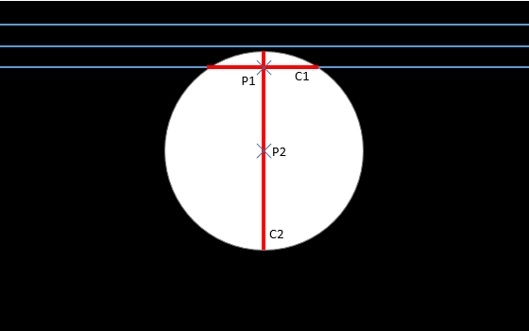
CIRCLE
DETECTION

Slide 7
FLEE BEHAVIOR
Closer the enemy ~ More the threat
The flee behavior will have weight factors for enemies based on their threat level
Flee vector = Sum (Displacement vectors of enemies * Weight factor)
This Flee vector will give resultant (x,y) position for flee behavior and mouse pointer will be shifted to this position to move the bot

Slide 8
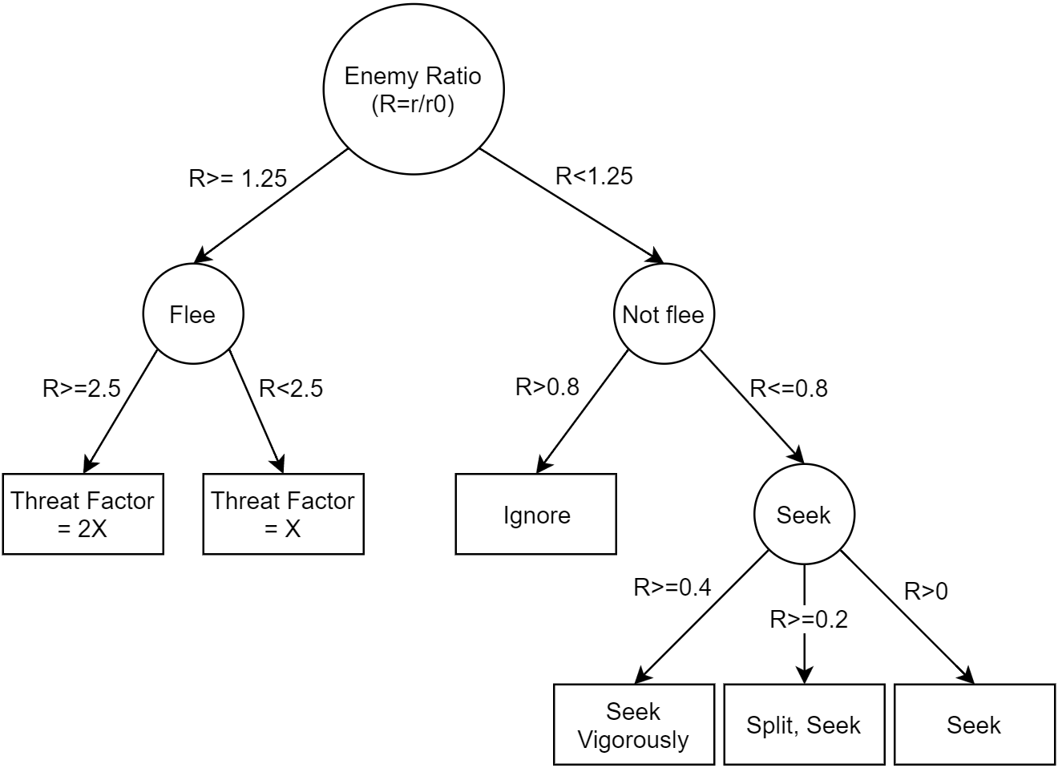
DECISION
MAKING

Slide 9
SEEK RANGE
Bot will consider those pellets which are in the conical range of Flee vector’s direction.
The size of this cone (angle of the cone), is decided by the threat level in the general direction of the flee vector. More the threat, smaller the size (range) of this cone.
Range of seek = maximum seek range – 4*(summation of ratio of radii)
Final range of seek will be from 0 to 20 degree on both side of the direction making it total [-20,20] degree range.

Slide 10
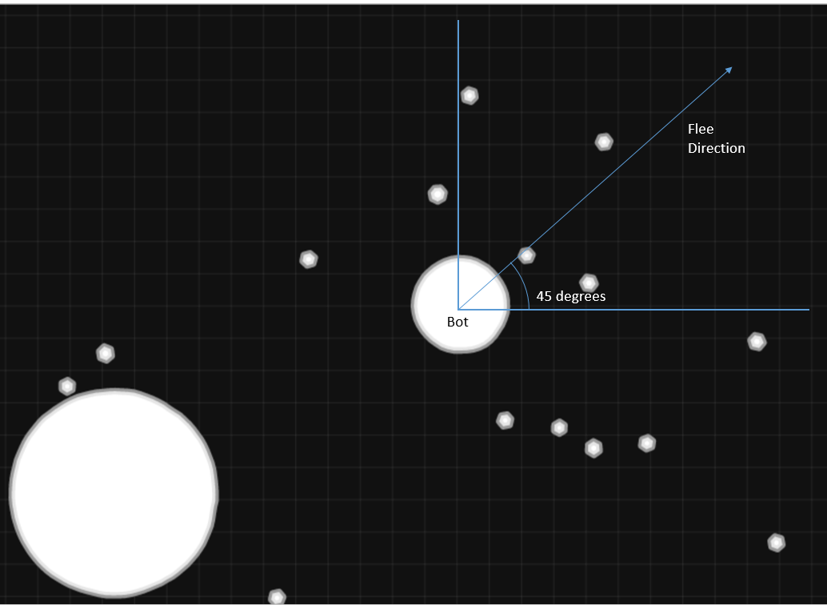
SEEK
RANGE

Slide 11
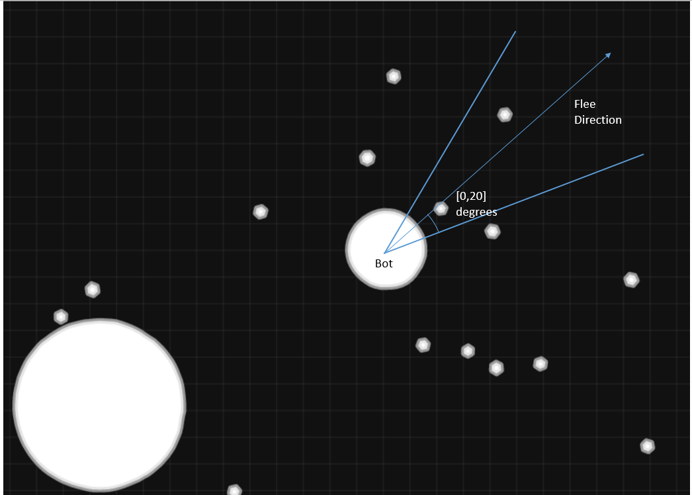
SEEK
RANGE

Slide 12
SEEK
When there is at least one threat on the screen, the bot will seek the nearest pellet in the seek range
When Bot is not under flee effect, it will try to maximize the score by eating as many food pellets as possible
We used two methods to optimize seeking:
We divided the screen into rectangular areas and found the one with the most number of pellets. Bot will seek the nearest pellet from that region.
We seek the nearest pellet by euclidean distance
The second method produced better results hence we used that method for the final implementation

Slide 13
VIRUS DETECTION AND SPLIT
Virus are stationary in the game environment.
Bot uses modified flee behavior to avoid collision with viruses.
When size of the enemy we are seeking is in split range, bot will split into two halves and from then the bigger half will be considered and controlled by the bot.

Slide 14
Flow

Slide 15
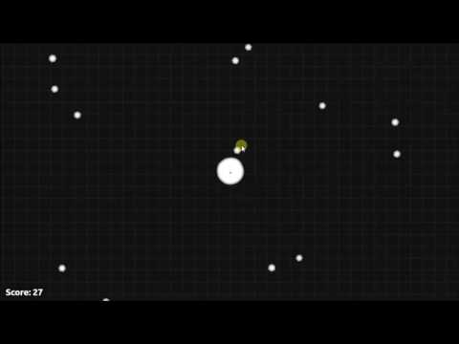
BOT DEMO

Slide 16
ANALYSIS
Stages of improvement:
Flee Vector
Range of Seek
Seek Closest vs Seek Block
Split to Eat
Notes:
<CREATE TABLE>

Slide 17
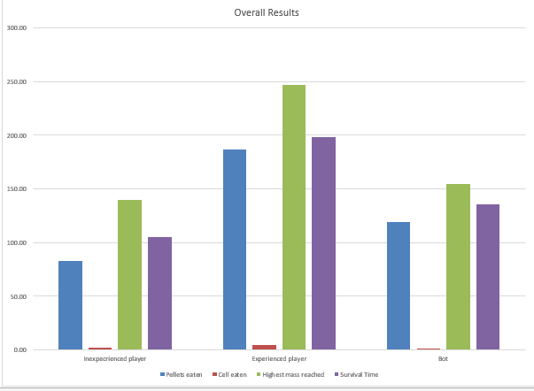
ANALYSIS

Slide 18
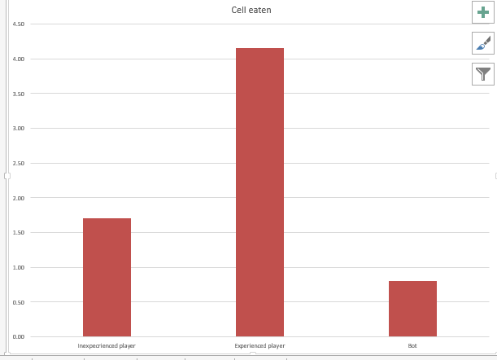
ANALYSIS

Slide 19
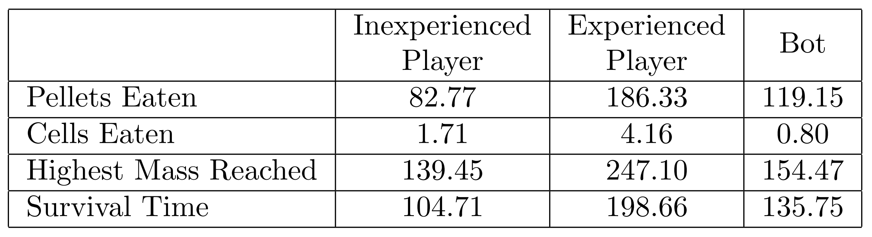
RESULTS
Follows the motto - ‘I will survive…’ (Flee behavior)
Considers the most imminent threats first and acts accordingly
Not able to get out of tough situations as a human player would

Slide 20
LIMITATIONS
Not using json to get the raw data; thus not following real time movements (Processing at a particular snapshot)
Less accurate as compared to an online bot; because no access to time domain data (such as speed and direction)
Image Processing proves to be the bottleneck

Slide 21
POSSIBLE UPGRADES
Shooting mass -- To move faster, to partner, to shift/split virus
Working multiple instances of the bot in sync
Make image processing more efficient
Using Viruses to bots advantage (Hide when smaller, dodge/ direct bigger players towards virus)

Slide 22
CONCLUSION
With just a combination of simple behaviors, the bot satisfies the basic goals defined.
The bot performs better than an amateur, but is still one league short of Advanced and Experienced Players.
Implementing advanced techniques like Machine Learning to modify the weights, or genetic algorithms for better analysis would make the bot superior.

Slide 23
THANK YOU

Slide 24
REFERENCES
Millington, I.; and Funge, J. 2009. Artificial intelligence for games. Burlington, MA: Morgan Kaufmann/Elsevier.
Valadares, M. 2015. Agar.io. Available at: http://agar.io/
Agarioguide.com, 2016. Game Mechanics | Agar.io Skins. http://www.agarioguide.com/game-mechanics
AgarioZone, 2015. Agario Strategies - 10 agario strategies to help you survive. http://agariozone.com/agario-strategies/
Reddit.com. 2016. Reddit. https://www.reddit.com /r/agario

