Slide 1
Trunk Pool Project
Faster delivery at cheaper price

Slide 2
Introduction
A Trunk pool is a sharing of trunk transport so that more than one person can transport his or her stuff. Using Trunk pool both the trunk owner as well as trunk pooler gets benefited. It reduces cost of transport such as fuel cost and tolls and also time too.

Slide 3
Problem Statement
Customer Trust
Dispute
Security
Delay in delivery

Slide 4
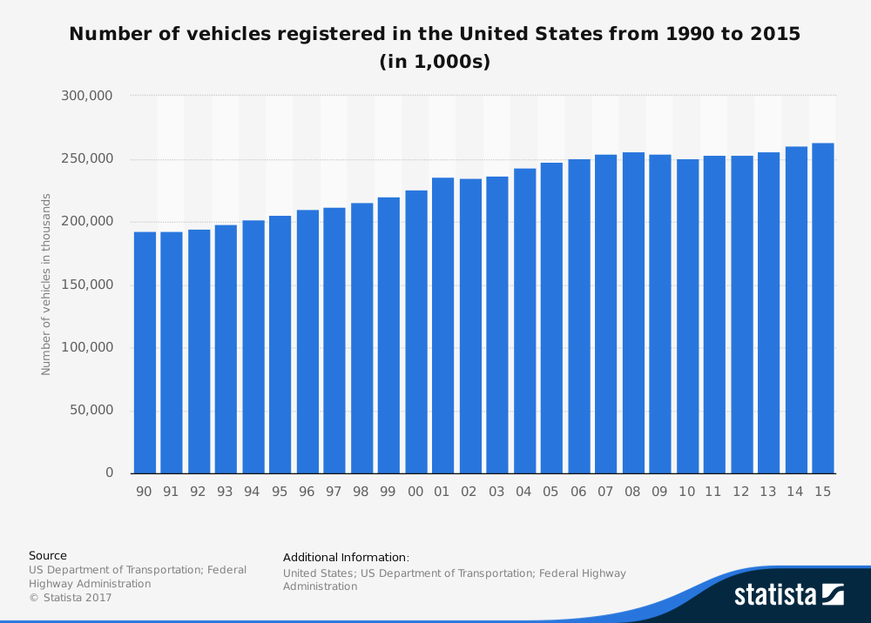
Fact Time
There are more then 2.5 Billion cars registered in United States alone.

Slide 5
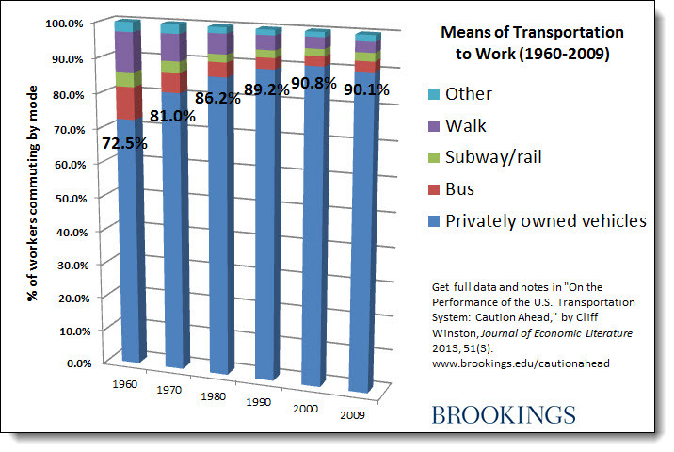
Preferred way to work
more than 90% people drive their own vehicles to work every day

Slide 6
Benefits to Trunk Owner
Benefits to Trunk Pooler
Reduces cost of his own transport
Save cost on Tolls
Reduces cost of transport
Reduces Time.
Save packaging materials

