Slide 1
Project on School Application Prototype

Slide 2
Introduction
What is a Prototype ?
A prototype is an early sample, model or representation of a product built to test a concept or process. It is often used to evaluate a new design.

Slide 3
Continued
Low Fidelity and High Fidelity Prototyping
Low fidelity prototype are often paper-based and do not allow user interactions. They range from a series of hand-drawn mock-ups to printouts.
High Fidelity prototype are often paper-based and do not allow user interactions. They range from a series of hand-drawn mock-ups to printouts.

Slide 4
School Application Prototype
Purpose
Application prototype made using JustInMind software.
Application is for students and teachers of the college for accessing their portal on their mobile phones.
Students can access their grades , assignments , important alerts on their phone
Teachers can use it to upload the assignments ,grades , important notes and lectures for the students
Easy access to the portal on the go to stay up to date with the events going on in the college.

Slide 5

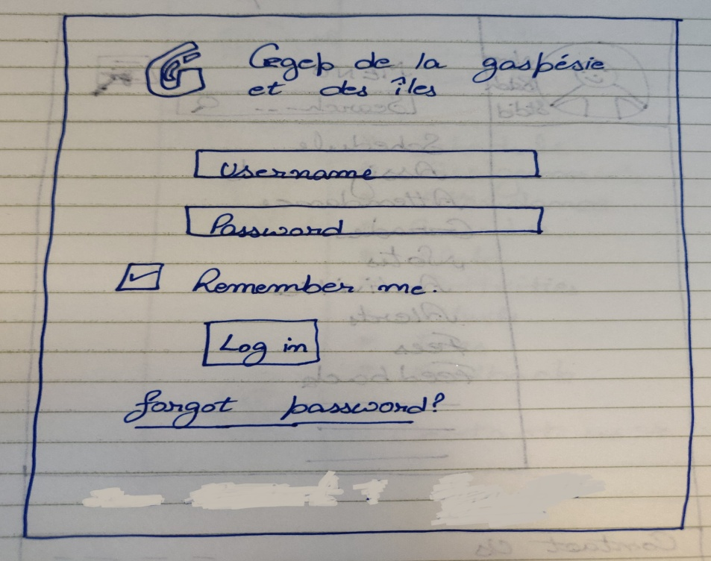
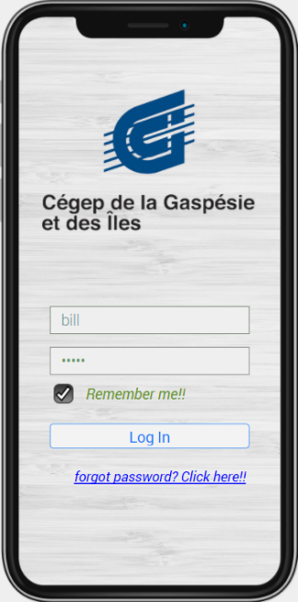
Log In Page
Enter User Name and Password to get
access to the portal .
Remember me checkbox to save the
username and password.
Forgot password to recover/create
a new password.

Slide 6
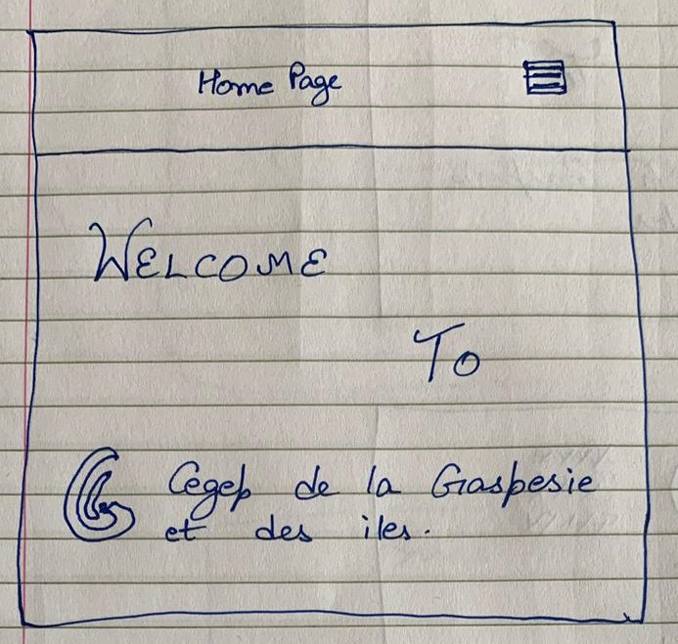

Home Page
This is the home page of our school project.
Displays the Welcome message and the school logo.
Top right corner has menu button.

Slide 7
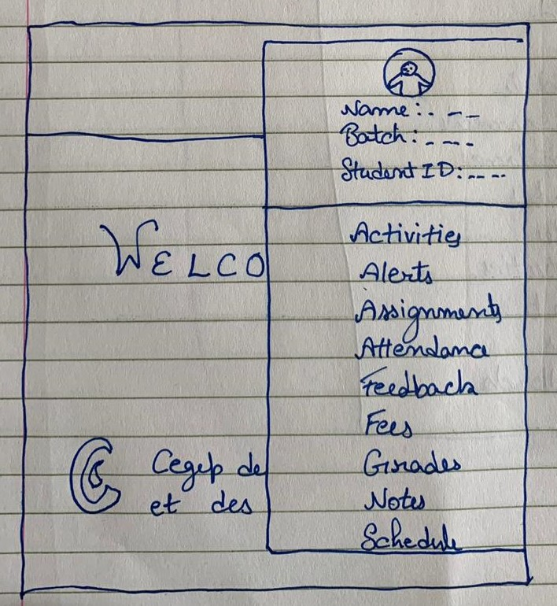
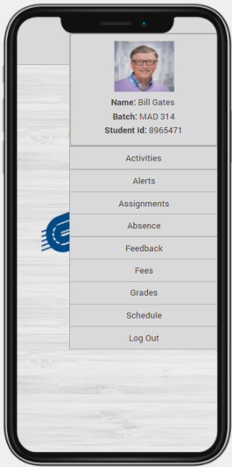
Home page menu
Clicking the menu button displays the user info (name, batch and student id)on the top
A number of options are displayed (Activities,
Alerts ,Assignment ,Absences ,Feedback ,Fees, Grades ,Schedule, Logout)

Slide 8
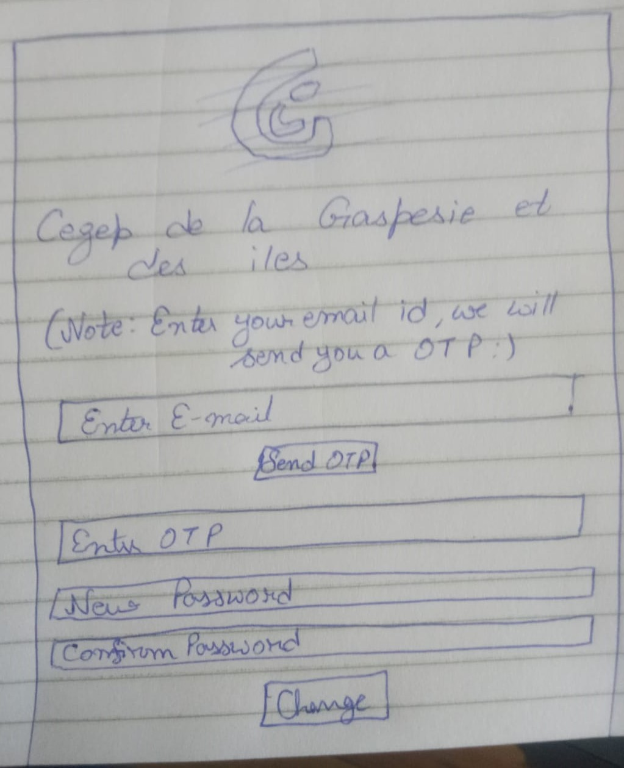
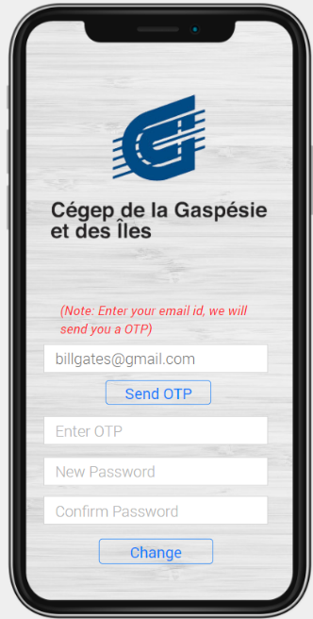
Forgot password
Forgot Password link gets you to the password recovery page.
Enter the registered email to get the OTP (One Time Password)
Enter the OTP and create a new password.

Slide 9
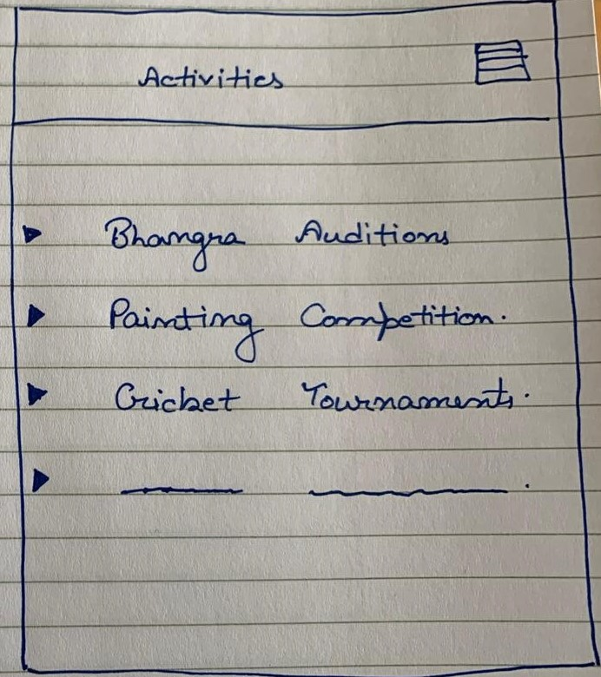
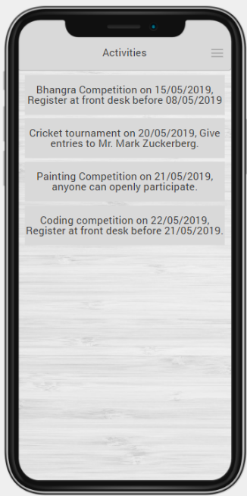
Activities
This page shows the various activities being organized in the college
Can check the past activities hosted on/off campus
Best way to stay up to date about what is happening on campus around you .

Slide 10
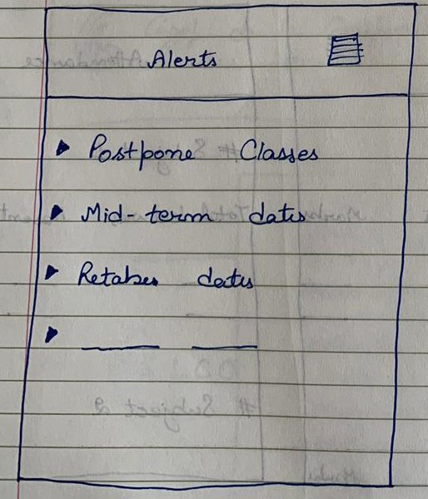
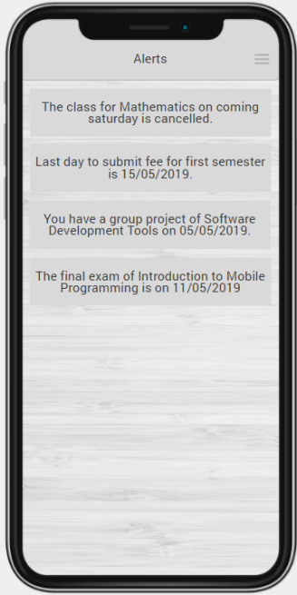
Alerts
Notifies about any updates from the college administration.
Notifies about the events happening around the campus.
Notifies about the assignments ,grades and documents uploaded by the teachers.

Slide 11
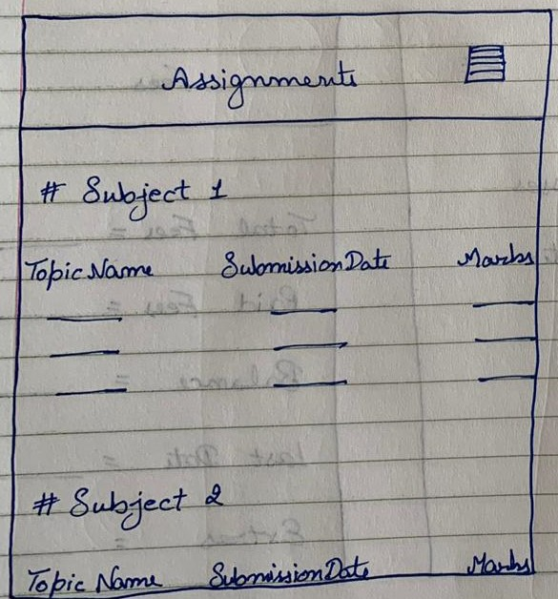
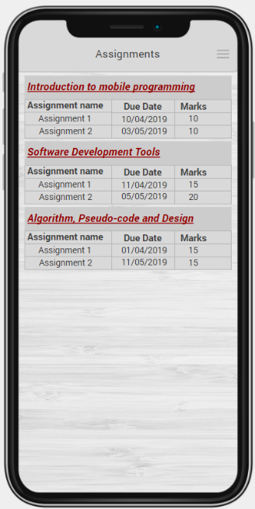
Assignments
We can check the assignments of all subjects on this page
We can check the marks of the submitted assignments.
Assignments due date can also be checked .
Assignments can also be submitted through this page .

Slide 12
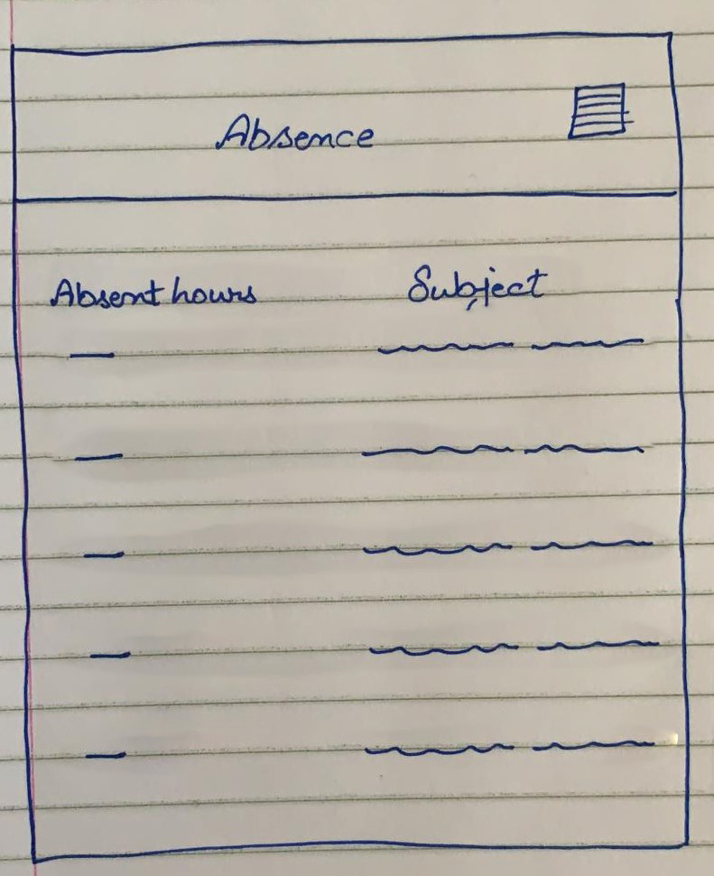
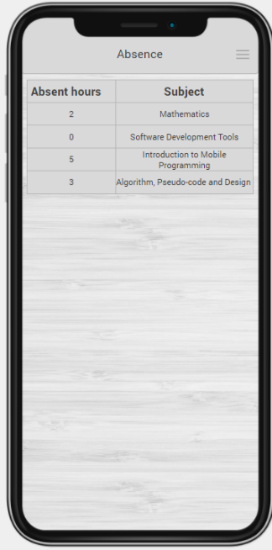
Absence
This page shows the number of absences .
The absences are shown in terms of number of hours absent per subject.
Students can keep track of their absences through this page.

Slide 13
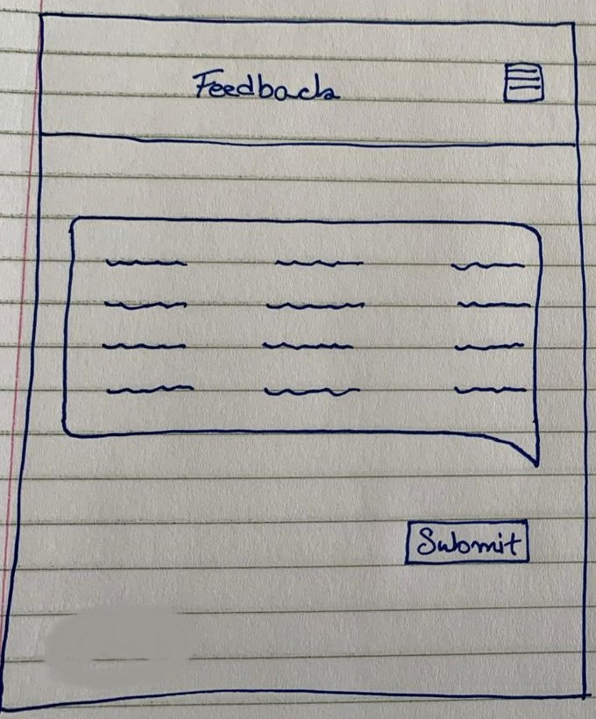
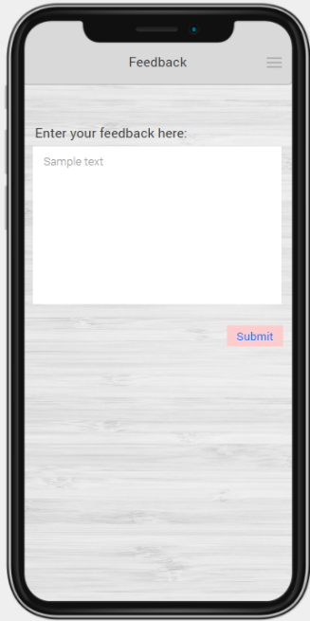
Feedback
Students can give their feedback about anything through this page
The feedback is anonymous.

Slide 14
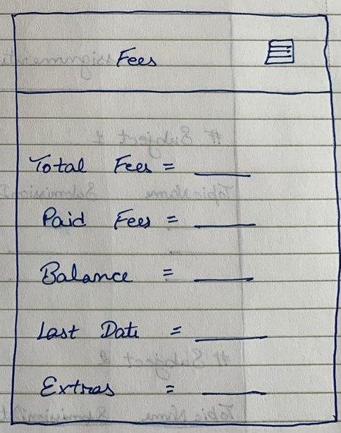
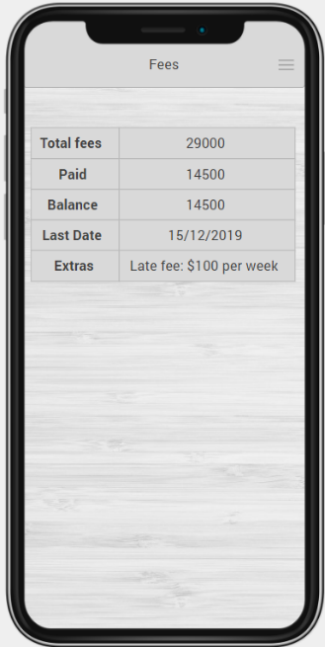
Fees
This page has information about the fees.
Students can check the total fees ,how much they have paid and how much they owe to the college all on this page.
Also the due date and late fee charges are displayed.

Slide 15
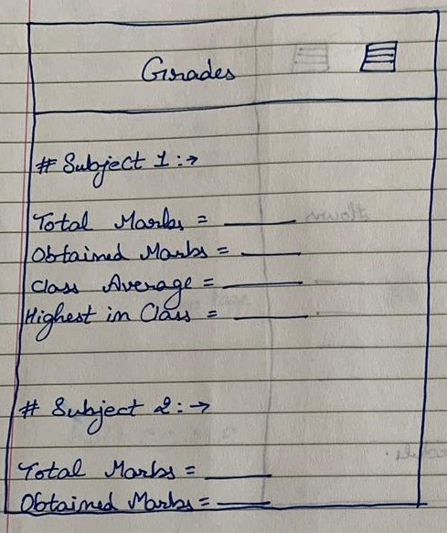
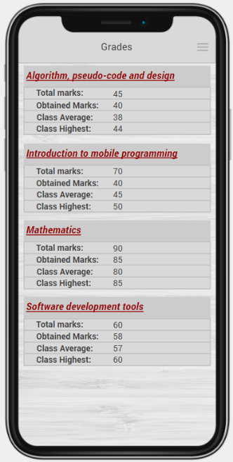
Grades
The grades are displayed on this page.
The total marks obtained till present by the student in each subject are displayed here.
Class average and class highest are also displayed .

Slide 16
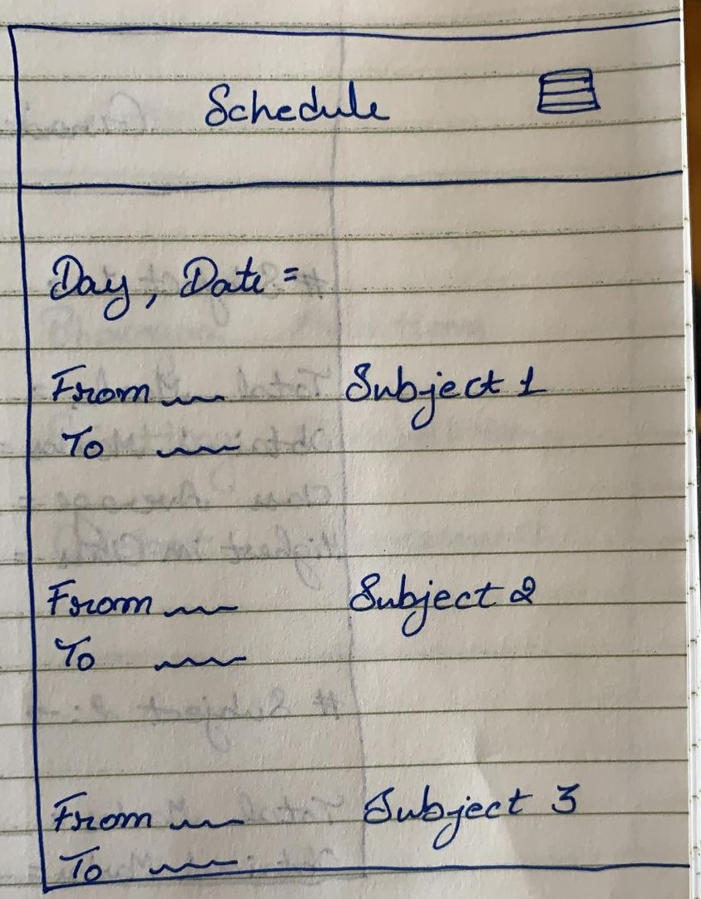
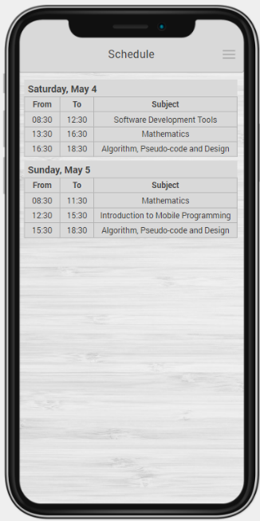
Schedule
The schedule for the classes is available on this page.
All subject classes their timings and classrooms can be found here
Any change in schedule will be updated and displayed here .

Slide 17
Design Decisions
We have used text view for the email input.
Password input field for password which does not show the password while typing.
Checkbox for the remember me field .
We placed the forgot password link just below the sign button as is in most apps to ensure ease of access.
The Home menu is pretty simple easy and self explanatory.
For all normal inputs the text view field is used and for the email there is email input field and for passwords we used the password input field.

Slide 18
The End Thank You

Slide 19
Submitted by :
Sandeep Singh (1896201)
Avtar Singh(1896909)
Jatinder Singh Mann(1896568)
Jaskaran Singh (1898348)
Sahil Rangra (1896322)

