Slide 1
DATA SCIENCE
Beyond data- a world of opportunities

Slide 2




Data All Around
Lots of data is being collected and warehoused
Web data, e-commerce
Financial transactions, bank/credit transactions
Online trading and purchasing
Social Network

Slide 3
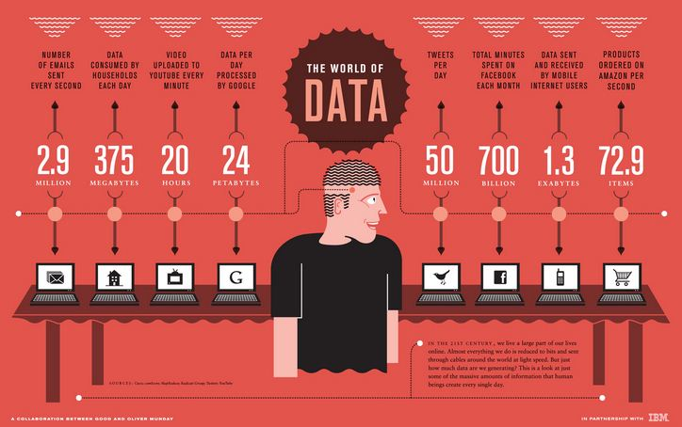
How Much Data Do We have?
Google processes 20 PB a day (2008)
Facebook has 60 TB of daily logs
eBay has 6.5 PB of user data + 50 TB/day (5/2009)
1000 genomes project: 200 TB

Slide 4
Types of Data We Have
Relational Data (Tables/Transaction/Legacy Data)
Text Data (Web)
Graph Data
Social Network,
Streaming Data

Slide 5
What To Do With These Data?
Learn how to use data
Explore: identify patterns
Predict: make informed guesses
Infer: quantify what you know

Slide 6
Data Science
An interdisciplinary field, data science deals with processes and systems, that are used to extract knowledge or insights from large amounts of data.
Data science invokes methods from
Probability models,
Machine learning
Data mining,
Databases
Data visualization
Pattern recognition and learning,
Computer programming
Notes:
KDD
Picture-diagram summary

Slide 7
Why we need data science
Increased need to make data-driven decisions
Better decisions increase quality of life, productivity and profitability

Slide 8
Application of Data science in Health analytics
As attempts in the industry are being to provide quality health care at reasonable costs.
Use cases of data science in medicine and healthcare.
Medical image analysis
Genetics and genomics
Predictive medicine: prognosis & diagnostic accuracy

Slide 9
Application of Data science in Finance
Embracing the ability of data science to cope with a number of principal financial tasks.
Use cases of data science in finance:
Managing customer data
Predictive analysis
Fraud detection
Consumer analytics
Product development and targeted marketing

Slide 10
Application of Data science in Education
Aims to improve learning outcomes, student performance, and teacher effectiveness
Predict/focus performance of students in class
Using statistical models
Student recruitment
Predictive models to evaluate the risks of student dropouts
Better ways of assessing teachers

Slide 11
Techniques used in Data science
Several kinds of analysis that a business/project could do to retrieve valuable data.
Every type of data science project will have varying result or impact.
The type of data science technique used really depends on the kind of business problem to be addressed.

Slide 12
Anomaly detection
Anomaly detection is a technique used to identify unusual patterns that do not conform to expected behaviour, called outliers.
Anomalies can be broadly categorized as:
Point anomalies
Contextual anomalies
Collective anomalies

Slide 13
anomaly detection techniques are mostly statistical methods or machine learning techniques.
Machine learning based approaches
Density based anomaly detection
Clustering based anomaly detection
Simple statistical methods
The simplest approach to identifying irregularities in data is to flag the data points that deviate from common statistical properties of a distribution, including mean, median, mode

Slide 14
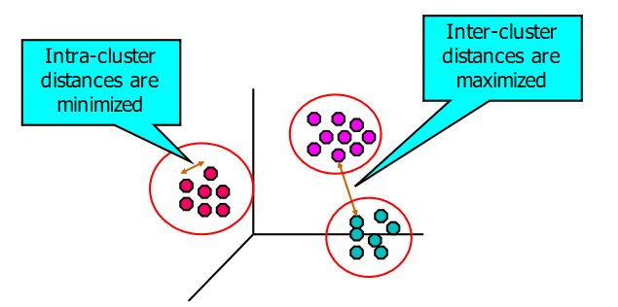
Cluster analysis
Cluster Analysis: Finding groups of objects/ data points such that the objects in a group will be similar to one another and different from the objects in other groups

Slide 15
Clustering analysis is broadly used in many applications such as market research, pattern recognition, data analysis, and image processing.
Clustering can also help marketers discover distinct groups in their customer base. And they can characterize their customer groups based on the purchasing patterns.

Slide 16
Association analysis
Allows for the discovery of concealed patterns in the data, as well as the co-occurrences of various variables.
Makes use of association rules to show the relationships between data items in large datasets
Association rules are basically if-then associations
Association rules are created by searching data for frequent if-then patterns and using the following criteria to identify the most important relationships
Support
Support is an indication of how frequently the items appear in the data.
Confidence
Confidence indicates the number of times the if-then statements are found true.

Slide 17
Association analysis useful for analyzing and predicting customer behaviour
Customer analytics,
Product clustering
Market Basket Analysis

Slide 18
Classification analysis
Classification is a technique for determining class the dependent belongs to based on the one or more independent variables.
Classification is used for predicting discrete responses.
A classification model attempts to draw some conclusion from observed values.
Given one or more inputs a classification model will try to predict the value of one or more outcomes.
Notes:
For example, when filtering emails “spam” or “not spam”, when looking at transaction data, “fraudulent”, or “authorized”. In short Classification either predicts categorical class labels or classifies data (construct a model) based on the training set and the values (class labels) in classifying attributes and uses it in classifying new data.

Slide 19
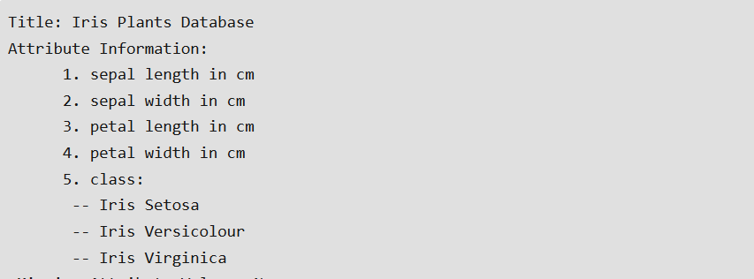
an example of classification

Slide 20
Applications for Classification include
Spam detection
Identify loan applicants ratings

Slide 21
Summary
Data Science In 5 Minutes - Data Science For Beginners - What Is Data Science - Simplilearn.mp4

